Slide 1
Get to know the Mathematics and Computer Science CRAI Library
Academic year 2018-19

Slide 2
What's the aim of this session?
To present the CRAI Mathematics and Computer Science Library and its services
http://crai.ub.edu/en/about-crai/libraries/mathematics
To present the general services and resources offered by the Learning and Research Resources Centre (CRAI)
crai.ub.edu/en

Slide 3
What will we be talking about?
Where are we? When we're open
Library map
Equipment and facilities
The collection: books, journals, etc.
Start using CRAI
Cercabib
How do I take books out? UB Card
Document loans
Study rooms and laptop loans
Checking your library record: My account
Library consortium loans (PUC)
Interlibrary loans
Access to online resources
Virtual Campus
Information resources
Usernames and passwords
S@U, User Support Service
Instructiona librarian: user training
Guided searches
Wi-Fi and access to Faculty computers
Follows us on social networks and in virtual exhibitions
And if you still have questions...

Slide 4
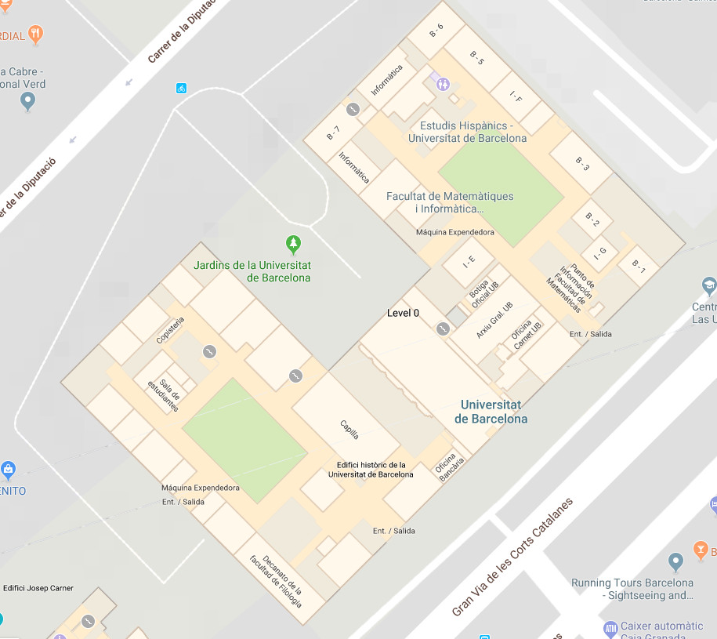
Where are we? When we're open
Mathematics and Computer Science CRAI Library
Address
C/ Gran Via de les Corts Catalanes, 585
Tel. 93 4021662
bibmat@ub.edu
Addresses of other libraries
Opening hours:
Monday-Friday from 8 to 20 h.
Special opening hours in exam periods and at weekends
Library service regulations
CRAI service charter

Slide 5
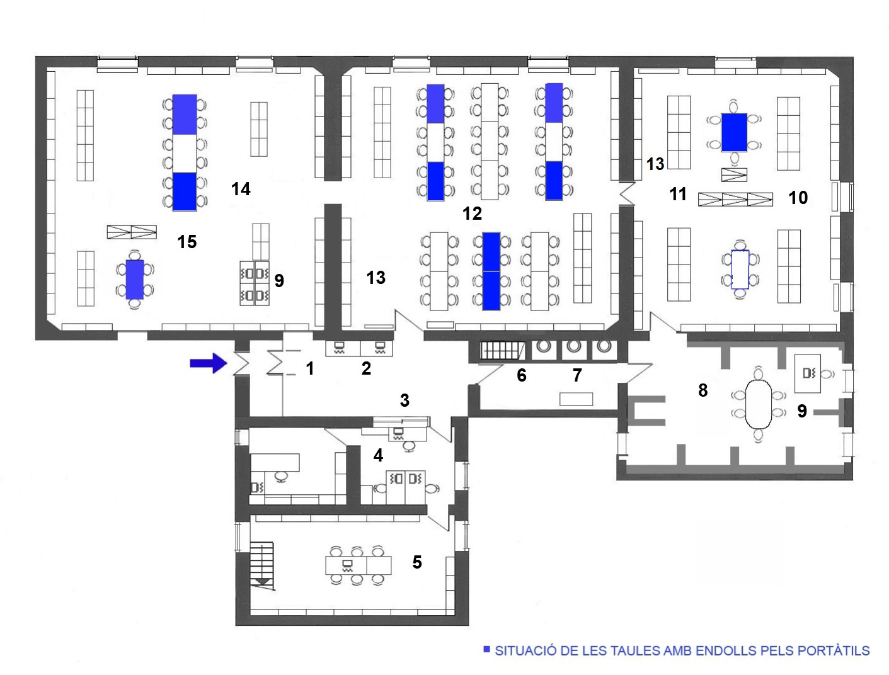
Library map
1. Entrance / Exit 2. PCs: Library resources 3. Reference and Loan Desk 4. Library staff 5. Ancient books and journals 6. Ancient books and journals 7. Toilet 8 i 11. Journals 9. PCs: Library resources 10. Last journals received 13. Reference books and theses 12 i 14. Study rooms 15. New acquisitions
Power supply tables

Slide 6
Equipment and facilities
7 computers
8 laptops for loan (with dual boot GNU/Linux (Kubuntu) and Windows)
10 laptops for classroom loan (with dual boot GNU/Linux (Kubuntu) and Windows) only and exclusively for authorised subjects
109 single-user reading desks
Wi-Fi area
Journal room and archive
Notes:
Aules: explicar les normes d’ús

Slide 7
The collection: books, journals, etc.
The Mathematics and Computer Science CRAI Library contains research and specialized collections for the following studies: Mathematics, Computer Sciences, and Statistics.
The overall collection comprises monographs, printed journals, electronic resources, statistical publications, doctoral theses and audiovisual materials.
Books, theses and audiovisual material are organized using the American Mathematical Society and the Association for Computing Machinery subject classification. Journals are classified alphabetically.
You can fill in this form to send us your proposals for book purchases.
Notes:
Conèixer el CRAI Biblioteca de XXXX. Curs 20xx-xx
Aules: explicar les normes d’ús

Slide 8
Start using CRAI [cat]

Slide 9
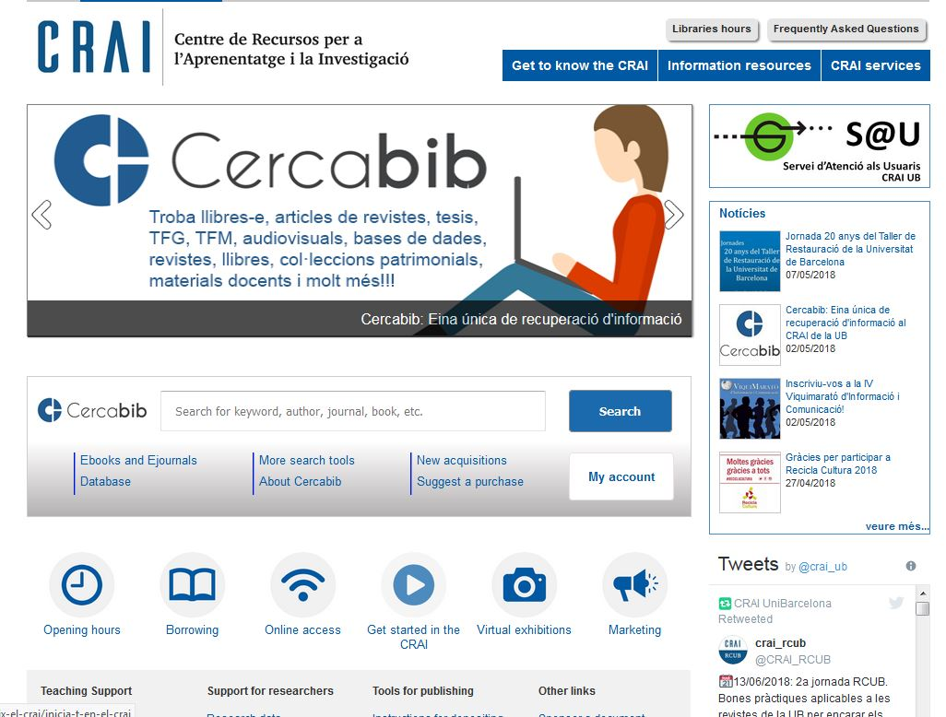
Cercabib
Notes:
El CRAI és el Centre de Recursos per a l’Aprenentatge i la Investigació, una part del qual són totes la Biblioteques de la UB
Hi podeu accedir des de:
El web de la UB → Informació sobre → Biblioteca
El web de la Facultat → Serveis → Biblioteca
MonUB → Beques i Serveis → Biblioteca
Directe des de Bookmarks/Favorits http://www.bib.ub.es/bub/bub.htm

Slide 10
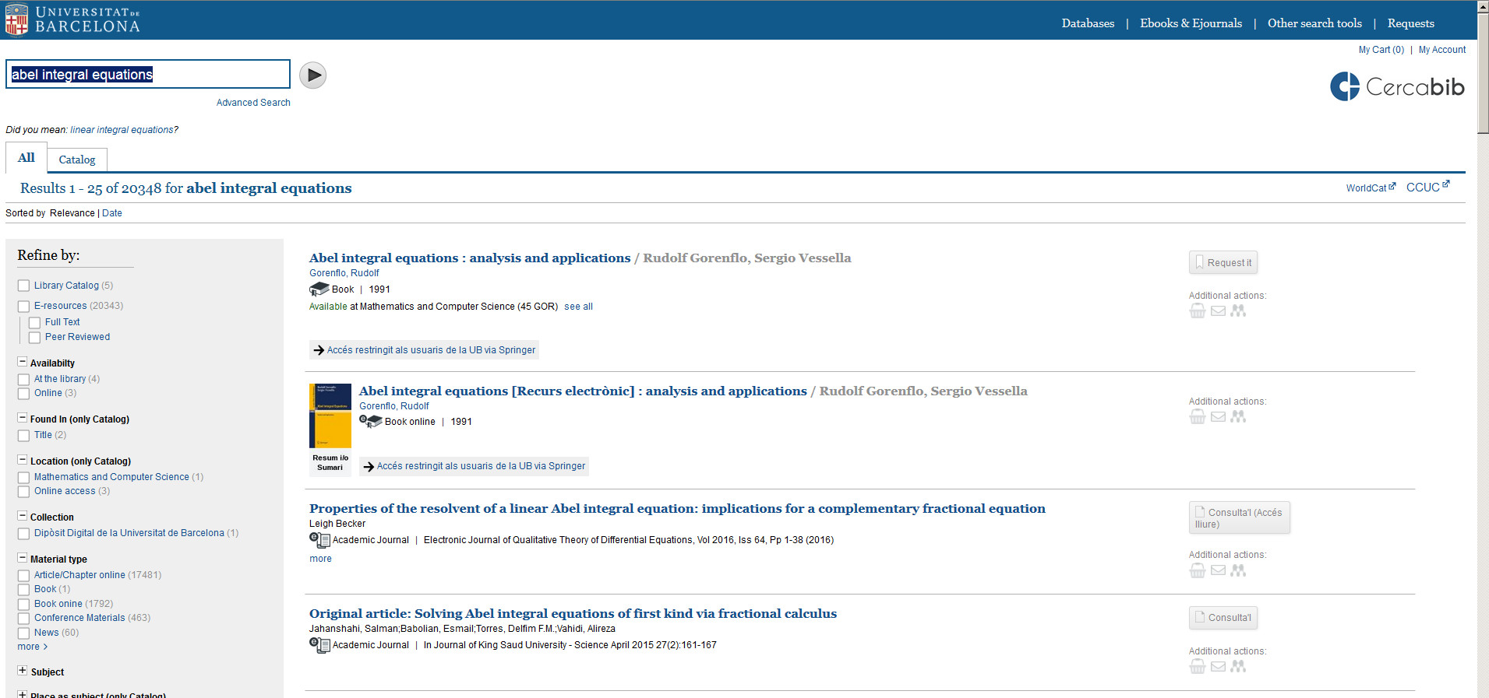
Cercabib: quick search
Notes:
El CRAI és el Centre de Recursos per a l’Aprenentatge i la Investigació, una part del qual són totes la Biblioteques de la UB
Hi podeu accedir des de:
El web de la UB → Informació sobre → Biblioteca
El web de la Facultat → Serveis → Biblioteca
MonUB → Beques i Serveis → Biblioteca
Directe des de Bookmarks/Favorits http://www.bib.ub.es/bub/bub.htm

Slide 11
Where do I find it? (I)
Notes:
Conèixer el CRAI Biblioteca de XXXX. Curs 20xx-xx

Slide 12
Where do I find it? (II)
Paper
Online
Notes:
Conèixer el CRAI Biblioteca de XXXX. Curs 20xx-xx

Slide 13
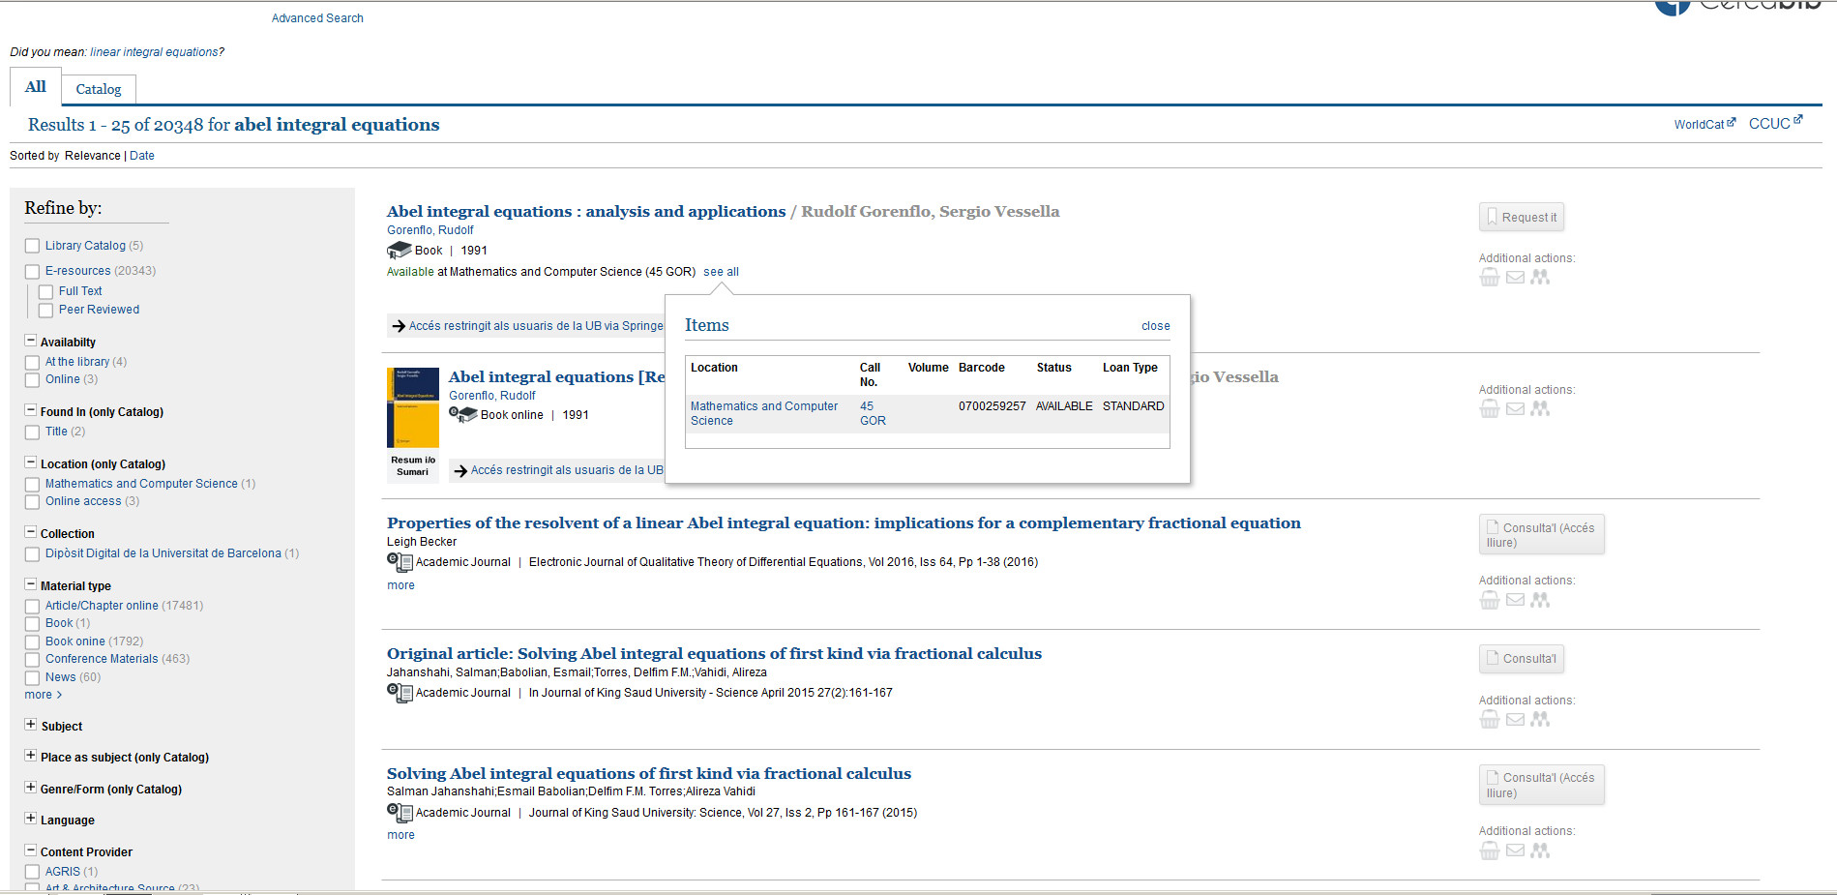
Where do I find it? (III)

Slide 14
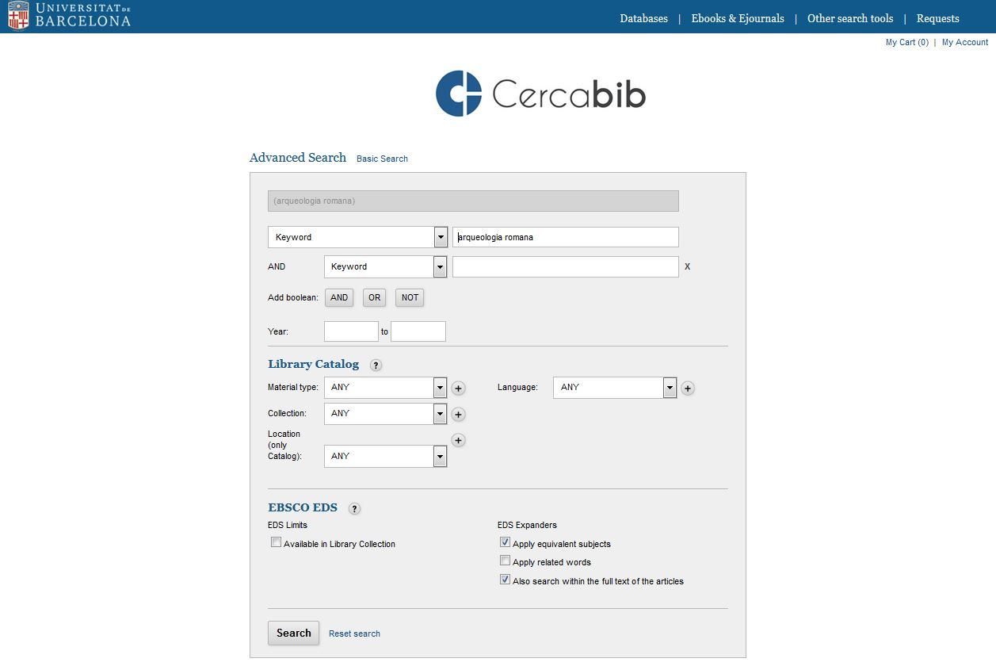
Cercabib: advanced search
Combine search fields and/or refine your search.

Slide 15
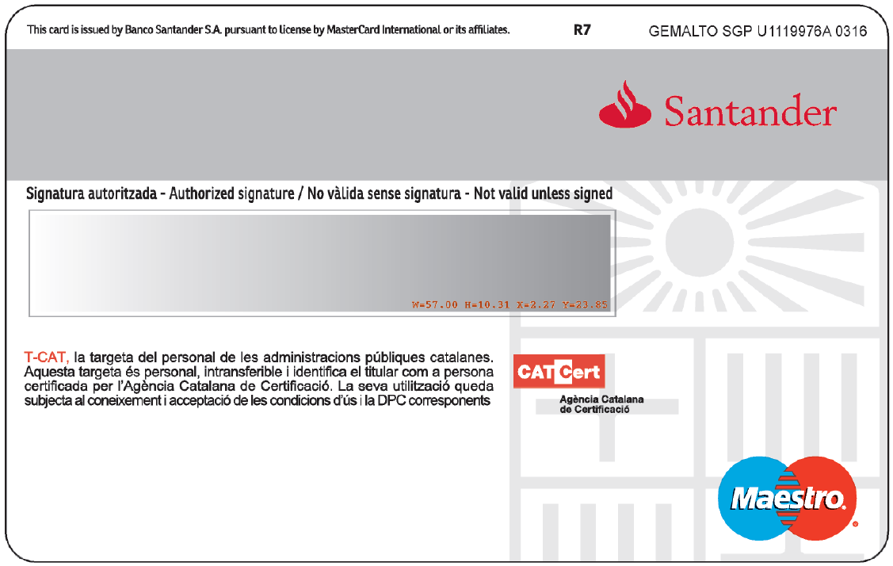
How do I take books out? UB Card
You need a UB Card
Validate it in any library before use it for the first time
UB user number
(card barcode)

Slide 16
Document loan
Document loan allow you to consult CRAI resources off library premises for a specified period of time.
You must have a UB Card or ID that provides you are entitled to take out loans.
Loan service regulations.
Documents that cannot be taken out on loan:
Journals and works of reference (encyclopedias, dictionaries, etc.). If digital versions are available online you can consult them off UB premises.
Rare books and manuscripts.
Books with a red dot or the label "Not for loan".
Key Readings list:
Loan for up to 10 days.
These items can only be reserved at the loan desks in CRAI libraries.

Slide 17
Users | Documents | Normal loan period
UB teaching and research staff (PDI): current, retired and emeritus staff of the UB, of affiliated with venia docendi, of the School of Modern Languages (EIM), the Hispanic Studies unit and Language Services (SL), guest and visiting teaching and research staff, departmental researchers and members of UB research groups, and researchers affiliated to the Jaume Almera Institute of Earth Sciences | 40 | 60
Postgraduate students and administrative and service staff (PAS): PhD students, postdoctoral fellows with teaching responsibilities, university master’s degree, inter-university master’s degree and UB-specific master’s degree students, and current or retired PAS | 20 | 30
Bachelor's degree, postgraduate and university extension students: bachelor’s degree students at the UB or affiliated centres, interuniversity students, national or international mobility students, IL3 students taking courses, and students enrolled in UB-specific postgraduate courses, university extension courses and University of Experience courses | 10 | 20
Health professionals at university hospitals (Hospital Clínic, Hospital de Bellvitge, Hospital de Sant Joan de Déu), UB teaching and research staff (PDI) affiliated to centres with specific collaboration agreements with the UB or that belong to the UB Group (including teaching staff of Institute of Education Sciences with UB contracts and research fellows from the Jaume Almera Institute of Earth Sciences) and researchers at affiliated or associated research institutes, research institutes in which the UB participates, and research institutes with specific collaboration agreements with the UB or that are members of the UB Group | 15 | 20
Audiovisual material: 7 days
Key Readings list: 10 days
Weekend Key Readings list (from Friday to Monday): 3 days
Notes:
Conèixer la Biblioteca de ........ (2005-2006)
17

Slide 18
Renewals
Reservations
You can renew loans as often as you need, as long as the item in question has not been reserved by another user. You can renew documents at the loan desk, by telephone, or via My account on the CRAI website. Watch the video
You can reserve a maximum of 8 items, through My account or from the loan desks. Watch the video
Penalties
History
If you do not return books in time, you will be barred from using the service for 1-6 days, depending on the item and the number of days overdue:
Normal loan and audiovisual material: 1 day
Key reading list: 4 days
Weekend Key reading list: 6 days
Activate the Record function in in My account to keep a list of the items you have taken out on loan during your time at the UB.
Notes:
Conèixer la Biblioteca de ........ (2005-2006)
18

Slide 19
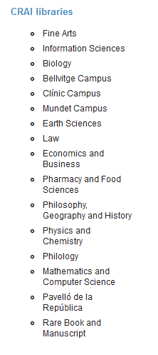
Loan from other UB libraries
If you need an item from another UB library you can:
a) go to the library where the item is held and take it out on loan, or
b) ask the loans desk in your library to transfer the item from its home library. You will receive it in 2 to 3 days.

Slide 20
Study room loans
Even thought there aren’t study rooms within the library you can use those within other libraries. This loan service is designed to make it easier to use CRAI library work rooms for individual or group work. You can reserve documents from the Cercabib using the option in My account. Watch the video
How to use the study rooms
Laptop loans
You can choose to use either Windows or Kubuntu
Request and return laptops at the loans desk
Read, complete and sign the loan agreement form
Service not available to users currently under a late returns penalty
Laptops loans available for up to 4 hours
No reservations
Laptops can only be used on library premises
Regulations

Slide 21
Laptops for Classroom Loan to students enrolled in authorised subjects from the Computer Science degree.
Laptops with dual boot GNU/Linux –Kubuntu- and Windows.
Laptops are borrowed and must be returned to the loan desk at the library.
You need to read, fill in and sign properly the loan contract form.
Sanctioned users are banned from this service.
The loan period covers the time length of the class, always during the school period.
These laptops don’t allow reservations.
The Faculty determine which subjects from the Computer Science degree qualifies for this special loan.
Regulations

Slide 22
Checking your library record: My account

Slide 23
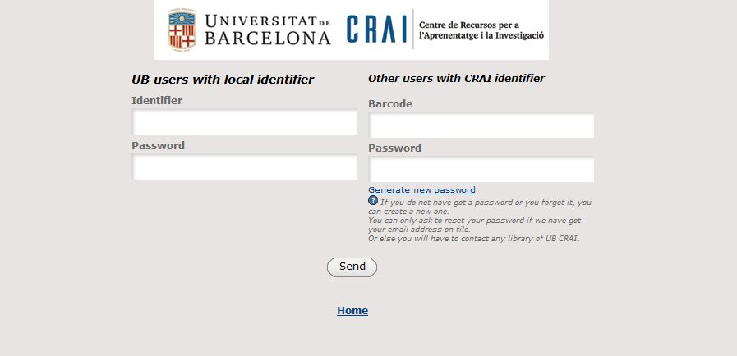
Checking your library record: My account (II)
This service enables you to access your CRAI user record.
Once you have logged on, you can view and renew your loans, reserve new items, create lists of records, etc.

Slide 24
Library consortium loans (PUC)
The PUC is a free loan service through which users can request and borrow items from another library in the Consortium of University Services of Catalonia (CSUC).
How to request an item:
In person, at the library that holds the item: PUC in situ.
Online, using the PUC web portal. Watch the video
Where to return items:
To any CRAI library.
To any of the libraries linked to the institution that holds the item.
Notes:
El CRAI és el Centre de Recursos per a l’Aprenentatge i la Investigació, una part del qual són totes la Biblioteques de la UB
Hi podeu accedir des de:
El web de la UB → Informació sobre → Biblioteca
El web de la Facultat → Serveis → Biblioteca
MonUB → Beques i Serveis → Biblioteca
Directe des de Bookmarks/Favorits http://www.bib.ub.es/bub/bub.htm

Slide 25
Web
Requirements:
- You must be registered in your institution's library user database.
- You MUST NOT have any overdue loans at your institution.
- You MUST NOT be blocked from using your library account by your institution.
Access University Union Catalog of Catalonia (CBUC): puc.cbuc.cat/
Check availability and request the item. Choose where you would like to pick it up.
When your item arrives at the chosen library you will receive email notification.
You can return the item to any of the libraries at your university or at the institution that owns the item.
Notes:
El CRAI és el Centre de Recursos per a l’Aprenentatge i la Investigació, una part del qual són totes la Biblioteques de la UB
Hi podeu accedir des de:
El web de la UB → Informació sobre → Biblioteca
El web de la Facultat → Serveis → Biblioteca
MonUB → Beques i Serveis → Biblioteca
Directe des de Bookmarks/Favorits http://www.bib.ub.es/bub/bub.htm

Slide 26
PUC loan conditions
Users | Items | Renewals | Loan period: printed docs. | Loan period: audiov. material
Bachelor’s degree students, first- or second-cycle pre-EHEA students, authorized Alumni UB | 4 | 4 | 10 | 5
Postgraduate, third-cycle, master’s degree and doctoral students | 8 | 4 | 20 | 5
University teaching and research staff (PDI) and registered users of the National Library of Catalonia | 8 | 4 | 20 | 5
University administrative and service staff (PAS) and staff of the National Library of Catalonia | 8 | 4 | 20 | 5
Other authorized users | 4 | 4 | 10 | 5
Notes:
El CRAI és el Centre de Recursos per a l’Aprenentatge i la Investigació, una part del qual són totes la Biblioteques de la UB
Hi podeu accedir des de:
El web de la UB → Informació sobre → Biblioteca
El web de la Facultat → Serveis → Biblioteca
MonUB → Beques i Serveis → Biblioteca
Directe des de Bookmarks/Favorits http://www.bib.ub.es/bub/bub.htm

Slide 27
Interlibrary loan
The inter-library loan service enables users to locate and obtain the original or a copy of any item that is not held by the CRAI and is not available from other Catalan universities through the PUC. It also centralizes the loan of CRAI collection items to other institutions. This is a paid service.

Slide 28
Access online resources
Use the E-Resources Access Service (SIRE) to consult the electronic information resources to which the CRAI subscribes from a computer or device within or outside the UB network.
To access SIRE, you will need the UB username and password that you use to access UB intranets (PDI, PAS or MónUB).
Watch the video

Slide 29
Virtual Campus (I)
Virtual Campus

Slide 30
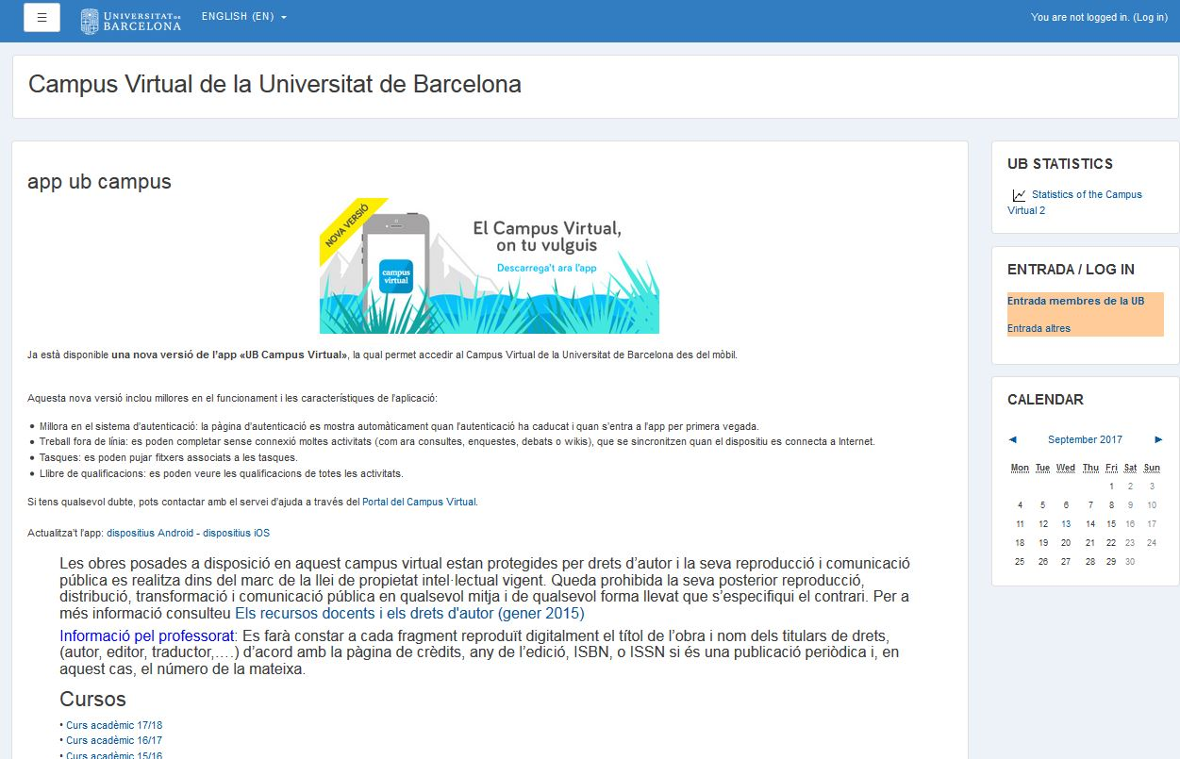
Virtual Campus (II)
The online tool for accessing your subjects and consulting recommended reading lists, teaching materials and activities.
UB id. and password
Subjects

Slide 31
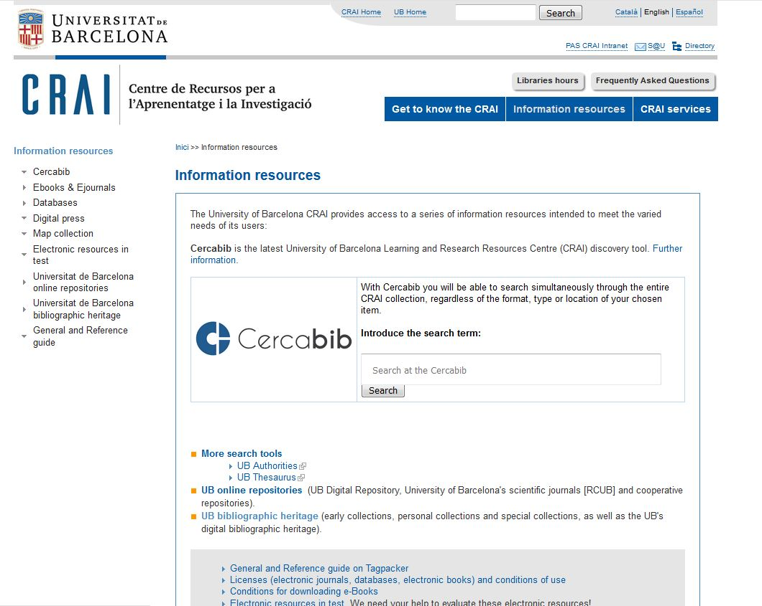
Information resources

Slide 32
Usernames and passwords
Service | Username | Password
Computer access UB Wi-Fi Accessing electronic resources (SIRE) Check Library Record Library “My account” (Cercabib: reservations, renewals, free copies, record of loans, etc.) Catalan university library loan (PUC) | From the UB email address: For the address: mgarm008@alumnes.ub.edu The username is: mgarm008.alumnes | Món UB password
Virtual Campus UB email Món UB Accessing electronic resources (SIRE) Inter Library Loan | Món UB id. (4 characters: see your enrolment confirmation) | Món UB password
Eduroam Wi-Fi Virtual Desktops / Licensed software | From the UB email address: For the address: mgarm008@alumnes.ub.edu The username is: mgarm008.alumnes@ub.edu | Món UB password
Watch the video

Slide 33
Usernames and passwords
Software
Download software licensed under the Microsoft Imagine Premium program.
Virtual Desktops
Access to a virtual computer room such as those found in the faculty to work with proprietary software among other tools.
http://www.ub.edu/informaticapersonal/programari/

Slide 34
S@U, User Support Service
A 24x7 online information and reference service manned by specialized librarians, who can answer any doubts you have about the CRAI libraries and the full range of services and resources.
S@U is also the channel for delivering your complaints, suggestions and acknowledgements!
Notes:
Conèixer la Biblioteca de ........ (2005-2006)
34
Què és?
A què respon?

Slide 35
Instructional library
Advanced training courses are available to users who wish to improve their knowledge and search skills; for example, courses on specialized databases or the Mendeley reference manager.
Information about scheduled training courses is available on the CRAI Web, and personalized courses can be arranged on request.
Independent learning resources are also available on the CRAI web.
Notes:
Conèixer la Biblioteca de ........ (2005-2006)
35
Què és?
A què respon?

Slide 36
Guided searches [cat]
A series of short articles comprising a selection of open academic information resources related to the academic and research topics of the Faculty.
Their substance has been chosen based on the usability related to help to improve the search for high-value information.
You will find the entries in the CRAI's Mathematics and Computing Blog under the hashtag : Cerques Guiades.
Notes:
Conèixer la Biblioteca de ........ (2005-2006)
36
Què és?
A què respon?

Slide 37
Wi-Fi and access to Faculty computers
The University's Wi-Fi service enables you to connect to the Internet without a physical connection to the network. To use UB Wi-Fi, configure your laptop and log on using your local username.
The University of Barcelona is actively involved in the Eduroam project, which promotes a unique e-mobility environment giving users access to the Internet at all participating organizations. Consult the Eduroam configuration guide
User group | Ending | Email address | Local username
PAS / PDI |  | joan.pere.garcia@ub.edu cherrera@ub.edu | joan.pere.garcia cherrera
Students | .alumnes | jherg07@alumnes.ub.edu | jherg07.alumnes
Alumni UB | .a | pperez@alumni.ub.edu | pperez.a
Notes:
Què és?
A què respon?

Slide 38
Follow us on social networks!
Blog de la Biblioteca de Matemàtiques i Informàtica [cat]
https://blocmat.ub.edu/
Twitter
@BibmatUB
Check our virtual exhibitions
Notes:
Diapositiva optativa

Slide 39
And if you still have questions...
Ask the CRAI staff
Library staff can answer the majority of your questions
CRAI home page
The section "Frequently asked questions"
provides answers to a number of common queries
S@U, User Support Service
Online information service for any questions about CRAI Libraries and the full range of resources and services. S@U is staffed by specialized librarians and is available 24 hours a day, seven days a week.
Or call us on
934 021 662

Slide 40
Thank you!
© CRAI Universitat de Barcelona, academic year 2018-19

