Slide 1
Get to know the Pharmacy and Food Science CRAI Library Torribera Campus
Academic year 2020-21

Slide 2
What's the aim of this session?
To present the Pharmacy and Food Science CRAI Library Torribera Campus and its services
https://crai.ub.edu/en/about-crai/libraries/pharmacy
To present the general services and resources offered by the Learning and Research Resources Centre (CRAI)
crai.ub.edu/en

Slide 3
How to borrow books?
Where are we? When we're open
Library map
Equipment and facilities
The collection: books, journals, etc.
Start using CRAI
Cercabib
How to borrow books? UB Card
Document loans Service
Study rooms and laptop loans
What do I have on loan? My account
Library consortium loans (PUC)
Interlibrary loans
Access to online resources
Virtual Campus
Information resources
Usernames and passwords
S@U, User Support Service
User training
Collections
Wi-Fi and access to Faculty computers
Follows us on social networks and in virtual exhibitions
And if you still have questions...

Slide 4
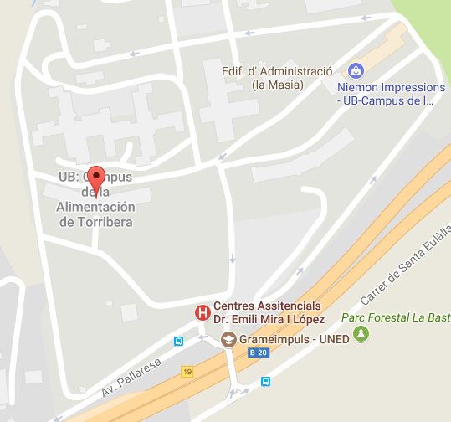
Where are we? When we're open
Pharmacy and Food Science CRAI Library Torribera Campus
Address
Avinguda Prat de la Riba, 171
08921 Santa Coloma de Gramenet 934 031 950 bibnhid@ub.edu
Addresses of other libraries
Opening hours:
Monday-Friday from 8.30 to 20.00 h.
Special opening hours in exam periods and at weekends
Library service regulations
CRAI service charter
LOCATION MAP

Slide 5
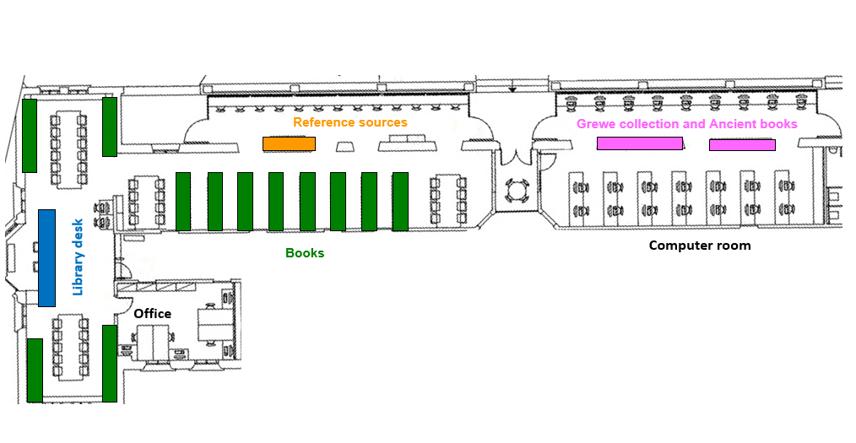
Library map

Slide 6
Equipment and facilities
Computer room with 35 computers
2 computers, one of them with a reading and writing support program (ClaroRead)
2 rooms for group work
3 laptops for loan
Wi-Fi area
81 single-user reading desks
1 scanner
Notes:
Aules: explicar les normes d’ús

Slide 7
The collection: books, journals, etc.
The Pharmacy and Food Science CRAI Library Torribera Campus contains research and specialized collections for the following studies: Human Nutrition and Dietetics, Food Science and Technology and Technology and Culinary and Gastronomic Science.
The overall collection comprises monographs, printed journals, electronic resources, statistical publications, doctoral theses and audiovisual materials.
Books, theses and audiovisual material are organized using the CDU classification method. Journals are classified alphabetically.
The library also houses a series of special collections: Grewe collection: food and gastronomy.
You can use this form to send your proposals for book purchases.
Notes:
Conèixer el CRAI Biblioteca de XXXX. Curs 20xx-xx
Aules: explicar les normes d’ús

Slide 8
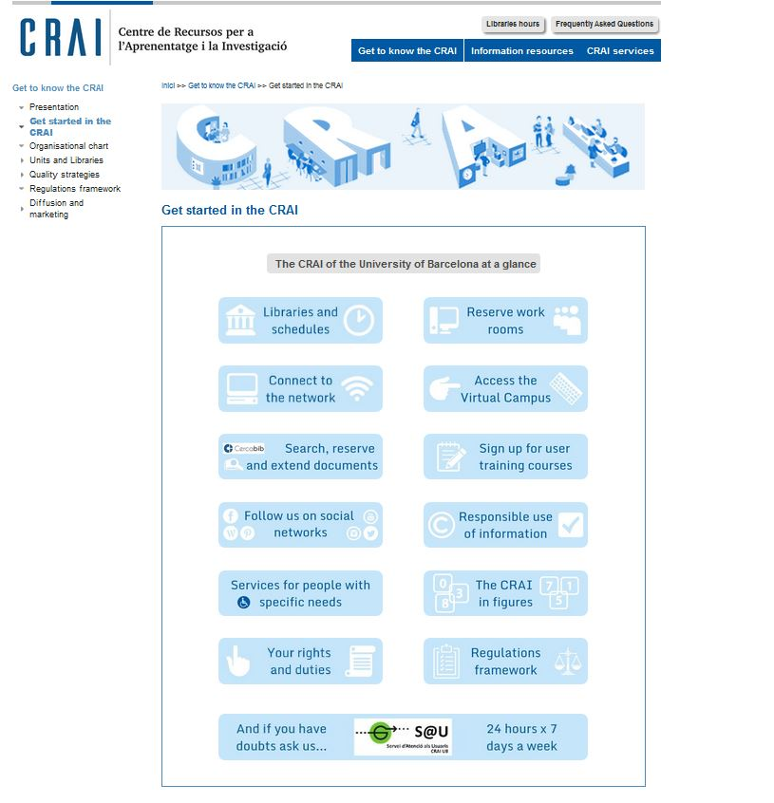
Start using CRAI https://crai.ub.edu/en/about-crai/get-started-in-the-crai

Slide 9
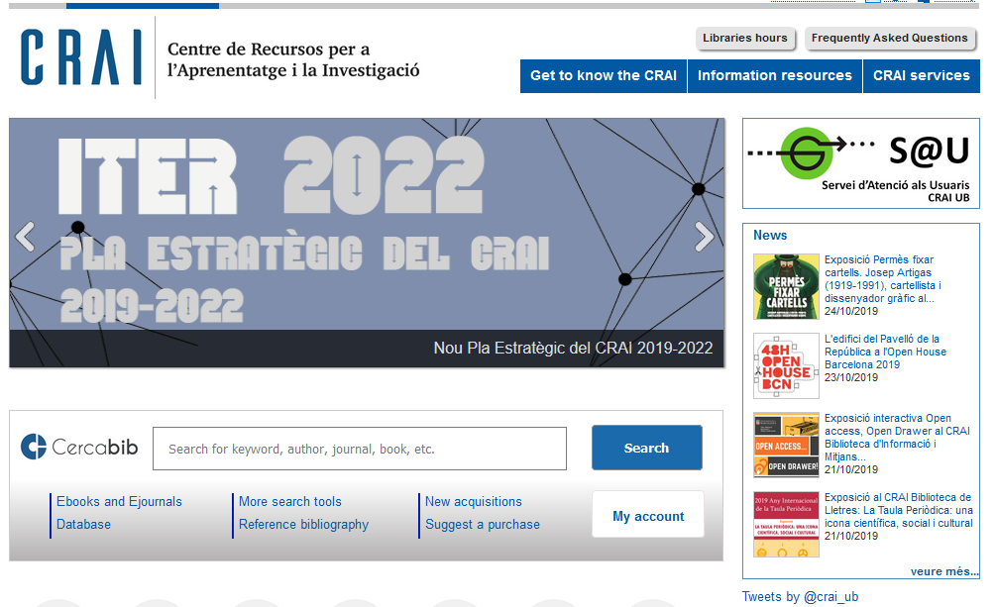
Cercabib https://cercabib.ub.edu/iii/encore/?lang=eng
Video
Notes:
El CRAI és el Centre de Recursos per a l’Aprenentatge i la Investigació, una part del qual són totes la Biblioteques de la UB
Hi podeu accedir des de:
El web de la UB → Informació sobre → Biblioteca
El web de la Facultat → Serveis → Biblioteca
MonUB → Beques i Serveis → Biblioteca
Directe des de Bookmarks/Favorits http://www.bib.ub.es/bub/bub.htm

Slide 10
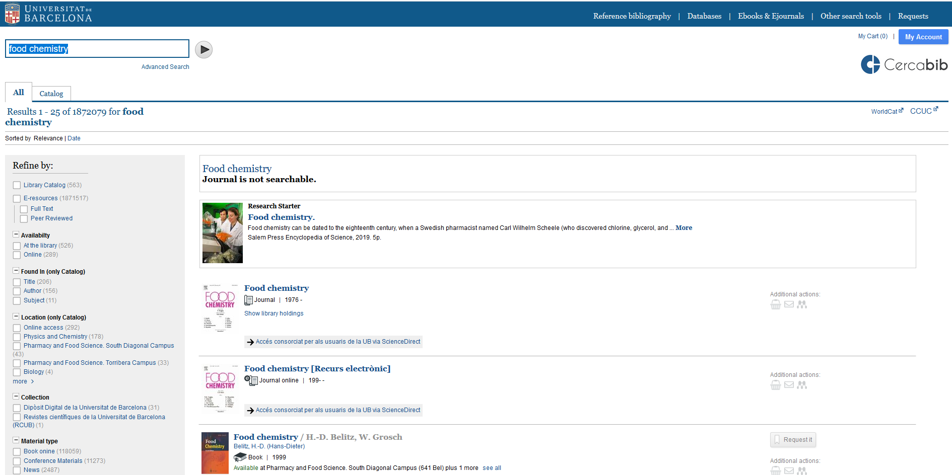
Cercabib: quick search
Notes:
El CRAI és el Centre de Recursos per a l’Aprenentatge i la Investigació, una part del qual són totes la Biblioteques de la UB
Hi podeu accedir des de:
El web de la UB → Informació sobre → Biblioteca
El web de la Facultat → Serveis → Biblioteca
MonUB → Beques i Serveis → Biblioteca
Directe des de Bookmarks/Favorits http://www.bib.ub.es/bub/bub.htm

Slide 11
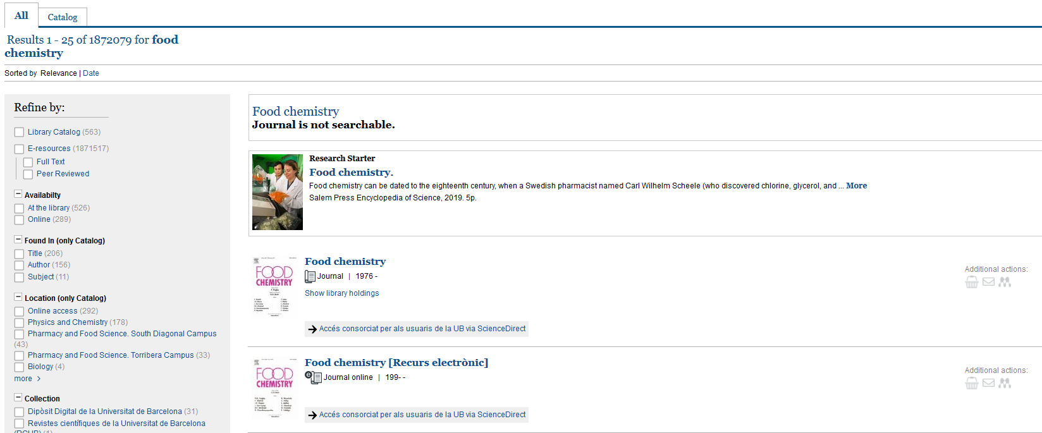
Where do I find it? (I)
Notes:
Conèixer el CRAI Biblioteca de XXXX. Curs 20xx-xx

Slide 12
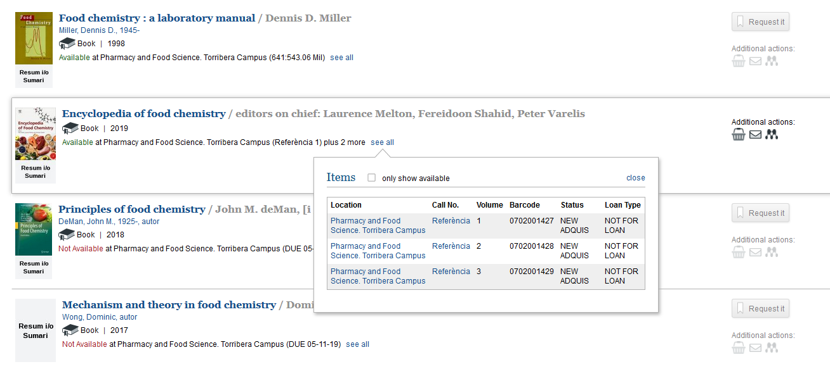
Where do I find it? (II)

Slide 13
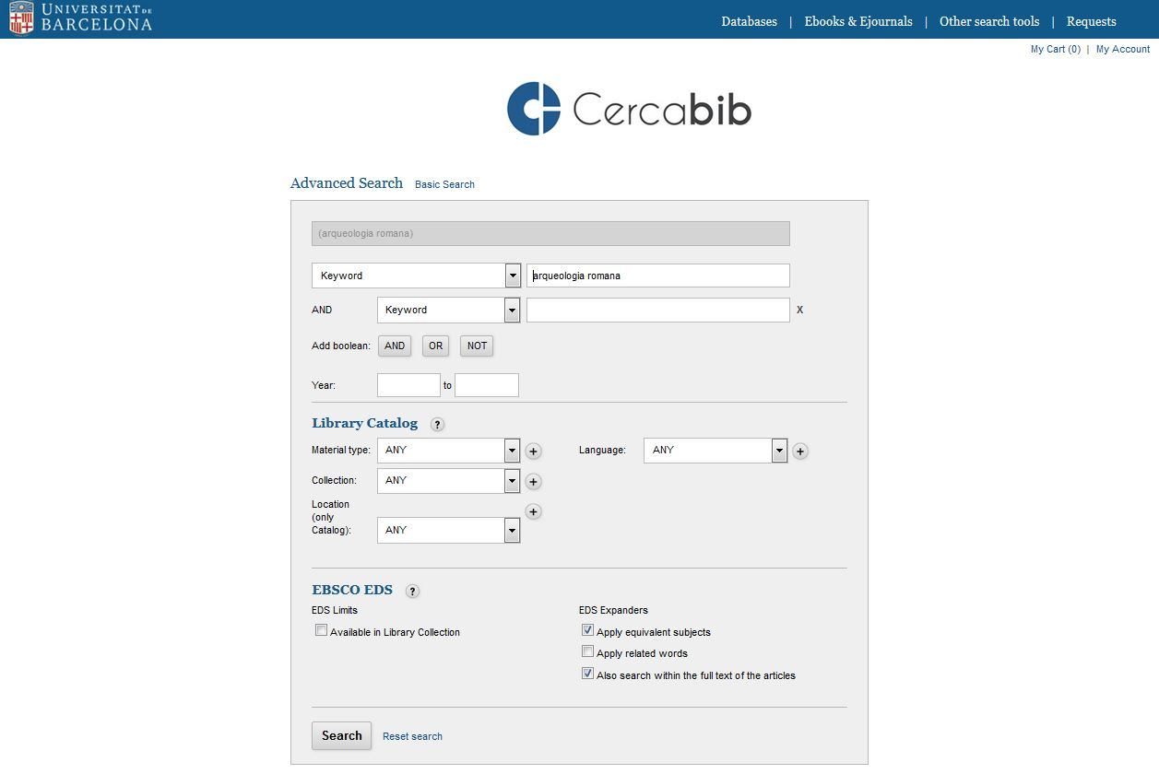
Cercabib: advanced search
Combine search fields and/or refine your search.

Slide 14
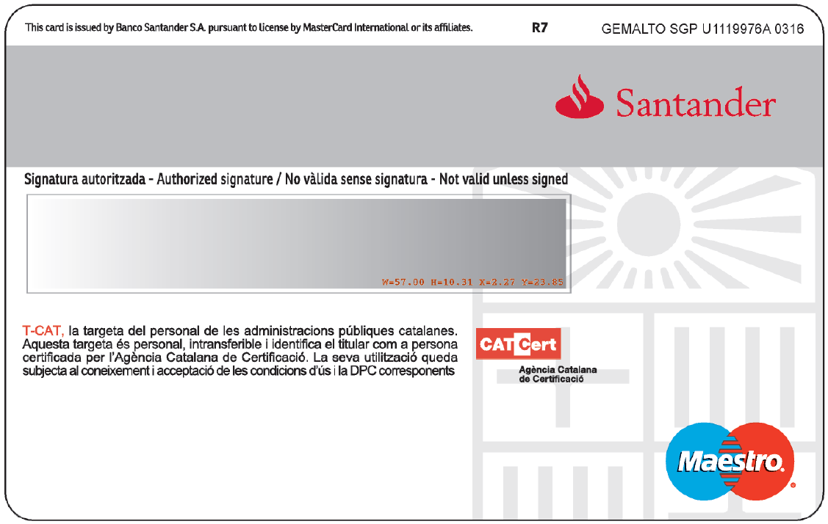
How do I take books out? UB Card
You need a UB Card
Validate it in any library
You can then take items out on loan
UB user number
(card barcode)

Slide 15
Document loans (I)
https://crai.ub.edu/en/crai-services/loans/loansUB
Document loans allow you to consult CRAI resources off library premises for a specified period of time.
You must have a UB Card or ID that provides you are entitled to take out loans.
Loan service regulations (in Catalan)
Documents that cannot be taken out on loan:
Journals and works of reference (encyclopaedias, dictionaries, etc.). If digital versions are available online you can consult them off UB premises.
Rare books and manuscripts.
Books with a red dot.
Recommended reading list:
Loan for up to 10 days.
These items can only be reserved at the loan desks in CRAI libraries.
Books with a green dot.

Slide 16
Document loans (II)
https://crai.ub.edu/en/crai-services/loans/loansUB
Users | Documents | Normal loan period
UB teaching and research staff (PDI): current, retired and emeritus staff of the UB, of affiliated with venia docendi, of the School of Modern Languages (EIM), the Hispanic Studies unit and Language Services (SL), guest and visiting teaching and research staff, departmental researchers and members of UB research groups, and researchers affiliated to the Jaume Almera Institute of Earth Sciences | 40 | 60
Postgraduate students and administrative and service staff (PAS): PhD students, postdoctoral fellows with teaching responsibilities, university master’s degree, inter-university master’s degree and UB-specific master’s degree students, and current or retired PAS | 20 | 30
Bachelor's degree, postgraduate and university extension students: bachelor’s degree students at the UB or affiliated centres, interuniversity students, national or international mobility students, IL3 students taking courses, and students enrolled in UB-specific postgraduate courses, university extension courses and University of Experience courses | 10 | 21
Health professionals at university hospitals (Hospital Clínic, Hospital de Bellvitge, Hospital de Sant Joan de Déu), UB teaching and research staff (PDI) affiliated to centres with specific collaboration agreements with the UB or that belong to the UB Group (including teaching staff of Institute of Education Sciences with UB contracts and research fellows from the Jaume Almera Institute of Earth Sciences) and researchers at affiliated or associated research institutes, research institutes in which the UB participates, and research institutes with specific collaboration agreements with the UB or that are members of the UB Group | 15 | 21
Audiovisual material: 7 days
Recommended reading list: 10 days
Recommended weekend reading list (from Friday to Monday): 3 days
Notes:
Conèixer la Biblioteca de ........ (2005-2006)
16

Slide 17
Document loans (III)
https://crai.ub.edu/en/crai-services/loans/loansUB
Renewals
Reservations
You can renew loans as often as you need, as long as the item in question has not been reserved by another user. You can renew documents at the loan desk, by telephone, or via My account on the CRAI website. Watch the video
You can reserve a maximum of 8 items, through My account or from the loan desks. Watch the video
Penalties
History
If you do not return books in time, you will be barred from using the service for 1-6 days, depending on the item and the number of days overdue:
Normal loan and audiovisual material: 1 day
Recommended reading list: 4 days
Weekend recommended reading list: 6 days
In My account you could see the list of the items you have taken out on loan during your time at the UB.
Notes:
Conèixer la Biblioteca de ........ (2005-2006)
17

Slide 18
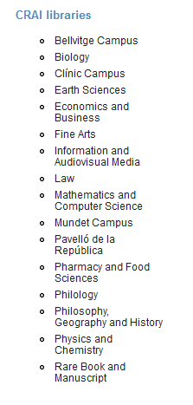
Loan from other UB libraries
If you need an item from another UB library you can:
a) go to the library where the item is held and take it out on loan, or
b) ask the loans desk in your library to transfer the item from its home library. You will receive it in 2 to 3 days.

Slide 19
Using study room loans https://crai.ub.edu/en/crai-services/loans/ub-equipment
This loan service is designed to make it easier to use CRAI library work rooms for individual or group work. You can reserve documents from the Cercabib using the option in My account. Watch the video
How to use the study rooms and Rules of use the study rooms
Laptop loans
https://crai.ub.edu/en/crai-services/loans/ub-equipment
You can choose to use either Windows
Request and return laptops at the loans desk
Read, complete and sign the loan agreement form
Service not available to users currently under a late returns penalty
Laptops loans available for up to 4 hours
No reservations
Laptops can only be used on library premises
Regulations

Slide 20
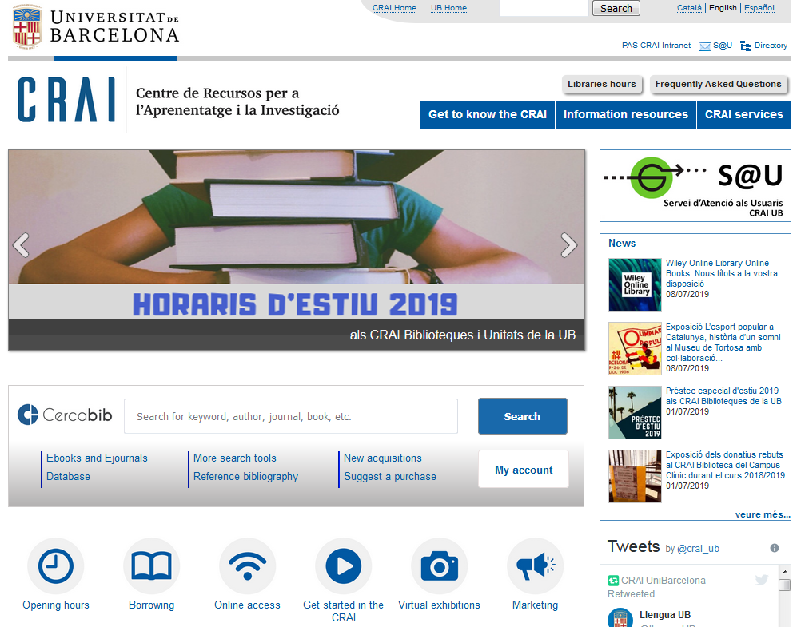
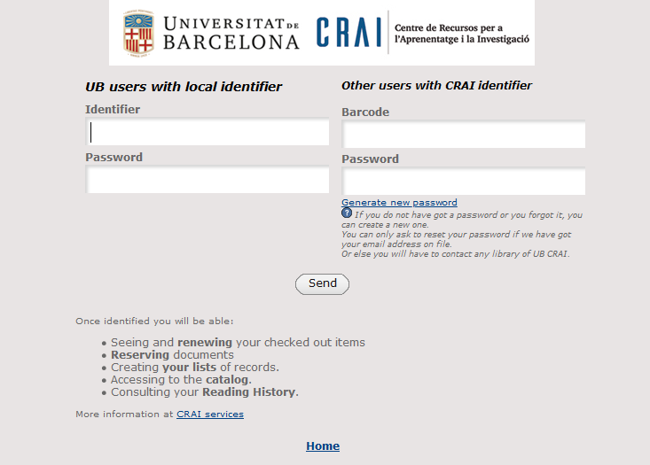
What do I have on loan? My account
This service allows you to access your CRAI user registration.
Once identified, you can view and renew your loans, reserve documents or get lists of bibliographic records, among other services.

Slide 21
Library consortium loans (PUC) https://crai.ub.edu/en/crai-services/loans/loans-puc
The PUC is a free loan service through which users can request and borrow items from another library in the Consortium of University Services of Catalonia (CSUC).
How to request an item:
In person, at the library that holds the item: PUC in situ.
Online, using the PUC web portal. Watch the video
Where to return items:
To any CRAI library.
To any of the libraries linked to the institution that holds the item.
Notes:
El CRAI és el Centre de Recursos per a l’Aprenentatge i la Investigació, una part del qual són totes la Biblioteques de la UB
Hi podeu accedir des de:
El web de la UB → Informació sobre → Biblioteca
El web de la Facultat → Serveis → Biblioteca
MonUB → Beques i Serveis → Biblioteca
Directe des de Bookmarks/Favorits http://www.bib.ub.es/bub/bub.htm

Slide 22
Puc online https://crai.ub.edu/en/crai-services/loans/loans-puc
Requirements:
- You must be registered in your institution's library user database.
- You MUST NOT have any overdue loans at your institution.
- You MUST NOT be blocked from using your library account by your institution.
Access University Union Catalog of Catalonia (CCUC): https://ccuc.csuc.cat/search*eng
Check availability and request the item. Choose where you would like to pick it up.
When your item arrives at the chosen library you will receive email notification.
You can return the item to any of the libraries at your university or at the institution that owns the item.
Notes:
El CRAI és el Centre de Recursos per a l’Aprenentatge i la Investigació, una part del qual són totes la Biblioteques de la UB
Hi podeu accedir des de:
El web de la UB → Informació sobre → Biblioteca
El web de la Facultat → Serveis → Biblioteca
MonUB → Beques i Serveis → Biblioteca
Directe des de Bookmarks/Favorits http://www.bib.ub.es/bub/bub.htm

Slide 23
PUC loan conditions
Users | Items | Renewals | Loan period: printed docs. | Loan period: audiov. material
Bachelor’s degree students, authorized Alumni UB | 10 | 6 | 21 | 5
Postgraduate, master’s degree and doctoral students | 10 | 6 | 21 | 5
University teaching and research staff (PDI) and registered users of the National Library of Catalonia | 10 | 6 | 21 | 5
University administrative and service staff (PAS) and staff of the National Library of Catalonia | 10 | 6 | 21 | 5
Notes:
El CRAI és el Centre de Recursos per a l’Aprenentatge i la Investigació, una part del qual són totes la Biblioteques de la UB
Hi podeu accedir des de:
El web de la UB → Informació sobre → Biblioteca
El web de la Facultat → Serveis → Biblioteca
MonUB → Beques i Serveis → Biblioteca
Directe des de Bookmarks/Favorits http://www.bib.ub.es/bub/bub.htm

Slide 24
Interlibrary loans https://crai.ub.edu/en/crai-services/loans/inter-library-loans
The interlibrary loan service enables users to locate and obtain the original or a copy of any item that is not held by the CRAI and is not available from other Catalan universities through the PUC. It also centralizes the loan of CRAI collection items to other institutions. This is a paid service.

Slide 25
Access to online resources
https://crai.ub.edu/en/crai-services/resources-online/proxy
Use the E-Resources Access Service (SIRE) to consult the electronic information resources to which the CRAI subscribes from a computer or device within or outside the UB network.
To access SIRE, you will need the UB username and password that you use to access UB intranets (PDI, PAS or MónUB).
Watch the video

Slide 26
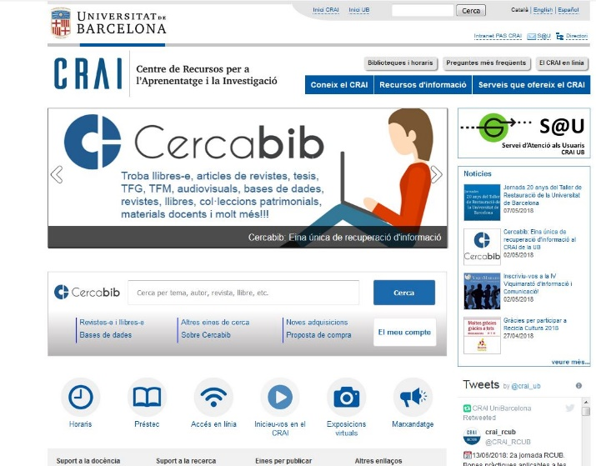
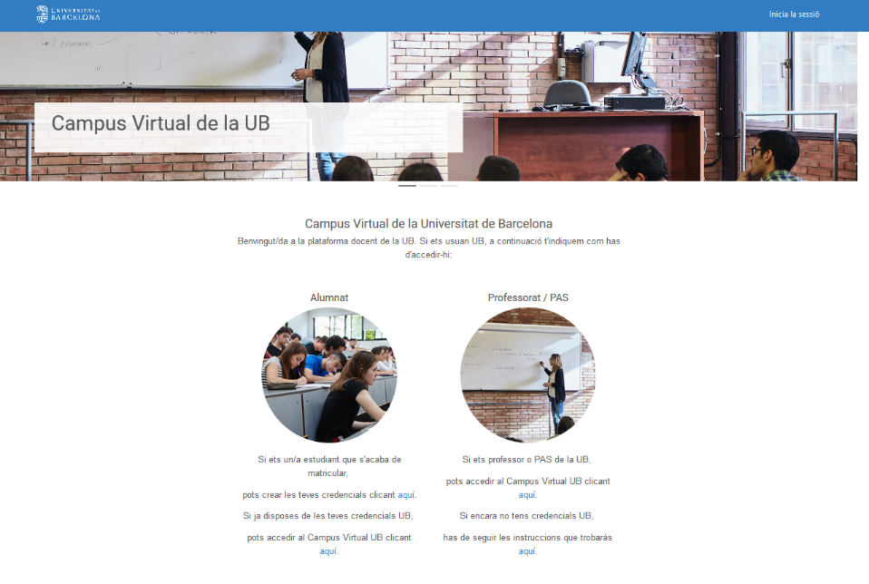
Campus Virtual
https://campusvirtual.ub.edu
It is the work tool with which you access your subjects and visualize the recommended bibliography, teaching materials and activities.
Campus Virtual
Identifier
and password

Slide 27
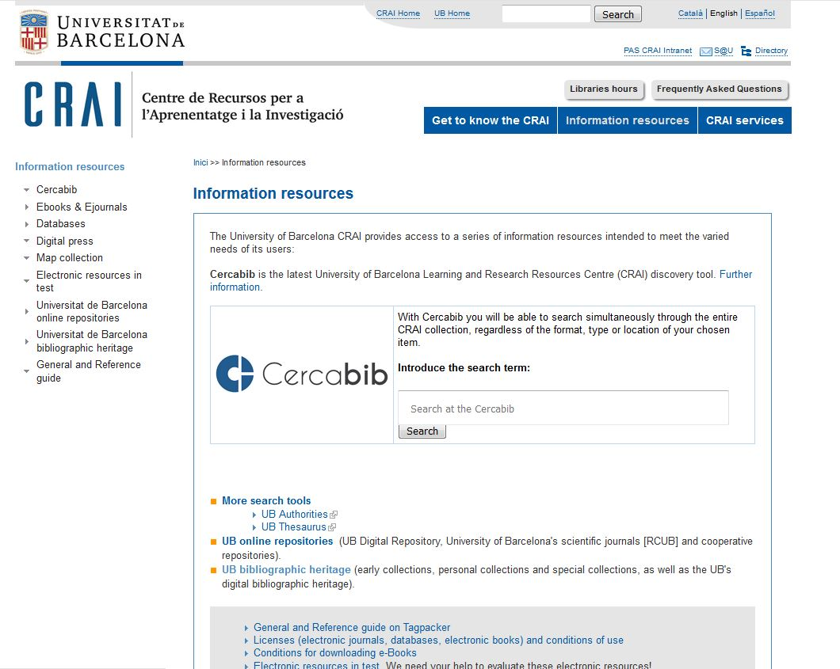
Information resources
https://crai.ub.edu/en/information-resources

Slide 28
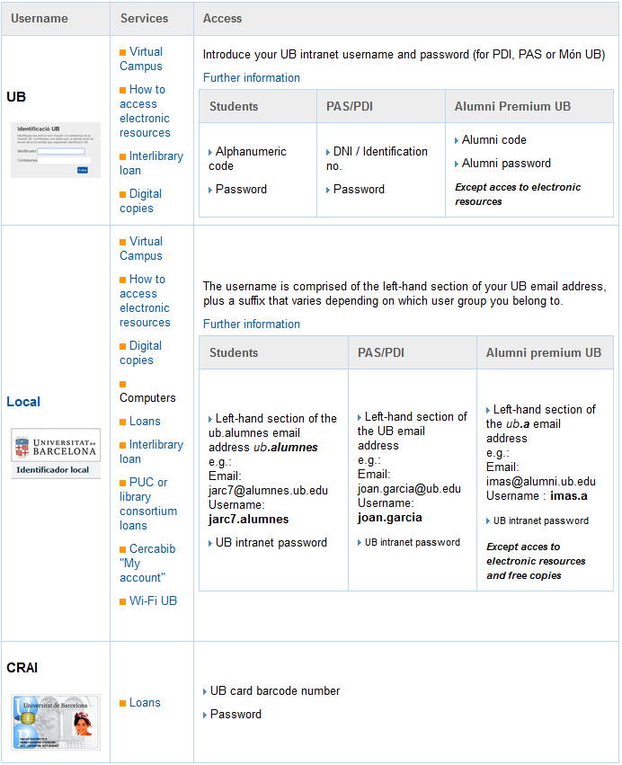
Usernames and passwords
https://crai.ub.edu/en/crai-services/resources-online/authentication
Watch the video

Slide 29
S@U, User Support Service https://crai.ub.edu/en/crai-services/sau
A 24x7 online information and reference service manned by specialized librarians, who can answer any doubts you have about the CRAI libraries and the full range of services and resources.
S@U is also the channel for delivering your complaints, suggestions and messages of thanks!
Notes:
Conèixer la Biblioteca de ........ (2005-2006)
29
Què és?
A què respon?

Slide 30
User training https://crai.ub.edu/en/crai-services/user-training
Advanced training courses are available to users who wish to improve their knowledge and search skills; for example, courses on specialized databases or the Mendeley reference manager.
Information about scheduled training courses is available on the CRAI Web, and personalized courses can be arranged on request.
Independent learning resources are also available on the CRAI web.
Notes:
Conèixer la Biblioteca de ........ (2005-2006)
30
Què és?
A què respon?

Slide 31
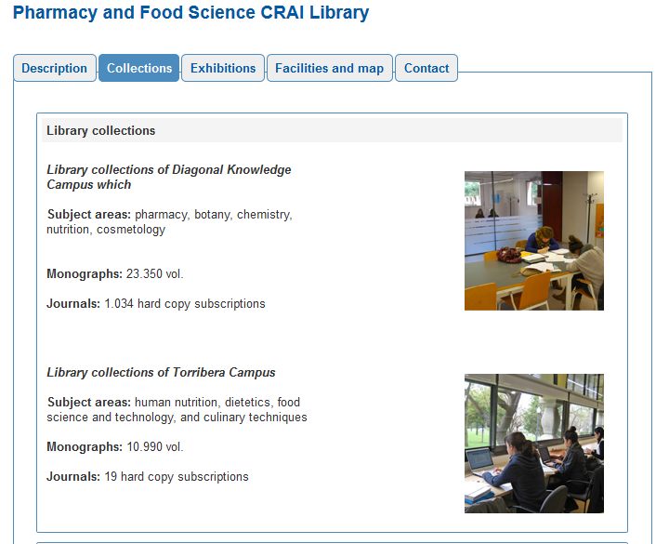
Collections https://crai.ub.edu/en/about-crai/libraries
Each CRAI Biblioteca has this section in this web.
It is a selection of information resources related to the subject areas of teaching and research at the University. You will find databases, books and electronic journals, text books, etc.
Notes:
Conèixer la Biblioteca de ........ (2005-2006)
31
Què és?
A què respon?

Slide 32
Wi-Fi and access to Faculty computers
https://crai.ub.edu/en/crai-services/resources-online/wifi-eduroam
The University's Wi-Fi service enables you to connect to the Internet without a physical connection to the network. To use UB Wi-Fi, configure your laptop and log on using your local username.
The University of Barcelona is actively involved in the Eduroam project, which promotes a unique e-mobility environment giving users access to the Internet at all participating organizations. Consult the Eduroam configuration guide.
User group | Ending | Email address | Local username
PAS / PDI |  | joan.pere.garcia@ub.edu cherrera@ub.edu | joan.pere.garcia cherrera
Students | .alumnes | jherg07@alumnes.ub.edu | jherg07.alumnes
Alumni UB | .a | pperez@alumni.ub.edu | pperez.a
Notes:
Què és?
A què respon?

Slide 33
Follow us on social networks! https://crai.ub.edu/ca/coneix-el-crai/difusio-marqueting/blogs-i-xarxes-socials
Instagram
https://www.instagram.com/craifcca
Facebook
https://www.facebook.com/craiubfcca
Twitter
https://twitter.com/craiubfcca
And Pharmacy and Food Science CRAI Library Torribera Campus virtual exhibitions.
Notes:
Diapositiva optativa

Slide 34
And if you still have questions...
Ask the CRAI staff
Library staff can answer the majority of your questions
CRAI home page
The section "Frequently asked questions"
provides answers to a number of common queries
S@U, User Support Service
Online information service for any questions about CRAI Libraries and the full range of resources and services. S@U is staffed by specialized librarians and is available 24 hours a day, seven days a week.
Or call us on
934 031 950

Slide 35
Thank you!
© CRAI Universitat de Barcelona, academic year 2020-21

