Slide 1
Madrid
Resource Sharing
Adelaida FERRER TORRENS
Director, CRAI

Slide 2
organization of the UB ILL service

Slide 3
Once upon a time – ILL at the Universitat de Barcelona
Born in1987
Originally decentralized service
At first, the service was manual and only for monogram and paper collections
Early technology limited by the technology of the time: “Minitel”
Only one terminal and a few hours/day
Access by Telnet and order via MS-DOS commands

Slide 4
- End of the 80’
1989 - Universitat de Barcelona the first institution to use OCLC in Spain,
1989 – Birth of the Rebiun network of Spanish universities
Notes:
Explain: tanto su módulo de PI como la integración de su fondo en el catálogo colectivo OCLC

Slide 5
The 1990s
Automation with a library system
Implementation of SOD - ILL (aka GTBib)
Collaboration with OCLC for other services:
For instance,1991 subscribed to BiblioFile (CD-ROM) for copy-cataloging from OCLC
Confidential - Not for Distribution

Slide 6
Beginning of the XXI century
2002 – Centralized service for ILL ar Universitat de Barcelona (from central 4 to 1 unit for ILL)
2004 – The CRAI is born, and the ILL becomes part of the Users’ Services Unit
Confidential - Not for Distribution

Slide 7
Strengths

Slide 8
Some values
Primery supplier of documents for universities and research institutions in Spain
Largest supplier of OCLC in Europe
Large and key collections at the library (2M)

Slide 9
What can we lend?
+ 2 milions items
+ 20.000 e-journals
Heritage library
Authors’ collections: personal papers
Digital library
Etc.

Slide 10
Average response time
Copies - 4 days maximum
Loans – 8 days maximum

Slide 11
Average response time
In reality – as soon as possible.
ie mostly of the time in a few hours.

Slide 12
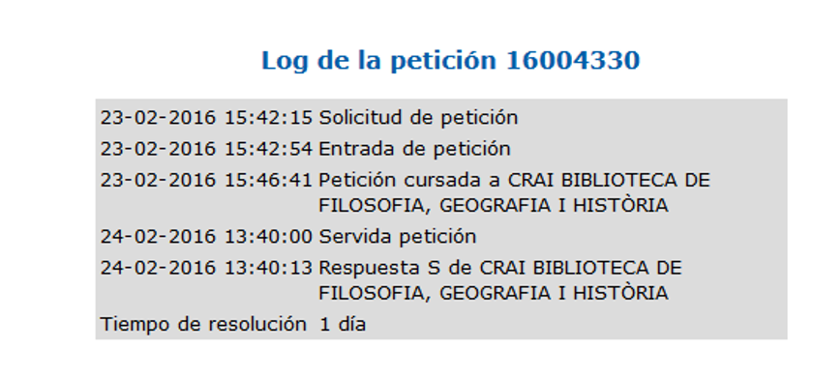
Response time, some examples Digitalized article, original in paper
Request: The University of Arizona, Tucson, Arizona

Slide 13
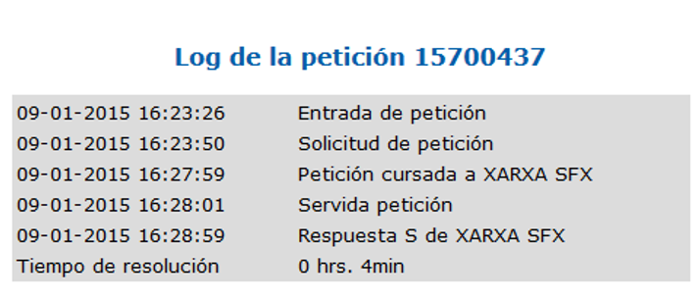
Response time, some examples E-journal article
Request: University of Michigan

Slide 14
Some statistics

Slide 15
Universitat de Barcelona ILL Service Requests and borrows

Slide 16
Universitat de Barcelona ILL Service Totals

Slide 17
UB ILL requests to OCLC

Slide 18
UB ILL requests to OCLC Evolution

Slide 19
OCLC requests to UB ILL 2011-2015

Slide 20
2012 OCLC requests Before and after UB Catalog emerge in OCLC WorldCat

Slide 21
2012 OCLC requests Before and after UB Catalog emerge in OCLC WorldCat

Slide 22
Benefits and Revenue streams

Slide 23
The benefits for UB CRAI
Increased visibility of the collections
More requests for ILL
Increase in revenue and services (such as Collection Manager)
Tremendous prestige of the University

Slide 24
Thank you, and vote for me ☺
Adelaida Ferrer
Director CRAI
aferrer@ub.edu

