Slide 1


Slide 2


Slide 3
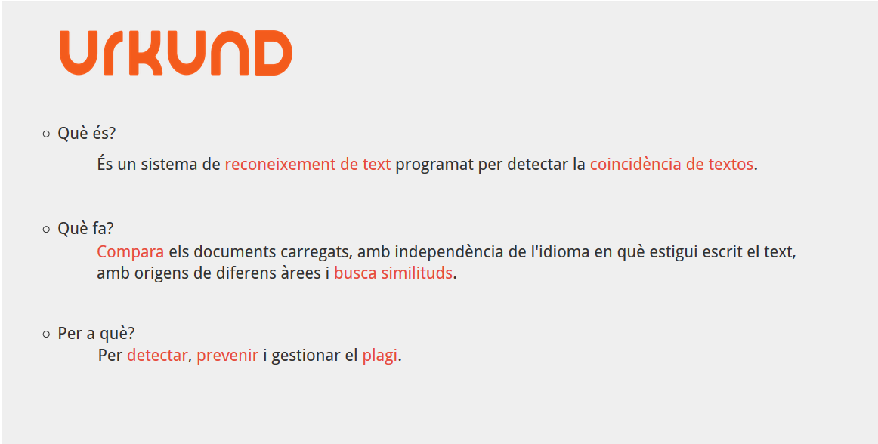

Slide 4
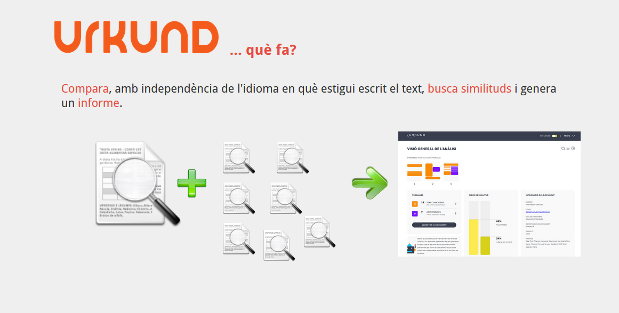

Slide 5


Slide 6
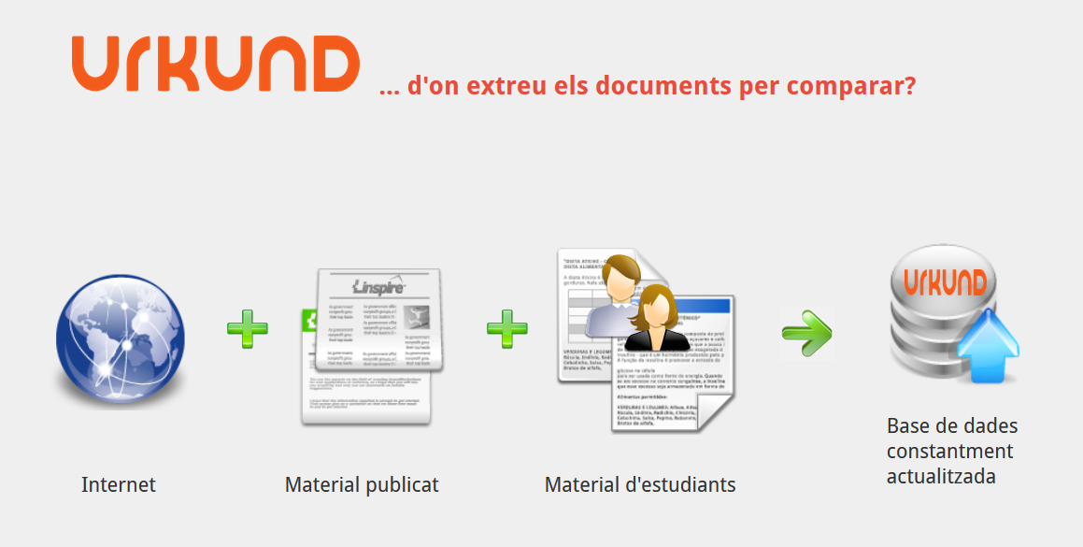

Slide 7

Moltes gràcies!!!
Totes les icones By Everaldo Coelho and YellowIcon; - All Crystal Clear icons were posted by the author as LGPL on kde-look;, LGPL, https://commons.wikimedia.org/wiki/Crystal_Clear

