Slide 1




Informal grammar learning from OV TV series: Captioning mode, watching strategies, and feeling of learning
Anastasia Pattemore
Mª del Mar Suárez
Carme Muñoz
Notes:
Our presentation revolves around the preferences and perceptions of EFL students towards extended L2 viewing. Specifically, we explore what they feel they learn when watching audiovisual material in the L2 and how this is mediated by the viewing mode. We are not going to discuss watching strategies as it is indicated in the presentation title.

Slide 2
Exploring L2 TV preferences and perceptions: Feeling of learning and viewing mode.
Anastasia Pattemore
Mª del Mar Suárez
Carme Muñoz
Notes:
Consequently, the title that best suits our presentation would be…

Slide 3
Literature review on extensive TV series viewing
Positive effects of extensive exposure to L2 media (Webb, 2014; Vanderplank, 2016)
Vocabulary (Pujadas & Muñoz 2019; Suárez & Gesa, 2019)
Comprehension (Rodgers & Webb, 2017)
Pronunciation (Wisniewska & Mora, 2020)
Grammar (Pattemore & Muñoz, 2020)
Notes:
To contextualize our study, it’s been widely proven that extensive exposure to L2 media has positive effects on several aspects of language, such as vocabulary, comprehension or grammar. We would like to highlight here the study by Pattemore & Muñoz 2020, which presents a study with the same participants as this one. In this study, a positive effect of extensive exposure to TV series was found for grammar constructions learning. Also, students who were exposed to English captions achieved higher gains than those who watched without captions.

Slide 4
Perception of learning
Captions and subtitles promote language awareness (Hanf, 2014 )
Vocabulary, expressions, spelling, and accents’ comprehension (Vanderplank, 1988)
78% of participants reported feeling of vocabulary and expressions learning from watching in L2 outside of the classroom (Kusyk & Sockett, 2012)
No feeling of vocabulary learning from a short intervention (Sydorenko, 2010)
Feeling of vocabulary learning from an extensive intervention (Pujadas, 2019)
Notes:
But, how do FL learners perceive these, in principle, positive effects? Captions and subtitles have been found to promote Language awareness among learners and, more specifically, feeling of learning of vocabulary, expressions, spelling and accents’ comprehension, in both short and long interventions. However, some interventions have also been counterproductive in this regard, as in Sydorenko short-intervention study, where participants reported they didn’t have that feeling of learning because of lack of feedback during the intervention. However, in an extensive intervention such as Pujadas, students did report positive feeling in that regard.

Slide 5
Attitudes and captions choice
Most of the participants believed they needed captions for better content and listening comprehension (Montero-Perez et al., 2013)
The majority of the participants watch with L1 subtitles (59%) followed by L2 captions (28%) (Sockett & Kusyk, 2012)
Vanderplank (2019) participants tended to use captions more at the start of the viewing intervention
Feeling of learning does not correspond to actual learning (Pujadas, 2019)
Notes:
As for preference for type of captions, there is a wide variety of findings. Preference for captions over no captions has been found for better content and listening comprehension although the students’ daily habits might differ in such a way that they prefer L1 subtitles. Two factors might be relevant when it comes to choosing one type over another. First, if students are asked at the beginning or at the end of the intervention, after having been exposed to one viewing mode or another, be it of their original preference or not. Another factor might be the learner’s proficiency level, them prefering L1 subtitles if their proficiency level is not too high while prefering other modes as their proficiency increases. Preference of one viewing mode or another might also be determined by feeling of learning. For instance, in Pujadas, students exposed to non-captioned TV series felt they were learning more although, when comparing their learning gains with other conditions, it was actually the opposite.

Slide 6

Research questions
a. Perception of learning:
RQ1: What is students’ perception of learning from extensive classroom exposure to L2 TV series?
RQ2: Is this feeling of learning related to viewing modes?
b. Preferred viewing mode:
RQ3: To what extent does students’ experience with the different viewing modes affect preferred viewing mode?
RQ4: Is this viewing mode change related to in-class viewing mode?
Notes:
Given the current gaps in the field, we aim at exploring two issues: feeling of learning and viewing mode preference. As for feeling of learning, we wonder what is the students’ perception of learning from extensive classroom exposure to L2 TV series and whether this perception is related to viewing mode.
Regarding the participants’ preference for one viewing mode or another, we set out to answer the following issues: if the students’ experience with the different viewing modes affected their original preference and supposing there is a change in their preferred viewing mode, and whether this change is mediated by the in-class viewing mode.

Slide 7
Methodology
Notes:
Now, moving on to Methodology…

Slide 8

Participants
4 intact non-Linguistics university classes N = 136
Catalan/Spanish bilinguals
A1 - C2 Proficiency (Mean=B2)
17 - 32 years old (Mean=19)
Viewing mode:
With captions (71)
Without captions (27)
With (38) (Pattemore & Muñoz, under review)
Notes:
The study involved 4 intact classes composed of 136 Catalan/Spanish bilingual undergraduate students. The participants’ proficiency varied from A1 to C2 with a mean of B2 according to CEFR levels. Their age varied from 17 to 32 years old with a mean of 19 years old. The classes were randomly assigned to three different viewing conditions: With captions, without captions, and with enhanced captions which were a focus of another study

Slide 9

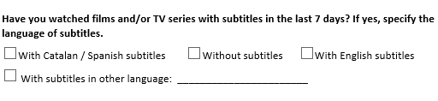
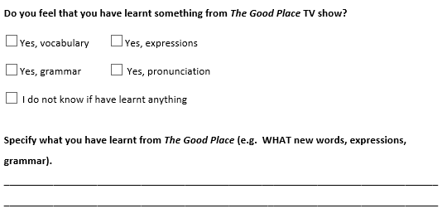
Instruments
10 episodes of authentic L2 TV series (227 minutes total)
Oxford Placement Test (OPT) (Allan, 2004)
Out-of-school exposure to L2 media questionnaire
Grammar pre-/ posttest (see Pattemore & Muñoz, 2020)
Follow-up questionnaire
Notes:
The students watched 10 episodes of The Good Place TV series weekly, which makes a total of 227 minutes of exposure. Their proficiency level, which ranged from A1 to C2, was measured with the Oxford Placement Test. We collected data on their viewing preferences and feeling of learning from their out of school exposure to L2 media by means of an online questionnaire, which was followed by a follow-up questionnaire after the participants watched all the episodes. Also, although it’s beyond the scope of this paper to cover their learning gains from the TV series exposure, we should mention anyway that they took a pre- and post-test containing several grammar target structures and expressions that appeared in the TV series. The questions tackled in this presentation are., first, “Have you watched filmns and/or TV series with subtitles in the last 7 days? If yes, specify the language of subtitles.” And second, “Do you feel you have learned something from TGP TV show? The students had to say whether what they had learned was vocab, exprssions, gramar, or pronunciation and they could also say that they didn’t have any feeling of learning. And then they also had to specify what they had actually learned.

Slide 10
Procedure
With Captions
OPT, Pre-test,
Questionnaire
Treatment
(22 min episode twice a week)
Immediate
Post-test,
Follow-up questionnaire
With Enhanced Captions
Without Captions
Notes:
The three groups completed the same tasks, the only difference was their exposure to the TV series: with captions, with enhanced captions or without caption. Before starting watching the TV series, the participants took the proficiency test, the pre-test with the target grammar structures and expressions and the viewing habits questionnaire. Then they started the treatment, which consisted in watching the TV series and doing a series of grammar activities after watching the second weekly episode. Finally, after watching those 10 episodes, they took an immediate post-test, the same as the pre-test but with the target structures in a randomized order, and answered a follow-up questionnaire on their viewing habits and feeling of learning for TGP.

Slide 11
RQ1: What is the students’ perception of learning from extensive classroom exposure to L2 TV series?
Notes:
The first research question adressed feeling of learning from the TV series watched in the classroom. Students reported that they have learned mostly expressions and vocabulary, while they do not think they are learning so much grammar or pronunciation (the percentages drop dramatically) and 19% affirm they do not know if they have actually learned anything.

Slide 12
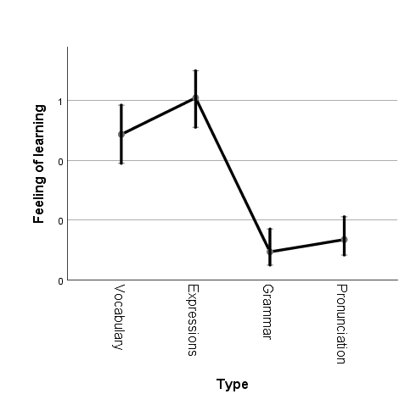
RQ1: What is the students’ perception of learning from extensive classroom exposure to L2 TV series?
Expressions – Vocabulary | p = .028
Expressions – Grammar | p < .001 *
Expressions – Pronunciation | p < .001 *
Vocabulary – Grammar | p < .001 *
Vocabulary – Pronunciation | p < .001 *
Grammar – Pronunciation | p = .690
Notes:
These results are confirmed by the binominal linear regression, where we find that expressions were perceived to be learnt the most, followed by the vocabulary. Both expressions and vocabulary were perceived to be learnt more than grammar and pronuncation. Grammar and pronunciation were felt to be learned the least and there was no significant difference between these two language features.

Slide 13
RQ2: Is the students’ perception of learning from extensive classroom exposure to L2 TV series related to viewing modes?
Notes:
Our second RQ refers to the relation between the students’ perception of learning from exposure to the L2 TV series and the viewing modes they experienced during the intervention.
We can observe that for all viewing modes, students perceive they are learning vocabulary and expressions more than grammar and pronunciation. Some students do not perceive any learning advances, especially in the captions group.

Slide 14
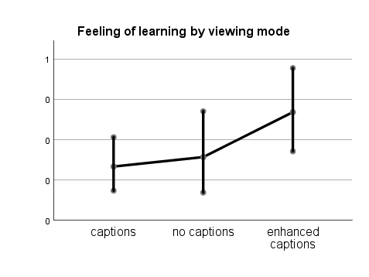
RQ2: Is the students’ perception of learning from extensive classroom exposure to L2 TV series related to viewing modes?
Enhanced captions had a stronger feeling of learning than Captions (p = .016)
Notes:
Regarding the in-class viewing mode and overall feeling of learning, there was a significant association between the viewing mode students watched the TV series in and feeling of learning.
The pairwise comparison has shown that the enhanced captions group had a significantly stronger feeling of learning than the captions group

Slide 15
RQ3: To what extent does students’ experience with the different viewing modes affect preferred viewing mode?
*
Notes:
Moving on to the issue of how viewing modes affected the students’ preference for captions and subtitles, the McNemar nominal paired samples analysis showed that those students who preferred L1 subtitles before the intervention didn’t experience any change in their preference. It also showed a significant change in the other two groups. There was a significant drop in use of L2 captions and a significant increase in watching without captions. We could actually claim that those that before the viewing intervention preferred the L2 captions mode preferred watching audiovisual material mostly without captions after the intervention.
However, no student preferring L2 captions or no captions at all before the intervention preferred the L1 subtitles mode after it.

Slide 16
RQ4: Is this viewing mode change related to in-class viewing mode?
Percentage of participants who watched using different viewing modes in the previous week
beginning
end
Notes:
Finally, we looked further and checked if these changes depended on the type of exposure that the participants’ experienced during the intervention, that is, captions, no captions or enhanced captions, the results show that both captions and enhanced captions groups significantly decreased their use of L2 captions and increased watching without captions. While the no captions group significantly decreased their preference for use of L2 captions.

Slide 17
Discussion 1: Perceptions of learning
Expressions and vocabulary: salient per se (and so, more noticeable)
Expressions and vocabulary: effect of enhanced captions
Expressions = out-of-class exposure viewing habits (Kusyk & Sockett, 2012; Vanderplank, 2019)
Grammar upper proficiency not challenging (Pattemore & Muñoz, 2020)
Grammar and pronunciation not perceived as learnt because not tackled explicitly (Sydorenko, 2010)
Pronunciation: not enough tokens to notice
Enhanced captions group: they feel they learn more → noticing
Notes:
These results lead to the following discussion.
To start with, it seems that the students perceive they learn expressions and vocabulary more than anything else. The reasons for this feeling could be several. To start with, expressions and vocabulary are Language elements that could be perceived as more salient than grammar and pronunciation, so they are easier to notice than others. Also, as expressions and grammatical constructions were those target ítems appearing highlighted in the enhanced captions group, this could have led to a feeling that it was this type of items, and not others, the ones being learned. Also, as found in Kusyk and Sockett’s and Vanderplank’s studies, these are the linguistic aspects that are paid more attention to in out-of-class exposure, so it shouldn’t be a surprise that they are also the ones perceived as most learned by our participants.
Proficiency might have also played a role for those with a higher level. It might also be the case that these students didn’t find the target grammar structures challenging enough and hence, their lack of feeling of learning them.
Grammar is the aspect that is felt to be learned the least. The reason for this might be that it is a language aspect that is traditionally addressed either implicitly or rather explicitly in the FL classroom. Also, as it was not further practised (only highlighted in the enhanced captions group and practised in the immediate post-tasks but no feedback was provided), the students might have felt that they were missing out on opportunities to learn those structures that they had perhaps even perceived. However, we must also point out that this lack of feeling of learning grammar does not actually reveal what was actually happening. As found in Pattemore and Muñoz 2020, all groups, regardless of the viewing mode they were exposed to, did learn the target grammar constructions.
The participants didn’t feel they were learning much pronunciation either. This might be because it was difficult for them to perceive any pronunciation challenges in specific words in contrast with the way they thought they were pronounced,
In any case, it’s the enhanced captions group the one perceiving they were learning more than the others in all the types asked about, including grammar, which was a type not so popular in the other two conditions. This might be due to the immediate post-task that the enhanced captions group took after each episode, which gave them a false feeling of learning, as the results of the immediate post-test actually reveal that this group is not the one with the highest learning gains.

Slide 18
Discussion 2: Preferred viewing mode
Significant drop in viewing with L2 captions and increase in viewing without captions
B1-B2 / C1-C2 preferred L2 captions → after 5 weeks → without captions confident
Those who preferred L1 subtitles keep the same option → not confident enough / lower proficiency / they realize that with L2 captions is too difficult, challenging (intervention – affective filter), regularly being exposed, uncomfortable
Captions and enhanced captions group → without captions: bothering them, they felt they didn’t need them as time went by (Vanderplank, 2019)
Non-captions → decrease in L2 captions, they get used to the new situation
Notes:
As for the students’ viewing mode preference both before and after the intervention, we can see that there is a significant change for those used to viewing FL TV series with L2 captions, who start watching series without any type of captions. We hypothesize that these students might be those with higher proficiency level, who after 5 weeks of extensive exposure to FL non-captioned TV felt confident enough to view TV series in this mode.
Those who preferred L1 subtitles before the experience keep the same option. That might be due to their perhaps lower proficiency, which prevents them from shifting from one mode to the other. Also, some sort of affective filter might make them feel uncomfortable watching TV series with captions or no captions at all.
Our results are in the same line as Vanderplank’s when it comes to preferring no captions for the captions and enhanced captions group. These students might have felt that any text on screen was bothering them, and hence their change for a non-captions mode.

Slide 19
Conclusions & further research
Extended exposure to L2 viewing led to positive feeling of learning → positive experience
Enhanced captions group → higher feeling of learning
Expressions and vocabulary are perceived to be learned the most → emphasis in other language areas or explicit instruction (Sydorenko, 2010)
It is easier to notice vocabulary and expressions (multi-word collocations) than underlying abstract constructions (rules)
There is a switch from L2 captions to without captions → learner confidence might have been fostered
Further research:
Different results mediated by proficiency levels
Use of watching strategies should be looked into
Notes:
We can conclude that the students felt they were learning from this extended exposure to L2 viewing, so it was an overall positive experience for them.
We could see that noticing played a role on several occasion, especially for the enhanced captions group, who are those that felt they were learning more. Also, both expressions and vocabulary are perceived to be learned the most. It is easier to notice vocabulary and expressions (multi-word collocations) than underlying abstract constructions (rules).
That could be because they were more noticeable as well. However, the fact that the other areas of language were felt to be learned less might be because of the way they are traditionally presented in the Spanish FL classrooms.
We could also see there is a switch in the students. Those used to watching audiovisual material with L2 captions moved on to use no captions, so this extensive viewing experience might have fostered their confidence as active viewers and FL learners.
As for further research, we hypothesize that the learner behaviours presented here might be different depending on the learners’ proficiency levels, so that’s an area that certainly deserves further exploration, as does the use of learner strategies.
Thank you for your attention.

Slide 20


Thank you!
"Optimal conditions for language learning through original version audio-visual input. Input and learner factors " (PID2019-110594)
Anastasia Pattemore anastasia.plotnikova@ub.edu
Mª del Mar Suárez mmsuarez@ub.edu
Carmen Muñoz munoz@ub.edu

