Slide 1
Universal design in a summer camp on robotics
Mireia Ribera (ribera@ub.edu), Eloi Puertas (eloi@maia.ub.es)
Department of Mathematics and Computer Science
Universitat de Barcelona
Notes:
Hello everybody and thanks for attending this talk. I’m Mireia, and we are from this wonderful city.
In this presentation I will talk you about an experience that will be done next week, addressed to teenagers, before entering the University.

Slide 2
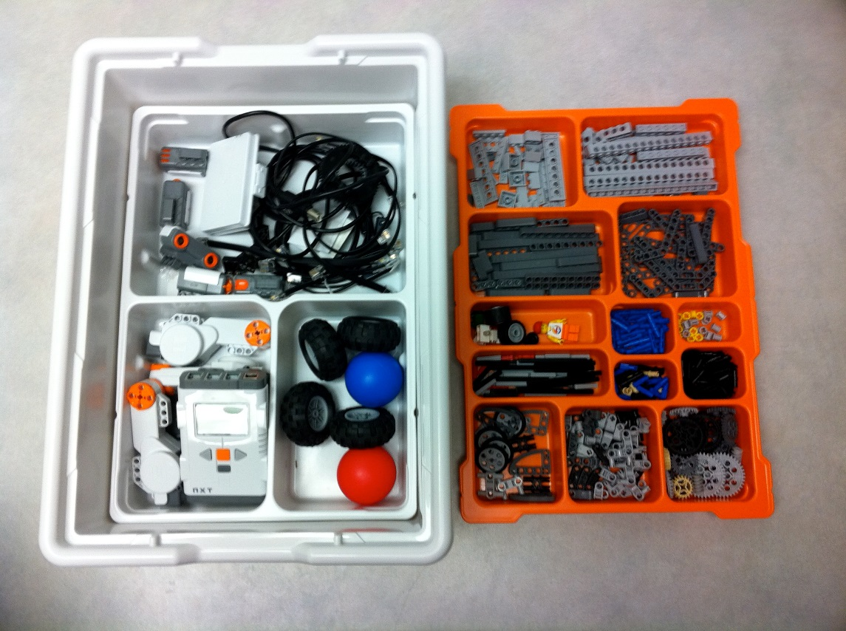
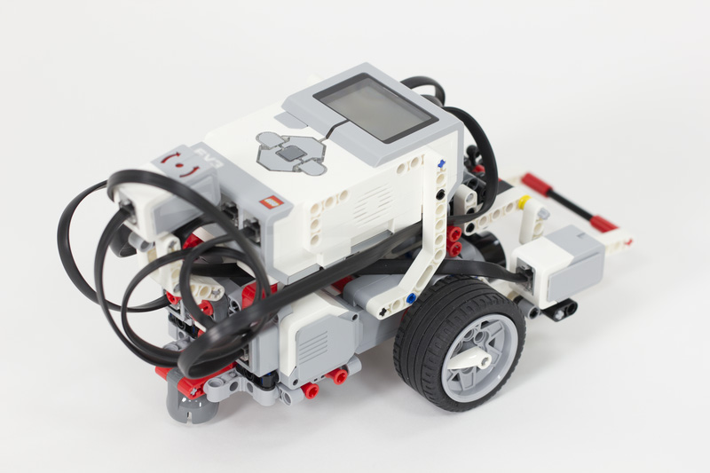
The initial activity:
Building
Notes:
This proposal started as a “typical” robotics summer camp, to motivate students on STEM careers. The students had some challenges and work in teams to build and program a Lego Mindstorm EV3 robot.

Slide 3

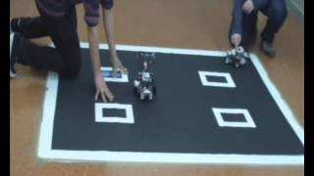
The initial activity:
Competition and Coding task
Notes:
After the building participants will code the robots to follow a White line relying on their sensors, to follow another robot, or to do a Sumo fight.
All this programming is done on MIT App inventor 2, a very intuitive tool where every part of the program corresponds to a jigsaw piece that only fits with coherent parts

Slide 4

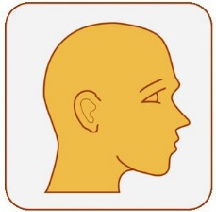
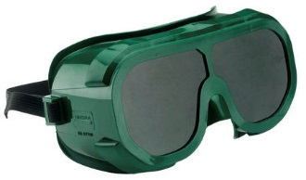
Innovation in accessibility:
Awareness
Notes:
The innovation of this summer camp has been the introduction of universal design thinking and design. Students need to lear different users’ needs and experience them too. So as a first step we introduce participants to the inclusive design toolkit, and then we make them work with three pairs of gloves and with simulation glasses to wear the shoes of users with disabilities.

Slide 5
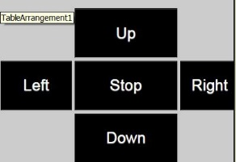
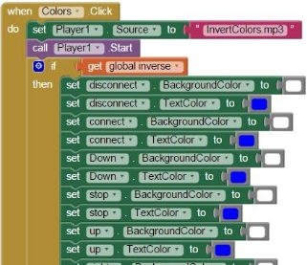
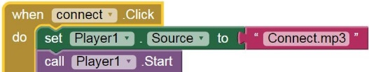


Innovation in accessibility:
Accessibility design
Notes:
After they are conscious of different needs students will improve the design of the app taking into accout: motor impairments and low vision with big and contrasted buttons; blind users with sounds associated to each button as auditive feedback; two options for colors in buttons configurable in the app.

Slide 6
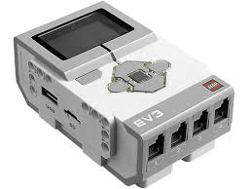
Innovation in accessibility: changes in robots
Notes:
Finally the students will include auditive feedback to every button of lego robots, and also different lights will be activated depending on the user action. Therefore they will understand multimodal feedback.

Slide 7
Future research
Participants with disabilities
Technical aids
Notes:
With this summer camp we want to introduce a new issue in design, related to user preferences and needs, which can be applied (and should) to any other design activity in the students’ career.
To go further, we would like to include participants with disabilities in future summer camps and to explore the integration of technical aids with the coding and playing tasks.

Slide 8
INDICATORS: knowledge and skills
K1. Are all users equal?
K2. Which user groups do you have to take into account when designing a product?
K3. Mention two interface solutions for two different user groups
App MIT inventor
K4. Whose fault is it if someone is not able to use an app?
SK1. Are you able to set width, height and font-size of an actionable element of an app?
SK2. Are you able to add audio to an actionable element of an app?
SK3. Are you able to programmatically change colours of a screen element of an app?
SK4. What else are you able to do in order to give more flexibility to your apps?
Lego Mindstorm programming
K5. What is a multimodal feedback?
SK1. Are you able to include audio and light responses to a robot?
SK2. Are you able to program more than a simultaneous answer from the robot?
Notes:
This is the last slide of this presentation, but I will introduce it first: what do you think? Are you aware of this concepts and technical possibilities?
Universal design is now a real possibility, and the challenge is on changing the mind of developers and designers.

Slide 9
Last thoughts
Law
Ethics
Creativity
Education
Notes:
We believe that Education with initial capitals goes further than knowledge and capabilities. It should include ethical considerations and take into account legal, normative and societal frameworks. User diversity and different needs increase creativity and an open mind that benefit most users. We will not have a GPS on our cards, neither ebooks, neither a typing machine without previous research for people with disabilities.

Slide 10
Thanks for your attention!
Mireia Ribera (ribera@ub.edu), Eloi Puertas (eloi@maia.ub.es)
Department of Mathematics and Computer Science
Universitat de Barcelona

