Slide 1



CRAI User Services Unit

Slide 2


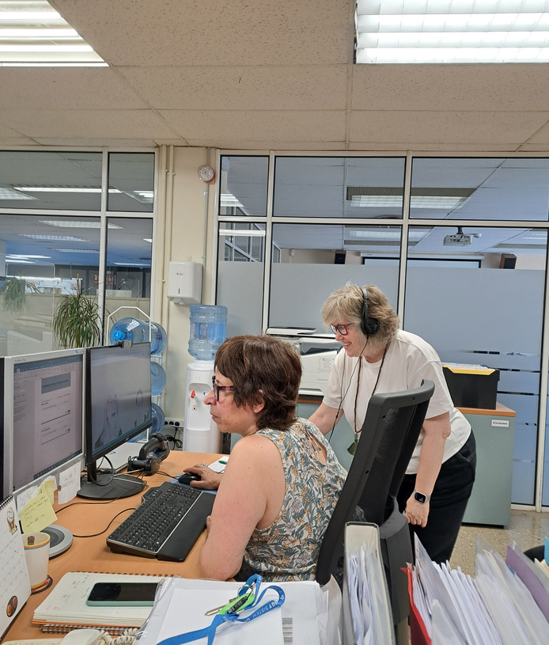
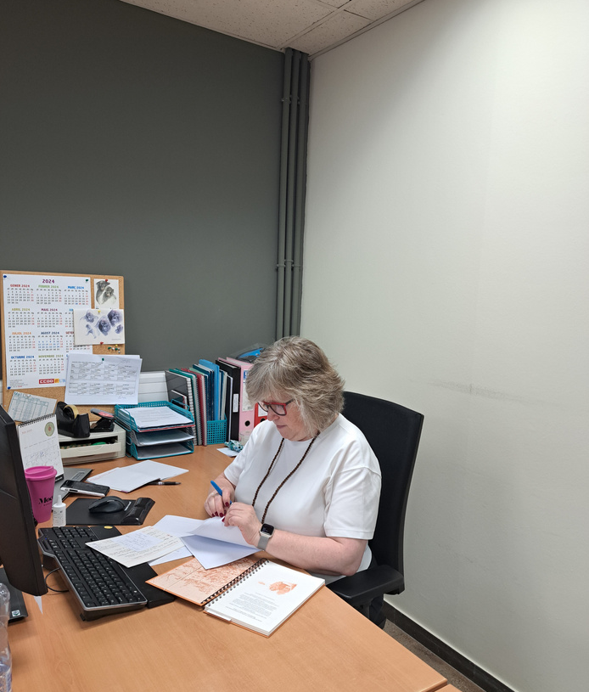
Presentation
The User Services Unit (USU) is one of the technical units of The Learning and Research Resources Centre (CRAI) of the University of Barcelona.
01

Slide 3

Mission
The mission of USU is to manage and coordinate processes associated with services for CRAI users, in accordance with current legislation and internal guidelines, to provide the best possible service to all users.
02

Slide 4


What services it coordinates
Document & equipment loans of UB
Services for users with specific needs
User training
Library consortium loans (PUC)
User support service (SAU)
Digital copies
Interlibrary loans (PI)
Statistical data & indicators
Laptop & other equipment contracts
Access to electronic resources (SIRE)
Bibliographical information
Regulatory documentation review
03

Slide 5









... and it is responsible for
CRAI statistical
data & indicators
Managing work by processes and quality in the CRAI
Creation and management of CRAI satisfaction surveys
Collecting complaints, suggestions and acknowledgments data of CRAI
External cooperation with REBIUN, CSUC, AQU, COBDC, IDESCAT, etc.
Drafting of the CRAI annual report
Developing of regulations, rules and work procedures related to the services it coordinates
Gender equality and harassment risk prevention data within the CRAI
CRAI’s Intranet & SharePoint maintenance
04

Slide 6



Thank you
CRAI of the University of Barcelona, academic year 2024-2025

