Slide 1

Resources and Tools to elaborate the Bachelor's Degree Final Project
Faculty of Economics and Business Studies

Slide 2
Resources and tools to elaborate the Bachelor's Degree Final Project
Elaboration of the final project
  Planning
  Choosing the topic
  Information sources and Boolean operators
Information search: tools and strategies
  Search strategy
  CRAI resources
  Open access. Concept and resources
  Other resources
  Criteria for evaluating information
Guidelines to use other people's works: copyright, plagiarism, etc.
How to cite and manage bibliography
Annex: I ara què?

Slide 3
1. Elaboration of the final project

Slide 4

Planning
ACTIVITIES | Oc | Nv | Ds | J n | Fb
Choosing a topic
Searching information
Writing the document
Review

Slide 5
Choosing a topic
Brainstorming
Concept map
Original
Contrasted
Strengths and weaknesses
Viable
Relevant
Bibliographic review
Limits

Slide 6
Information sources
PRIMARY SOURCES
SECONDARY SOURCES
They give direct access to the information
They collect information from the primary sources
Dictionaries
Encyclopedias
Monographs
Periodicals
Catalogs
Databases
Subject guides
Bibliographies

Slide 7


Boolean operators
AND
OR
NOT
Intersection
Union
Negation

Slide 8
2. Information search: tools and strategies

Slide 9
Search strategy
TO IDENTIFY
Key concepts
Type of information
Sources of information
Content level
Type of data
Chronological scope
Social Scope
Geographical scope
Keywords
Synonyms
Alternative terms
Catalogs
Databases
Internet

Slide 10
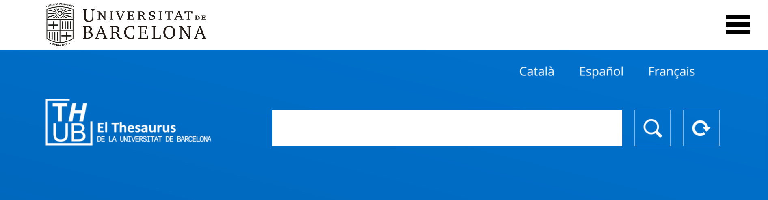
CRAI resources
TESAURUS
https://vocabularis.crai.ub.edu/en/thub

Slide 11
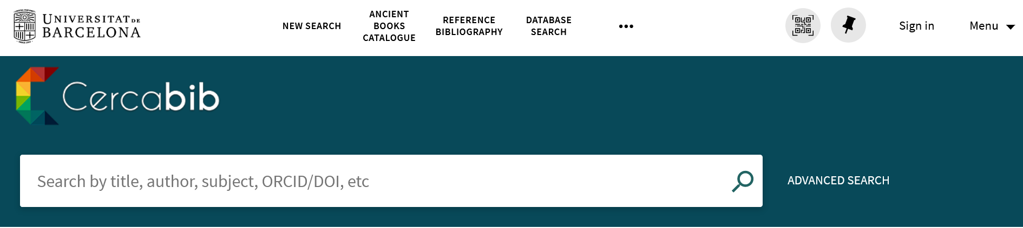
CRAI resources
CERCABIB
https://cercabib.ub.edu/

Slide 12
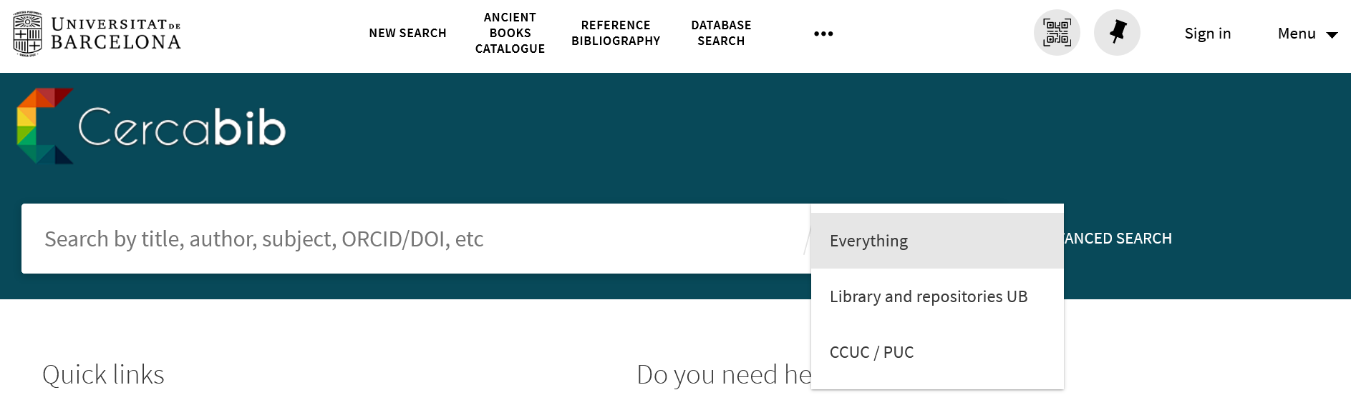
CRAI resources
CCUC/PUC
https://cercabib.ub.edu/

Slide 13

Open access
... we understand open access as the free availability on the web, allowing any user to read, download, copy, distribute, print, search or use for any legal purpose, without any economic, legal or technical barrier...
Budapest Manifesto, February 2002
http://www.budapestopenaccessinitiative.org/

Slide 14




Open Access
CREATIVE COMMONS
(BY) Attribution: AII CC licenses require that others who use your work in any way must give you credit the way you request, but not in a way that suggests you endorse them or their use. lf they want to use your work without giving you credit or for endorsement purposes, they must get your permission first.
(NC) NonCommercial: You let others copy, distribute, display, perform, and (unless you have chosen NoDerivs) modify and use your work for any purpose other than commercially unless they get your permission first.
(ND) No Derivative Works: You let others copy, distribute, display, and perform only original copies of your work. lf they want to modify your work, they must get your permission first.
(SA) Share Alike: You let others copy, distribute, display, perform, and modify your work, as long as they distribute any modified work on the same terms. lf they want to distribute modified works under other terms, they must get your permission first.
https://creativecommons.org/licenses/?lang=en

Slide 15
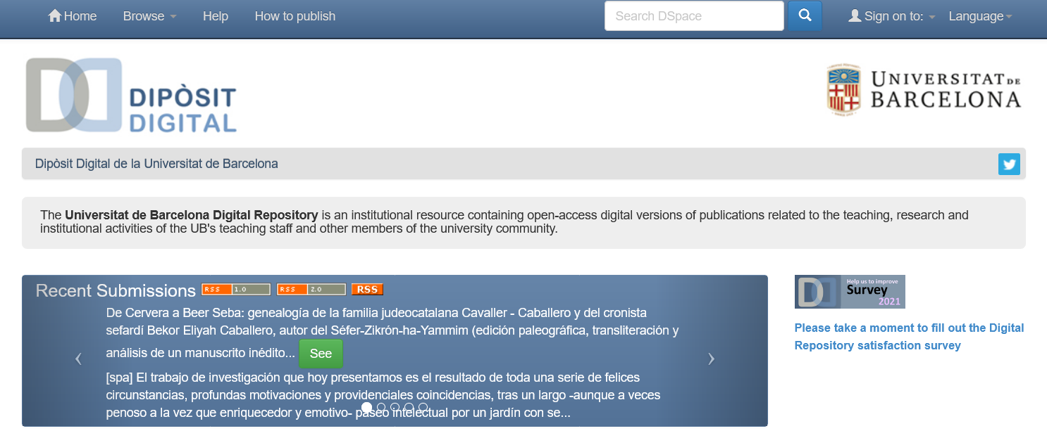
Open Access at the University of Barcelona
UB DIGITAL REPOSITORY
http://diposit.ub.edu/dspace/

Slide 16
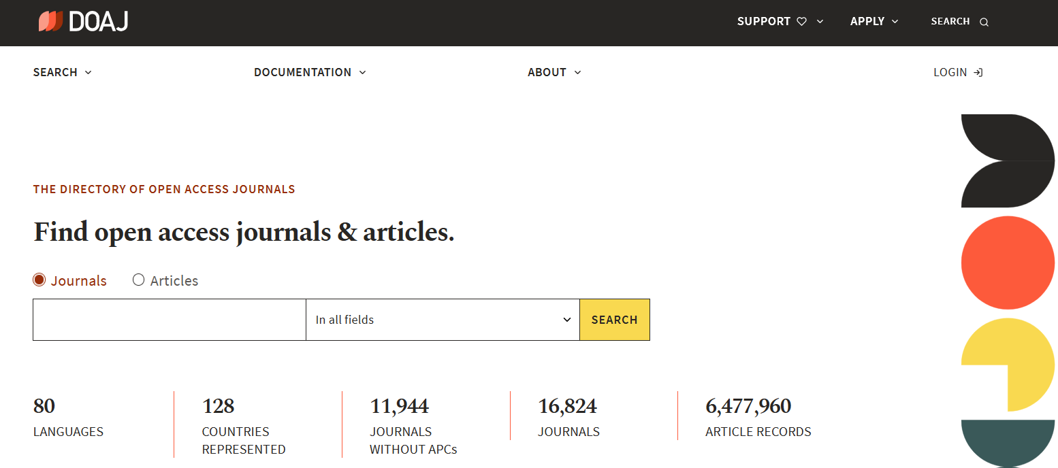
Other Open Access (OA) resources
DOAJ
https://doaj.org/

Slide 17
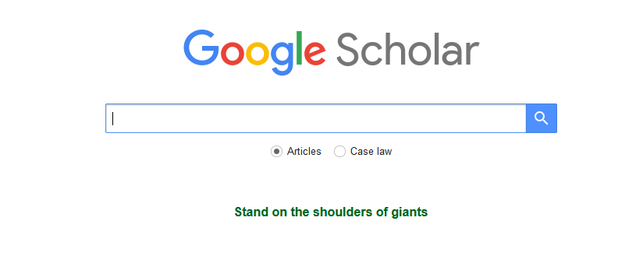
Other Open Access (OA) resources
GOOGLE SCHOLAR
https://scholar.google.com/

Slide 18
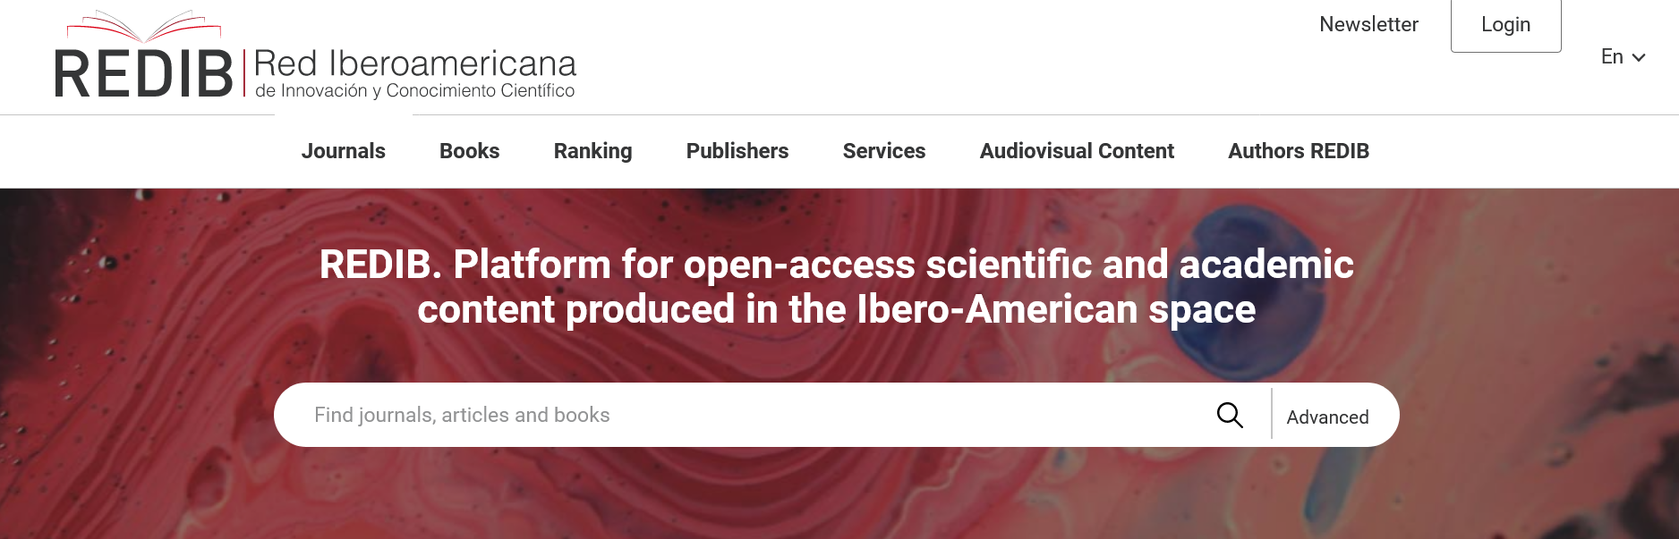
Other Open Access (OA) resources
REDIB
https://www.redib.org/

Slide 19
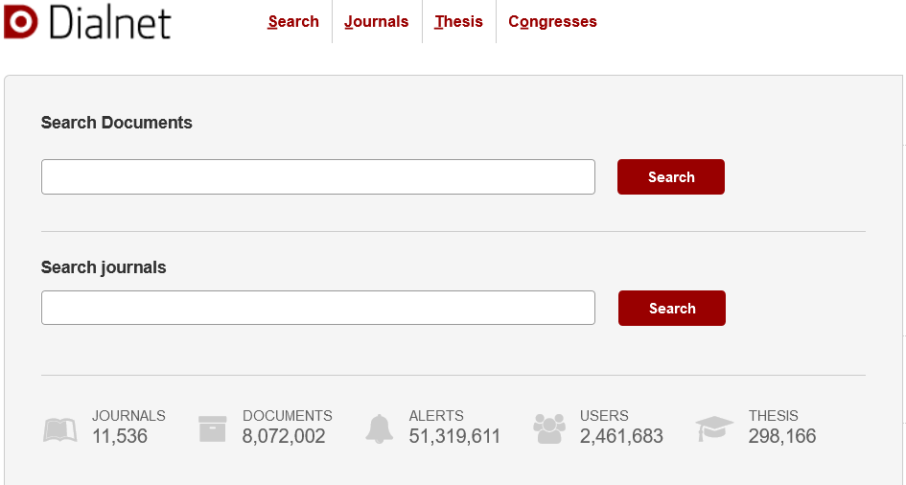
Other resources
DIALNET
http://dialnet.unirioja.es/

Slide 20
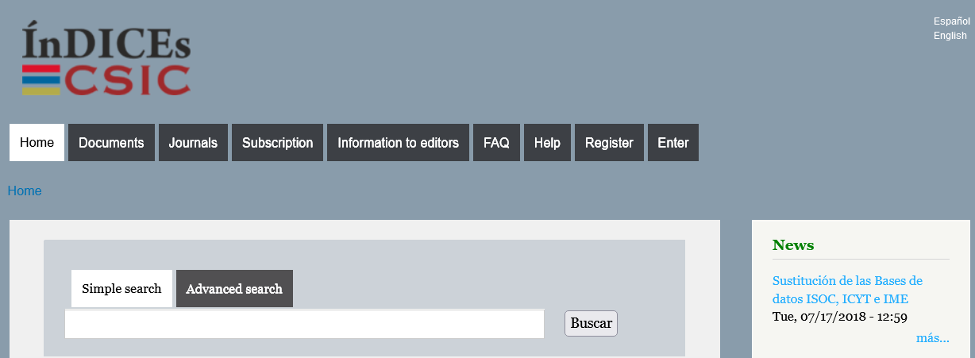
Other resources
ÍnDICEs CSIC
Full text in Cercabib: https://bit.ly/36sI1hO
Consult the summaries: https://indices.csic.es/

Slide 21
Criteria for evaluating information
Who is the author? Is he/she an expert in his/her field? Does he/she cite the sources? Does he/she include contact details?
AUTHORSHIP
CURRENT
Is it easy to find the publication date or the recent revisions?
SUBJECT MATTER
Is it relevant and useful to your work? Has it bibliography? Has it mistakes?
OBJECTIVITY
Is it impartial and precise? Does it contain opinions? Are they reasoned? Is the information verified with citations?

Slide 22
3. Guidelines to use other people's works: copyright, plagiarism, etc.

Slide 23
Guidelines to use other people's works
COPYRIGHT
PLAGIARISM
You must respect copyright. A work may not be used without express authorization from the author or copyright holder, unless otherwise indicated.
Plagiarism is "the act of presenting another's work or ideas as one's own" (CRAI UB, 2007).
-> Resources about plagiarism (CRAI)
We will use our own words to express other ideas, but always including the bibliographical references of the sources.
If we quote literally an excerpt from a book, journal’s article, Internet content... we will write it in quotation marks, and we will include the author's data.

Slide 24
4. How to cite and manage bibliography

Slide 25
How to cite and manage bibliography
APA FORMAT
Citations in the text
One author: (Marina, 2011)
Two authors: (García, & Magaz, 2009)
Until 5 authors: (Smith, Johnson, Williams, Jones & Davis, 2000)
Six or more authors: (Corbillon et al., 2008)
APA style

Slide 26
How to cite and manage bibliography
APA FORMAT
Books
Surname, name's initial letter. (year). Title in italic: subtitle (# edition). City: Publisher.
Codina, L. (1996). El llibre digital: Una exploració sobre la informació electrònica i el futur de l’edició (2a ed.). Barcelona: Generalitat de Catalunya, Centre d’Investigació de la Comunicació.
APA style

Slide 27
How to cite and manage bibliography
APA FORMAT
Journal's article
Surname, name's initial letter. (year). Article title: Article subtitle. Journal title in italic : Subtitle, # volume in italic (# of the number), # first page of the article-# last page of the article.
Heery, M. (1998). Organització de la biblioteca: Repàs d’estructures. Ítem: Revista de biblioteconomia i documentació, 23, 8-15.
APA style

Slide 28
How to cite and manage bibliography
APA FORMAT
Web pages
Author. (year). Title in italic. Date accessed http:// URL
Modern Language Association. (2003). MLA Style. Data accessed http://www.mla.org/
APA style

Slide 29
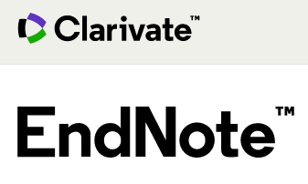


How to cite and manage bibliography
REFERENCE MANAGEMENT TOOLS
To create a personal library
To import documents
To organize them in folders
To add citations in a word processor and create bibliographies
To create a personal profile
https://crai.ub.edu/en/crai-services/citations-reference/bibliography-tools

Slide 30

We finish the bachelor's degree... and now?
What to do after university?

Slide 31


Thank you!
© CRAI Universitat de Barcelona, academic year 2021-22

