Slide 1

Get to know the Information and Audiovisual Media CRAI Library
Academic year 2021-22

Slide 2
What's the aim of this session?
To present the CRAI Information and Audiovisual Media Library and its services
https://crai.ub.edu/en/about-crai/libraries/information-sciences
To present the general services and resources offered by the Learning and Research Resources Centre (CRAI)
crai.ub.edu/en

Slide 3
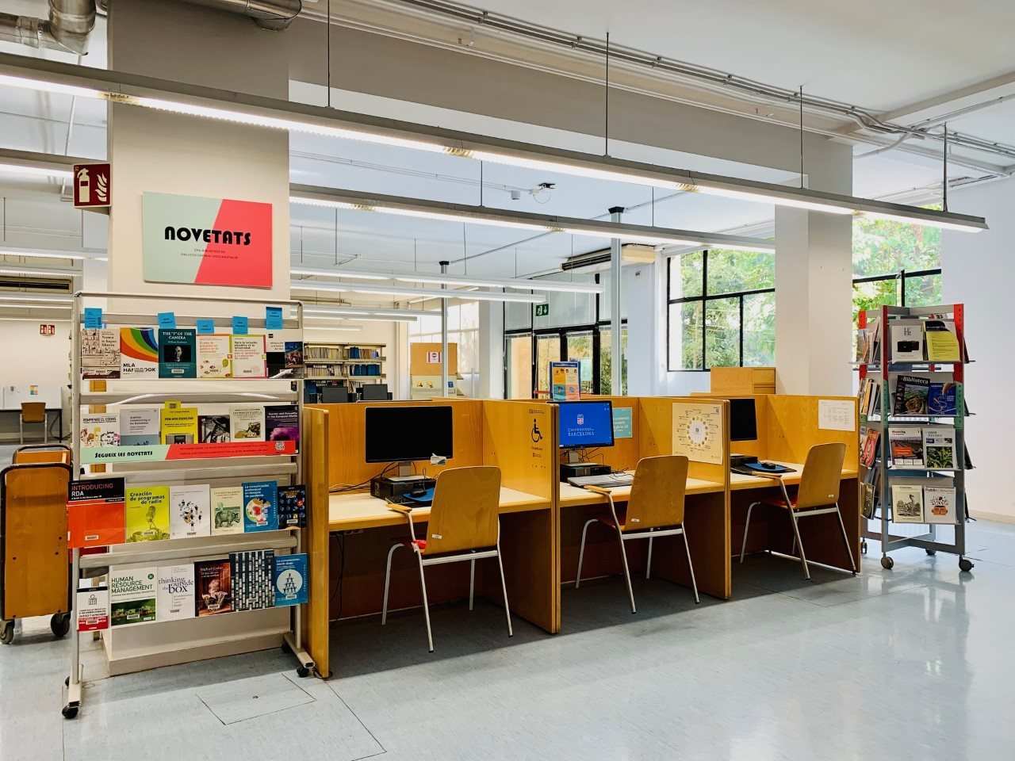
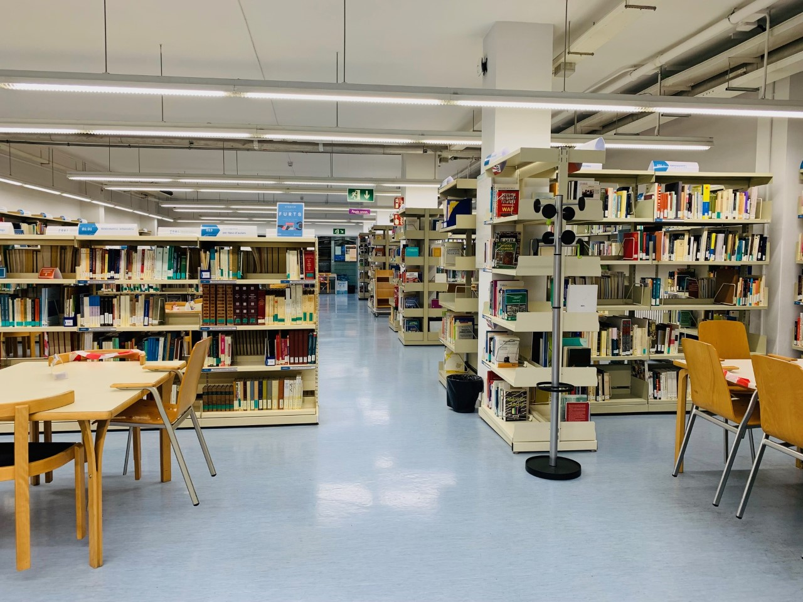
CRAI Information and Audiovisual Media Library
It was founded in 1920 as the Library of the Escola Superior de Bibliotecàries, the former school of library science created by the Catalan Mancomunitat in 1915. To know more about its history (Catalan)
Contact: bib.informacio.audiovisuals@ub.edu
Opening hours: Monday to Friday, from 8:30 am to 8:30 pm
CRAI UB Service Charter
Addresses of other libraries
Special opening hours in exam periods and at weekends (Catalan)
CRAI Libraries Regulation (Catalan)

Slide 4
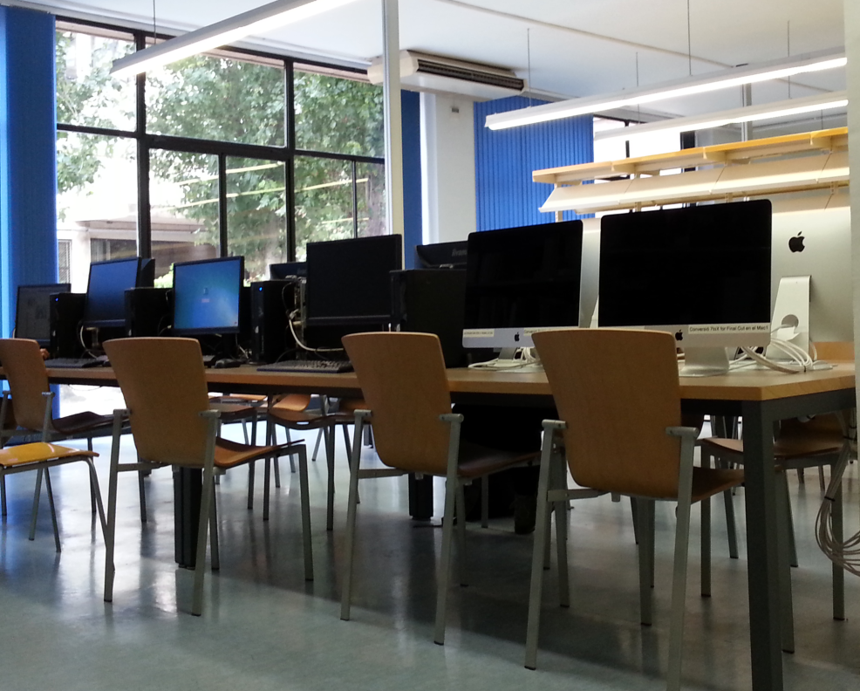
CRAI Information and Audiovisual Media Library
Equipment and facilities
143 seats
1 TV/video player
24 PCs, 5 Mac and 6 laptops
Wi-Fi area and Eduroam network throughout the Library. How to get connected
2 group study rooms (with PC/Mac and Smart TV)

Slide 5
The collection: books, journals, etc.
The Information and Audiovisual Media CRAI Library contains research and specialized collections for the following studies: Bachelor’s Degree in Digital Information and Documentation Management, Audiovisual Communication, Master’s Degree in Digital Content Management, School Libraries and the Promotion of Reading, Bookstore Postgraduate, etc.
The overall collection comprises monographs, printed journals, electronic resources, doctoral theses and audiovisual materials.
Books are organized using the Universal Decimal Classification (UDC). Journals are arranged alphabetically.
The Library also houses a series of special collections: Printing, Publishing and Bookselling Catalogues (UB Digital Heritage Library) and the Photographs of the School of Librarians. Books and other materials from the storeroom or glass cabinet (call numbers beginning with "R", "VITRINA" o "D22") must be requested one day in advance.
You can use this form (Catalan) to send your proposals for book purchases.

Slide 6
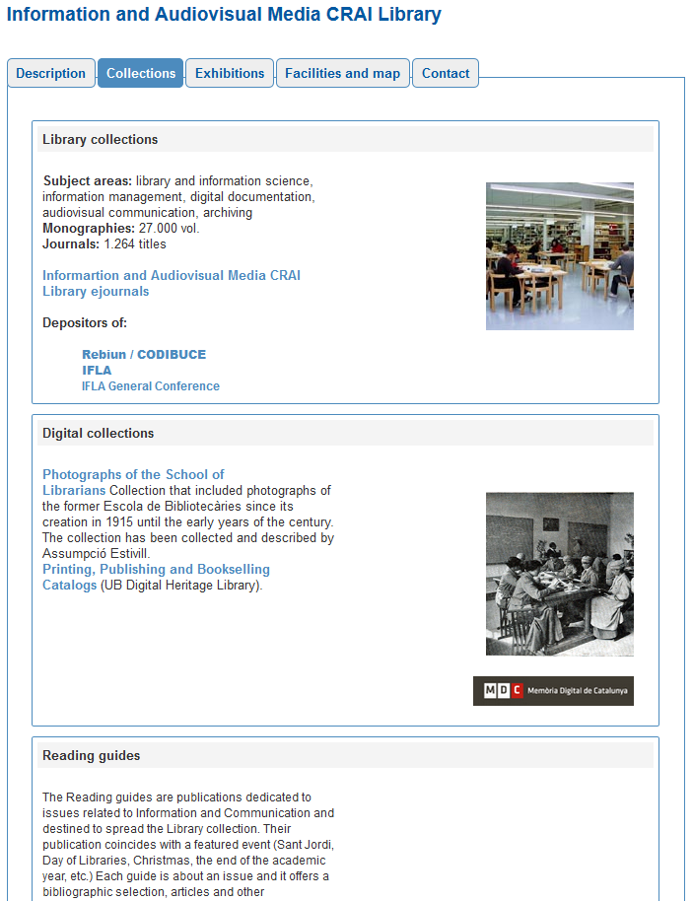
Collections and resources
Each CRAI Library has this section in this web.
It is a selection of information resources related to the subject areas of teaching and research at the Faculty. You will find databases, books and electronic journals, text books, etc.
Notes:
Conèixer la Biblioteca de ........ (2005-2006)
6
Què és?
A què respon?

Slide 7
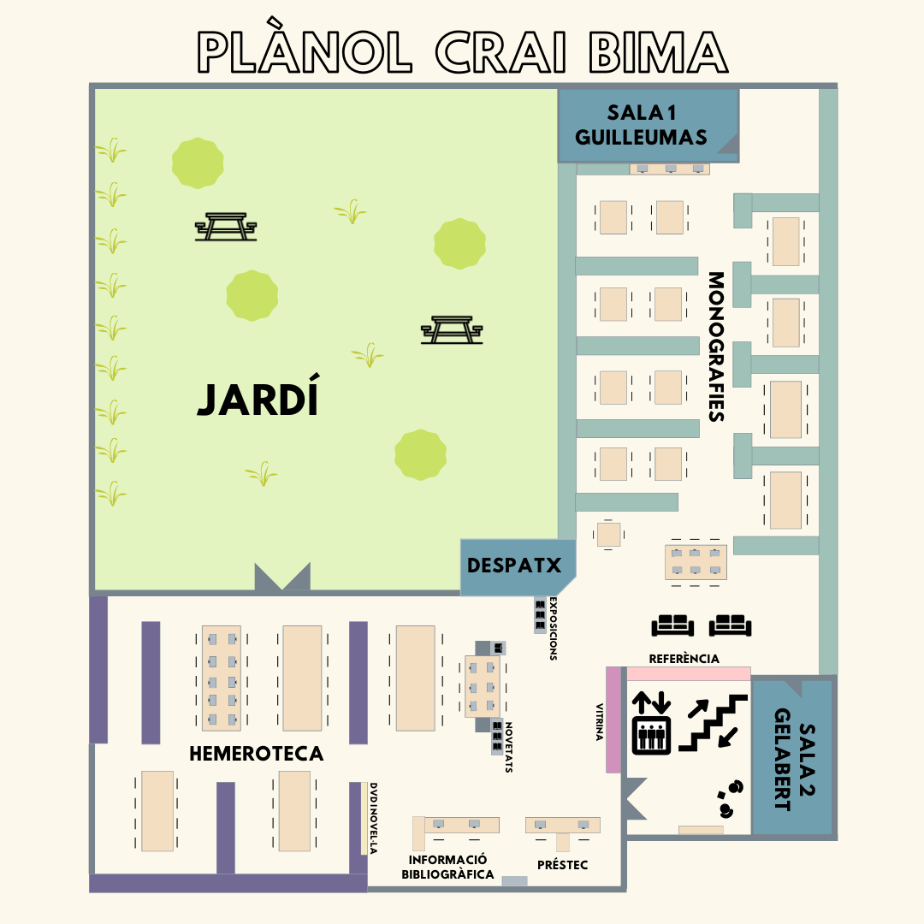
Library Map

Slide 8
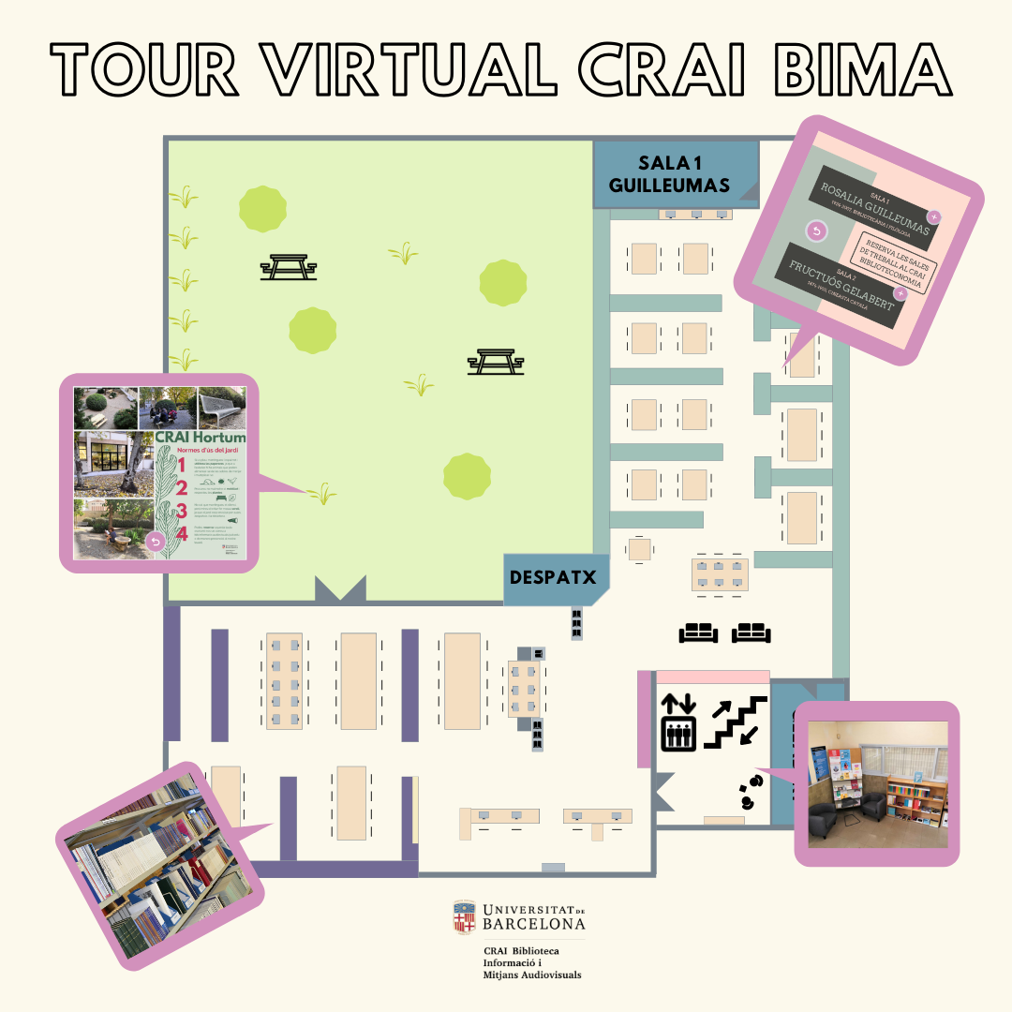
Library virtual tour

Slide 9
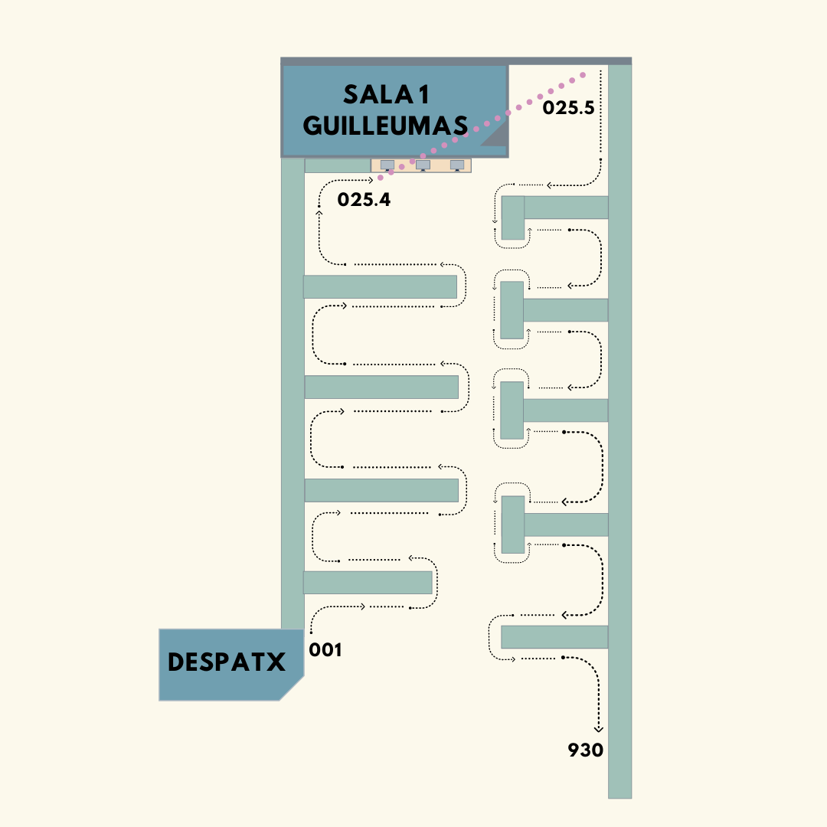
UDC: How does it work?
Our books are classified using the Universal Decimal Classification (UDC) that arrange the branches of knowledge in 9 main classes, numbered from 0 to 9.
Our collection begins in 001 (science and knowledge in general) next to the Director’s office and ends in 930.272 (paleography) next to the Fructuós Gelabert room.

Slide 10
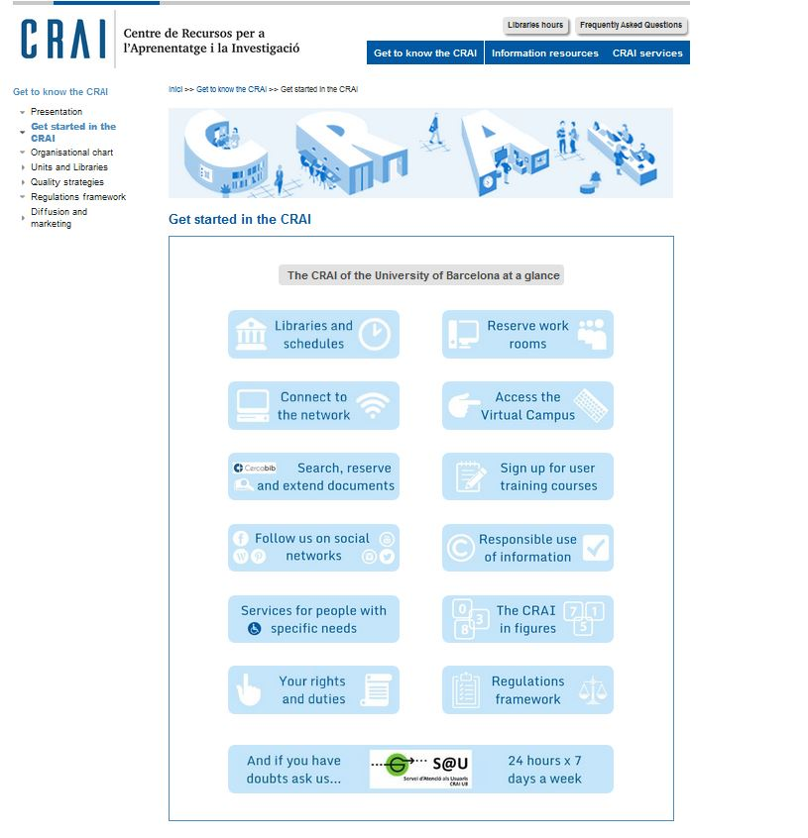
Start using CRAI

Slide 11
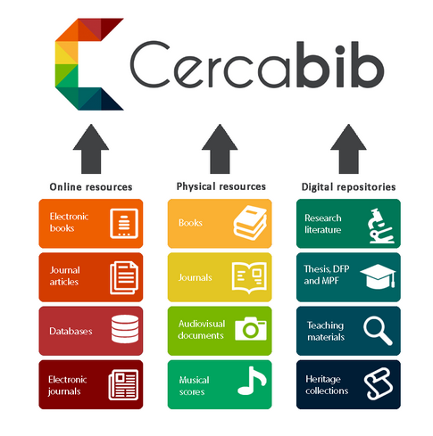
Cercabib
Cercabib is the University of Barcelona CRAI’s discovery tool, which allows you to search simultaneously through the entire CRAI collection, regardless of the format, type or location of your chosen item.
Notes:
El CRAI és el Centre de Recursos per a l’Aprenentatge i la Investigació, una part del qual són totes la Biblioteques de la UB
Hi podeu accedir des de:
El web de la UB → Informació sobre → Biblioteca
El web de la Facultat → Serveis → Biblioteca
MonUB → Beques i Serveis → Biblioteca
Directe des de Bookmarks/Favorits http://www.bib.ub.es/bub/bub.htm

Slide 12
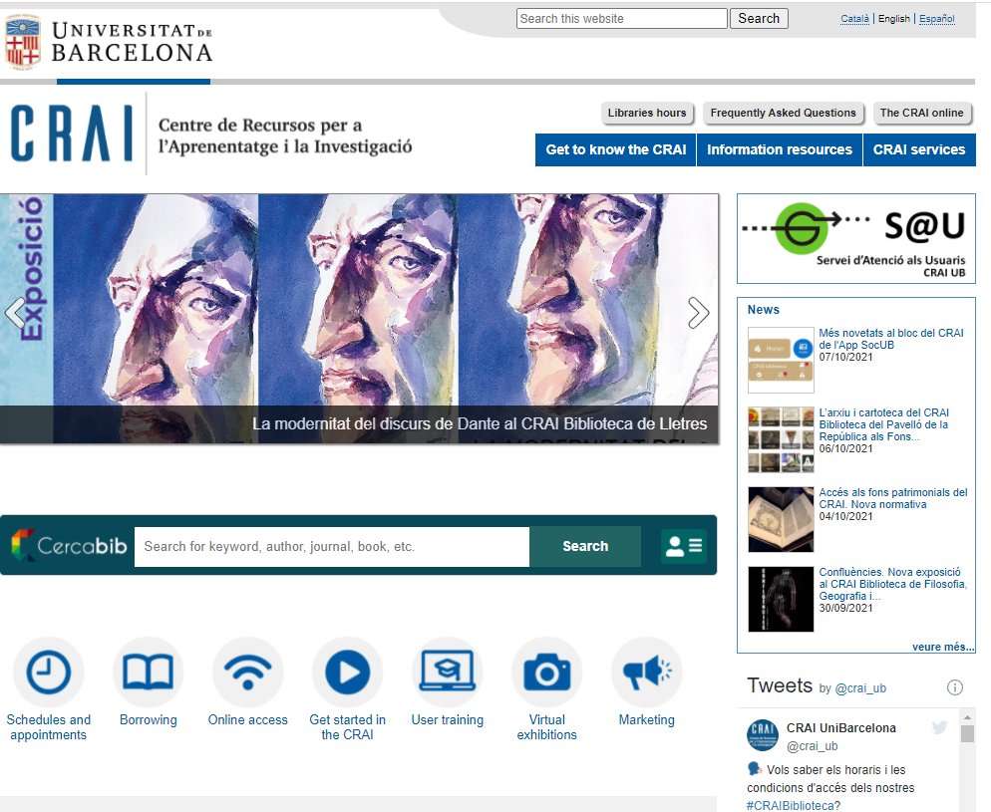
Cercabib. Two ways to access. Access from the CRAI website
Or else...
Notes:
El CRAI és el Centre de Recursos per a l’Aprenentatge i la Investigació, una part del qual són totes la Biblioteques de la UB
Hi podeu accedir des de:
El web de la UB → Informació sobre → Biblioteca
El web de la Facultat → Serveis → Biblioteca
MonUB → Beques i Serveis → Biblioteca
Directe des de Bookmarks/Favorits http://www.bib.ub.es/bub/bub.htm

Slide 13
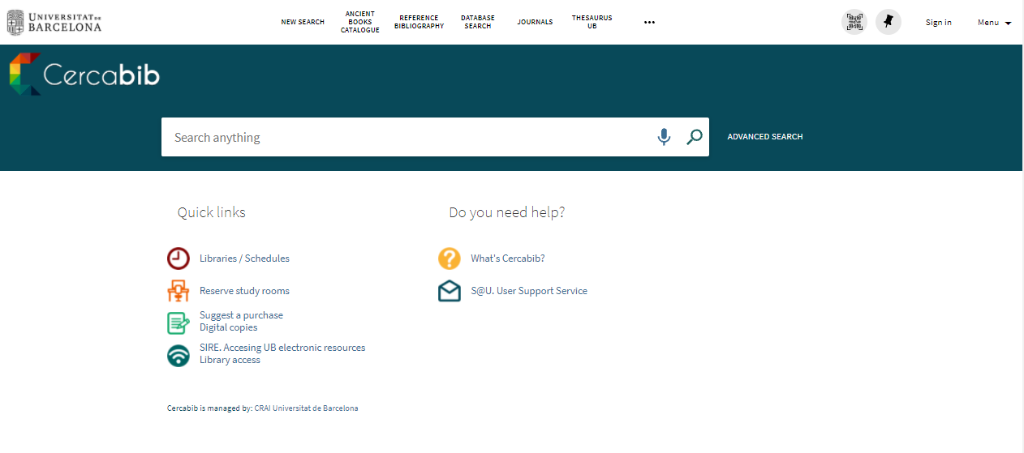
Cercabib Access from the Cercabib website
First, you must sign up to obtain the full results and to reserve documents

Slide 14
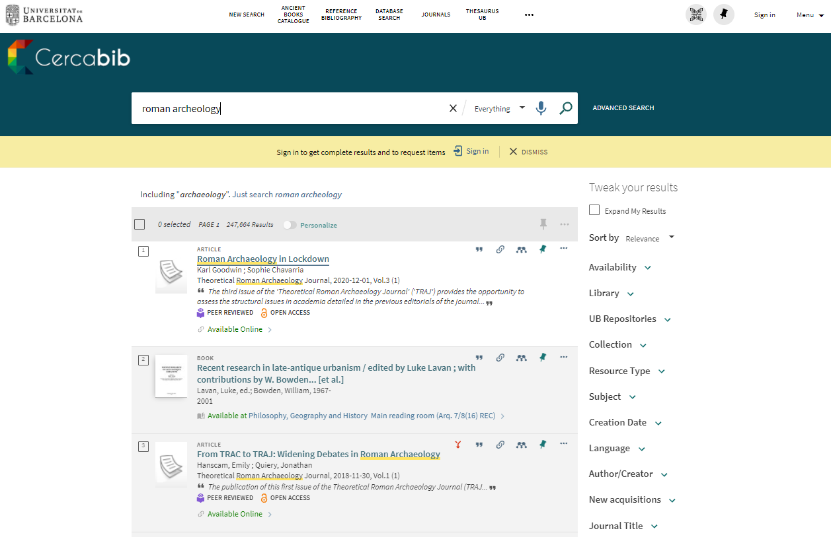

Cercabib: quick search
You can tweak your results
Notes:
El CRAI és el Centre de Recursos per a l’Aprenentatge i la Investigació, una part del qual són totes la Biblioteques de la UB
Hi podeu accedir des de:
El web de la UB → Informació sobre → Biblioteca
El web de la Facultat → Serveis → Biblioteca
MonUB → Beques i Serveis → Biblioteca
Directe des de Bookmarks/Favorits http://www.bib.ub.es/bub/bub.htm

Slide 15
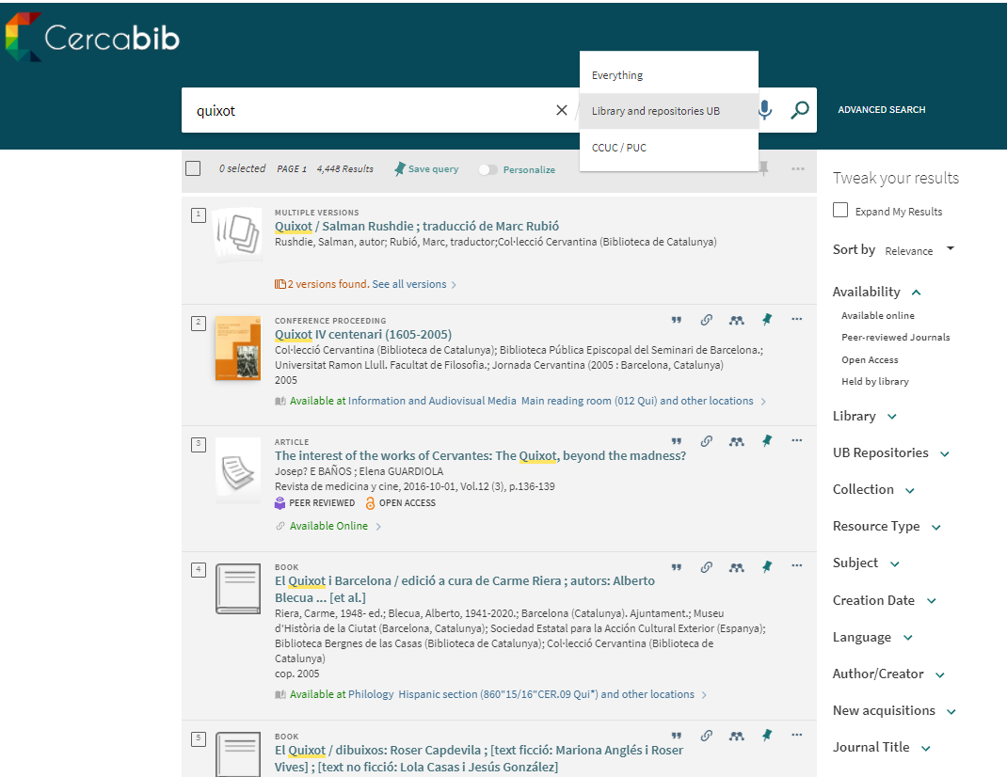
Where do I find it? (I)
Notes:
Conèixer el CRAI Biblioteca de XXXX. Curs 20xx-xx

Slide 16
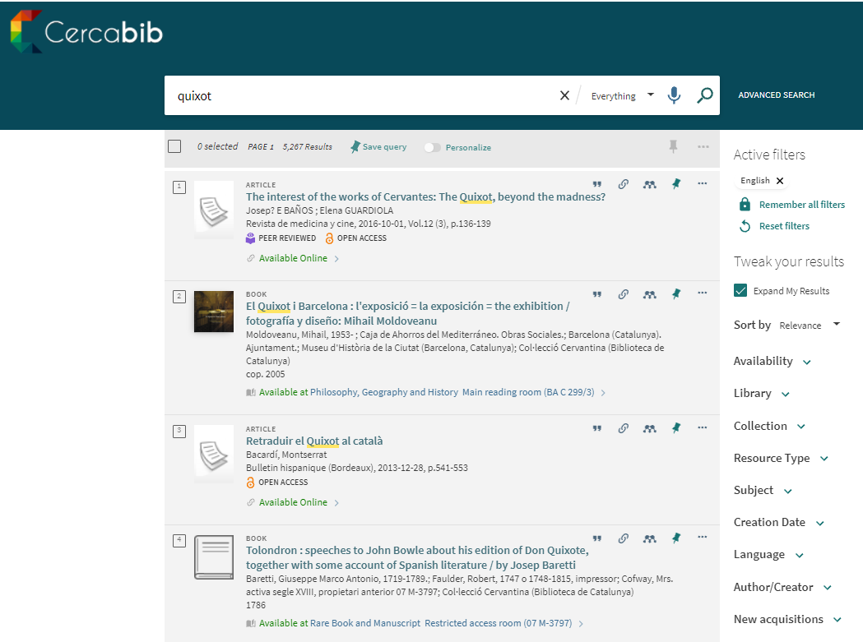
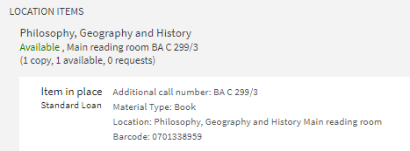
Where do I find it? (II)

Slide 17
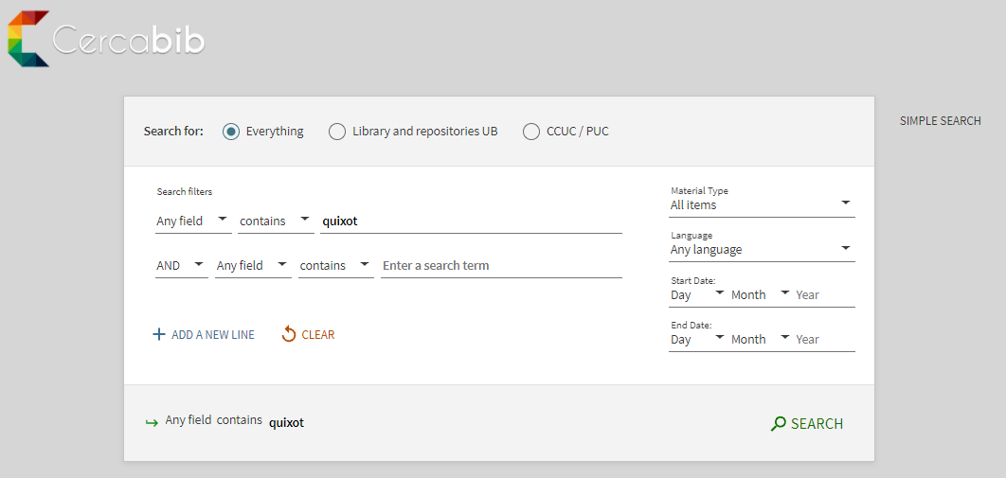
Cercabib: advanced search
Combine search fields and/or refine your search.

Slide 18

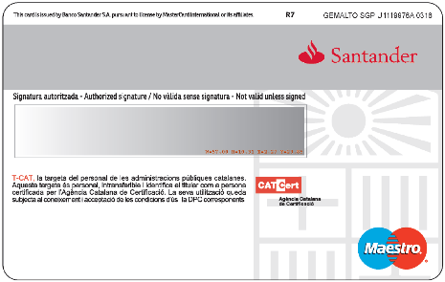
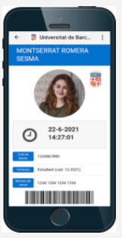
How to borrow books? UB Card
You need your UB Card. There are two types:
University smartcard
Validate it in any library.
UB User number
(barcode card)
Digital card, SocUB (Catalan)mobile app

Slide 19
Loans service (I)
Document loans allow you to consult CRAI resources off library premises for a specified period of time.
You must have a UB Card or ID that provides you are entitled to take out loans.
Loan service regulations (Catalan)
Documents that cannot be taken out on loan:
Journals and works of reference (encyclopaedias, dictionaries, etc.). If digital versions are available online you can consult them off UB premises.
Rare books and manuscripts.
Books with a red dot or the label "Not for loan".
Recommended bibliography:
Loan for up to 10 days.

Slide 20
Loans service (II)
Users | Items | Days
UB teaching staff (active, retired or emeritus)/ guest or visiting teaching staff / teaching staff from affiliated centres with venia docendi / EIM, Hispanic Studies, Language Services and IDP-ICE teaching staff / UB departments or research groups researchers / users with specific needs | 40 | 60
PhD students / university master’s degree, inter-university master’s degree and UB-specific master’s degree students / administrative and service staff (active or retired) | 20 | 30
UB bachelor’s degree students, students from affiliated, inter-university, accreditation, national or international mobility centres / students from the Institute for Lifelong Learning (IL3) taking courses at the University / students on UB-specific postgraduate courses / university extension students / students from the University of Experience / members of Alumni UB authorized by the UB | 10 | 21
Teaching hospitals staff (Clínic, Bellvitge, Sant Joan de Déu) / non-UB teaching staff of centres with an agreement, the UB Group and the IDP-ICE / staff of research institutes in which the UB participates, is affiliated, linked, with an agreement or of the UB Group / GEO3BCN-CSIC researchers and research fellows | 15 | 21
Students from centres with agreements or from the UB Group / EIM, Hispanic Studies, Language Services and the IDP-ICE students / teaching and research staff, administrative and service staff, doctoral and master's degree students from the Universitat d'Andorra and the Universitat Jaume I / UB Doctors’ Senate members / primary and secondary school teaching staff / COBDC members / UB charitable and teaching foundations members / users authorized by the UB teaching and research staff or by the CRAI. | 5 | 10
Audiovisual material loan: 21 days
Recommended bibliography: 10 days
Recommended bibliography for weekends (from Friday to Monday): 3 days

Slide 21
Loans service (III)
Renewals
Reservations
You can renew loans as often as you need, as long as the item in question has not been reserved by another user. You can renew documents at the loan desk, by telephone, or via My account on the CRAI website.
You can reserve a maximum of 8 items, through My account or from the loan desks.
Penalties
History
If you do not return books in time, you will be barred from using the service, depending on the item and the number of days overdue:
Normal loan and audiovisual material: 1 day
Loan of reference bibliography: 4 days
Loan of weekend reference bibliography: 6 days
You can see the list of the items you have borrowed during your studies at the UB under the Loans section in My account.
Notes:
Conèixer la Biblioteca de ........ (2005-2006)
21

Slide 22
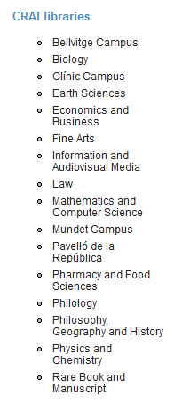
Loan from other UB libraries
If you need an item from another UB library you can:
a) go to the library where the item is held and take it out on loan,
b) ask the loans desk in your library to transfer the item from its home library. You will receive it in 2 to 3 days,
c) order it directly from My Account.

Slide 23
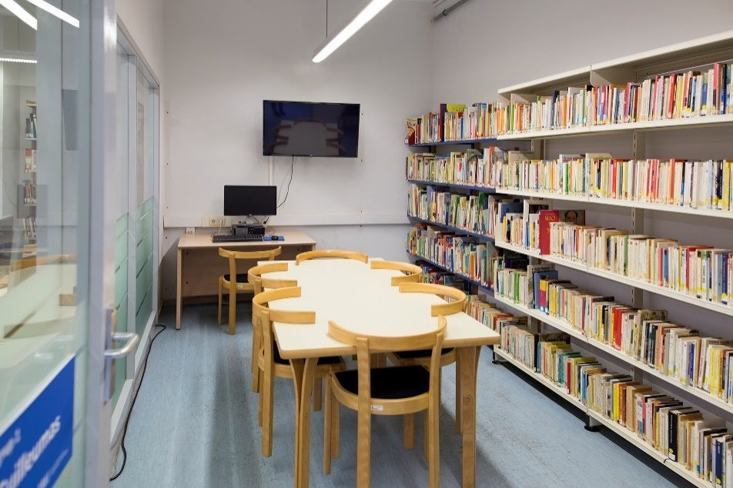
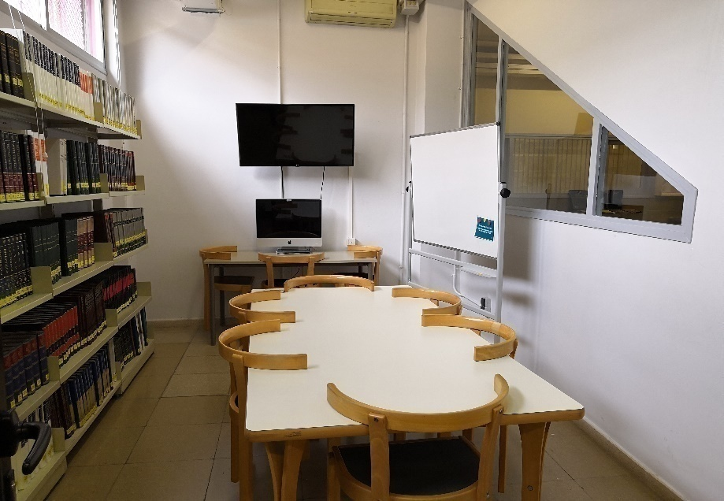
Using study rooms
This loan service is designed to make it easier to use CRAI library work rooms for individual or group work. You can reserve documents from the Cercabib using the option in My account.
Rules of use the study rooms (Catalan)

Slide 24
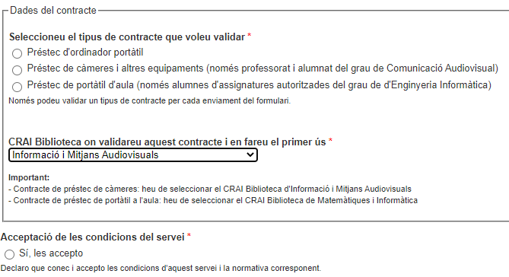
Loan of laptops and other equipment
Laptops loans available for up to 4 hours within the Library and without reservation in advance.
To use this service, you must be a member of the UB community and hold a UB Card or a document that indicates your entitlement to loan items.
Service not available to users currently under late returns penalty.
If you use this service for the first time, you must complete an agreement to accept the terms of service (Catalan) which must be validated in one of the CRAI Libraries to be effective.
In the case of cameras you have to choose the CRAI Information and Audiovisual Media Library

Slide 25
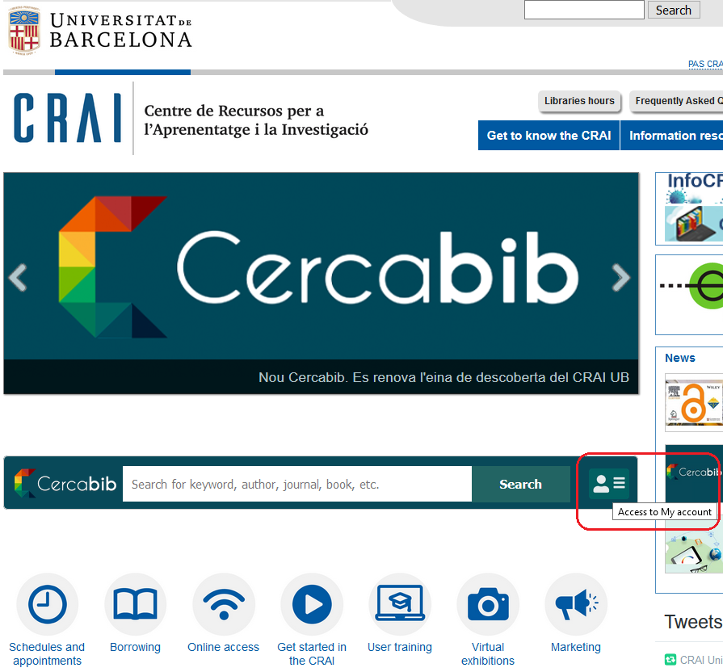
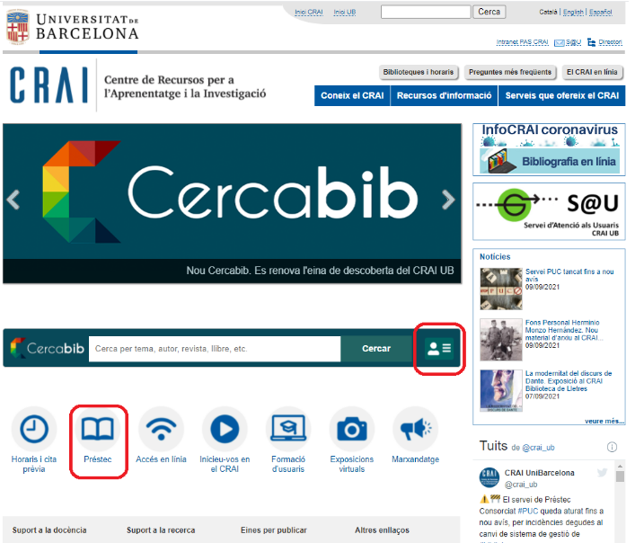
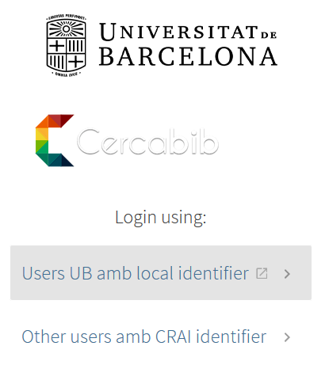
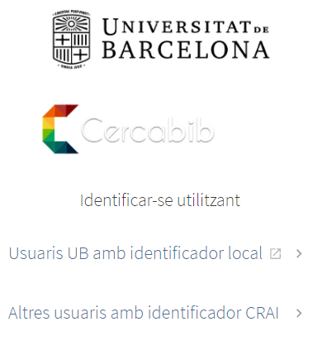
What do I have on loan? My account
This service allows you to access your CRAI user registration.
Once identified, you can view and renew your loans, reserve documents or get lists of bibliographic records, among other services.

Slide 26










Library consortium loans (PUC)
The PUC is a free loan service through which users can request and borrow items from another library in the Consortium of University Services of Catalonia (CSUC).
How to request an item:
In person, at the library that holds the item: PUC in situ.
Online, using the PUC web portal.
Where to return items:
To any UB CRAI library.
To any of the libraries linked to the institution that holds the item.
Notes:
El CRAI és el Centre de Recursos per a l’Aprenentatge i la Investigació, una part del qual són totes la Biblioteques de la UB
Hi podeu accedir des de:
El web de la UB → Informació sobre → Biblioteca
El web de la Facultat → Serveis → Biblioteca
MonUB → Beques i Serveis → Biblioteca
Directe des de Bookmarks/Favorits http://www.bib.ub.es/bub/bub.htm

Slide 27
PUC online
Requirements:
You must be registered in your institution's library user database.
You must not have any overdue loans at your institution.
You must not be blocked from using your library account by your institution.
Access University Union Catalogue of Catalonia (CCUC)
Check availability and request the item. Choose where you would like to pick it up.
When your item arrives at the chosen library you will receive email notification.
You can return the item to any of the libraries at your university or at the institution that owns the item.
Notes:
El CRAI és el Centre de Recursos per a l’Aprenentatge i la Investigació, una part del qual són totes la Biblioteques de la UB
Hi podeu accedir des de:
El web de la UB → Informació sobre → Biblioteca
El web de la Facultat → Serveis → Biblioteca
MonUB → Beques i Serveis → Biblioteca
Directe des de Bookmarks/Favorits http://www.bib.ub.es/bub/bub.htm

Slide 28
PUC loan conditions
Users | Items | Renewals | Days
Bachelor’s degree students, authorized Alumni UB Postgraduate, master’s degree and doctoral students University teaching and research staff (PDI) University administrative and service staff (PAS) | 10 | 6 | 21
Notes:
El CRAI és el Centre de Recursos per a l’Aprenentatge i la Investigació, una part del qual són totes la Biblioteques de la UB
Hi podeu accedir des de:
El web de la UB → Informació sobre → Biblioteca
El web de la Facultat → Serveis → Biblioteca
MonUB → Beques i Serveis → Biblioteca
Directe des de Bookmarks/Favorits http://www.bib.ub.es/bub/bub.htm

Slide 29

Interlibrary loan (PI)
The interlibrary loan service enables users to locate and obtain the original or a copy of any item that is not held by the CRAI and is not available from other Catalan universities through the PUC.
It also centralizes the loan of CRAI collection items to other institutions. This is a paid service.
Image source: Get to know the Philology CRAI Library (pdf)

Slide 30

Access to online resources
SIRE
Use the E-Resources Access Service (SIRE) to consult the electronic information resources to which the CRAI subscribes from a computer or device within or outside the UB network.
Must be installed previously the Sire button and drag it to Bookmarks.
To access SIRE, you will need the UB username and password that you use to access UB intranets (PDI, PAS or MónUB).
Library Access
Library Access (Catalan) is a browser extension that facilitates access to electronic resources subscribed by the CRAI of the University of Barcelona.

Slide 31
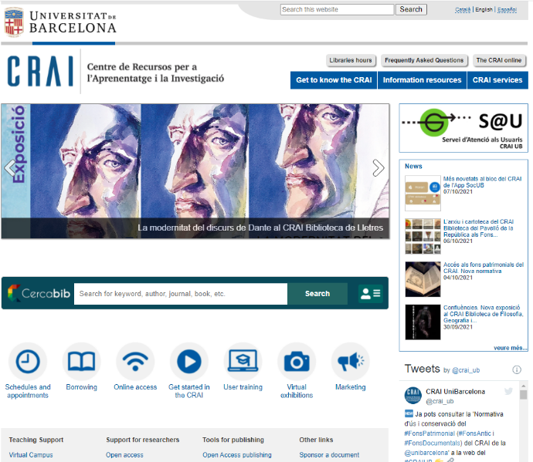
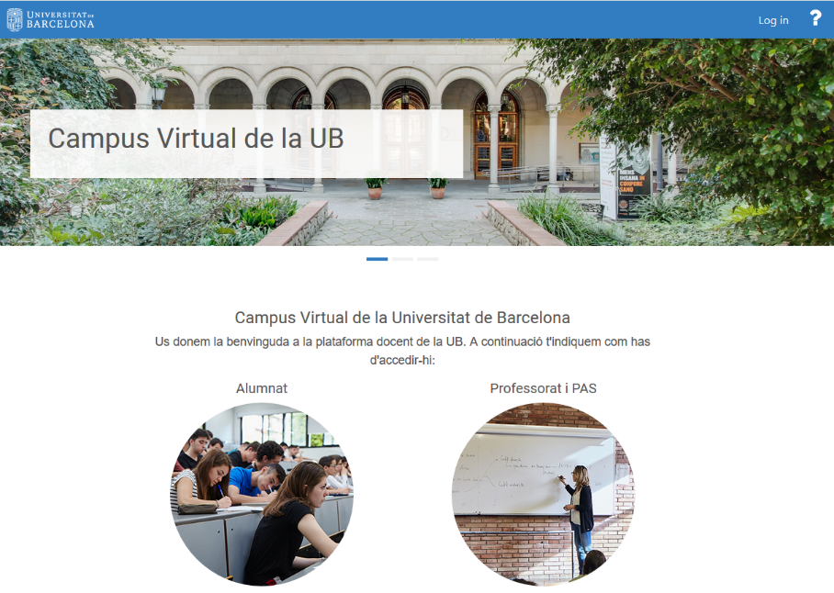
Virtual Campus
It is the work tool with which you access your subjects and visualize the recommended bibliography, teaching materials and activities.
Virtual Campus
Virtual Campus
Identifier
and password

Slide 32
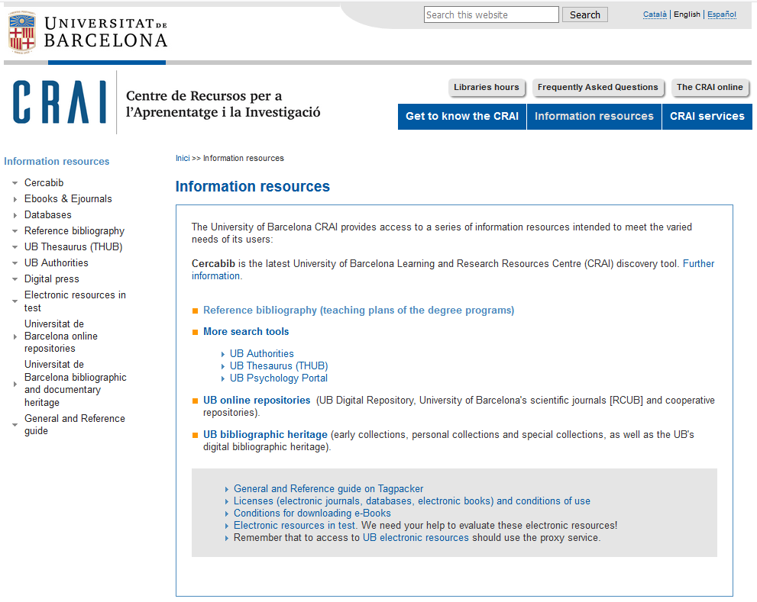
Information resources

Slide 33
Usernames and passwords
Username | Services | Access
UB | Virtual Campus How to access electronic resources Interlibrary loan Digital copies | Students: Alphanumeric code Password PAS/PDI: DNI/Identification no. Password Authorized UB Alumni: Alumni code Alumni password (except access to electronic resources and digital copies)
Local | Virtual Campus How to access electronic resources Digital copies Computers Loans Interlibrary loan PUC or library consortium loans Cercabib «My account» Wi-Fi UB | Students: Left-hand section of UB email address + .alumnes E.g.: Email: jarc7@alumnes.ub.edu Username: jarc7.alumnes and UB intranet password PAS/PDI: Left-hand section of UB email address E.g.: Email: joan.garcia@ub.edu Username: joan.garcia and UB intranet password Authorized UB Alumni: Left-hand section of UB email address + .a E.g.: Email: imas@alumni.ub.edu Username: imas.a and UB intranet password (except access to electronic resources and digital copies)
CRAI | Loans Cercabib «My account» | For: Student agreement center/UNED; PDI/PAS/3rd cycle UDA, UJI; Teacher at affiliated/agreement UB center; Primary/secondary school teacher; Researcher Research Institute/affiliated UB; Researcher GEO3BCN-CSIC; UB Doctoral Faculty; COBDC member; PDI and PAS UB Group Staff Clinic/Bellvitge/HSJD; Research Staff Institute /Agreement UB; Users authorized by CRAI Access: Code provided by CRAI Libraries + Password
A partir del correu UB | Wi-Fi Eduroam | PAS/PDI/External: @ub.edu email address Students: UB identification + @ub.edu E.g.: jhergar6@alumnes.ub.edu → jhergar6.alumnes@ub.edu
How to set the password and obtaining your ID (MónUB help desk)

Slide 34

S@U, User Support Service
S@U, User Support Service is a virtual information service that fields enquiries about CRAI libraries and their services and resources. Remember that you can also consult the FAQs, as your question may already have been answered.
S@U is also the channel for delivering your complaints, suggestions and messages of thanks.
This service is a 24x7 online information and reference service manned by specialized librarians.
Notes:
Què és?
A què respon?

Slide 35
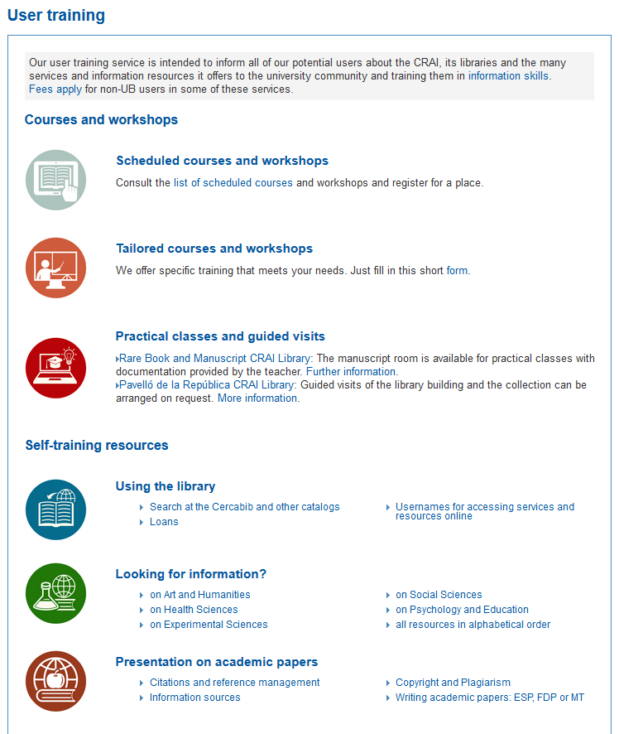
User training
Advanced training courses are available to users who wish to improve their knowledge and search skills; for example, courses on specialized databases or the Mendeley reference manager.
Information about scheduled training courses is available on the CRAI Web, and personalized courses (Catalan) can be arranged on request.
Self learning resources are also available on the CRAI web.
Notes:
Conèixer la Biblioteca de ........ (2005-2006)
35
Què és?
A què respon?

Slide 36
Wi-Fi and access to Faculty computers
The University's Wi-Fi service enables you to connect to the Internet without a physical connection to the network. To use UB Wi-Fi, configure (Catalan) your laptop and log on using your local username (Catalan).
The University of Barcelona is actively involved in the Eduroam project, which promotes a unique e-mobility environment giving users access to the Internet at all participating organizations. Consult the Eduroam configuration guide (Catalan).
User group | Ending | Email address | Local username
PAS / PDI |  | joan.pere.garcia@ub.edu cherrera@ub.edu | joan.pere.garcia cherrera
Students | .alumnes | jherg07@alumnes.ub.edu | jherg07.alumnes
Alumni UB | .a | pperez@alumni.ub.edu | pperez.a
Notes:
Què és?
A què respon?

Slide 37
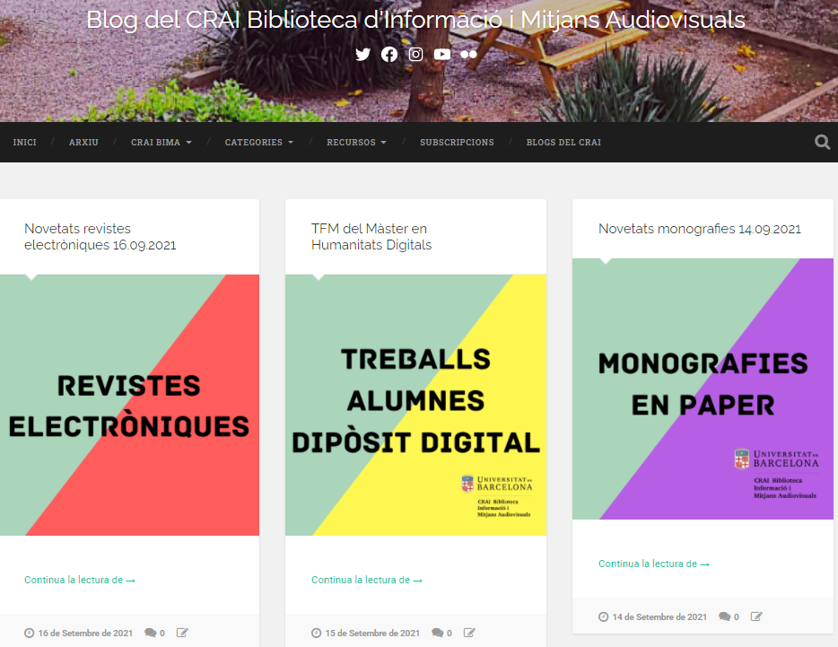




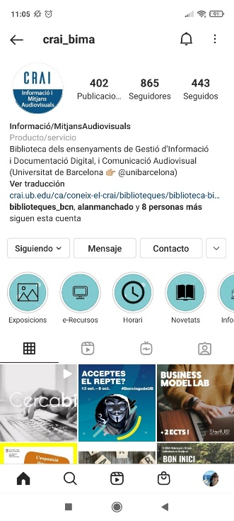
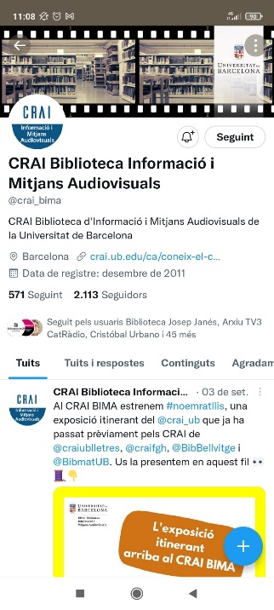



Follow us on social networks!
Blog
Instagram
Twitter
Youtube
Flickr
Issuu
Facebook
Notes:
El CRAI és el Centre de Recursos per a l’Aprenentatge i la Investigació, una part del qual són totes la Biblioteques de la UB
Hi podeu accedir des de:
El web de la UB → Informació sobre → Biblioteca
El web de la Facultat → Serveis → Biblioteca
MonUB → Beques i Serveis → Biblioteca
Directe des de Bookmarks/Favorits http://www.bib.ub.es/bub/bub.htm

Slide 38
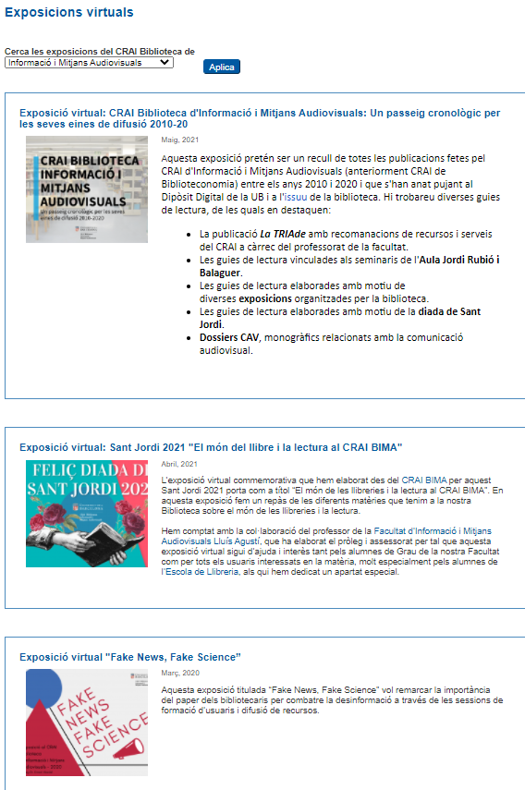
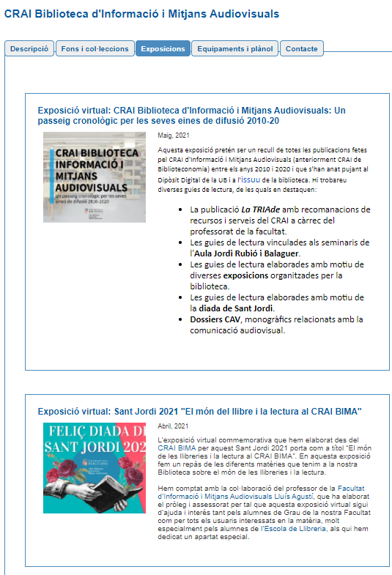
And virtual exhibitions
Notes:
El CRAI és el Centre de Recursos per a l’Aprenentatge i la Investigació, una part del qual són totes la Biblioteques de la UB
Hi podeu accedir des de:
El web de la UB → Informació sobre → Biblioteca
El web de la Facultat → Serveis → Biblioteca
MonUB → Beques i Serveis → Biblioteca
Directe des de Bookmarks/Favorits http://www.bib.ub.es/bub/bub.htm

Slide 39
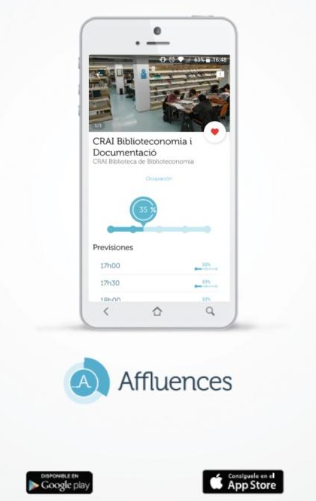
Affluences app
Affluences, is a free app available for iPhone and Android. This application shows you the occupancy rate of the Library and other facilities in real-time.
If you are interested knowing the occupancy rate of the CRAI Information and Audiovisual Media library in real-time or at any hour, you may download this app.

Slide 40

And if you still have questions...
Ask the CRAI staff
Library staff can answer the majority of your questions.
CRAI home page
The section "Frequently asked questions"
provides answers to a number of common queries
S@U, User Support Service
Online information service for any questions about CRAI Libraries and the full range of resources and services.
Or call us on
934 035 769

Slide 41


Thank you!
© CRAI Universitat de Barcelona, academic year 2021-22

