Slide 1
Meming while learning
Llengua estrangera per a l’ensenyament: anglès
Curs 2021-2022

Slide 2
Memes - Round 1!
Present and past tenses

Slide 3
Results - Leaderboard
Group | N of votes | N of points after Round 1
4B_B (Noelia Calcerrada et al.) | 9 | 25
4B_E (Christina Salguero et al.) | 8 | 20
4B_C (Mireia Bleda et al.) | 7 | 16
4B_D (Nerea Sánchez et al.) | 5 | 13
4B_A (Carme Amiell et al.) | 4 | 11
2D_D (Aleth Zambrano et al.) | 3 | 10
2D_B (Marta Lozano et al.) | 1 | 9
2D_C (Claudia Rodríguez et al.) | 1 | 9
2D_A (Ariadna Rubio et al.) | 0 | 8

Slide 4
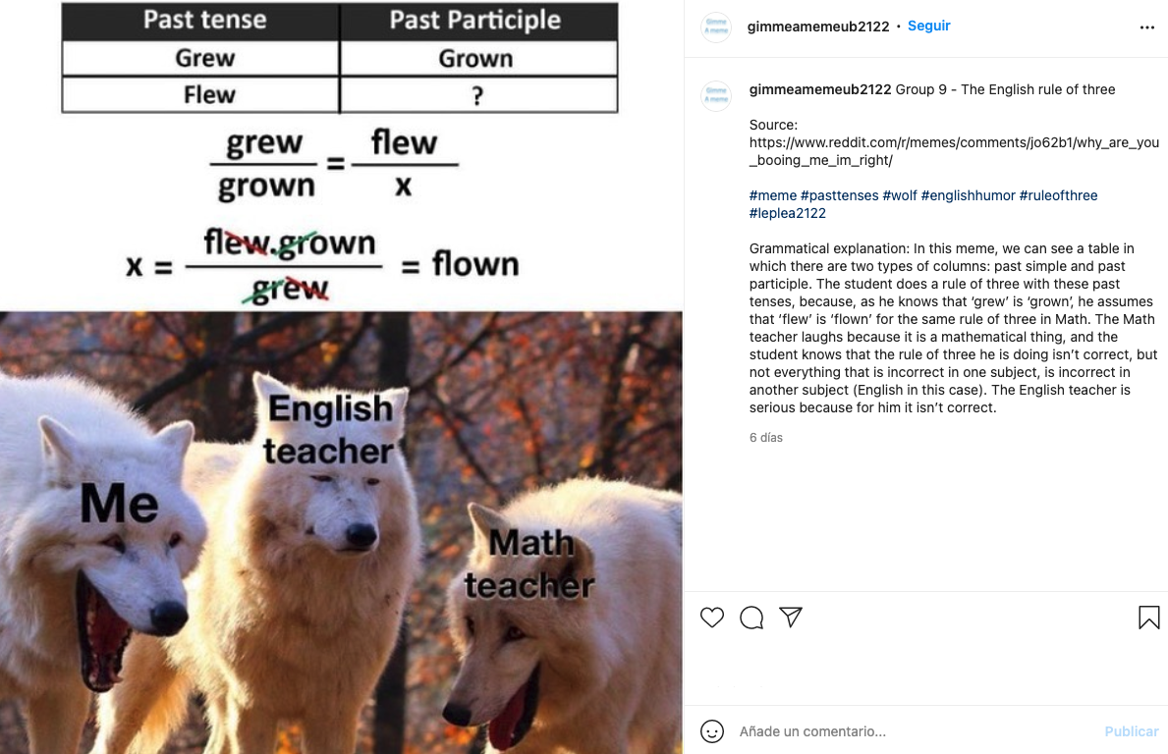
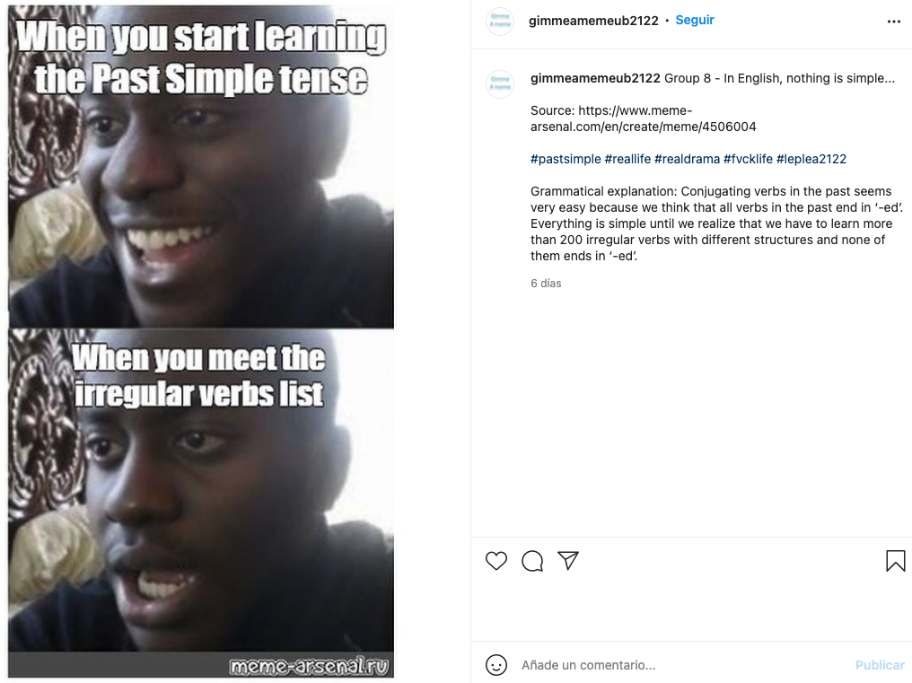
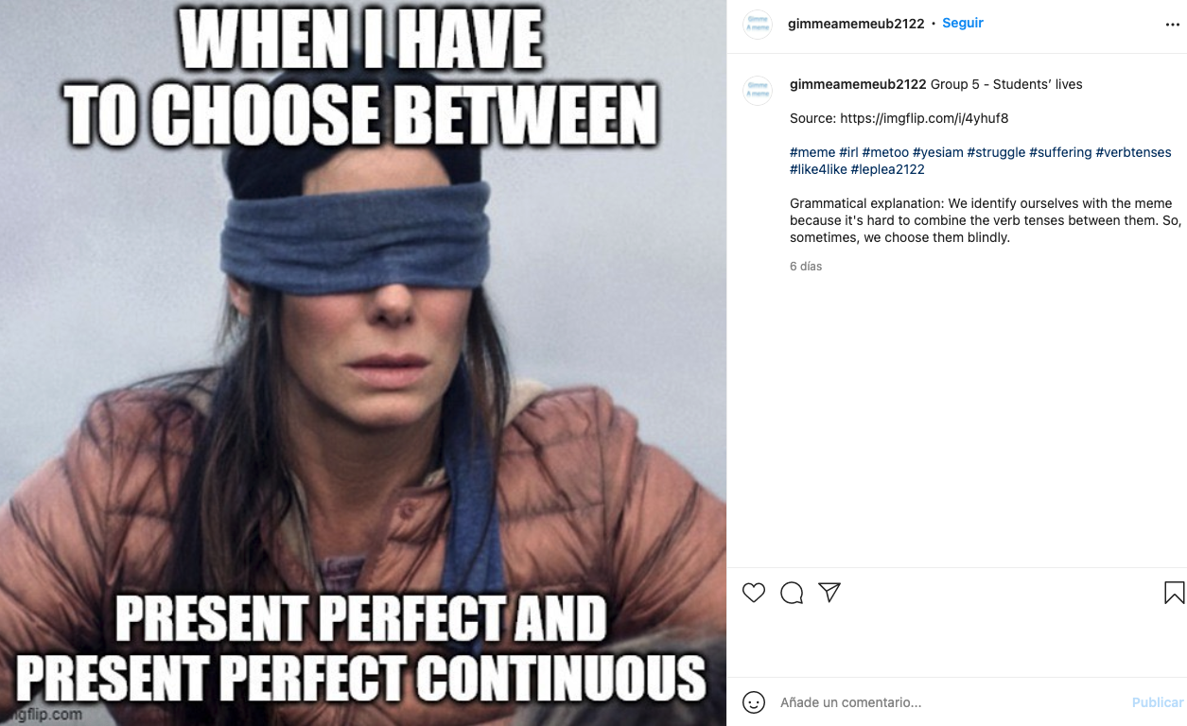
The top three memes were…
These were analysed and judged by CAV students

Slide 5
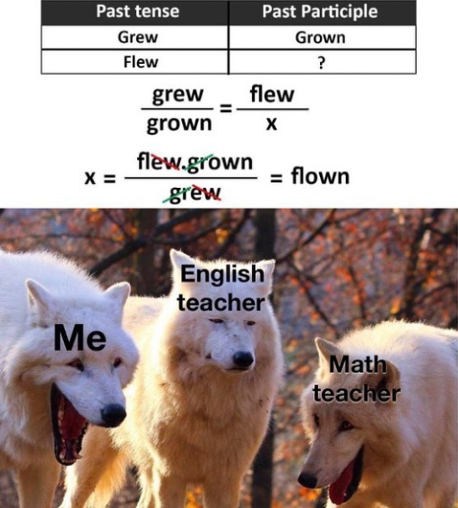

Albert & Sònia
Two-step meme. There is a relationship between the first part and the second one to understand the image
Irregular verbs are not learned like this
Using animals instead of humans also has a humorous intent. It shows how ridiculous the situation is.
Wolves are humanized. Human facial expressions.
3 wolves and 3 characters that correspond to the “rule of three”

Slide 6
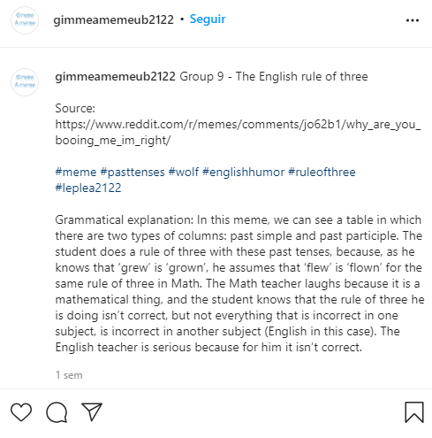
Albert & Sònia
Caption mixes both subjects (English + Maths)
“Rule of three” is a mistranslation, it’s not a mathematical concept.
No capital letters used to separate one word from the other
Hashtags describe the content of the meme (past tense, wolf…). They are too literal
The explanation is too long. It is complete and put in simple words, though.
Unnecessary comma between “subject” and “is”

Slide 7
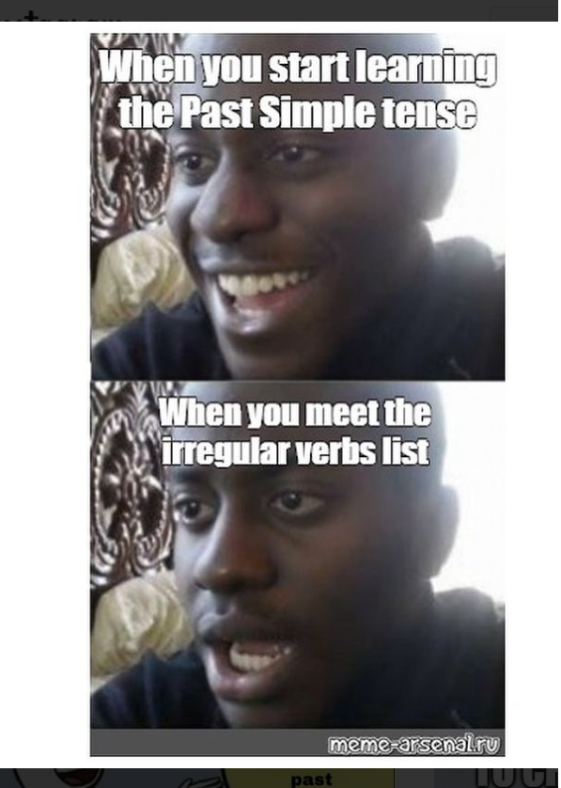
Sira & Queralt
- Anchorage relation
- Text and image are complementary. They do not overlap.
- Well balanced (all the meme)
- Typical font and size of the memes
- Easy to read
- Good position → the text connects with the image below
- Facial expressions help to understand and to feel related. - Fast change in mood → humorous intent
- Watermark makes the meme unprofessional
- Poor quality image
- Copyright?

Slide 8
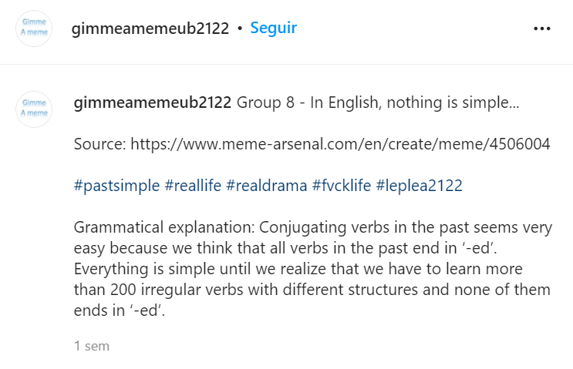
Sira & Queralt
- Simple and funny, but it doesn't give you info about the meme.
- Anchorage relation
- Too general
- “Nothing” is the subject → More emphasis
- Hashtags are not accurate. They do not relate to nor describe the image.
- Few hashtags
- Accurate and well explained.
- Effective. It helps to understand the meme (if you haven’t already)
Not traceable BUT changed “f*ck” for “fvck”

Slide 9
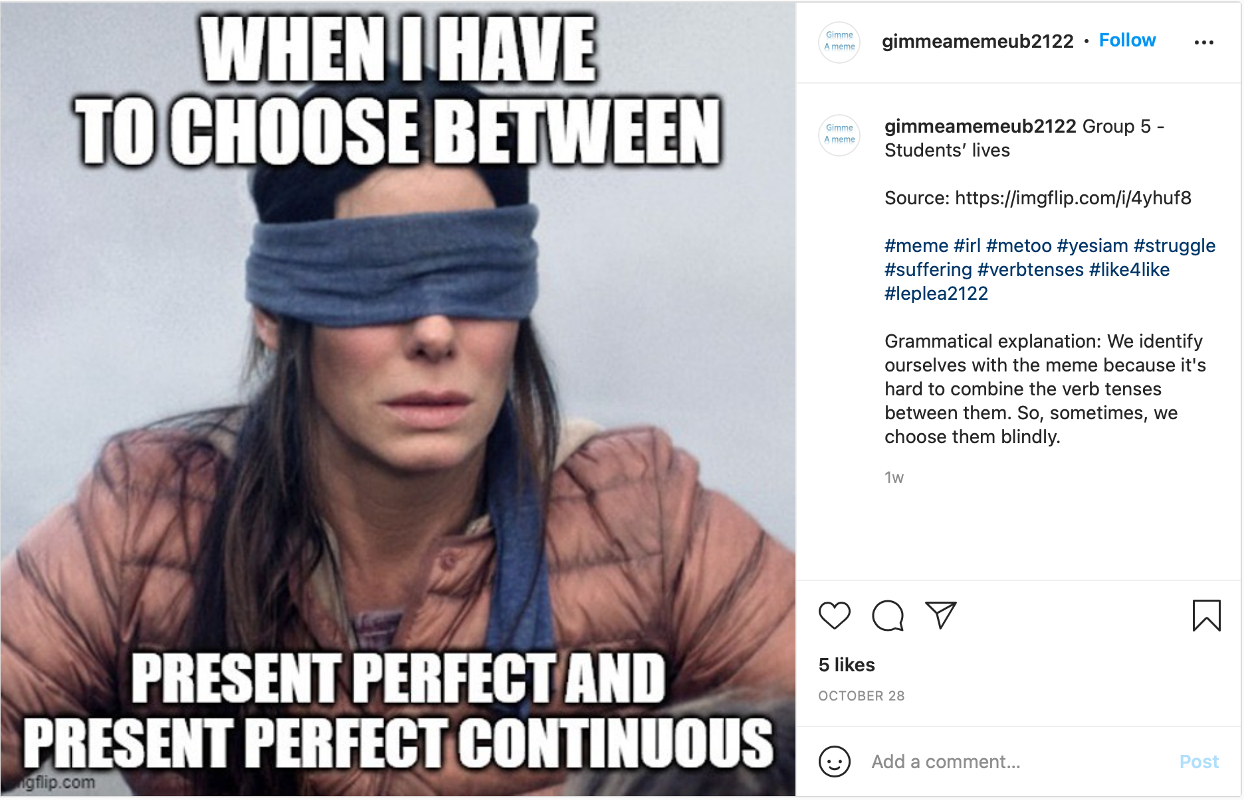
Laura & Alba
Text position for visual convenience
Typical meme font type, size and color
between closely linked to choose
Image-text → relay relation
Text above the picture and at the bottom → grammatical units are kept; prepositional phrase is split
Bullock is the protagonist of the image. Her face and her blinded eyes give the sense that she’s at a loss → humorous intent
Identification with the protagonist when having no idea what tense to choose, this may be students’ face → effective communication

Slide 10
Laura & Alba
Caption overgeneralized → not focused, applicable to other memes
The contents in the hashtags are probably familiar to you (#yesIam, #like4like)
They are funny and related to social media
Problem with #metoo
Source
No capitals used in the hashtags
Communicative effectiveness → feeling identified
Accurate but incomplete; difference between PPS and PPC?

Slide 11
CAV students’ analyses
Which of the three analyses do you like the best on the grounds of…
The clearest explanation in terms of content
The best oral performance (delivery, fluency, communication skills)
Hands up!

Slide 12
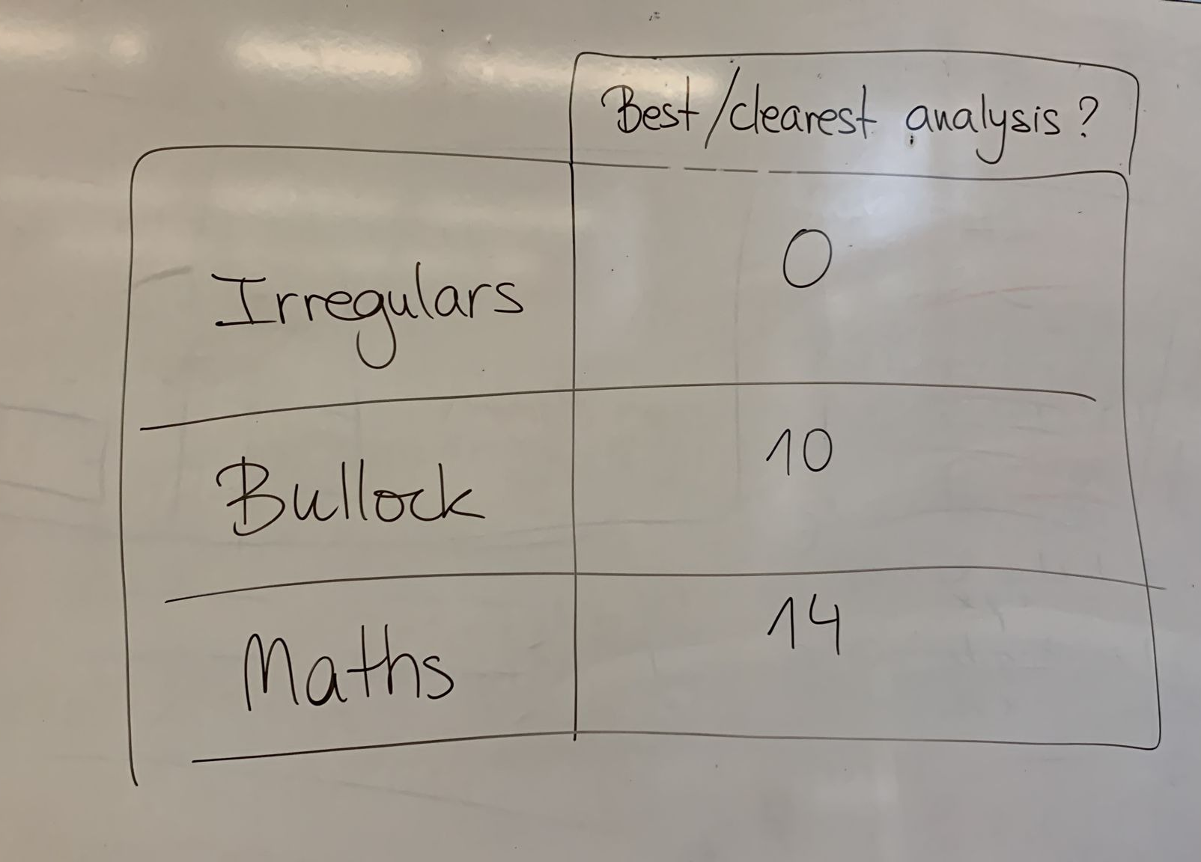
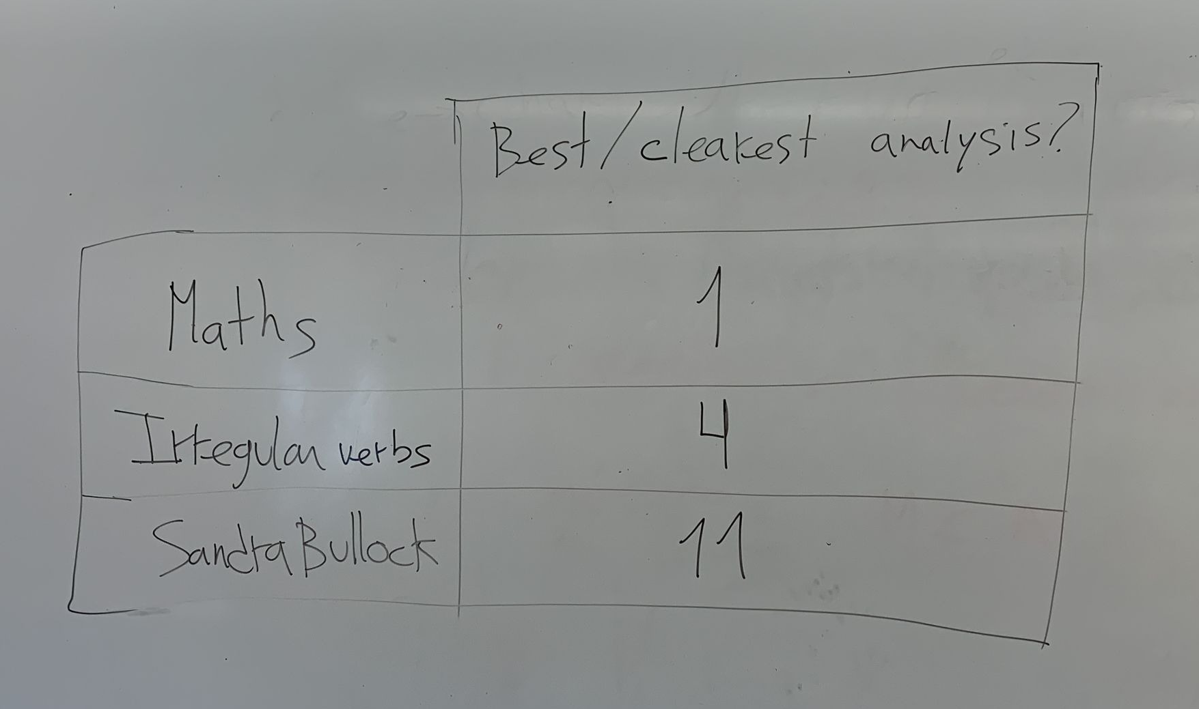
Round 1
Feedback group | Group 1 | Group 2 | Total
Maths (Albert Giró & Sònia Vázquez) | 1 | 14 | 15
Bullock (Alba Capella & Laura Obiols) | 11 | 10 | 21
Irregulars (Sira Jacobo & Queralt Vila-Masana) | 4 | 0 | 4

Slide 13
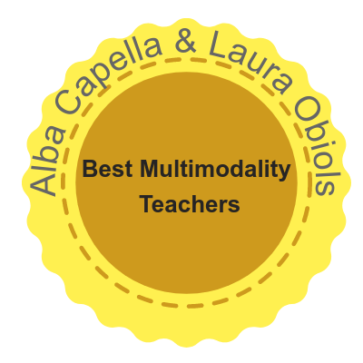
Round 1
+0.5 on your PPT performance

Slide 14
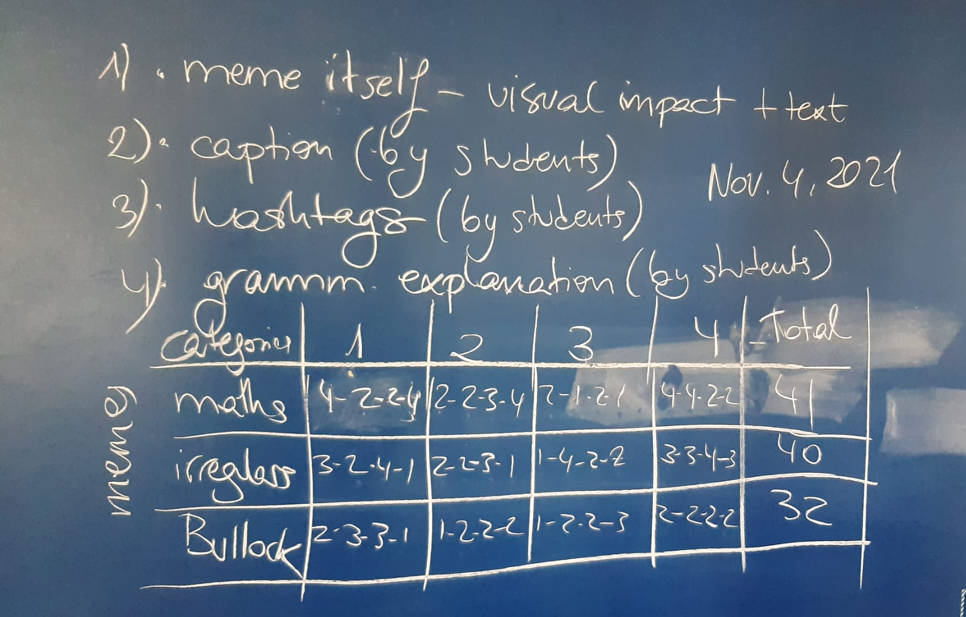
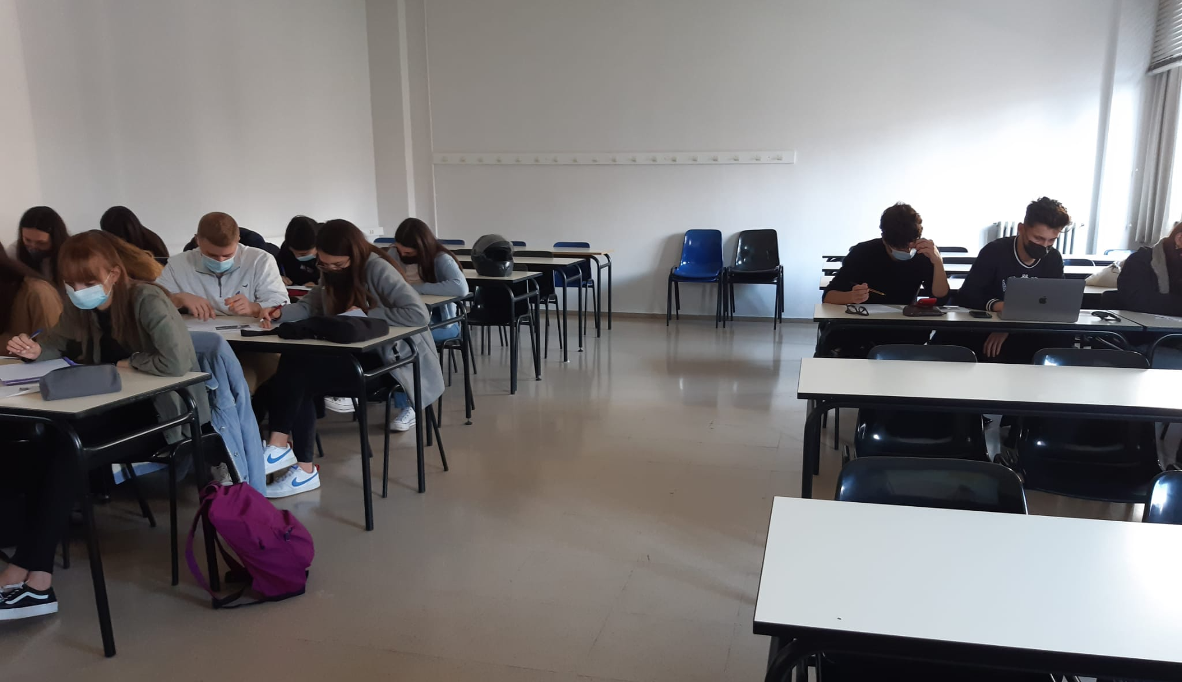
Results - Badges

Slide 15
Results - Badges
Four groups marked all memes on four criteria and on a scale from 1 to 4 (indeed, lots of 4s ☺)
Memes | Meme itself | Caption | Hashtags | Grammatical explanation | TOTAL
Maths (4B_B) | 4-2-2-4 | 2-2-3-4 | 2-1-2-1 | 4-4-2-2 | 41
Irregular verbs (4B_E) | 3-2-4-1 | 2-2-3-1 | 1-4-2-2 | 3-3-4-3 | 40
Sandra Bullock (4B_C) | 2-3-3-1 | 1-2-2-2 | 1-2-2-3 | 2-2-2-2 | 32

Slide 16
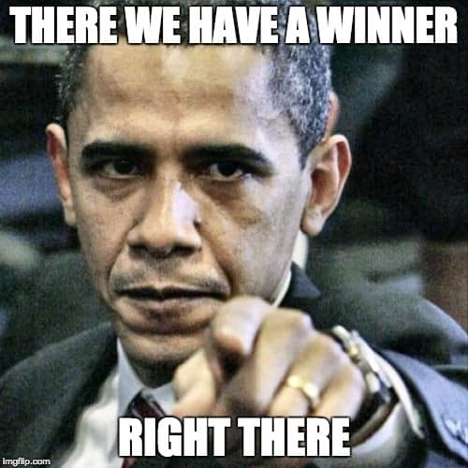
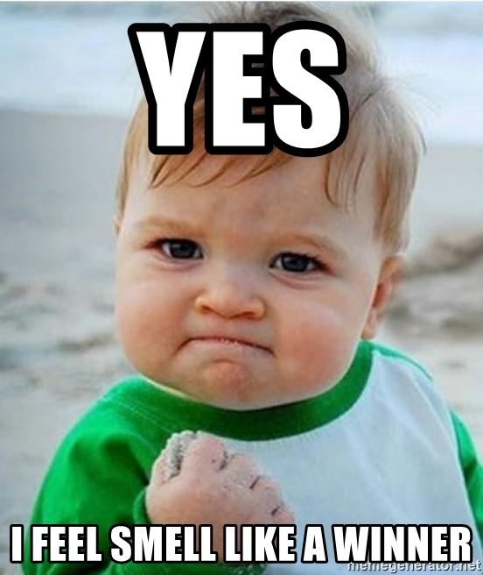
Results - Badges
Congratulations to Noelia Calcerrada, Núria Salas, Anaís Díaz and Emily Salas!!!
They have won a wild card in a (0) task!!!

Slide 17
And now it’s time for…
Round 2!
Comparatives and superlatives

Slide 18
Memes - Round 2!
Comparatives and superlatives

Slide 19
Results - Leaderboard
Group | N of votes R2 | N of points R2
2D_D (Aleth Zambrano et al.) | 10 | 25
4B_E (Christina Salguero et al.) | 8 | 20
2D_A (Ariadna Rubio et al.) | 6 | 16
4B_D (Nerea Sánchez et al.) | 5 | 13
4B_A (Carme Amiell et al.) | 4 | 11
2D_B (Marta Lozano et al.) | 3 | 10
2D_C (Claudia Rodríguez et al.) | 3 | 10
4B_C (Mireia Bleda et al.) | 1 | 9
4B_B (Noelia Calcerrada et al.) | 1 | 9

Slide 20
Results - Leaderboard
Group | N of points R1 + R2
4B_E (Christina Salguero et al.) | 20 + 20 = 40
2D_D (Aleth Zambrano et al.) | 10 + 25 = 35
4B_B (Noelia Calcerrada et al.) | 25 + 9 = 34
4B_D (Nerea Sánchez et al.) | 13 + 13 = 26
4B_C (Mireia Bleda et al.) | 16 + 9 = 25
2D_A (Ariadna Rubio et al.) | 8 + 16 = 24
4B_A (Carme Amiell et al.) | 11 + 11 = 22
2D_B (Marta Lozano et al.) | 9 + 10 = 19
2D_C (Claudia Rodríguez et al.) | 9 + 10 = 19

Slide 21
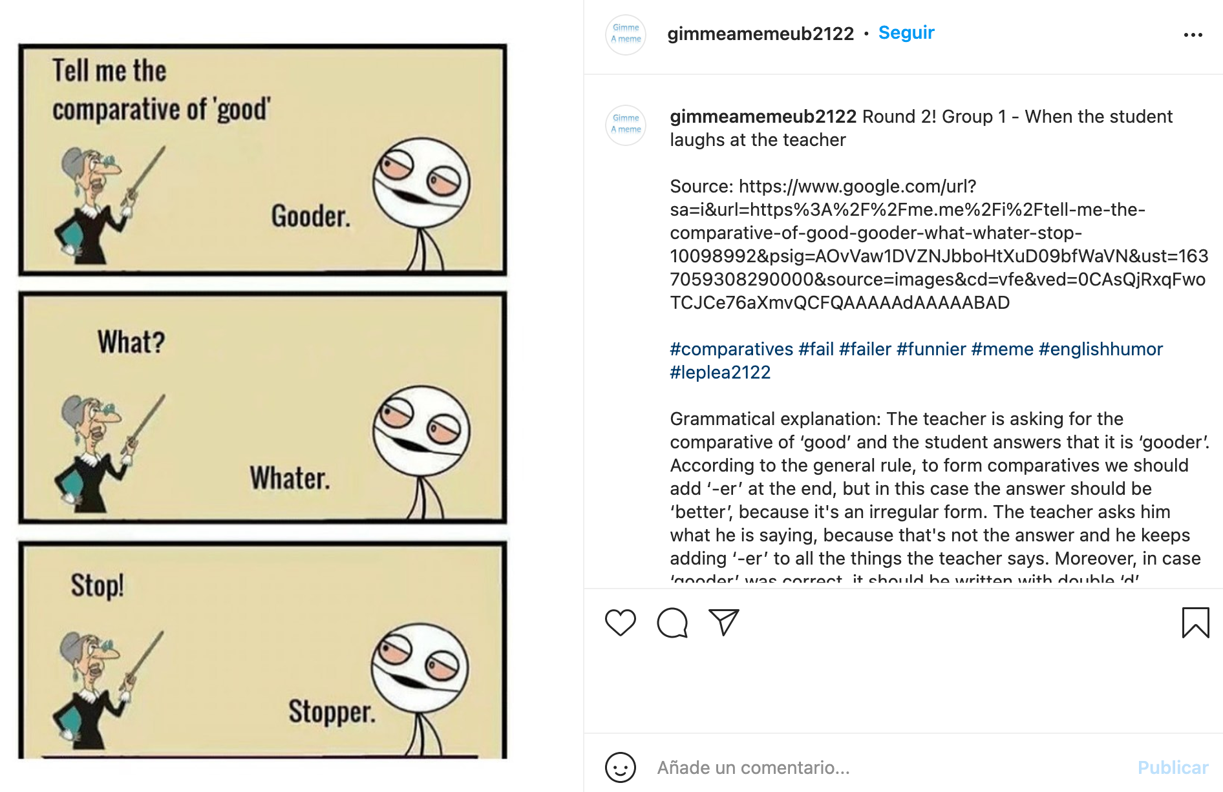
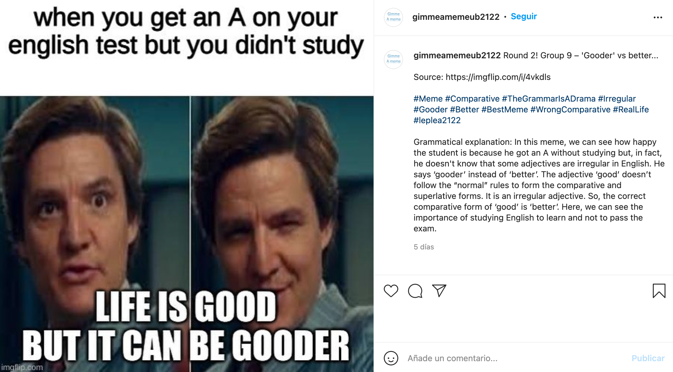
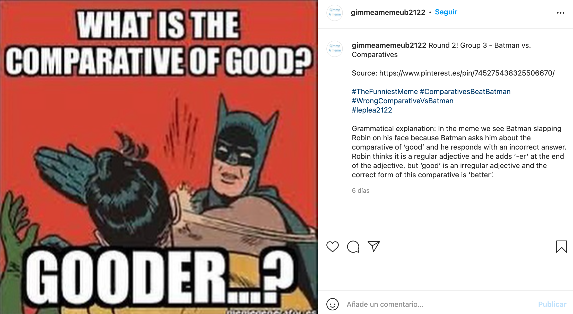
The top three memes were…
These were analysed and judged by CAV students

Slide 22
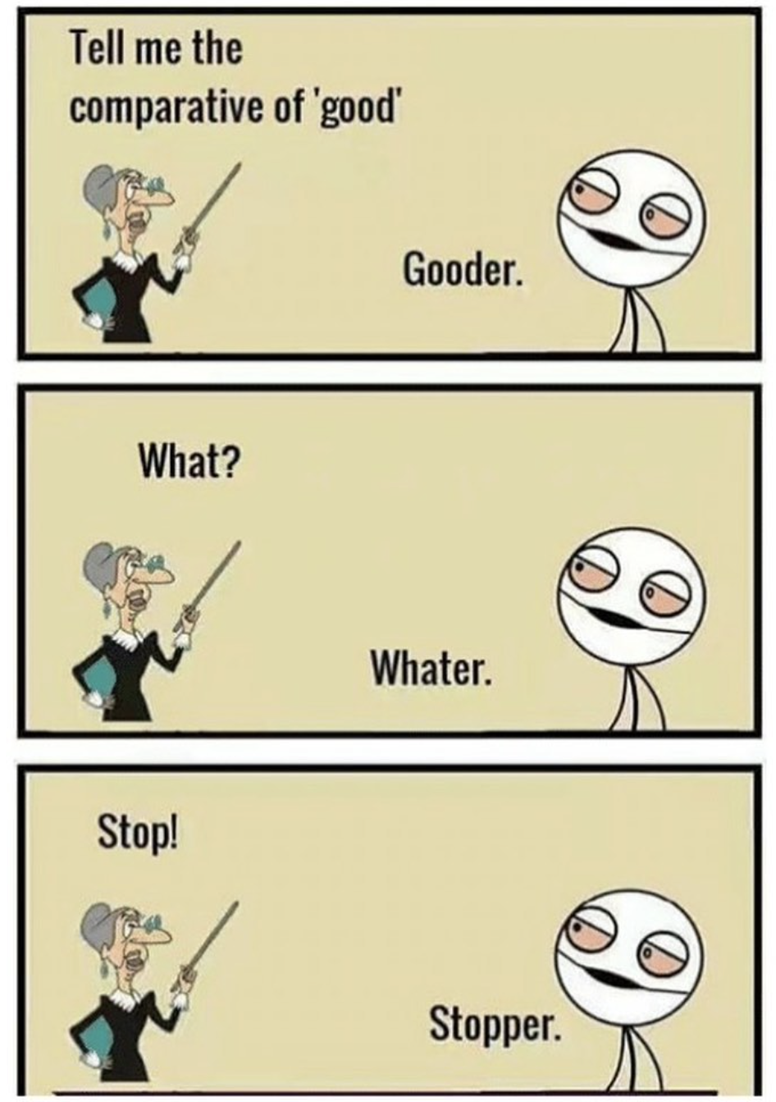
Alejandro & Natalia
Dialogue: relay between image and text
Full stop missing
Good structure, splits the meme in threes
Meme in a sequence: comedy comes in threes.
The student is clearly mocking his teacher
Dialogue takes benefits from the text position
Not the typical font, but readable and aesthetically pleasing
Takes advantage from the typical meme face

Slide 23
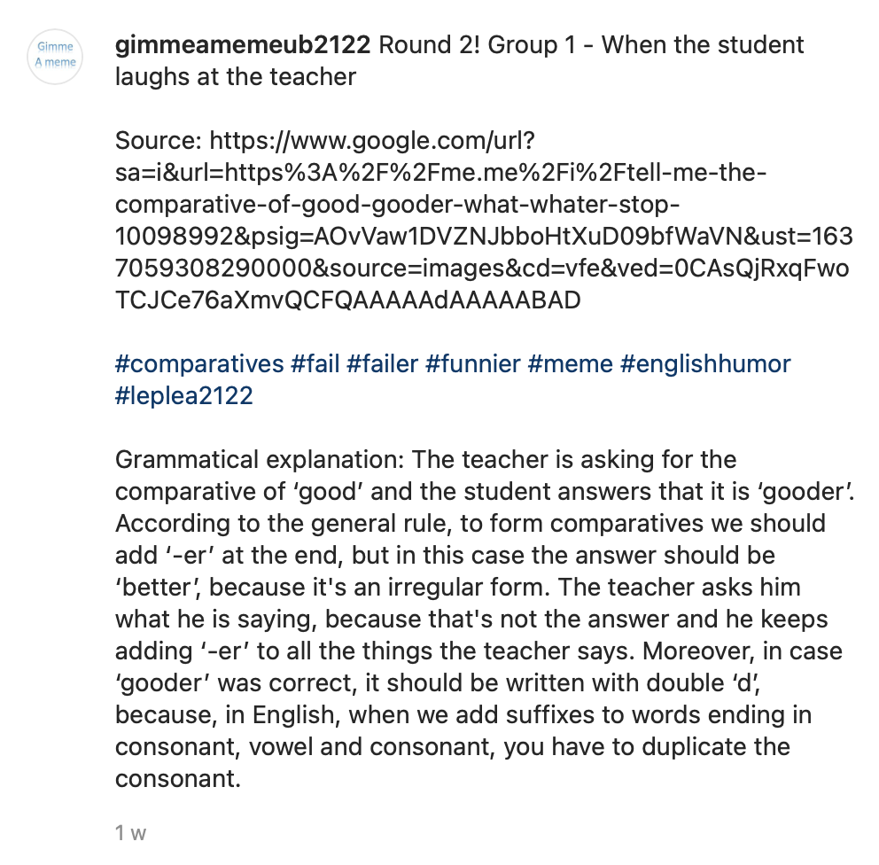
Alejandro & Natalia
Title not really funny with little humor intent
Identification with the meme, as students
Correct source, possibility to shorten the URL
Very conventional with little humor intent
No capital letters used in hashtags
Whatter shoud have double <t> too.
Wrong gramatical explanation: gooder is correct!

Slide 24
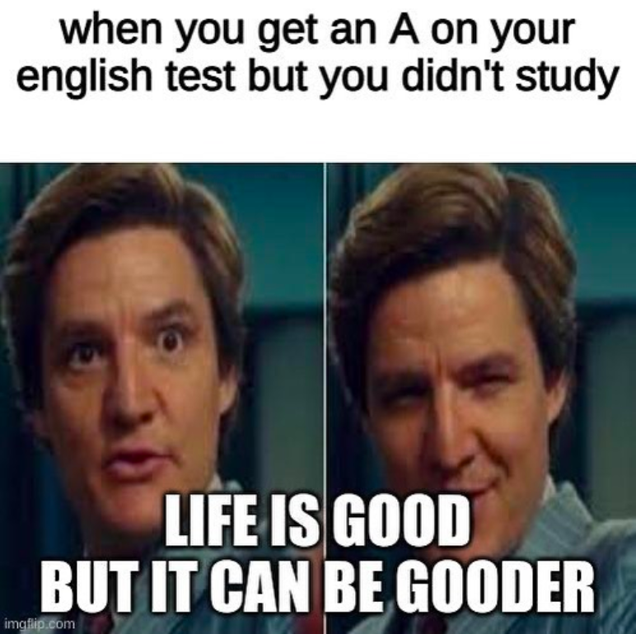
COMPOSITIONAL MEANING (VISUAL IMPACT)
Typical meme image: two part image with text on the top and the bottom.
The image is sequential. First, we should look at the image on the left, and then at the image on the right. The face gestures on the image are really telling: the first one shows surprise, and the second one shows certainty and cunning.
Laura & Ona

Slide 25
CAPTION (TEXT NEXT TO THE IMAGE)
There are no punctuation marks (colons missing after the word ’study’).
Everything is in lower case, including English which is always capitalized because it’s a proper noun.
The font is typical of memes. No punctuation marks either (full stop missing at the end of the sentence). Ungrammatical form ‘gooder’.
Laura & Ona

Slide 26
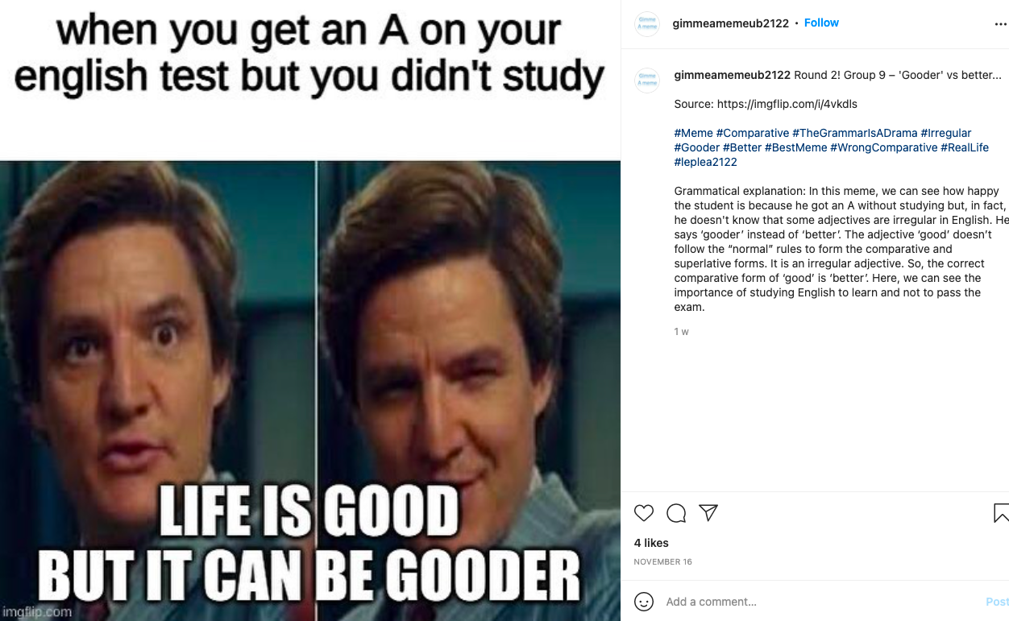
CAPTION (TEXT NEXT TO THE IMAGE)
The text is displayed in a sequential mode; from top to bottom. The first sentence of the bottom text is linked to the first image, and the second sentence is linked to the second image.
The caption has a clear identification with the theme of the image. Yet the three dots give the reader food for thought. They use punctuation marks for the ungrammatical form ‘gooder’, but not for ‘better’, to express there is an error in ‘gooder’. The conventional way is to add [sic.].
Laura & Ona

Slide 27
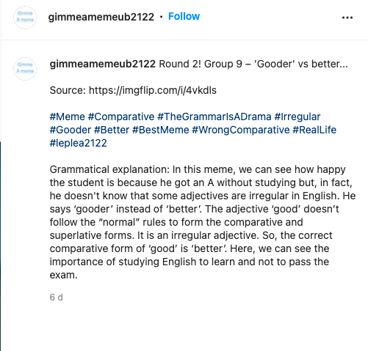
HASHTAGS COMPLIMENTING THE IMAGE
Hashtags use caps for better readability.
Hashtags are simple but also informative.
Hashtags contain grammar mistakes “the grammar” / “a drama” - but there is humor intent and rhyme.
Laura & Ona

Slide 28
GRAMMATICAL EXPLANATION
Grammatical explanation: we would rephrase it like “Studying English for learning purposes, not just for passing an exam”.
Laura & Ona

Slide 29
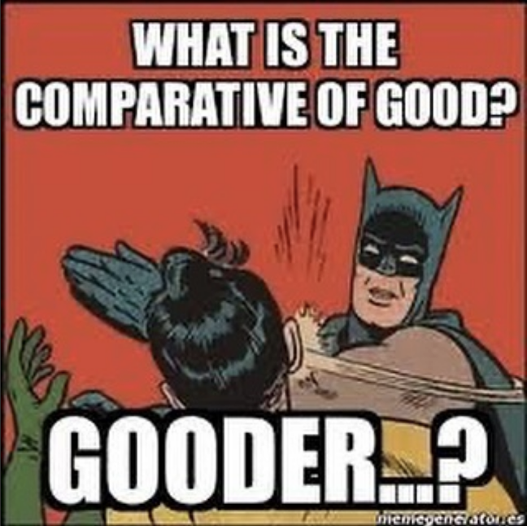

Carlota & Laura
Typical meme font type, size and color
Text on top of the image → to set the question;
sequential mode
Image and text → relay relation
Red color emphasizes:
- the pain of the slap
- incorrect answer
- batman's aggressiveness
Batman slaps Robin’s face → humorous intent. He slaps Robin because the answer is not correct.
Exaggerated reaction.
Robin’s face is not shown → reduces visual impact
Text at the bottom → the answer is larger than the question
…? → doubtful answer
Watermark and poor-quality image

Slide 30
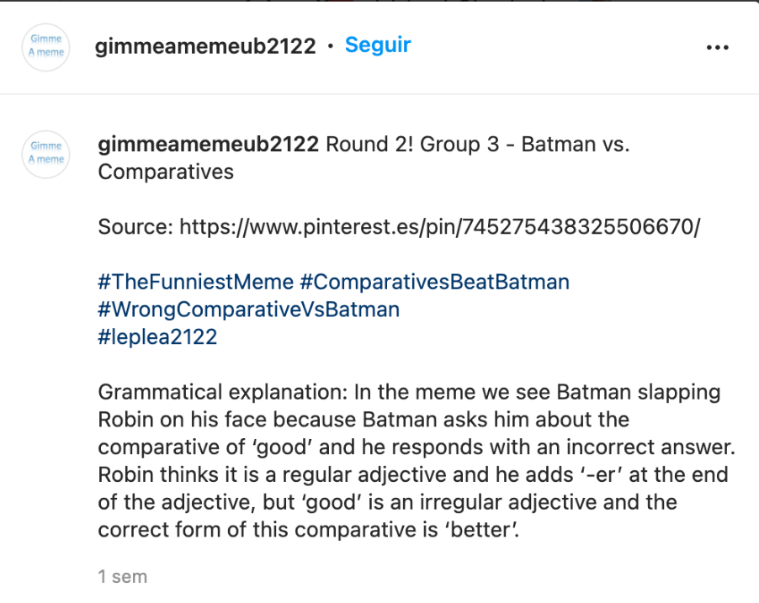
Carlota & Laura
The cap in “comparatives” is not needed since it’s not a proper noun.
No humorous intent. Specific, simple and informative.
Source
Few and unique hashtags. Use of caps to separate words.
Doesn’t exactly explain what is in the meme, just describes it.
Very detailed, complete and correct.
Great addition of the correct form of the comparative.

Slide 31
CAV students’ analyses
Which of the three analyses do you like the best on the grounds of…
The clearest explanation in terms of content
The best oral performance (delivery, fluency, communication skills)
Hands up!

Slide 32
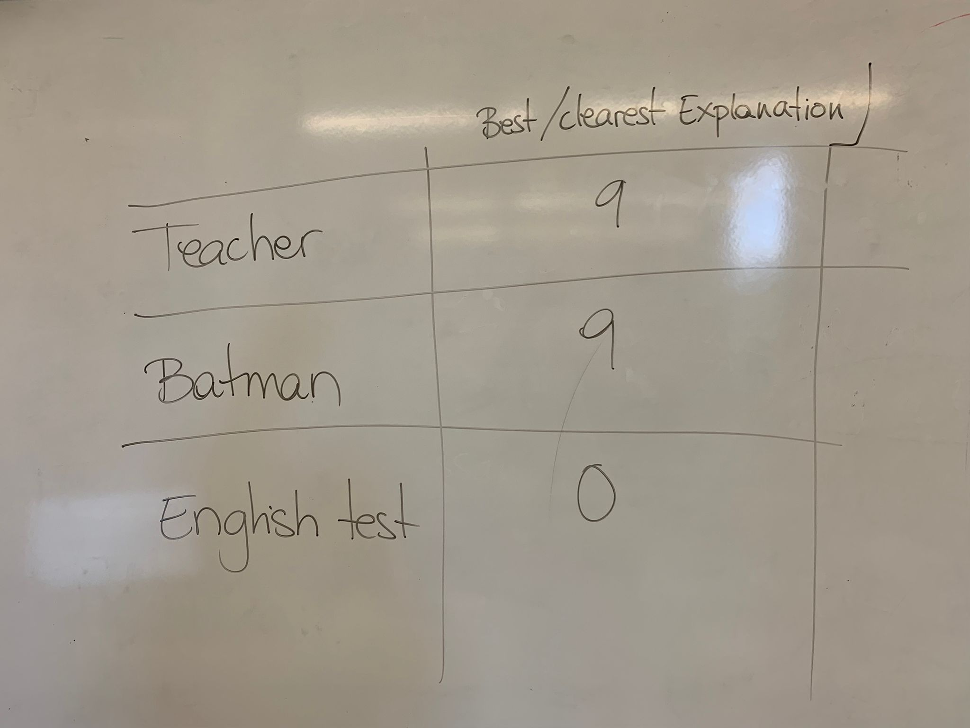
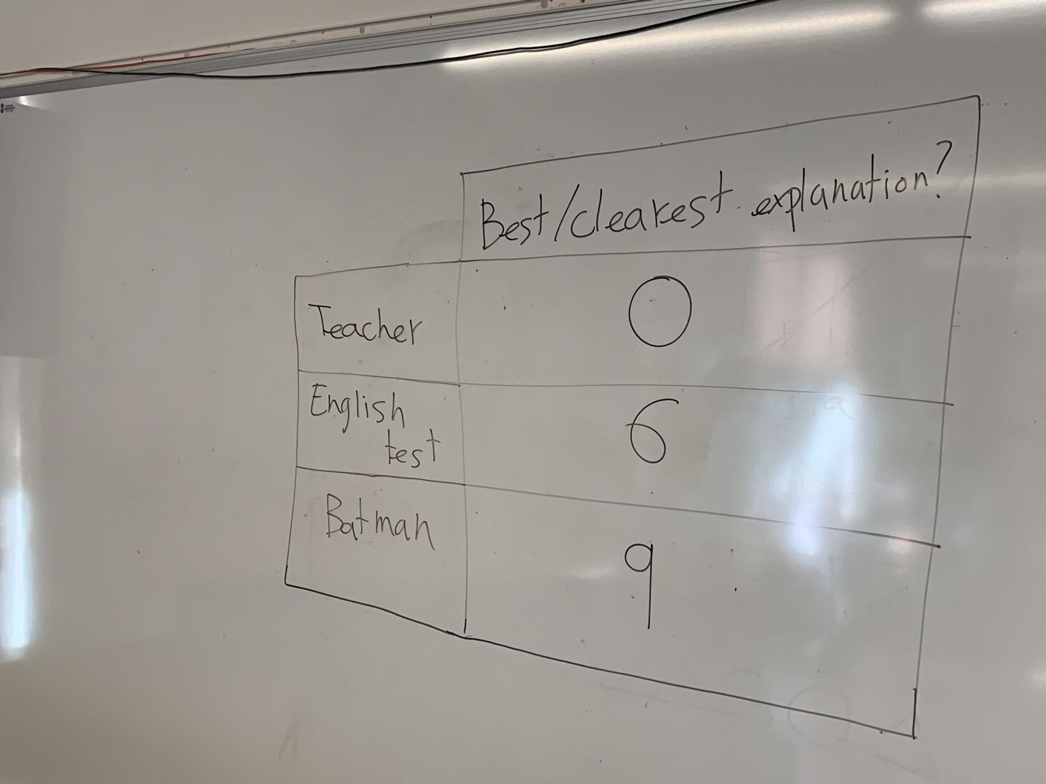
Round 2
Feedback group | Group 1 | Group 2 | Total
Teacher (Alejandro Carrión & Natalia Mercado) | 9 | 0 | 9
Batman (Carlota Barangé & Laura Madrid) | 9 | 9 | 18
English Test (Ona Rovira & Laura Sánchez) | 0 | 6 | 6

Slide 33
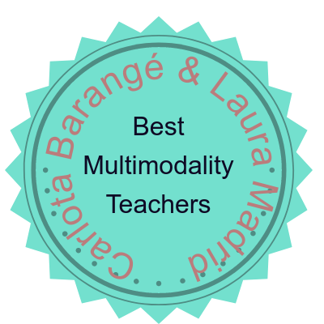
Round 2
+0.5 on your PPT performance

Slide 34
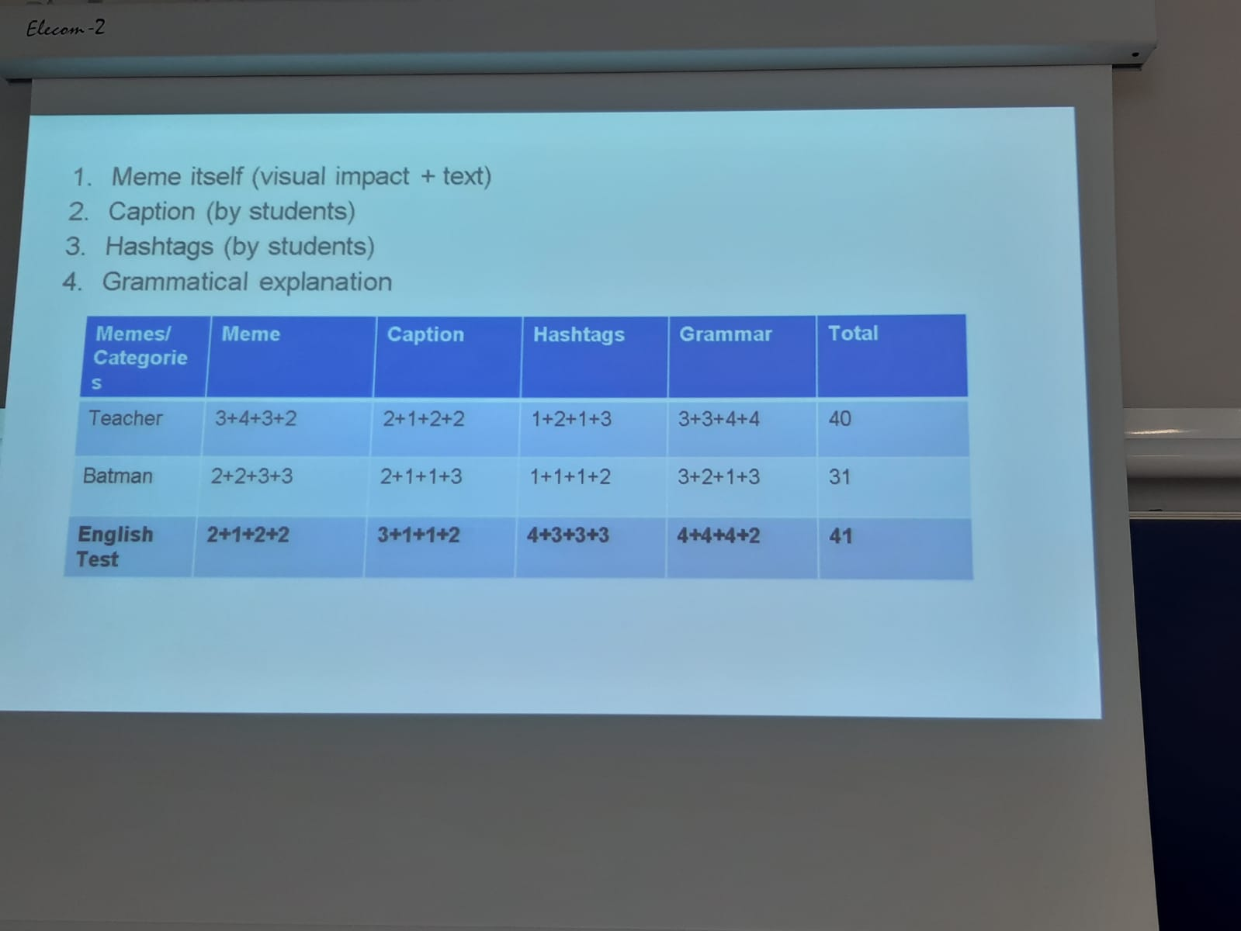
Results - Badges
Results - Badges

Slide 35
Results - Badges
Four groups marked all memes on four criteria and on a scale from 1 to 4 (indeed, lots of 4s ☺)
Memes | Meme itself | Caption | Hashtags | Grammatical explanation | TOTAL
Teacher (2D_D) | 3-4-3-2 | 2-1-2-2 | 1-2-1-3 | 3-3-4-4 | 40
Batman (2D_A) | 2-2-3-3 | 2-1-1-3 | 1-1-1-2 | 3-2-1-3 | 31
English test (4B_E) | 2-1-2-2 | 3-1-1-2 | 4-3-3-3 | 4-4-4-2 | 41

Slide 36
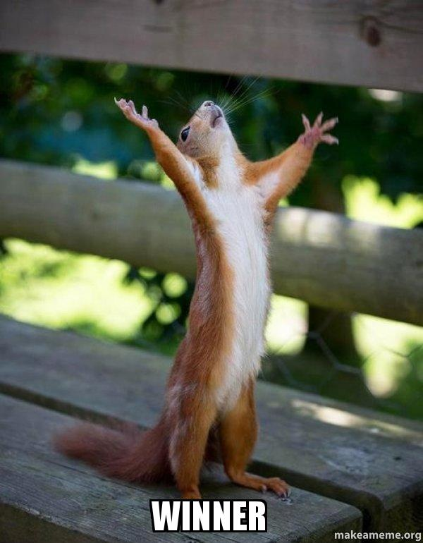
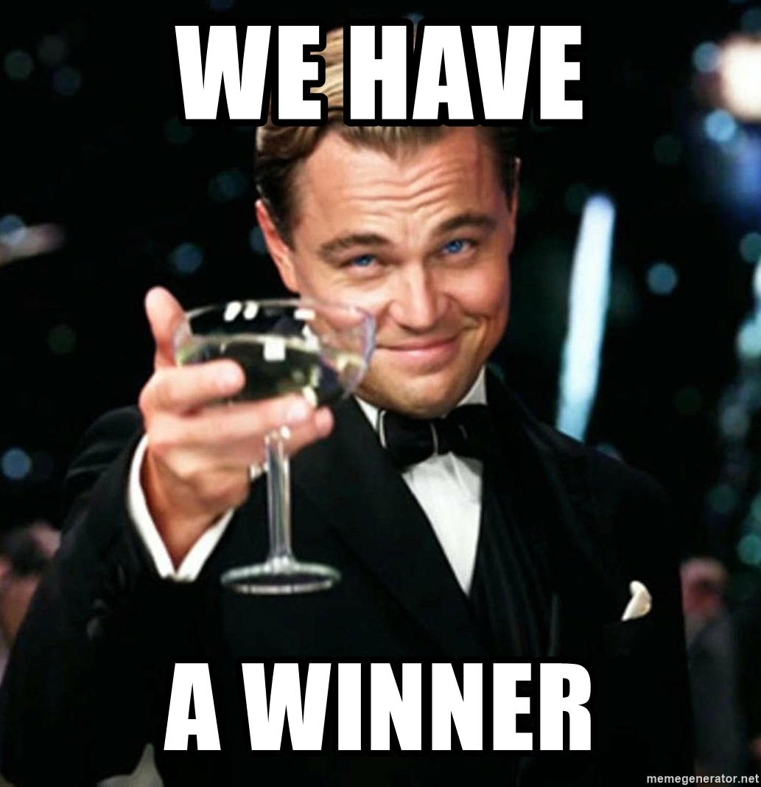
Results - Badges
Congratulations to Mar Bofarull, Paula García, Nadine Lombardo, Christina Salguero and Miriam Valero!!!
They have won a wild card in a (0) task!!!

Slide 37
And now it’s time for…
Round 3!
Relative clauses
or
Modal verbs of speculation and deduction

Slide 38
Memes - Round 3!
Relative clauses
or
Modal verbs of speculation and deduction

Slide 39
Results - Leaderboard
Group | N of votes R3 | N of points R3
2D_D (Aleth Zambrano et al.) | 13 | 25
2D_B (Marta Lozano et al.) | 7 | 20
4B_E (Christina Salguero et al.) | 6 | 16
2D_C (Claudia Rodríguez et al.) | 5 | 13
2D_A (Ariadna Rubio et al.) | 4 | 11
4B_A (Carme Amiell et al.) | 3 | 10
4B_C (Mireia Bleda et al.) | 3 | 10
4B_D (Nerea Sánchez et al.) | 1 | 9
4B_B (Noelia Calcerrada et al.) | 0 | 8

Slide 40
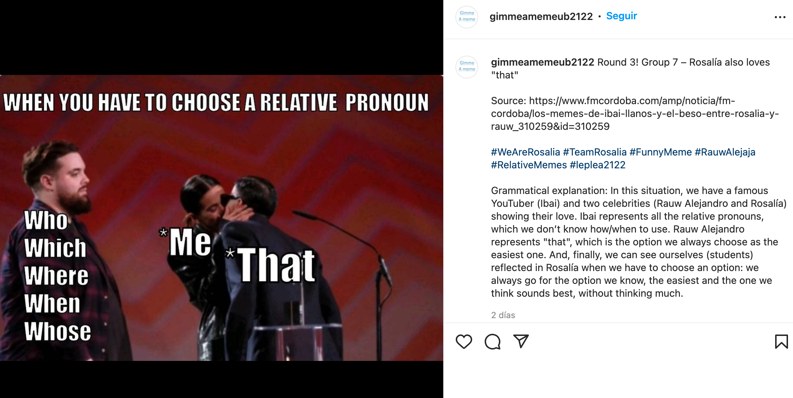
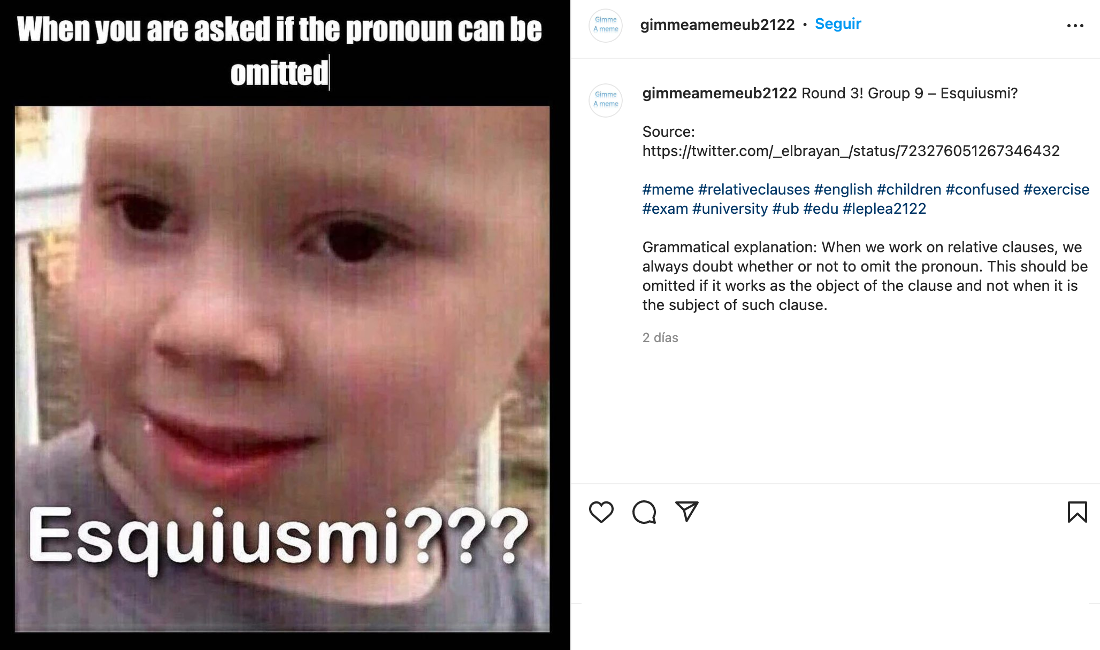
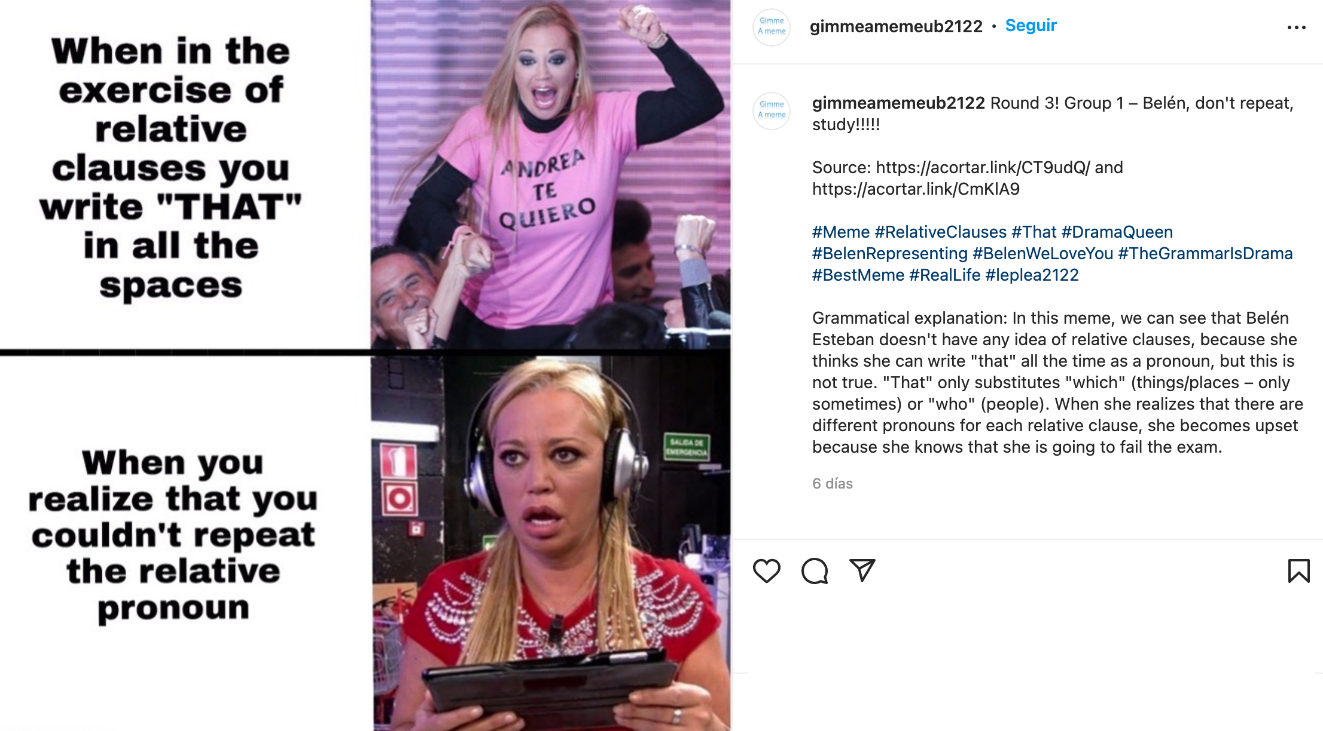
The top three memes were…
These were analysed and judged by CAV students

Slide 41
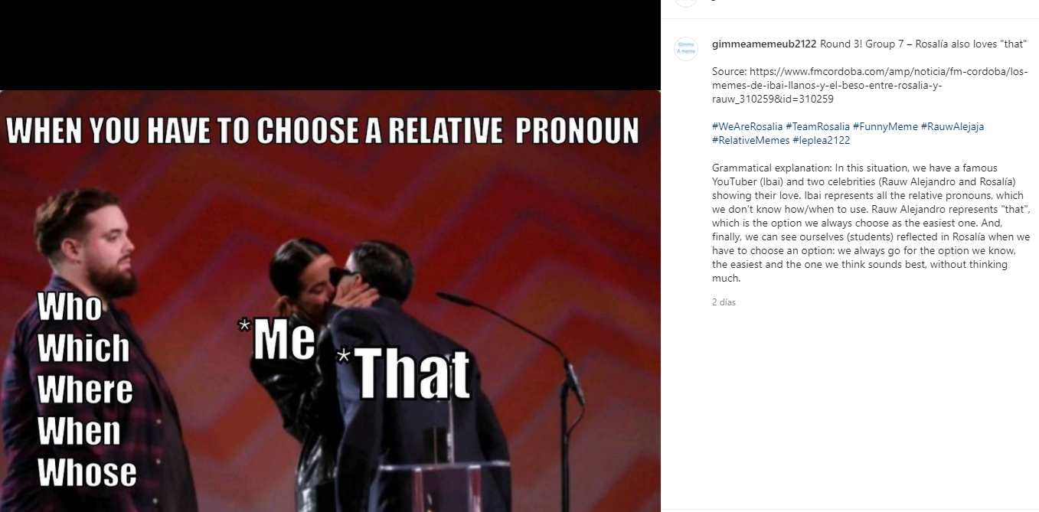

Compositional meaning
Los 40 Awards reference can help understand the meme
Typical meme structure: font, size and color for the “title”, which is in capital letters
To distinguish the hierarchy, the rest of the text is in lower case
“That” has a bigger size than the rest to emphasize Rosalía’s choice
It’s easy and pleasant to look at since all the colours are very similar and contrast with the text
Minimalist: it only includes the amount of text necessary to understand the meaning
Eva & Anna

Slide 42
Caption and source
There’s no humorous intention, unoriginality
We think it would have been more appropriate to use “Rosalía only loves “that””
Short, and the terms used are uncomplicated
Clear identification with the image
Double meaning of “that” referring to the pronoun and Rauw Alejandro
The source is very long
Eva & Anna

Slide 43
Hashtags and grammatical explanation
Humorous intention in the last name: “Alejandro” with “Alejaja”
Use of capitals to separate words
It could have mentioned all the people that appear, not just Rosalía
Some hashtag related to Los 40 Awards would have been interesting and helped people that didn’t watch the ceremony
Misuse of “relative” because, if it doesn’t have “pronouns” after it, it means family members
It doesn’t stress the importance of the relative pronouns and their misuse
It explains the meme and shows how the students relate to it
Eva & Anna

Slide 44
Gianluca & Denis

Slide 45
Image
Gianluca & Denis

Slide 46
Gianluca & Denis

Slide 47
Gianluca & Denis

Slide 48
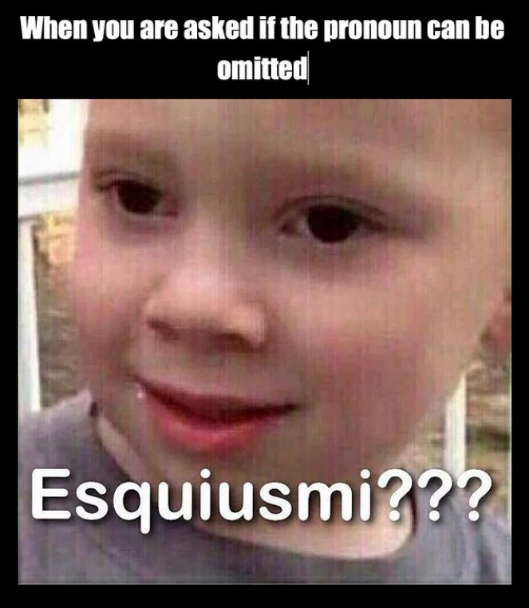
Typical meme image (familiarity) + text in a sequential mode (top + on image)
Relay relation with the image “When...”
Verb phrase wrongly split (can be – omitted) + cursor → sloppiness
Font type, size and colour →
meme-like on top, not at bottom
‘Esquiusmi’→ anchorage, describing the child’s facial expression
Phonological writing for humorous purposes + 3 question marks → standard for emphasis, but not meme-like
Maria del Mar

Slide 49
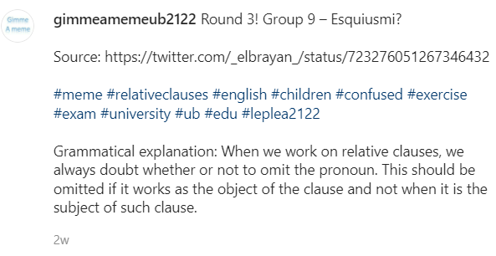
Caption: identification, repetition. Redundant. “Excuse me”.
Hashtags: unoriginal, not even conventional, just descriptive. No caps.
Complete and accurate explanation.
‘Excuse me’ is used to express a polite apology or to request that someone repeats something (American English);
it doesn’t convey ‘doubt’.
Maria del Mar

Slide 50
CAV students’ analyses
Which of the three analyses do you like the best on the grounds of…
The clearest explanation in terms of content
The best oral performance (delivery, fluency, communication skills)
Hands up!

Slide 51
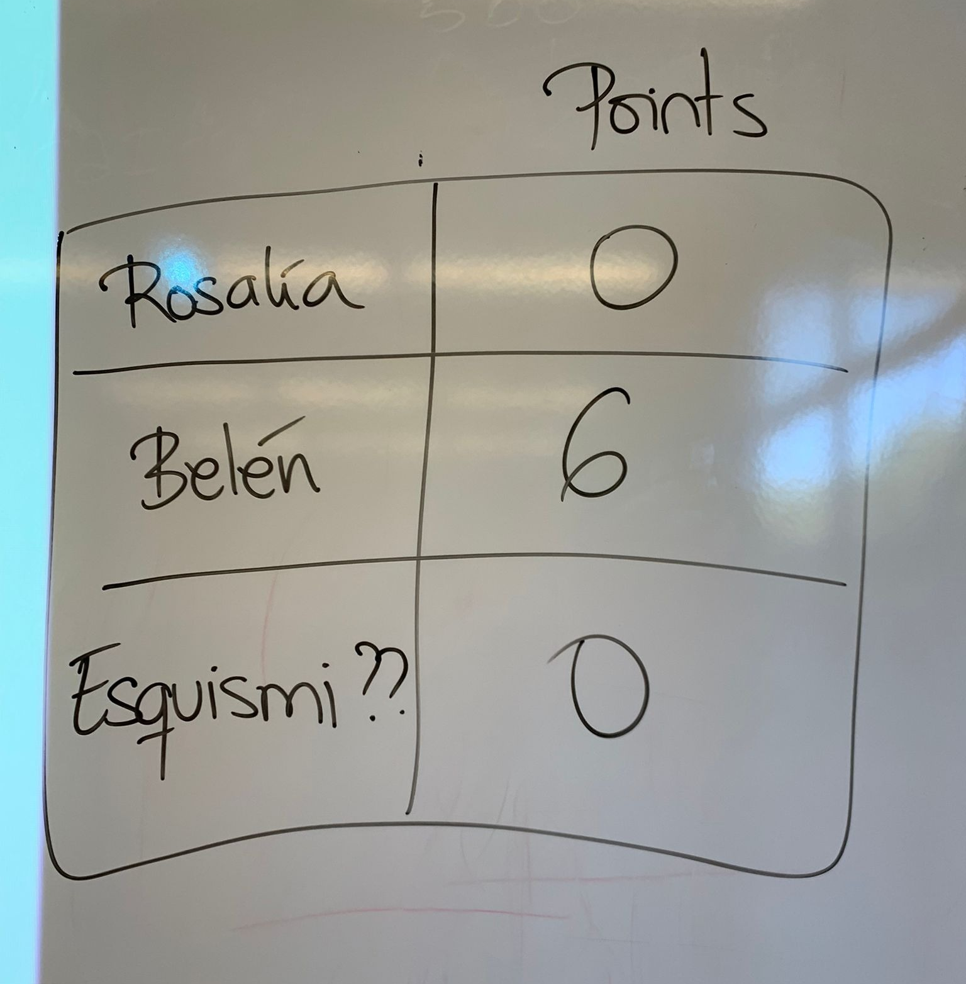
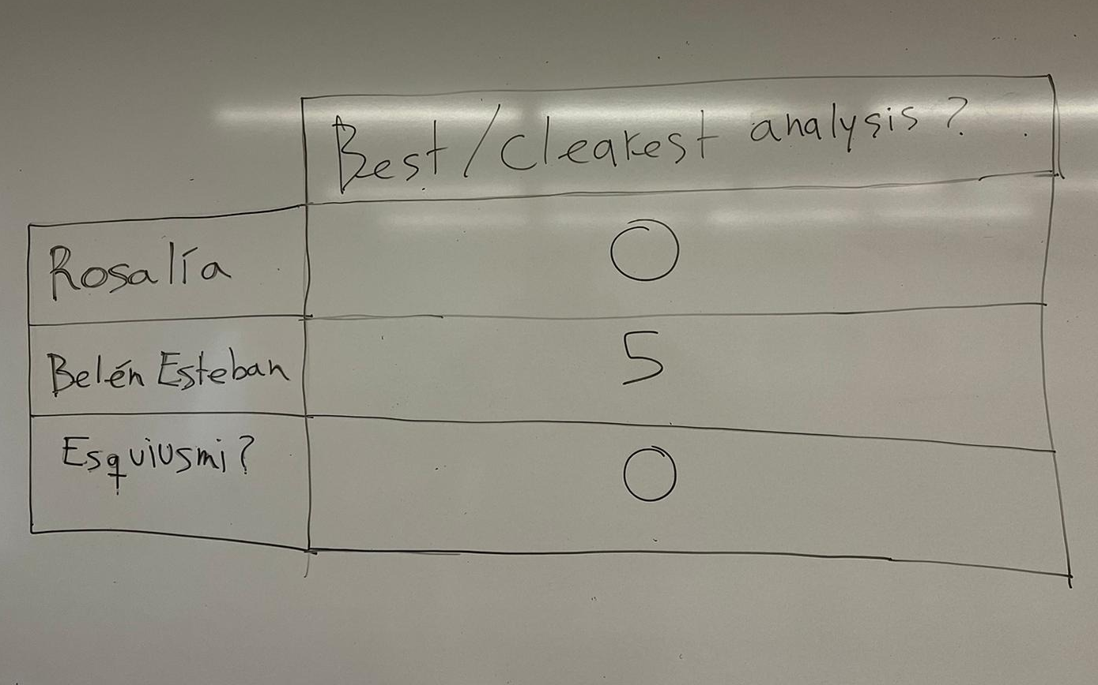
Round 3
Feedback group | Group 1 | Group 2 | Total
Rosalía (Eva Maestre & Anna Faustino) | 0 | 0 | 0
Belén Esteban (Gianluca Scognamiglio & Denis Bugaenco) | 5 | 6 | 11
Esquiusmi?? (Maria del Mar Suárez) | 0 | 0 | 0

Slide 52

Round 3
+0.5 on your PPT performance

Slide 53
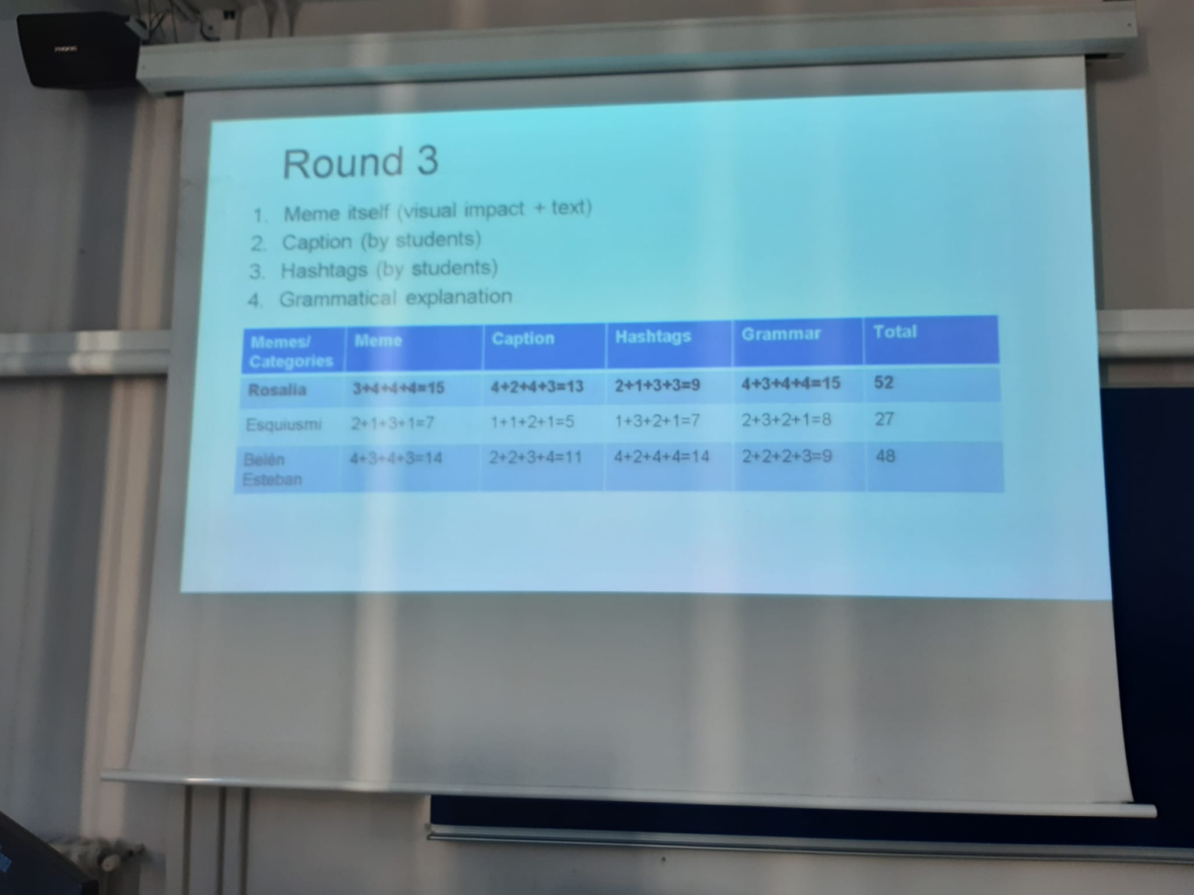
Results - Badges

Slide 54
Results - Badges
Four groups marked all memes on four criteria and on a scale from 1 to 4 (indeed, lots of 4s ☺)
Memes | Meme itself | Caption | Hashtags | Grammatical explanation | TOTAL
Rosalía (2D_D) | 3-4-4-4 | 4-2-4-3 | 2-1-3-3 | 4-3-4-4 | 52
Esquiusmi? (2D_B) | 2-1-3-1 | 1-1-2-1 | 1-3-2-1 | 2-3-2-1 | 27
Belén Esteban (4B_E) | 4-3-4-3 | 2-2-3-4 | 4-2-4-4 | 2-2-2-3 | 48

Slide 55
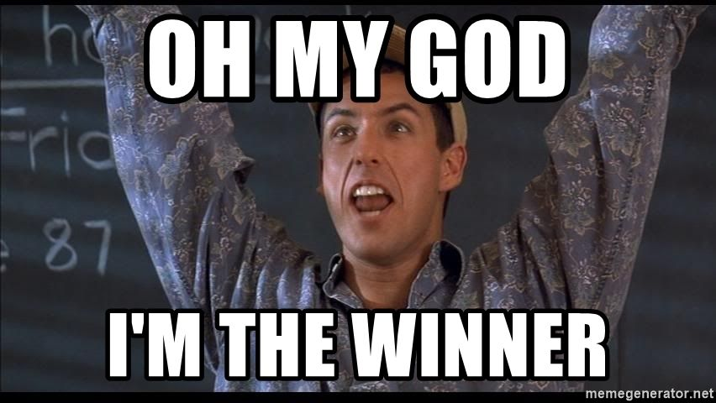
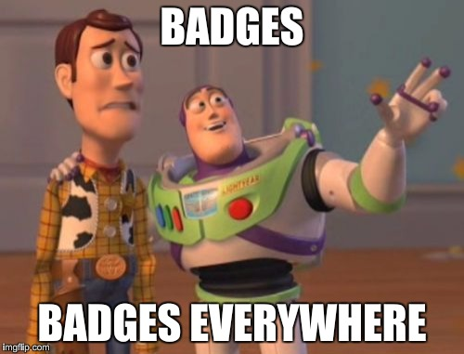
Results - Badges
Congratulations to Katia Colomer, Maria Estrada, Berta Ferrer, Alba Roca and Aleth Zambrano!!!
They have won a wild card in a (0) task!!!

Slide 56
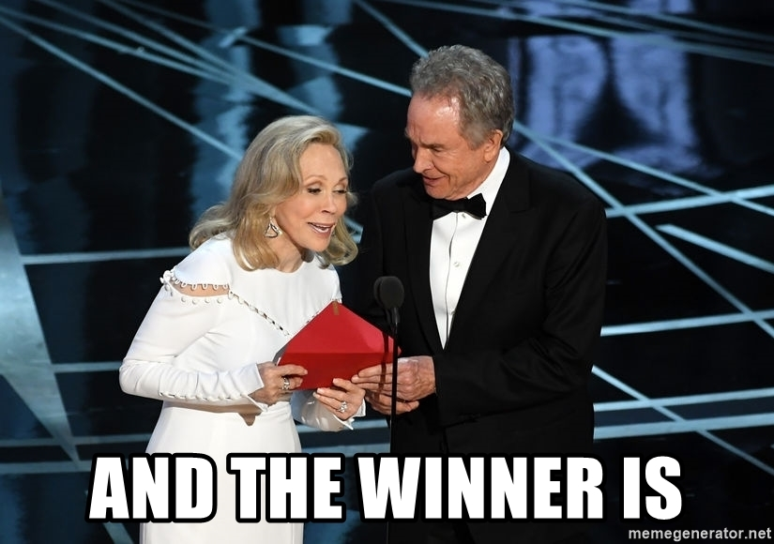

Slide 57
Let’s reveal the winners!
Final standing | Group | N of points R1 + R2 + R3

Slide 58
Let’s reveal the winners!
Final standing | Group | N of points R1 + R2 + R3
8 | 2D_C (Claudia Rodríguez et al.) | 9 + 10 + 13 = 32
8 | 4B_A (Carme Amiell et al.) | 11 + 11 + 10 = 32

Slide 59
Let’s reveal the winners!
Final standing | Group | N of points R1 + R2 + R3
5 | 2D_A (Ariadna Rubio et al.) | 8 + 16 + 11 = 35
5 | 4B_C (Mireia Bleda et al.) | 16 + 9 + 10 = 35
5 | 4B_D (Nerea Sánchez et al.) | 13 + 13 + 9 = 35
8 | 2D_C (Claudia Rodríguez et al.) | 9 + 10 + 13 = 32
8 | 4B_A (Carme Amiell et al.) | 11 + 11 + 10 = 32

Slide 60
Let’s reveal the winners!
Final standing | Group | N of points R1 + R2 + R3
4 | 2D_B (Marta Lozano et al.) | 9 + 10 + 20 = 39
5 | 2D_A (Ariadna Rubio et al.) | 8 + 16 + 11 = 35
5 | 4B_C (Mireia Bleda et al.) | 16 + 9 + 10 = 35
5 | 4B_D (Nerea Sánchez et al.) | 13 + 13 + 9 = 35
8 | 2D_C (Claudia Rodríguez et al.) | 9 + 10 + 13 = 32
8 | 4B_A (Carme Amiell et al.) | 11 + 11 + 10 = 32

Slide 61
Let’s reveal the winners!
Final standing | Group | N of points R1 + R2 + R3
3 | 4B_B (Noelia Calcerrada et al.) | 25 + 9 + 8 = 42
4 | 2D_B (Marta Lozano et al.) | 9 + 10 + 20 = 39
5 | 2D_A (Ariadna Rubio et al.) | 8 + 16 + 11 = 35
5 | 4B_C (Mireia Bleda et al.) | 16 + 9 + 10 = 35
5 | 4B_D (Nerea Sánchez et al.) | 13 + 13 + 9 = 35
8 | 2D_C (Claudia Rodríguez et al.) | 9 + 10 + 13 = 32
8 | 4B_A (Carme Amiell et al.) | 11 + 11 + 10 = 32

Slide 62
Let’s reveal the winners!
Final standing | Group | N of points R1 + R2 + R3
2 | 4B_E (Christina Salguero et al.) | 20 + 20 + 16 = 56
3 | 4B_B (Noelia Calcerrada et al.) | 25 + 9 + 8 = 42
4 | 2D_B (Marta Lozano et al.) | 9 + 10 + 20 = 39
5 | 2D_A (Ariadna Rubio et al.) | 8 + 16 + 11 = 35
5 | 4B_C (Mireia Bleda et al.) | 16 + 9 + 10 = 35
5 | 4B_D (Nerea Sánchez et al.) | 13 + 13 + 9 = 35
8 | 2D_C (Claudia Rodríguez et al.) | 9 + 10 + 13 = 32
8 | 4B_A (Carme Amiell et al.) | 11 + 11 + 10 = 32

Slide 63
Let’s reveal the winners!
Final standing | Group | N of points R1 + R2 + R3
1 | 2D_D (Aleth Zambrano et al.) | 10 + 25 + 25 = 60
2 | 4B_E (Christina Salguero et al.) | 20 + 20 + 16 = 56
3 | 4B_B (Noelia Calcerrada et al.) | 25 + 9 + 8 = 42
4 | 2D_B (Marta Lozano et al.) | 9 + 10 + 20 = 39
5 | 2D_A (Ariadna Rubio et al.) | 8 + 16 + 11 = 35
5 | 4B_C (Mireia Bleda et al.) | 16 + 9 + 10 = 35
5 | 4B_D (Nerea Sánchez et al.) | 13 + 13 + 9 = 35
8 | 2D_C (Claudia Rodríguez et al.) | 9 + 10 + 13 = 32
8 | 4B_A (Carme Amiell et al.) | 11 + 11 + 10 = 32

Slide 64
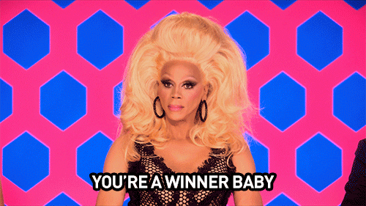
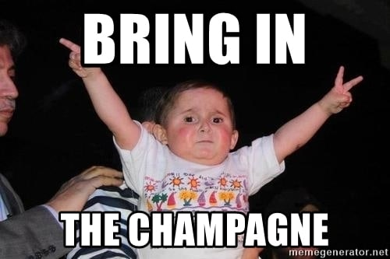
Let’s reveal the winners!
Congratulations to Katia Colomer, Maria Estrada, Berta Ferrer, Alba Roca and Aleth Zambrano!!!
They have won 0.5 points extra in the final mark!!!!!

Slide 65
And now it’s time for you to have your say!
Please answer the questionnaire on Moodle

