Slide 1

Get to know the Biology CRAI Library
Academic year 2025-2026

Slide 2
The objective of this session is:
To introduce you to the Biology CRAI Library and its services:
https://crai.ub.edu/en/about-crai/libraries/biology-crai-library
To talk to you about de resources and services that the UB CRAI offers:
https://crai.ub.edu/en

Slide 3
What are we going to talk about?
Where are we and when can you come?
Library floor plan
Facilities
The library collections: books, journals, etc.
Get started in the CRAI!
Cercabib
What do you have to do to borrow books?
The document loan service
Use of study rooms and loan of laptops
What do you have borrowed? My account
Consortial Borrowing Service (PUC)
Interlibrary loan
Accessing UB electronic resources
Virtual Campus
Learn | Services and Resources
Codes and passwords
User support service (SAU)
User training
Collections
Wi-Fi and access to the Faculty computers
Follow us on our social media and virtual exhibitions!
And if you still have questions...

Slide 4
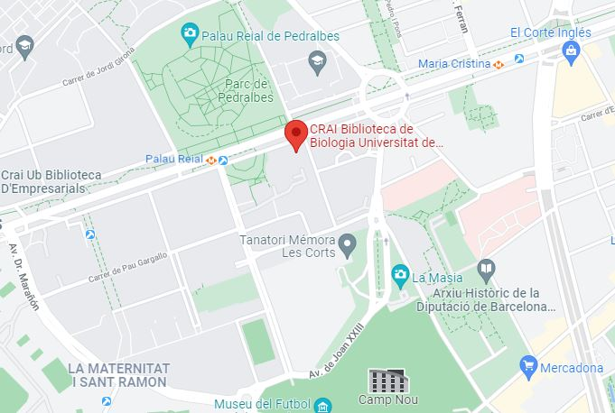
Where are we and when can you come?
The Biology CRAI Library
Address:
Av. Diagonal, 643
934 021 567
craibiologia@ub.edu
Addresses of the other libraries
Opening times:
From Monday to Friday from 8 a.m. to 8 p.m.
Special opening times during exams periods and weekends
CRAI libraries regulation (Catalan)
List of services offered by CRAI

Slide 5
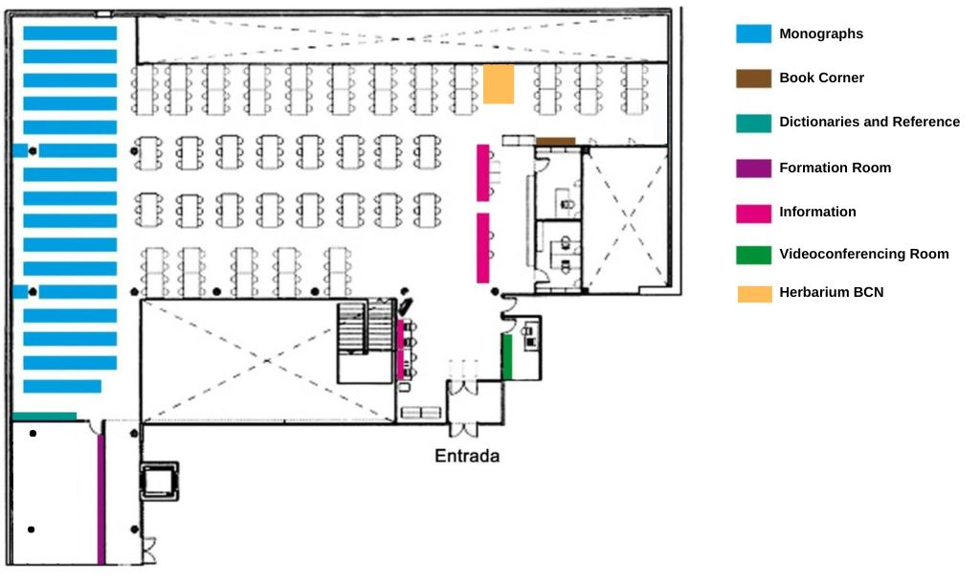
Library floor plan 1/2

Slide 6
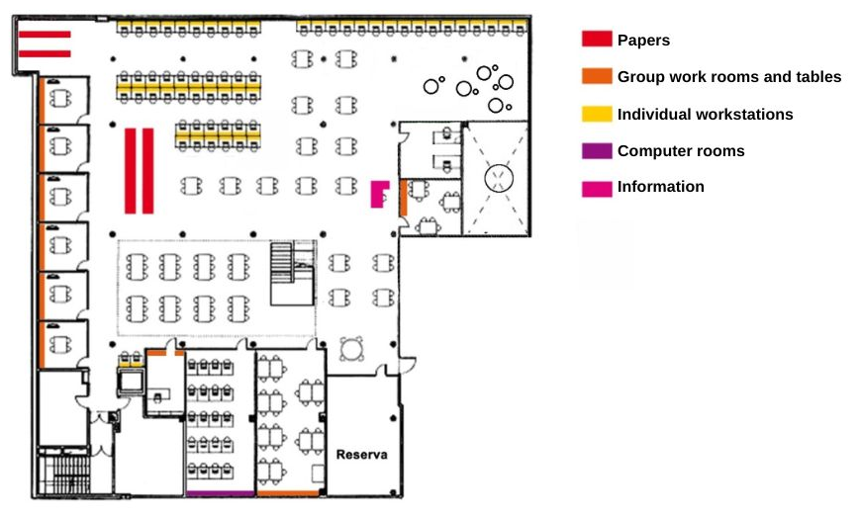

Library floor plan 2/2

Slide 7
Facilities
  1 computers room
  1 reference computer
  7 study rooms to do group or individual work
  6 tables for group work (Sala de Lupes)
  3 tables for group work (Sala Multiús)
  Wi-Fi Zone
  493 reading points
  58 tables for individual work
  Distended work zone
  Journal archive
  1 videoconference room
  1 formation room
Notes:
Aules: explicar les normes d’ús

Slide 8
The library collections: books, journals, etc.
The Biology CRAI Library combines the research collection and the specialised collections of the following studies: Biology, Environmental Sciences, Biotechnology, Biomedical Sciences and Biochemistry.
The collections are formed by monographs, paper journals, electronic resources, doctoral theses and audiovisual material.
There are also special collections at the Library, like the Ramon Margalef Lopez collection, the Antoni Prevosti Pelegrín one or the Oriol de Bolòs i Capdevila one among others.
You can submit your suggestions for book purchases in this form.

Slide 9
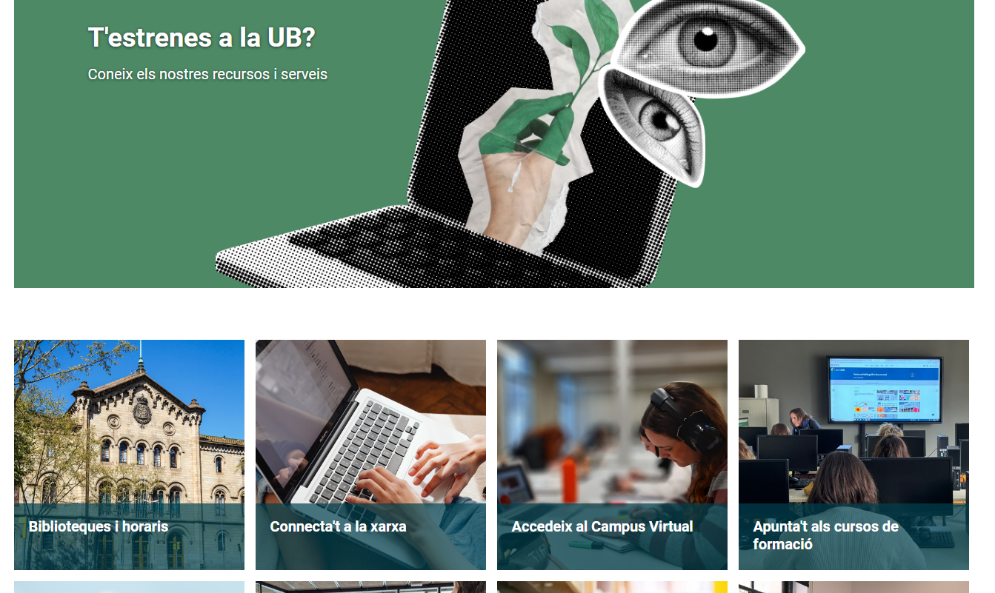
Get started in the CRAI! https://crai.ub.edu/en/get-to-know-crai/get-started-in-the-crai

Slide 10
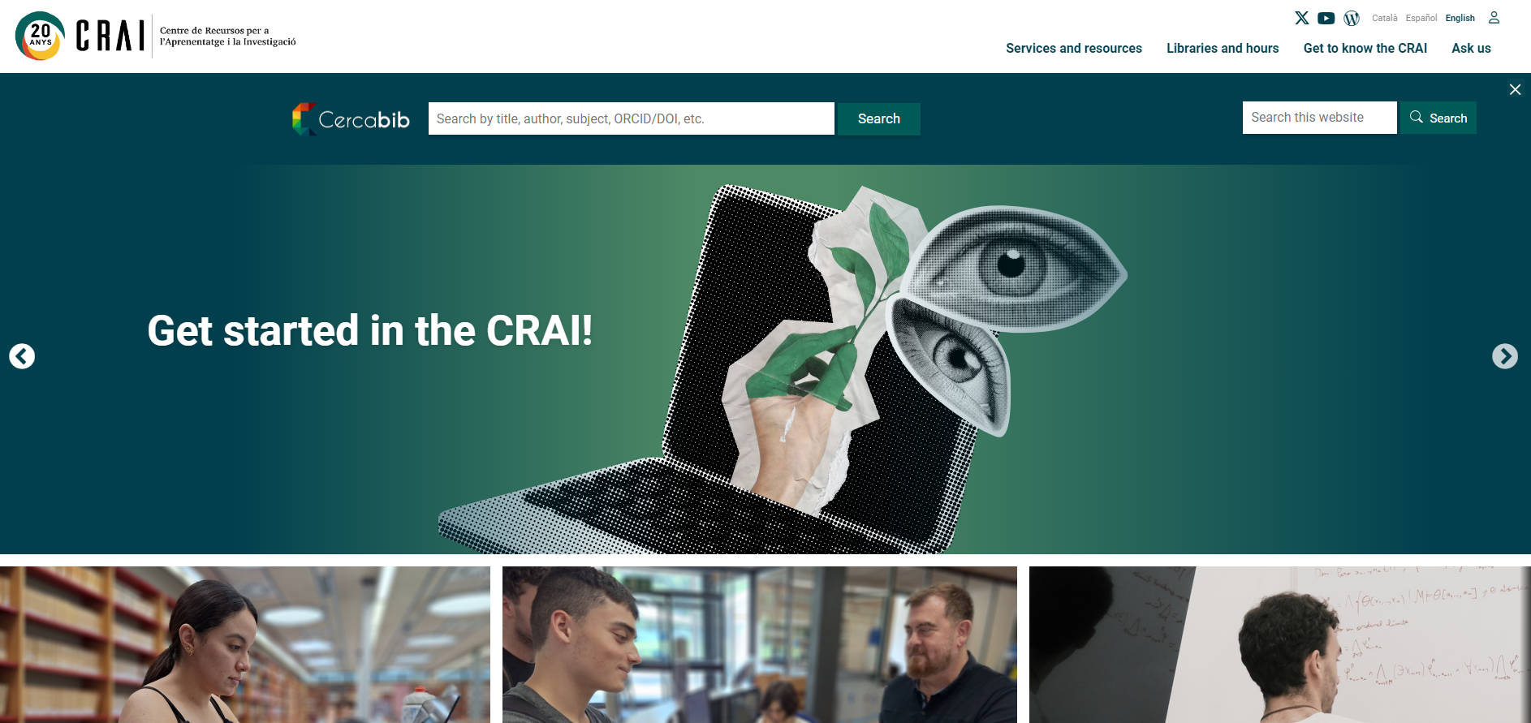
Cercabib. Two ways to access.
Access from the CRAI webpage https://crai.ub.edu/en
Or...
Notes:
El CRAI és el Centre de Recursos per a l’Aprenentatge i la Investigació, una part del qual són totes la Biblioteques de la UB
Hi podeu accedir des de:
El web de la UB → Informació sobre → Biblioteca
El web de la Facultat → Serveis → Biblioteca
MonUB → Beques i Serveis → Biblioteca
Directe des de Bookmarks/Favorits http://www.bib.ub.es/bub/bub.htm

Slide 11
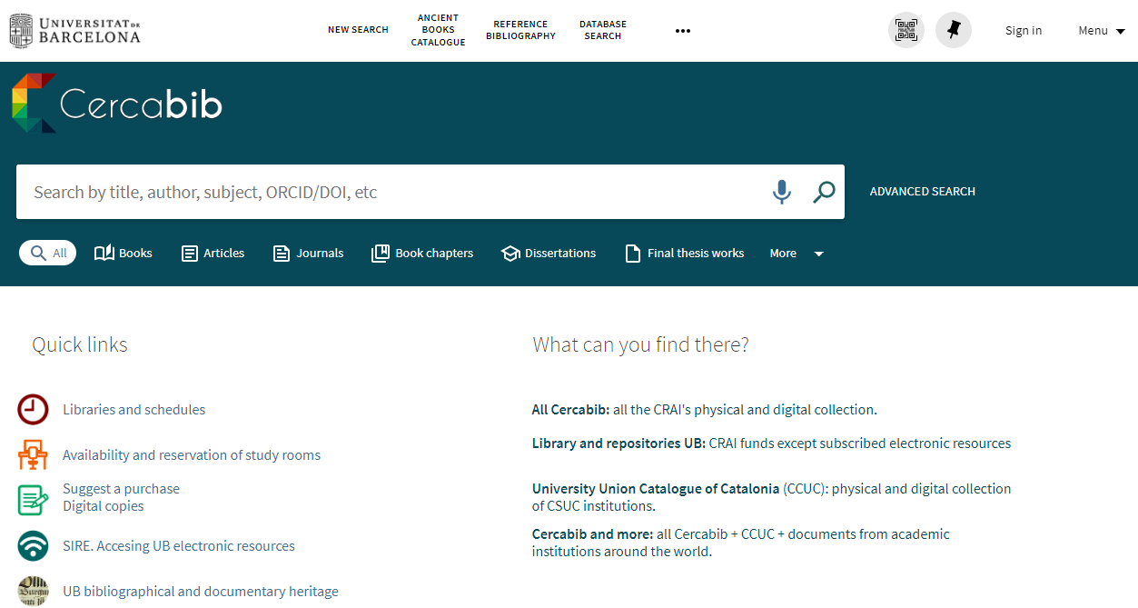
Cercabib
Access from the Cercabib webpage https://cercabib.ub.edu/discovery/search?vid=34CSUC_UB:VU1&lang=en
It’s necessary to sign in first, to get the complete results and to be able to request items

Slide 12
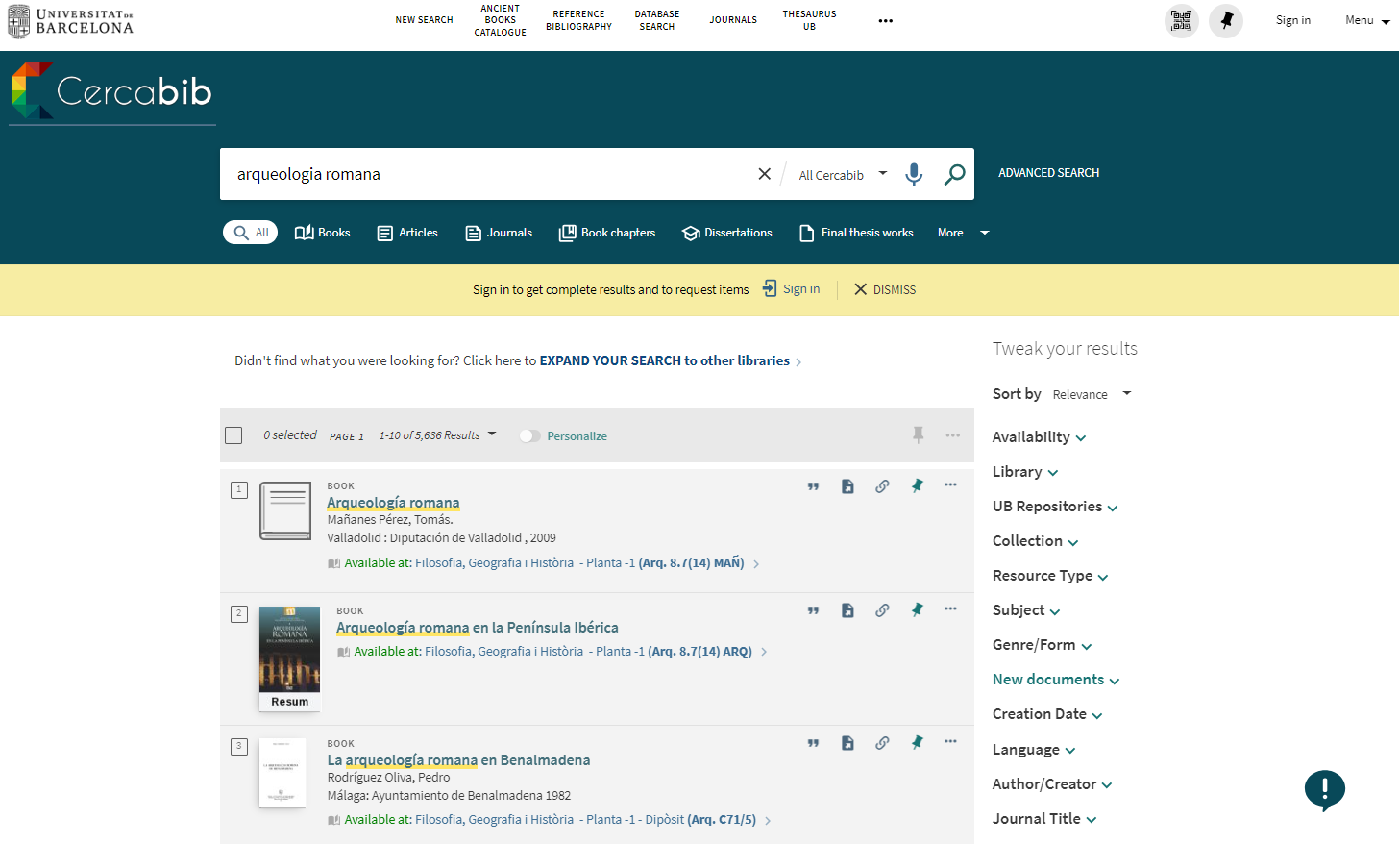

Cercabib: simple search
You can tweak your results
Notes:
El CRAI és el Centre de Recursos per a l’Aprenentatge i la Investigació, una part del qual són totes la Biblioteques de la UB
Hi podeu accedir des de:
El web de la UB → Informació sobre → Biblioteca
El web de la Facultat → Serveis → Biblioteca
MonUB → Beques i Serveis → Biblioteca
Directe des de Bookmarks/Favorits http://www.bib.ub.es/bub/bub.htm

Slide 13
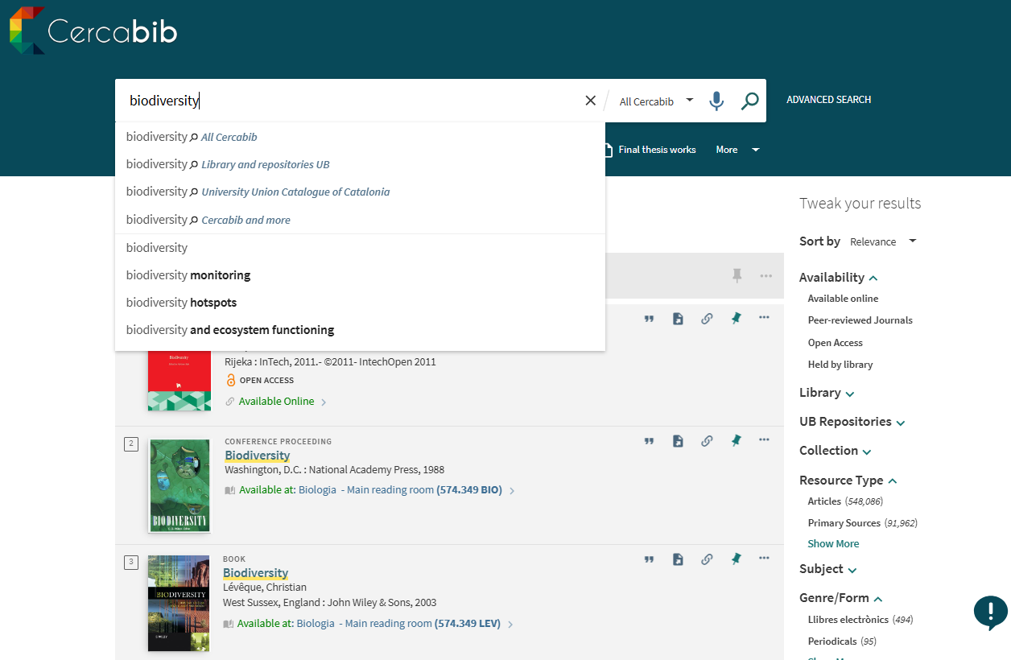
Where is the document? (I)
Notes:
Conèixer el CRAI Biblioteca de XXXX. Curs 20xx-xx

Slide 14
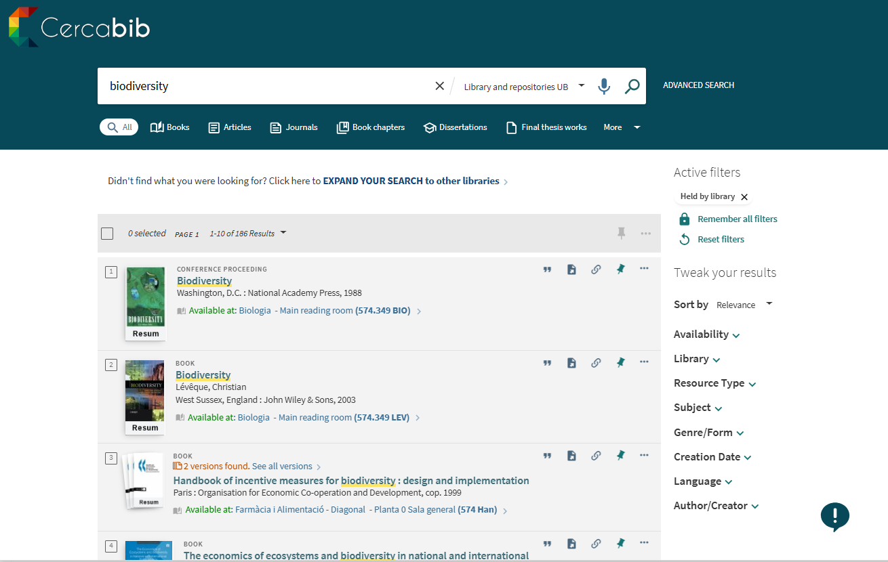
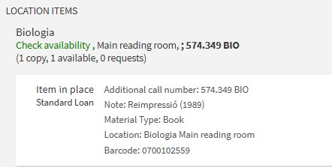
Where is the document? (II)

Slide 15
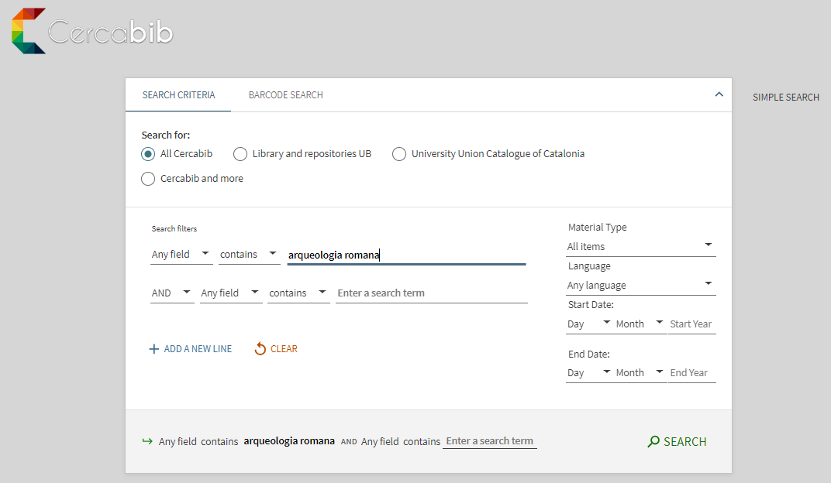
Cercabib: advanced search
It allows to combine more than one search field and to narrow the search.

Slide 16
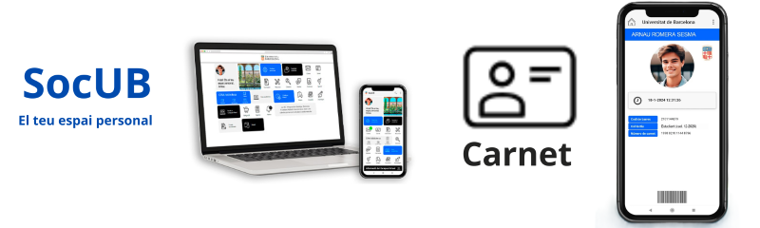
What do you have to do to borrow books?
You only need the UB digital card, available at the SocUB app.

Slide 17
The document loan service (I)
https://crai.ub.edu/en/services-and-resources/ub-documents-loan
The document loan service can be used to consult CRAI materials outside of library premises for a certain period of time.
You must hold a UB Card or another document that indicates your entitlement to loan items.
CRAI loan service regulation (Catalan)
Not loanable documents:
  Journals and reference works (encyclopedias, dictionaries, etc.). If they are online, they can be consulted from outside of the University.
  Rare book and manuscript collection.
  Books identified with a red dot or with the Exclòs de préstec (not loanable) label.
Reference bibliography:
  Loan length of 10 days.
  Request through My account, or at the loan counters of the CRAI libraries.

Slide 18
The document loan service (II)
https://crai.ub.edu/en/services-and-resources/ub-documents-loan
Users | Documents | Days
Active, retired or emeritus UB professors; guest or visiting faculty; teachers of the EIM, of Hispanic Studies, of the Linguistic Services and of the IDP-ICE; researchers from UB departments or research groups; users with specific needs | 40 | 60
Doctoral students and official, internal and inter-university master's students; Active or retired UB PTGAS | 20 | 30
Undergraduate student of the UB, affiliated, inter-university, homologation, national or international mobility centers; students from the Institute for Continuing Education (IL3) taking University courses; own postgraduate students; university extension students; students of the University of Experience; authorized UB Alumni members | 10 | 21
Staff of teaching hospitals (Clinic, Bellvitge and Sant Joan de Déu); teaching staff of affiliated centers with venia docendi; non-UB teaching staff from centers with agreements, from the UB Group and from the IDP-ICE; staff of research institutes involved, attached, linked, with an agreement or of the UB Group; researchers and research fellows of GEO3BCN-CSIC | 15 | 21
Student of centers with an agreement or of the UB Group; students of the EIM, Hispanic Studies, Linguistic Services and IDP-ICE; members of the Faculty of Doctors of the UB; primary and secondary teachers; members of the COBDC; members of charitable foundations of the UB; users authorized by PDI of the UB or by CRAI | 5 | 10
Audiovisual material loans: 21 days
Recommended bibliography: 10 days
Recommended bibliography for weekends (from Friday to Monday): 3 days

Slide 19
The document loan service (III)
https://crai.ub.edu/en/services-and-resources/ub-documents-loan
Renewals
Reservations
You can renew document loans as many times as you wish, as long as the document hasn’t been reserved. You can ask for the renewal at the loan counter, making a phone call or online, from the My account option.
You are allowed to make up to 10 simultaneous reservations, from My account or from the loan counters.
Suspensions
Loan history
Not returning on time the borrowed documents entails a suspension of the service, depending on the days of delay and the type of document:
Regular loan and audiovisual material: 1 day
Recommended bibliography loan: 2 days
Recommended bibliography for weekends: 3 days
You can see the list of the documents that you borrow throughout your studies at the UB, at the tab Loans inside My account.
Notes:
Conèixer la Biblioteca de ........ (2005-2006)
19

Slide 20
Loans with other UB libraries
CRAI libraries
Bellvitge Campus
Biology
Clínic Campus
Earth Sciences
Economics and Business
Fine Arts
Information and Audiovisual Media
Law
Mathematics and Computer Science
Mundet Campus
Pavelló de la República
Pharmacy and Food Science
Philology and Communication
Philosophy, Geography and History
Physics and Chemistry
Rare Book and Manuscript
If you need a document that is in another library from the UB, you may:
a) go to the library where it’s located and formalise de loan, or
b) request it at the loan counters of your library so that they have it brought there. You will receive it after 2 or 3 days.

Slide 21
Use of study rooms https://crai.ub.edu/en/services-and-resources/equipments-loan
The objective of this service is to facilitate the use of the CRAI libraries study rooms, so you can have a space to work, individually or in group. The reservations are made from Cercabib once you have signed in.
Instructions for study rooms us (Catalan)
Loan of laptops
https://crai.ub.edu/en/services-and-resources/equipments-loan
The laptops have Windows installed.
The laptops are requested and returned at the loan counters.
It is required to read, sign and fill out correctly the loan contract form (Catalan).
The suspended users cannot use this service.
The loan period is a maximum of 4 hours.
The laptops cannot be reserved.
Regulations (Catalan)

Slide 22
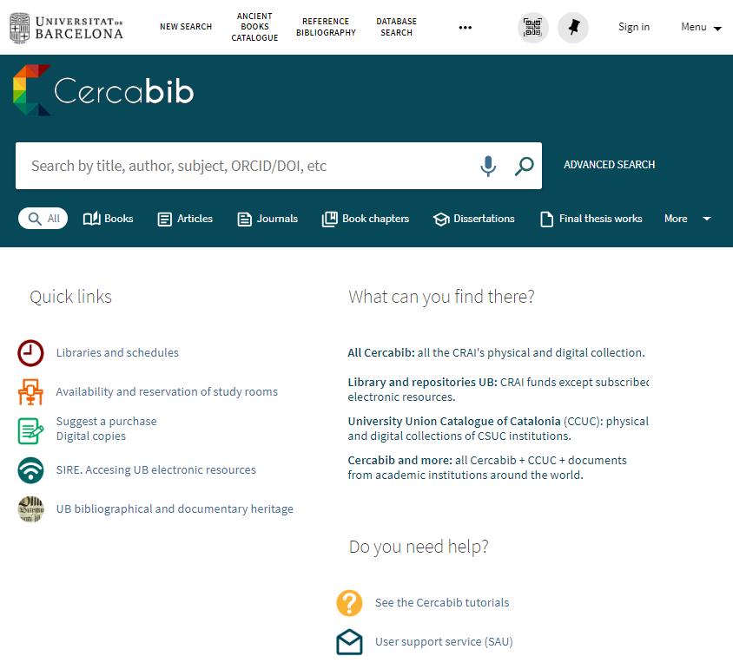
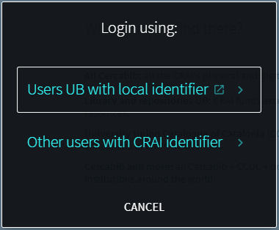
What do you have borrowed? My account
This service allows you to access your CRAI user record.
Once you have signed in, you can see and renew your loans, make document reservations or create record lists, among other services.

Slide 23










Consortial borrowing service (PUC) https://crai.ub.edu/en/services-and-resources/puc-loan
The Consortial Borrowing PUC is a free service that allows users to request and borrow documents from another library of the Consortium of University Services of Catalonia (CSUC).
How can you request documents?
a) In person, at the library where they are deposited: PUC in situ.
b) Remotely, through the interface of the PUC via web.
Where can you return the documents?
At any CRAI library from the UB.
At any library from the institution to which the document belongs.
Notes:
El CRAI és el Centre de Recursos per a l’Aprenentatge i la Investigació, una part del qual són totes la Biblioteques de la UB
Hi podeu accedir des de:
El web de la UB → Informació sobre → Biblioteca
El web de la Facultat → Serveis → Biblioteca
MonUB → Beques i Serveis → Biblioteca
Directe des de Bookmarks/Favorits http://www.bib.ub.es/bub/bub.htm

Slide 24
PUC via web https://crai.ub.edu/en/services-and-resources/puc-loan
Requisites:
  Be registered on the library users database of your institution.
  Have no overdue items.
  Not be temporarily blocked from using the loan’s service as a penalization for a late return or other problem.
1 Connect to the University Union Catalogue of Catalonia (CCUC): https://ccuc.csuc.cat/discovery/search?vid=34CSUC_NETWORK:CSUC_CCUC_UNION&lang=en
2 Search for the document and if it is available select it to request it. Sign in and choose where you want to pick it up.
3 When the document arrives at the chosen library, you will be notified via email.
4 You can return the document at any library from your institution or the institution to which it belongs.
Notes:
El CRAI és el Centre de Recursos per a l’Aprenentatge i la Investigació, una part del qual són totes la Biblioteques de la UB
Hi podeu accedir des de:
El web de la UB → Informació sobre → Biblioteca
El web de la Facultat → Serveis → Biblioteca
MonUB → Beques i Serveis → Biblioteca
Directe des de Bookmarks/Favorits http://www.bib.ub.es/bub/bub.htm

Slide 25
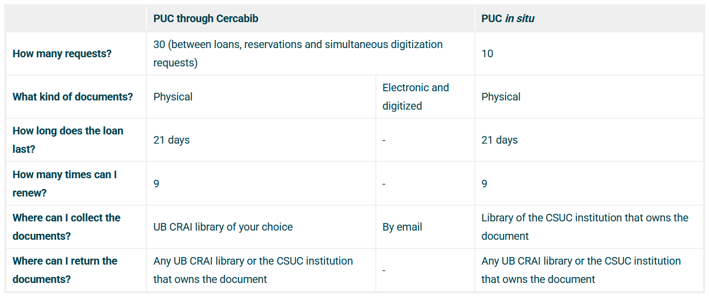
Conditions for PUC loans
Notes:
El CRAI és el Centre de Recursos per a l’Aprenentatge i la Investigació, una part del qual són totes la Biblioteques de la UB
Hi podeu accedir des de:
El web de la UB → Informació sobre → Biblioteca
El web de la Facultat → Serveis → Biblioteca
MonUB → Beques i Serveis → Biblioteca
Directe des de Bookmarks/Favorits http://www.bib.ub.es/bub/bub.htm

Slide 26
Interlibrary loan https://crai.ub.edu/en/services-and-resources/interlibrary-loan
The objective of the interlibrary loan service is to locate and obtain the original or a copy of any kind of document that cannot be found at the CRAI of the UB and that is not available through the Consortium Loans PUC.
This service also functions as a loan center of the CRAI UB collections for other institutions. This is a paid service.

Slide 27
Accessing UB electronic resources
https://crai.ub.edu/en/services-and-resources/electronic-resources-access
The electronic information resources contracted by the CRAI can be accessed through the E-Resources access Service (SIRE), from a computer/device inside or outside the University of Barcelona network.
To be able to use it, you must have your UB identifier and the password you use to access the UB intranet (PDI, PTGAS or SocUB).

Slide 28
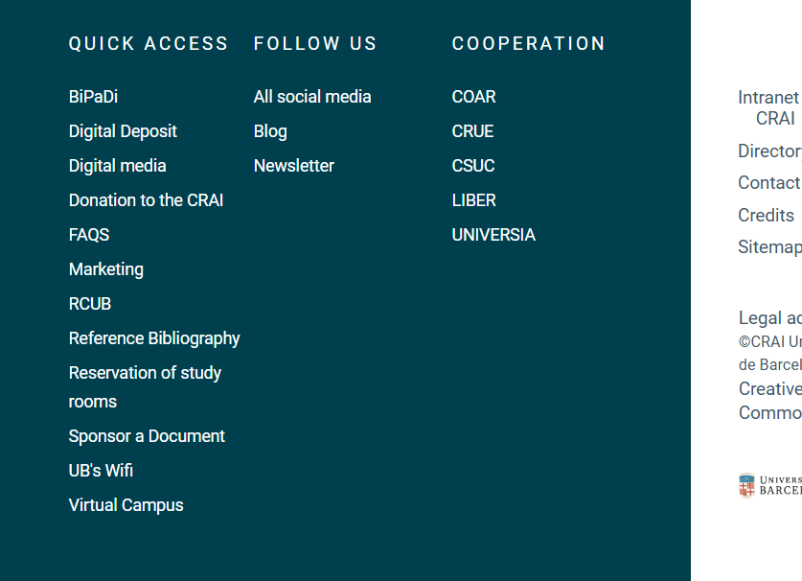
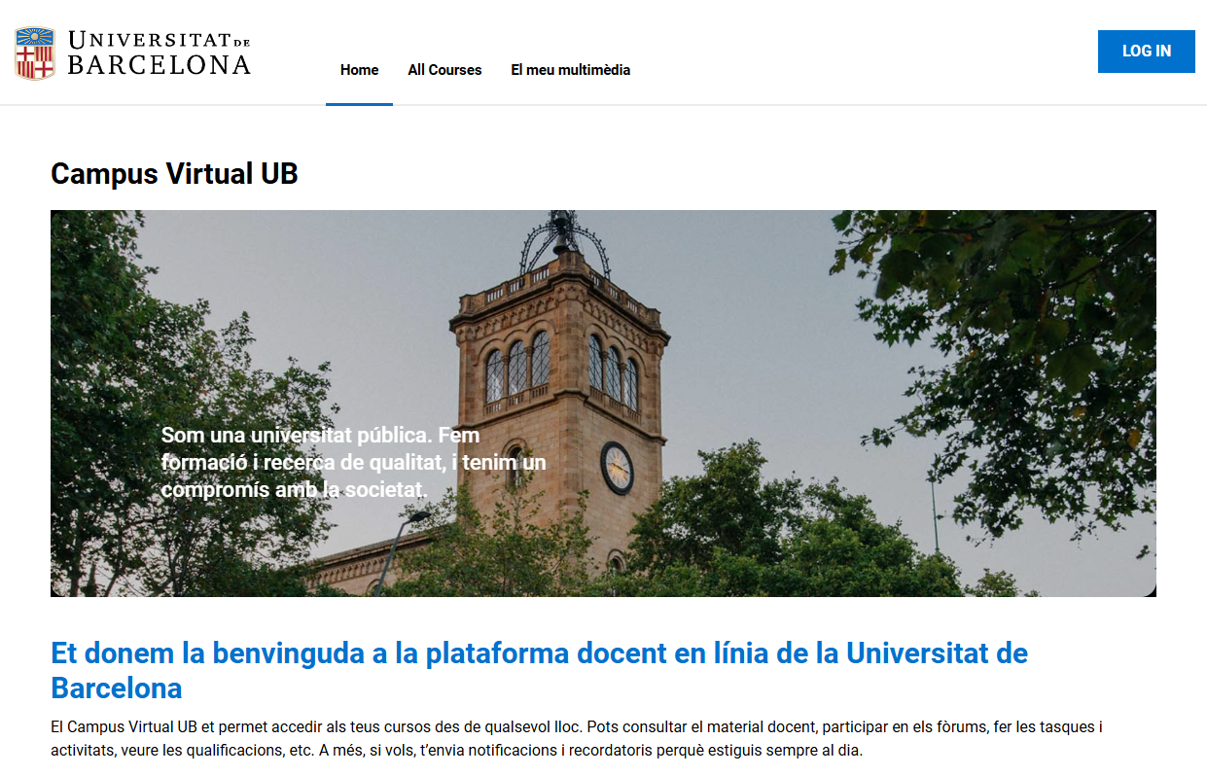
Virtual Campus
https://campusvirtual.ub.edu
It is a work tool with which you access your subjects and visualise the reference bibliography and the teaching materials and activities.
Virtual Campus
Identifier and password

Slide 29
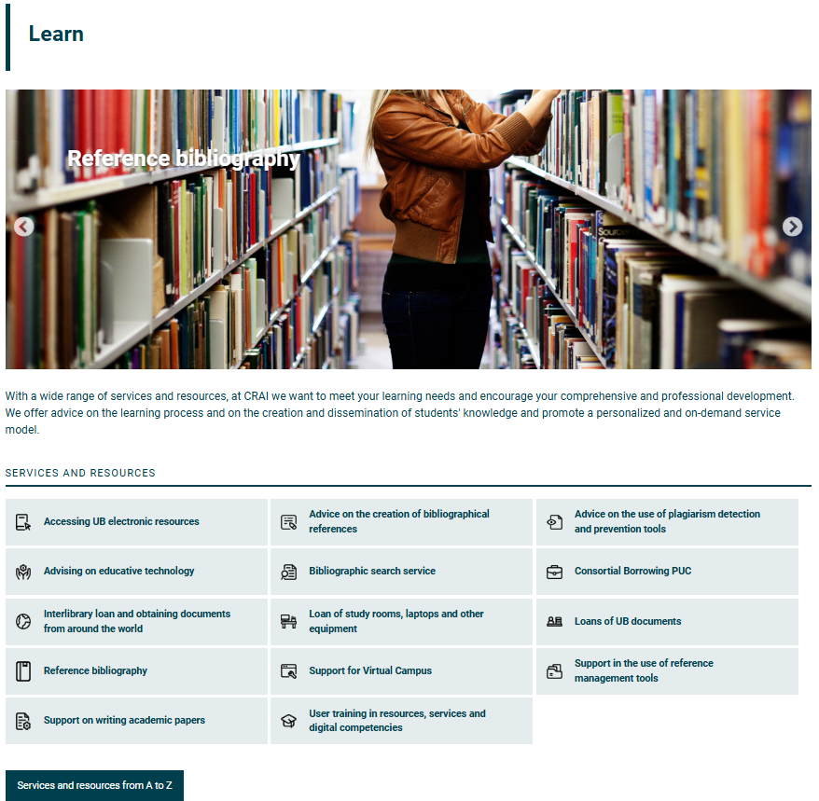
Learn | Services and Resources
https://crai.ub.edu/en/learn

Slide 30
Codes and passwords
https://crai.ub.edu/en/services-and-resources/electronic-resources-access/usernanmes-passwords-authentication
Identifier | Services | Access
UB | Virtual Campus Access to electronic resources Interlibrary loan Digital copies | Students: Alphanumeric code password PTGAS/PDI: DNI password Alumni UB Premium: Alumni Code Alumni password
Local | Virtual Campus Access to electronic resources Digital copies Computers Loan Interlibrary loan Consortial borrowing PUC Cercabib «My account» UB Wifi Zone | Students: Left part of the UB email +.alumnes Example: Email: jarc7@alumnes.ub.edu Identifier: jarc7.alumnes and the UB intranet password PTGAS/PDI: Left part of the UB email Example: joan.garcia@ub.edu Identifier: joan.garcia and the UB intranet password Alumni UB Premium: Left part of the UB email +.a Example: Email: imas@alumni.ub.edu Identifier: imas.a and the UB intranet password
CRAI | Loan Cercabib «My account» | For: Clínic, Bellvitge and Sant Joan de Déu staff; teaching staff at affiliated centres with venia docendi; teaching staff at non-UB centres with agreements, from the UB Group and IDP/ICE; researchers at research institutes or the UB Group; researchers and research fellows at GEO3BCN-CSIC; students at centres with agreements or the UB Group; students from EIM, Hispanic Studies, Language Services and IDP (IDP/ICE); UB Doctoral Faculty; primary and secondary school teachers; COBDC members; members of charitable foundations teaching at the UB; authorised by the UB PDI or CRAI.
Based on the UB email | Eduroam Wifi | PTGAS/PDI/External staff: Email address @ub.edu Students: local identifier + @ub.edu Ex: jhergar6@alumnes.ub.edu jhergar6.alumneSAUb.edu

Slide 31

User support service (SAU) https://crai.ub.edu/en/services-and-resources/sau
It is a virtual information service active the 24 hours of the day and the 7 days of the week, and assisted by specialized librarians.
Its purpose is to resolve any enquiry about CRAI libraries and their services and resources.
Through SAU you can also send complaints, suggestions and appreciations.
Notes:
Què és?
A què respon?

Slide 32
User training https://crai.ub.edu/en/services-and-resources/training
We offer you advanced training courses so you can improve your search knowledge and abilities, like courses about specialized databases or about the reference manager Mendeley.
At the CRAI users Training Service page you can consult the programmed training courses, and you can request a customized course that responds to your needs.
On the same page you will also find material for autonomous learning of the different resources and services.
Notes:
Conèixer la Biblioteca de ........ (2005-2006)
32
Què és?
A què respon?

Slide 33
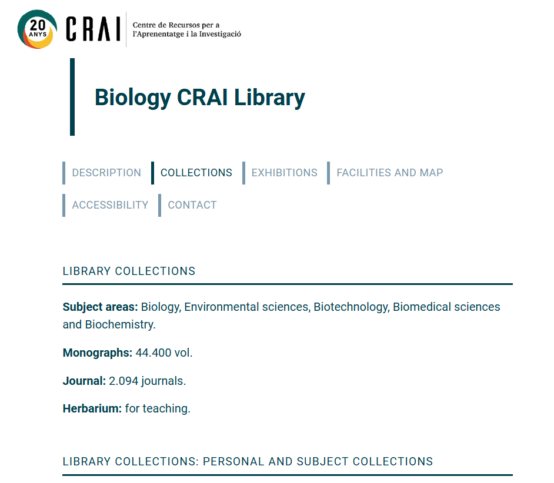
Collections https://crai.ub.edu/en/biblioteques-i-horaris
Every CRAI library has this section on their web. It’s a selection of information resources related to the teaching and research thematic areas of the University. You will find databases, books and electronic journals, manuals, etc.
Notes:
Conèixer la Biblioteca de ........ (2005-2006)
33
Què és?
A què respon?

Slide 34
Wi-Fi and access to the Faculty computers
https://crai.ub.edu/en/services-and-resources/connecting-wifi
The University Wi-Fi service offers an Internet connection without having to dispose of a fixed connection to the network. To use it, you have to configure your laptop and identify yourselves with your local identifier.
The University of Barcelona takes part in the Eduroam project, which aims to promote a unique mobility space that allows users to dispose of a virtual work environment with Internet connection upon arriving at another organization. You can consult the Eduroam configuration guide.
Collective | Termination | Email | Local identifier
PTGAS / PDI |  | joan.pere.garcia@ub.edu cherrera@ub.edu | joan.pere.garcia cherrera
Students | .alumnes | jherg07@alumnes.ub.edu | jherg07.alumnes
Alumni UB | .a | pperez@alumni.ub.edu | pperez.a
Notes:
Què és?
A què respon?

Slide 35



Follow us on our social media! https://crai.ub.edu/coneix-el-crai/difusio-marqueting/blogs-i-xarxes-socials
Bluesky
@craiubbiologia.bsky.social
Instagram
https://www.instagram.com/craibiologiaub/
Pinterest
https://www.pinterest.com/craibiologia/
And on our virtual exhibitions:
https://crai.ub.edu/en/coneix-el-crai/difusio-marqueting/exposicions-virtuals
Notes:
Diapositiva optativa

Slide 36
And if you still have questions...
Ask the CRAI library
The library staff will resolve your doubts.
Access the CRAI initial web
  In the «Frequently asked questions» section you will find the most usual enquiries already answered.
  Contact the SAU
  Virtual information service that fields enquiries about
  CRAI libraries and their services and resources.
Or call us!
934 02 15 67

Slide 37
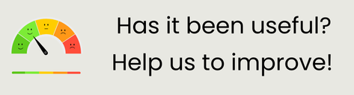

Thank you!
© CRAI Universitat de Barcelona, curs 2025-2026

