Slide 1


Vocabulary - Sport

Slide 2
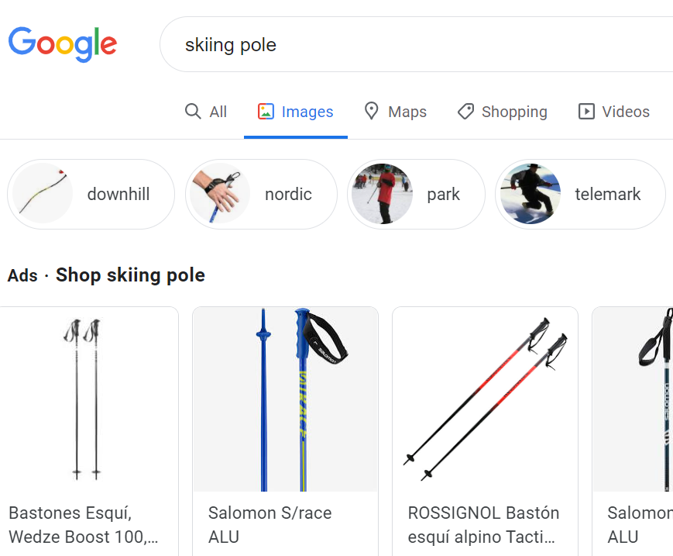
Vocabulary learning strategies
Word associations
Semantic fields
Google images
, etc.

Slide 3
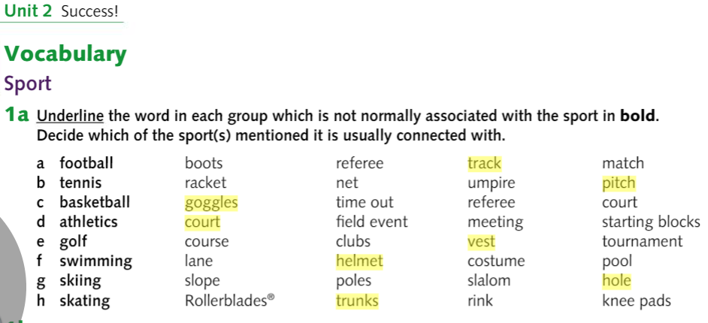

Slide 4
basketball
athletics
football
swimming

Slide 5
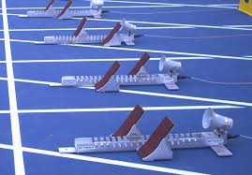
basketball
high jump, throwing…
≠ track event (race)

Slide 6
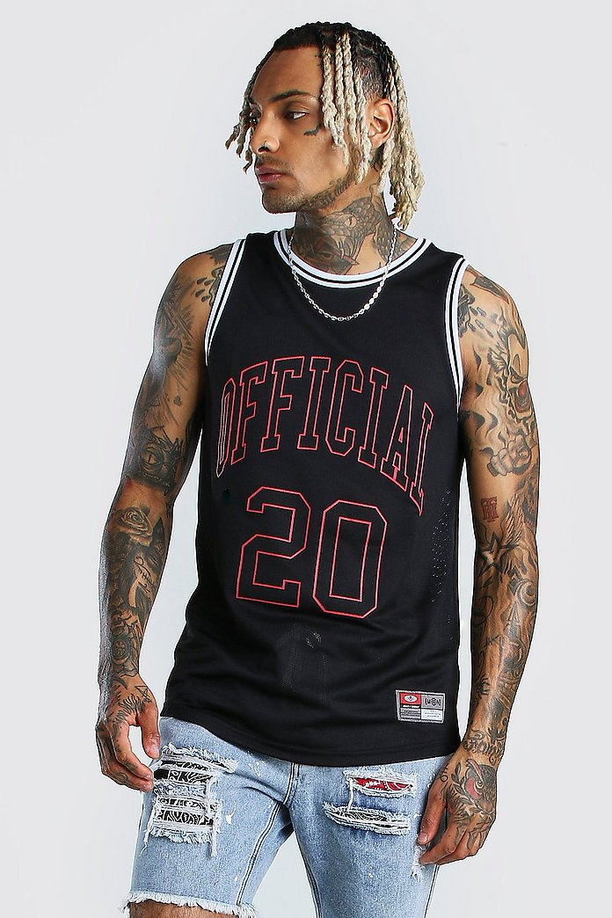
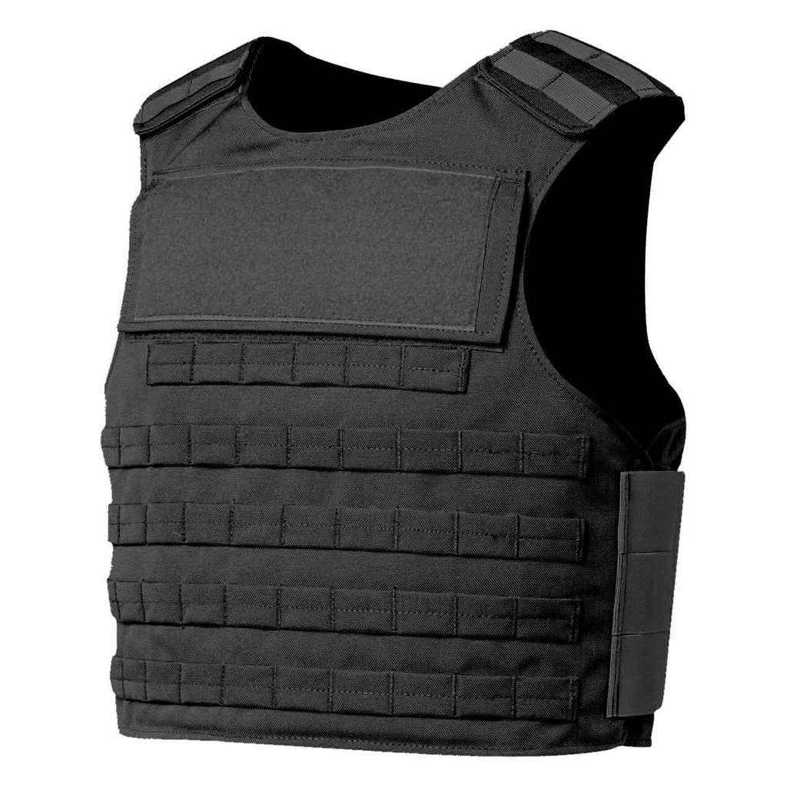
waistcoat – armilla/ chaleco (BrE)
UK
US

Slide 7
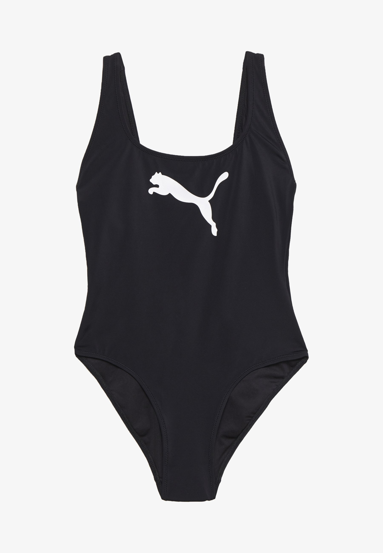
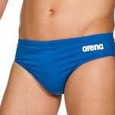
Swimming cap
Skiing, skating (extreme sports)
Also swimsuit (BrE)

Slide 8
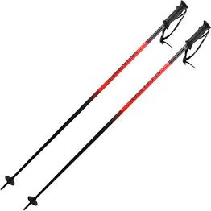
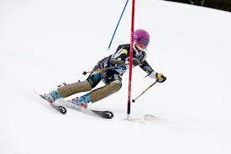

Slide 9
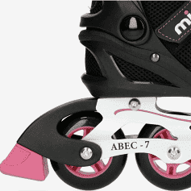
Roller skate

