Slide 1
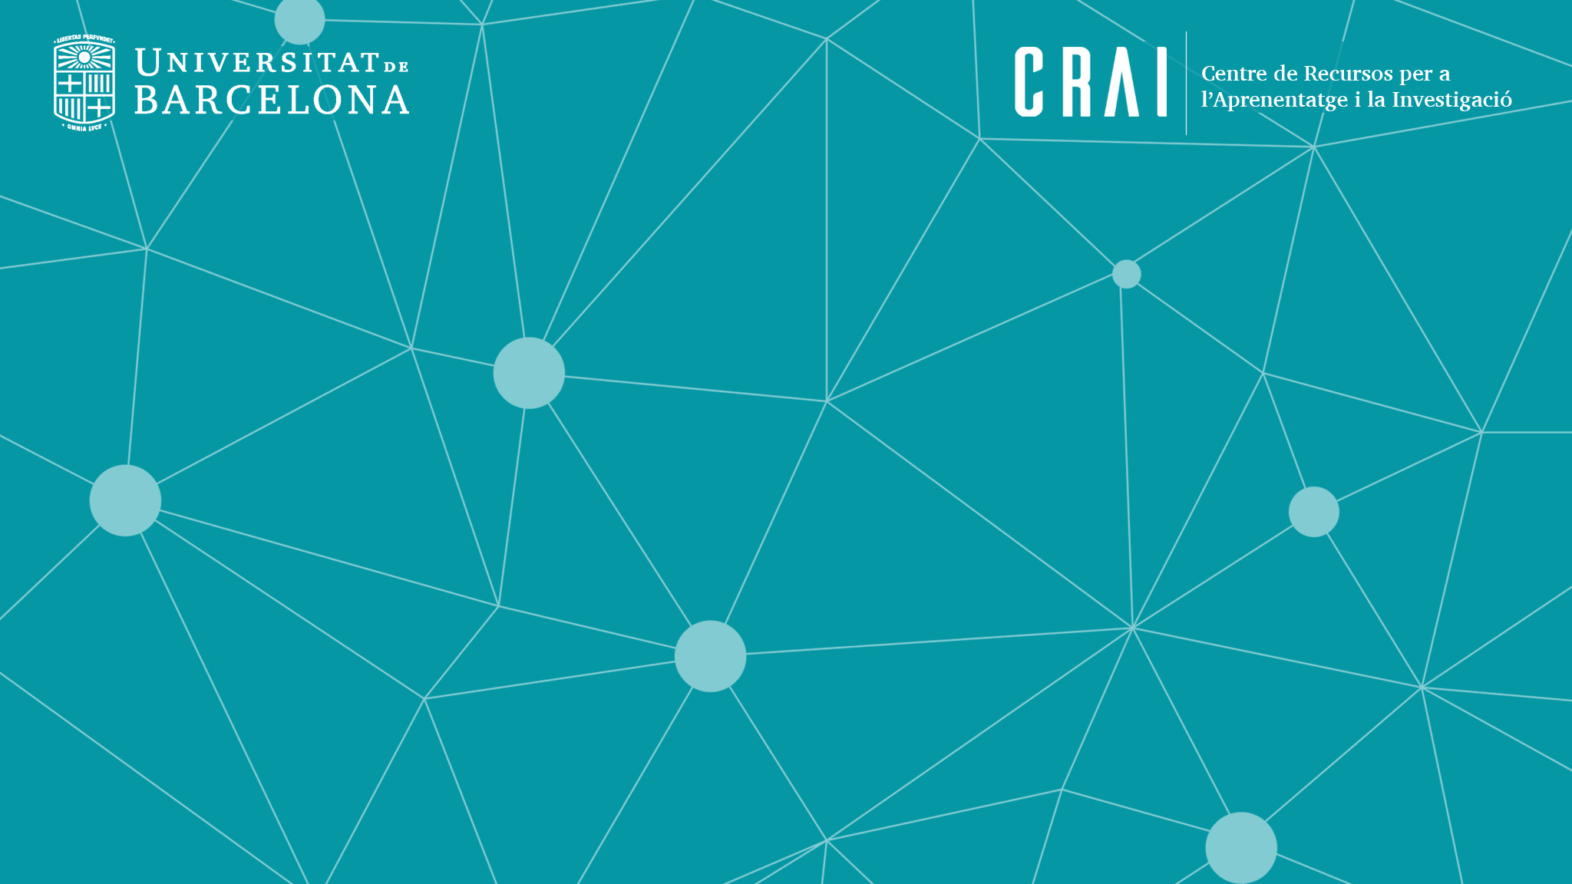
CRAI UB
Resources and Services

Slide 2
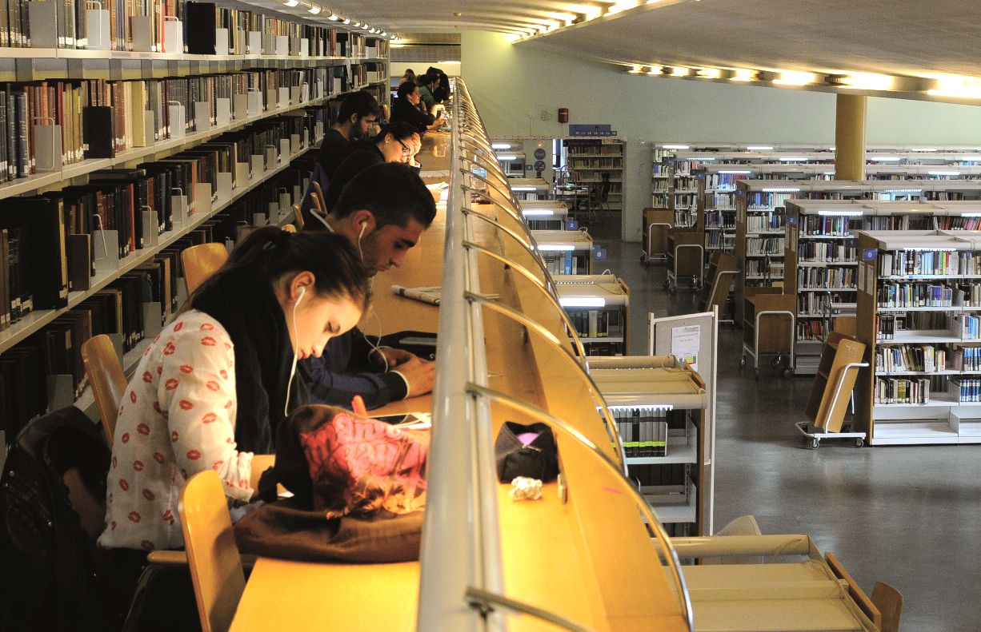
Contents
The University of Barcelona CRAI
  Learning and Research Resources Centre
  Libraries
  Website
Information Resources
  Cercabib
  Databases
  Repositories
Services
  Access to information resources
  Loans and document delivery service
  Support for teaching and research staff
  User training
  Communication and social networks

Slide 3
The University of Barcelona CRAI

Slide 4
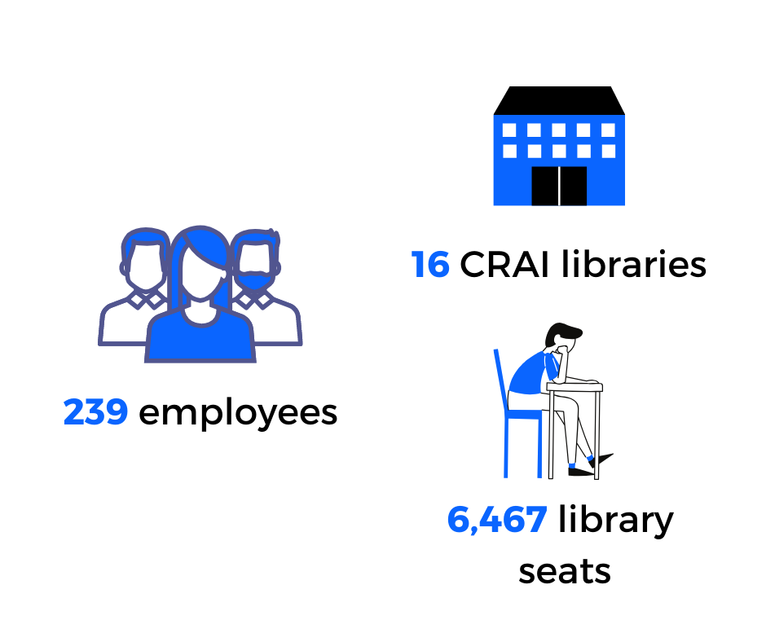
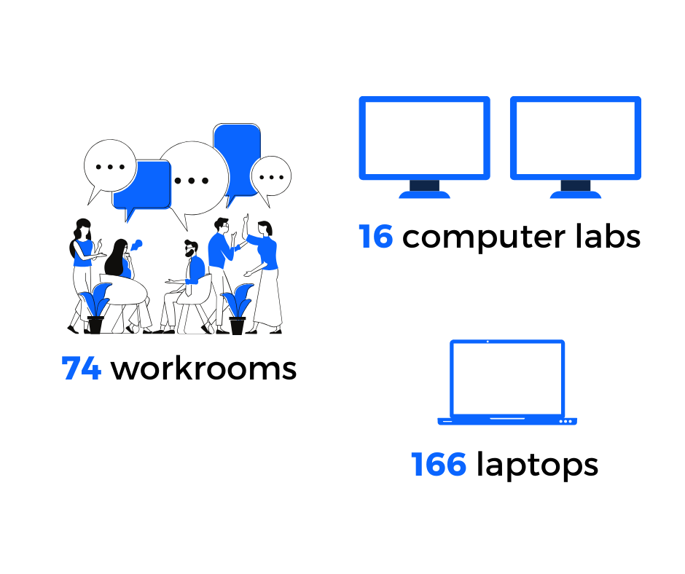

CRAI
Learning and Research Resources Centre

Slide 5


What do we offer?

Slide 6
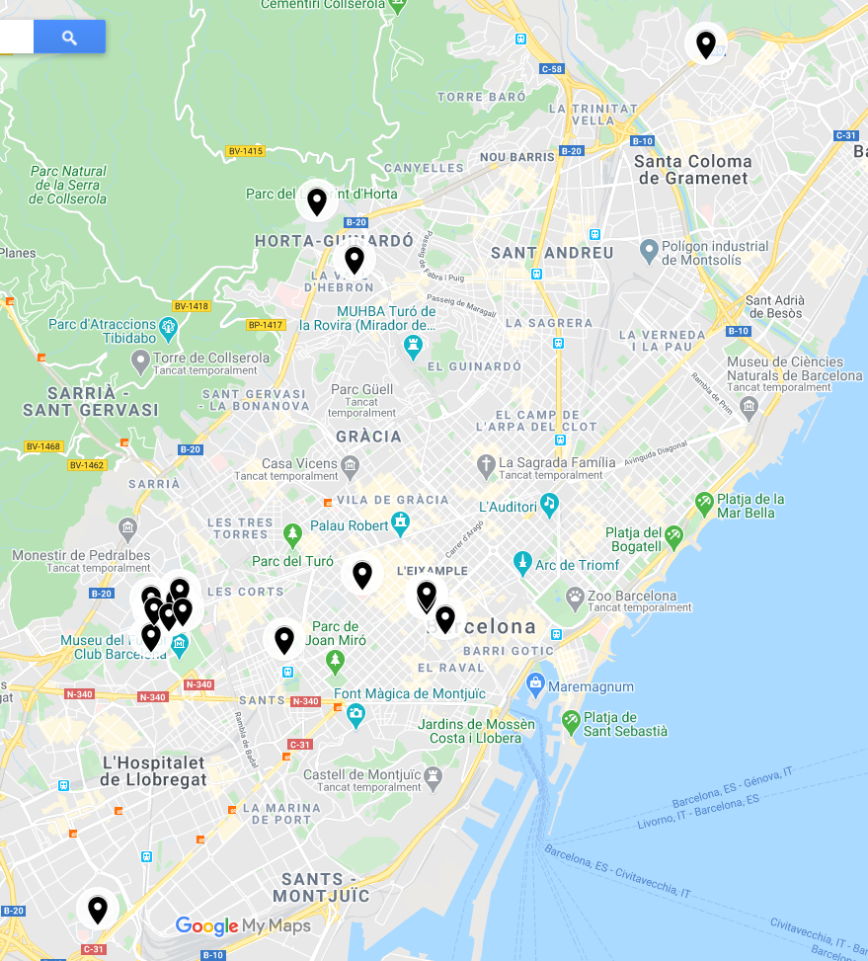
Libraries
Torribera
Mundet
Pavelló de la República
Biology
Earth Sciences
Economics and Business
Fine Arts
Law
Physics and Chemistry
Pharmacy and Food Science
Clínic
Maths | Philology | Rare Book and Manuscritp
Philosophy, Geography
and History
Information and
Audiovisual Media
Bellvitge

Slide 7
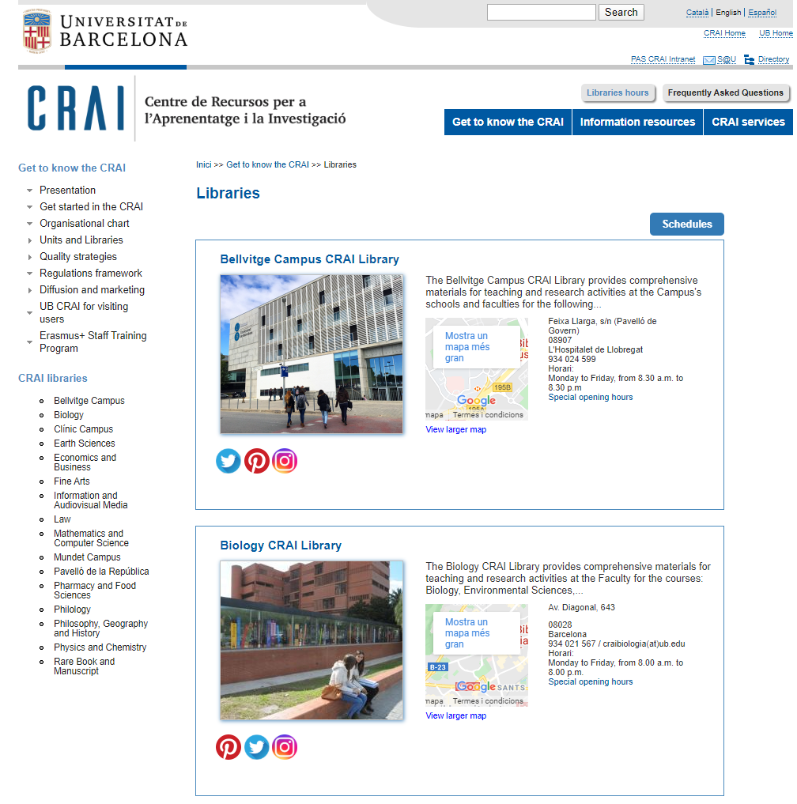
Libraries

Slide 8
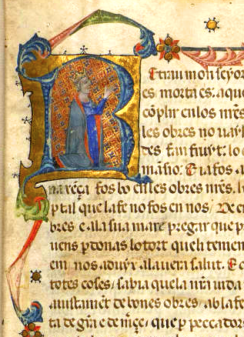

Rare Book and Manuscript CRAI Library
Heritage libraries
The Pavelló de la República CRAI Library
2,150 1,240 120,000 8,158 890 | manuscripts incunabula printed works engravings parchments
One of the leading archive libraries in the world about the Second Spanish Republic, the Spanish Civil War and exile, the Franco regime and Spain's transition to democracy.

Slide 9






Partners
Consortium of University Services of Catalonia (CSUC)
Network of Spanish University Libraries (REBIUN)
and other partner institutions.
The CRAI is member of

Slide 10
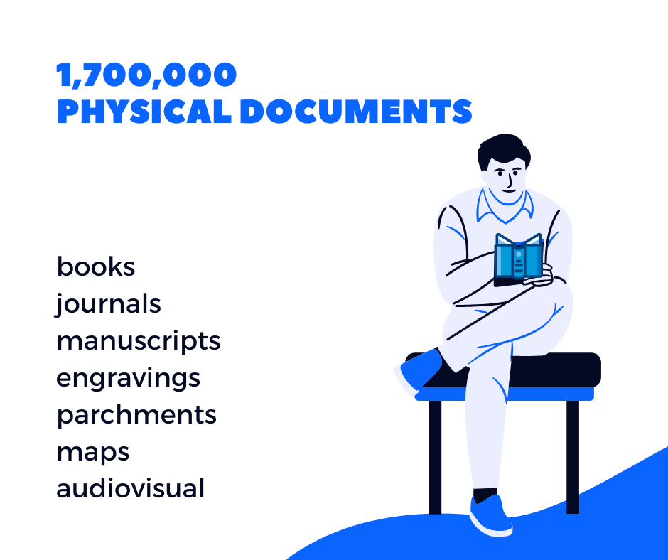
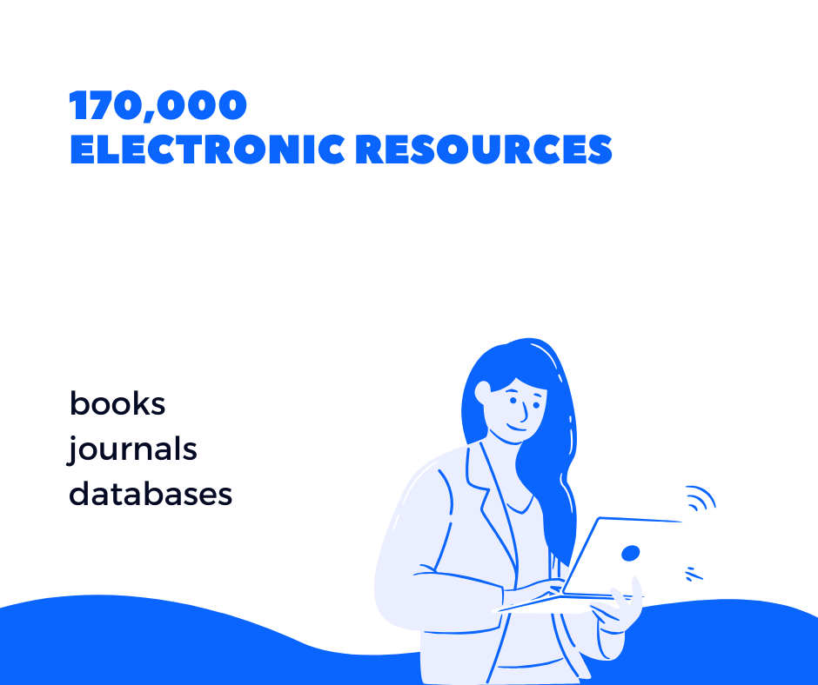
Information resources
Printed books, journals and other material, and a growing number of electronic resources

Slide 11



UB’s Digital Repositories
Universitat de Barcelona Digital Repository (DDUB)
Contains open-access digital versions of publications related to the teaching, research and institutional activities of the UB's community.
UB Scientific Journals (RCUB)
The UB journal portal offers access to scientific journals published or co-published by the UB.
The Digital Heritage Library (BiPaDi)
A portal offering digitized copies of the University of Barcelona’s heritage collections of books and documents, including manuscripts, incunabula and printed books from the sixteenth to the nineteenth century. It also contains other unique bibliographic collections of documents and archival resources.

Slide 12
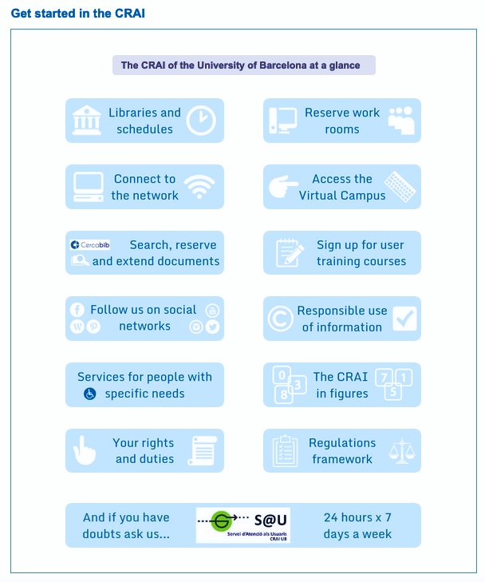
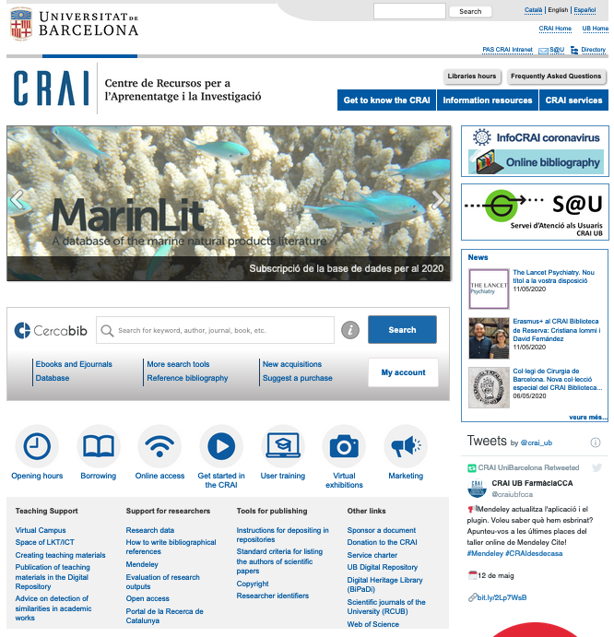
Getting started

Slide 13
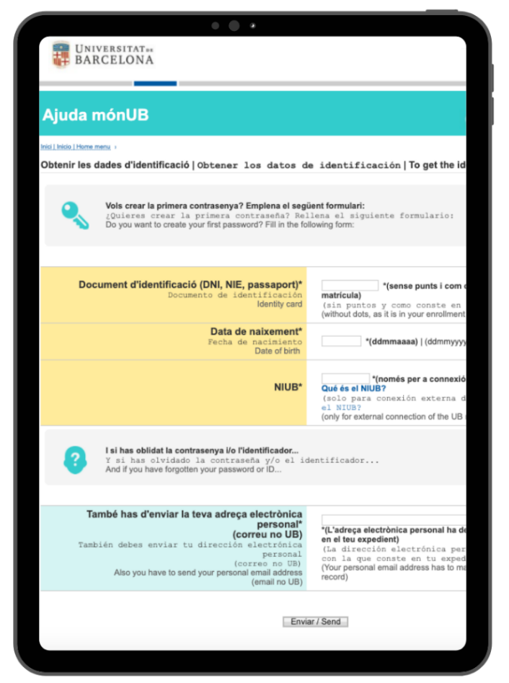
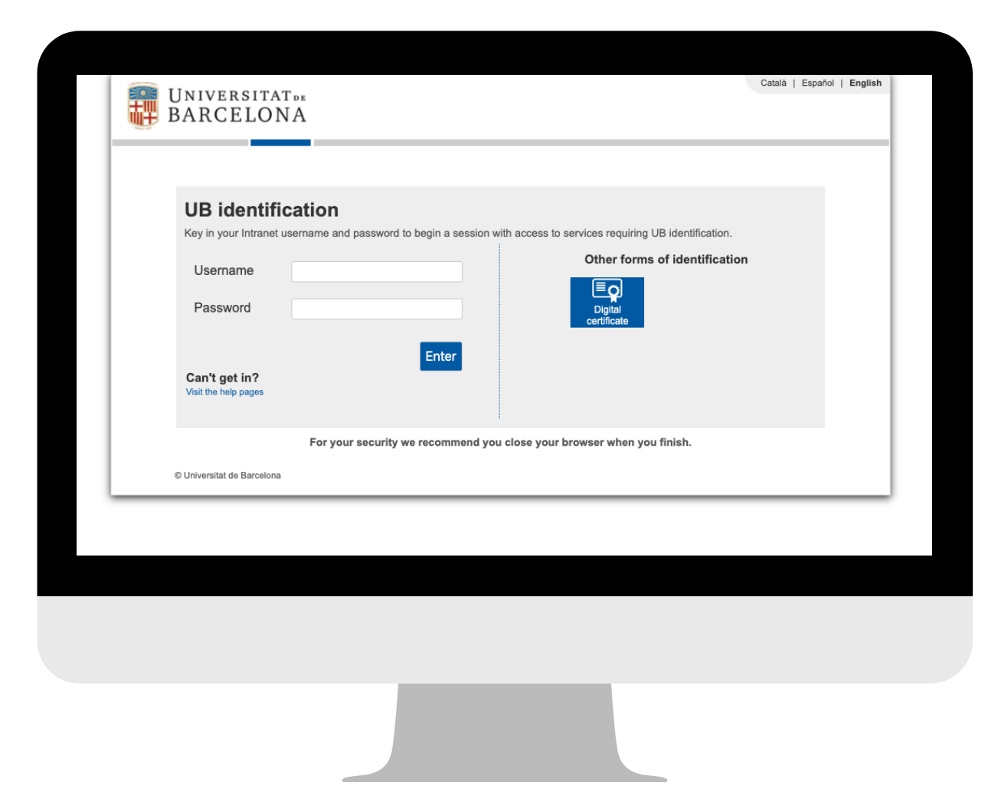
Authentication
One password: the one you created at Món UB (UB students’ intranet).
Three different usernames:
UB | local | eduroam

Slide 14
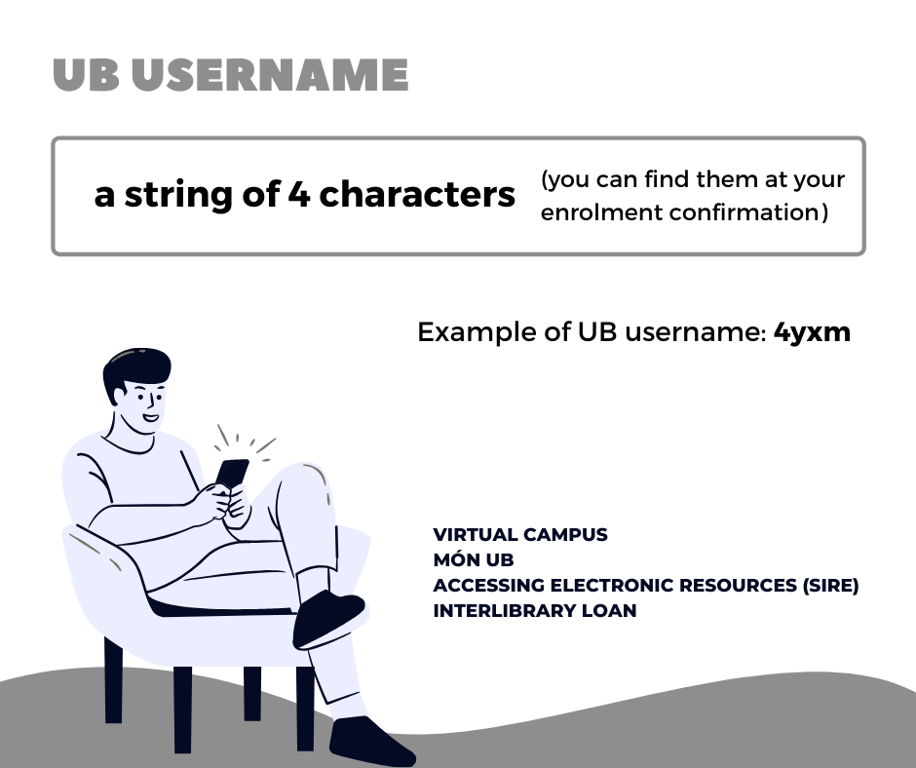
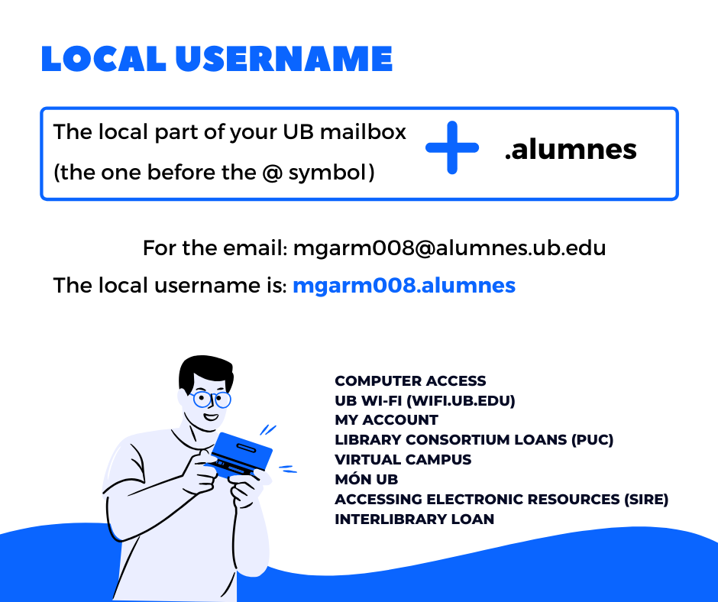
Log in

Slide 15
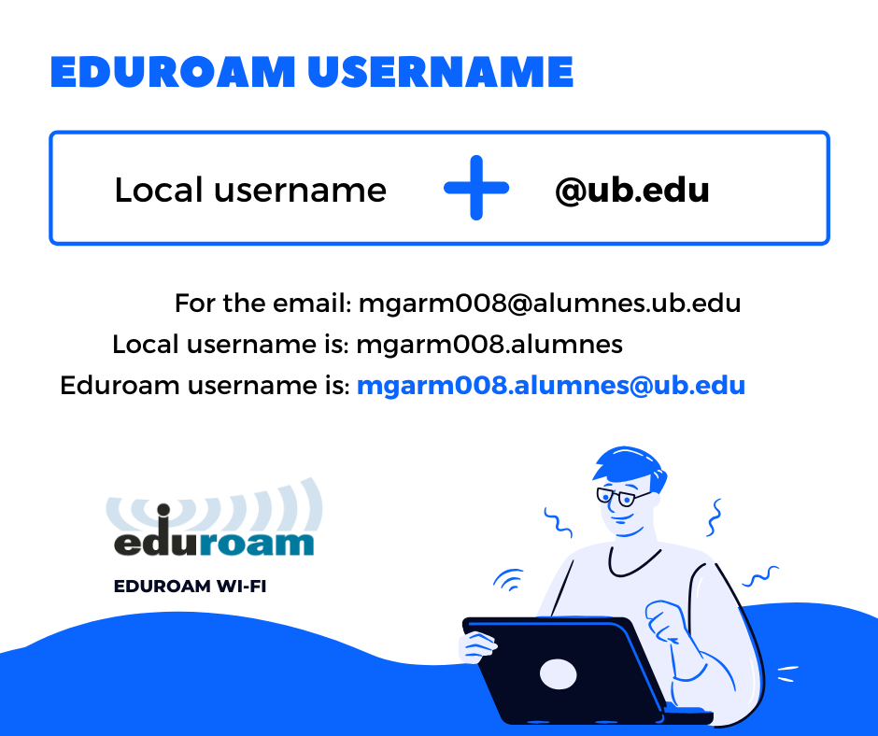
Eduroam
Whether you’re moving across campus or studying or working at another research and education institution, eduroam gives you seamless internet connectivity.
Wherever you see ‘eduroam’ appear in your list of Wi-Fi networks, you can get online.
Download the appropriate Eduroam installer for your device and operating system.

Slide 16
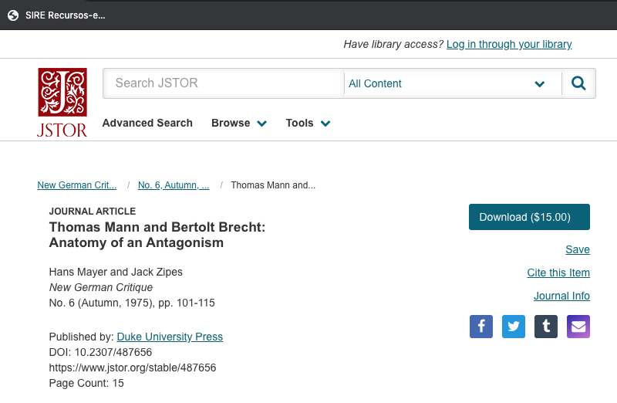
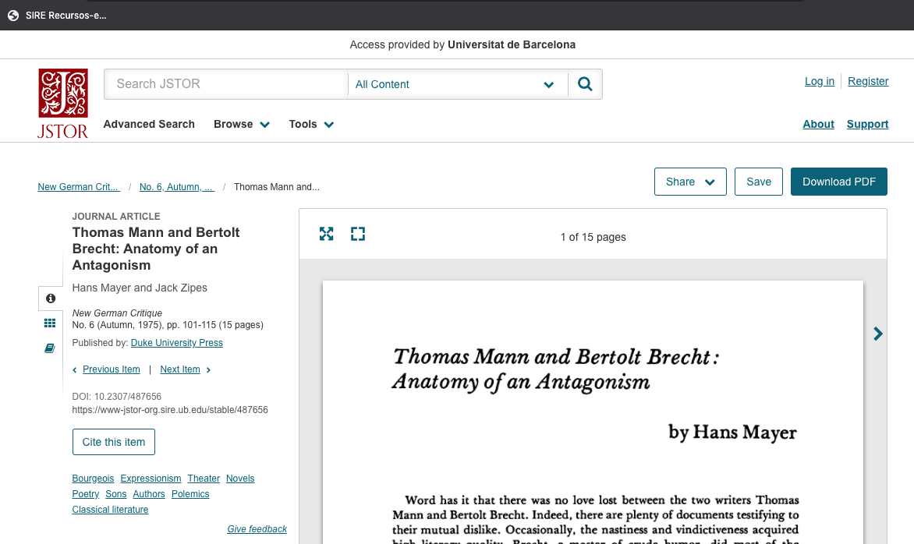
SIRE: E-Resources Access Service
Before SIRE
After SIRE

Slide 17
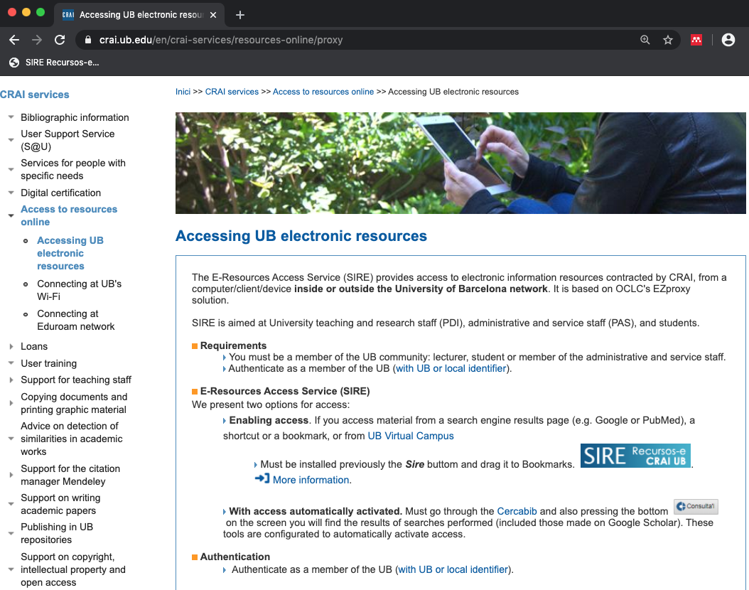
SIRE: E-Resources Access Service
The E-Resources Access Service (SIRE) facilitates access to the electronic information resources subscribed by the CRAI, either from the university computers or from home.
How do I install the SIRE button ?
Drag the button to the bookmarks bar.
To do so, you need to have the bookmarks toolbar visible on your browser.
Chrome
Firefox

Slide 18
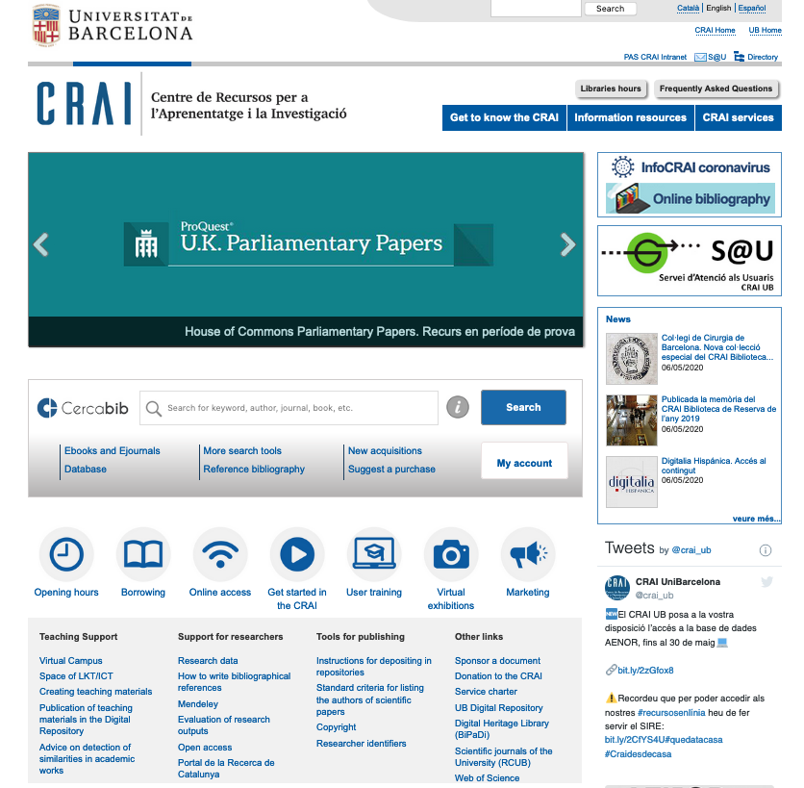
Website
Website
1
2
crai.ub.edu
3
1. Opening hours
2. Services and resources
3. User Support Service (S@U)
4. Cercabib
5. My account
6. Direct links
7. Support for researchers
8. Tools for publishing
4
5
6
7
8

Slide 19
Information resources

Slide 20
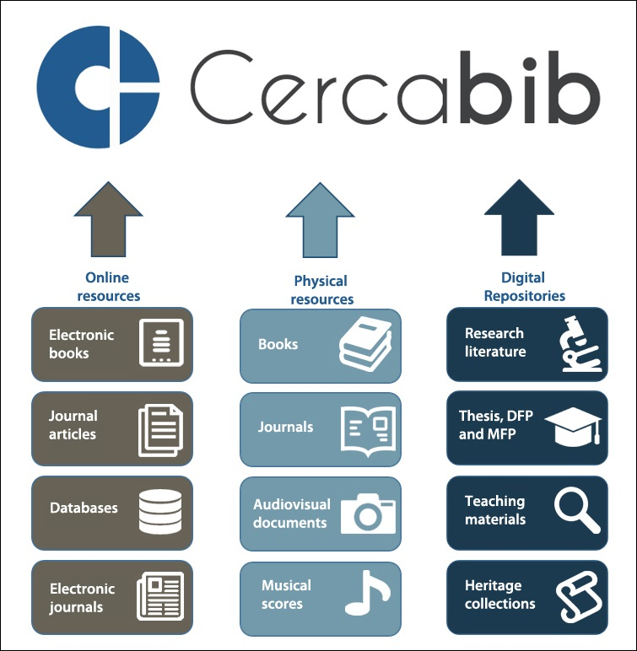
Cercabib
Cercabib is the searching tool of the CRAI. Is an all-in-one catalogue to search the entire CRAI collection, regardless of format, type or location.
Retrieved documents include items in any of the CRAI’s libraries and also items from online subscriptions or open access resources.

Slide 21
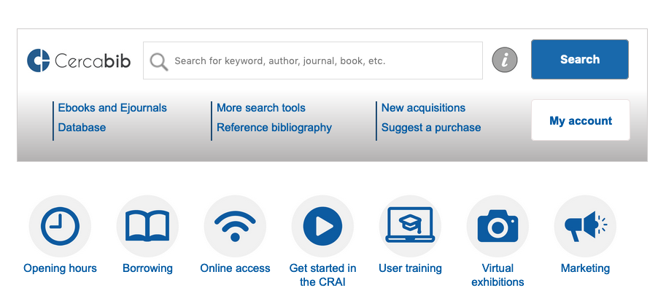
Cercabib
Start your search by typing a keyword or phrase into the search box

Slide 22
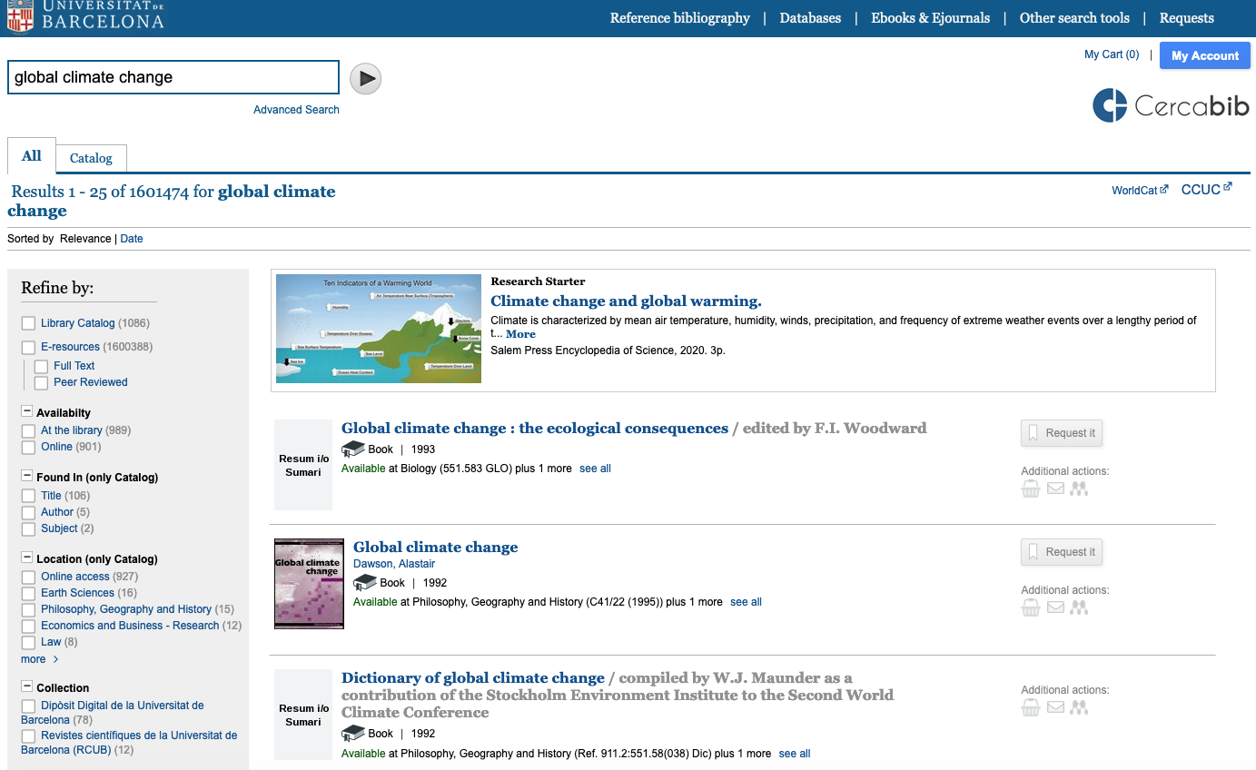
Basic search
Results are sorted by relevance but can be sorted by date
Refine search results here

Slide 23
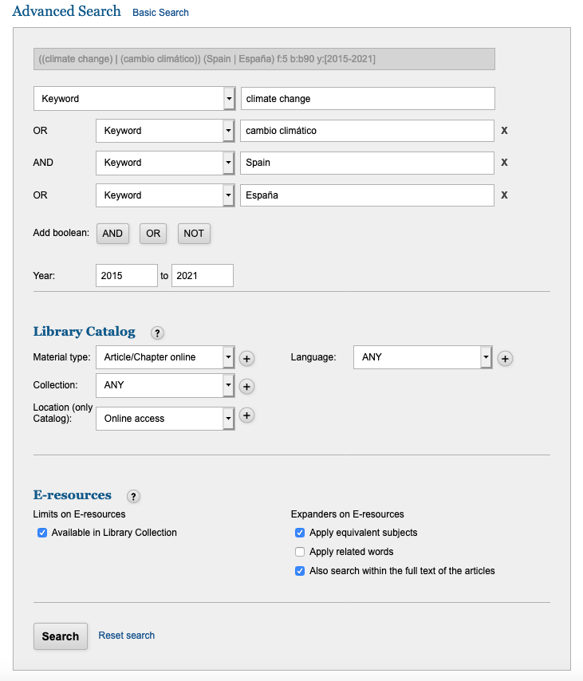
Advanced search
Select search fields and use Boolean operators
(AND, OR and NOT)
Apply filters before doing a search to further refine your query and limit the search results.

Slide 24
Library holdings

Slide 25
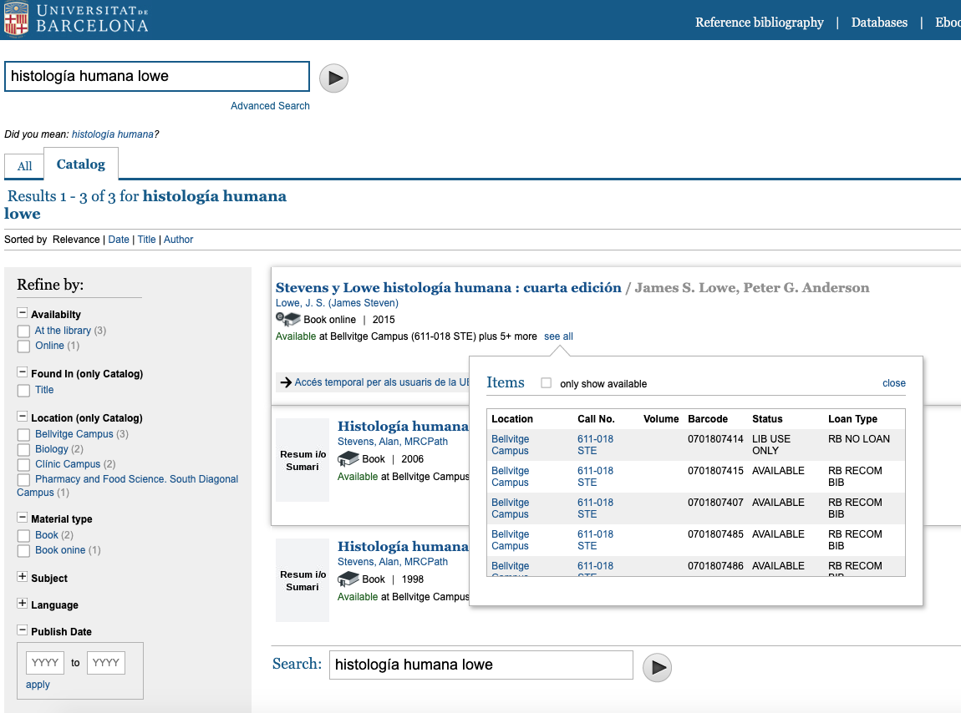
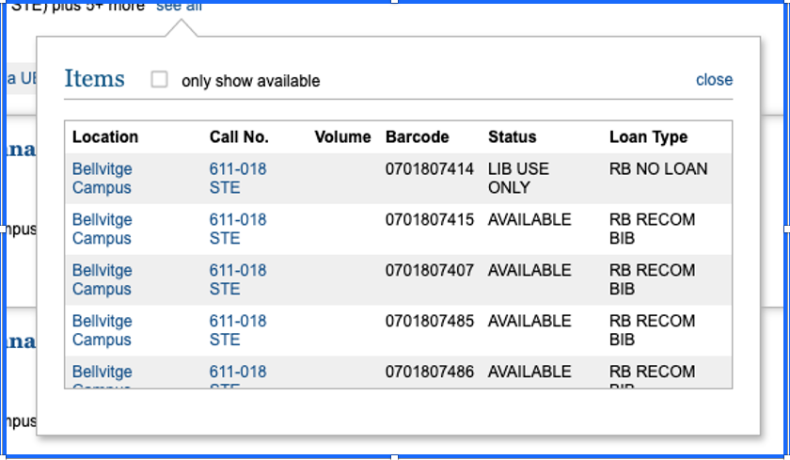
Library holdings

Slide 26
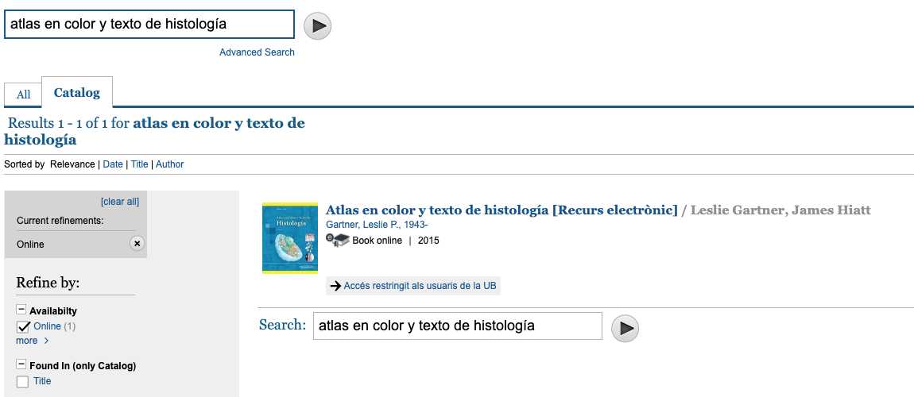
Electronic resources
When you click on the link, SIRE gets activated and you will be asked to log in.

Slide 27
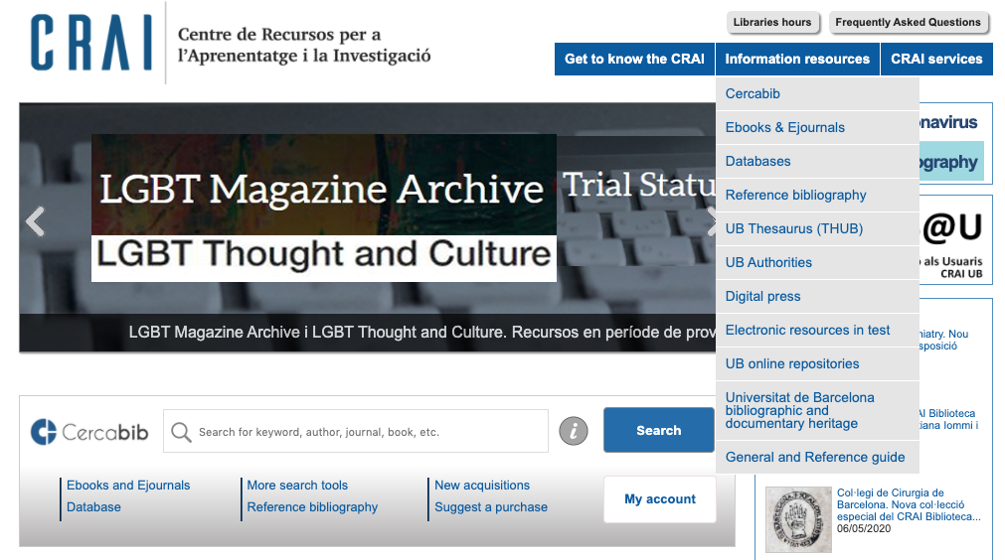
Databases

Slide 28
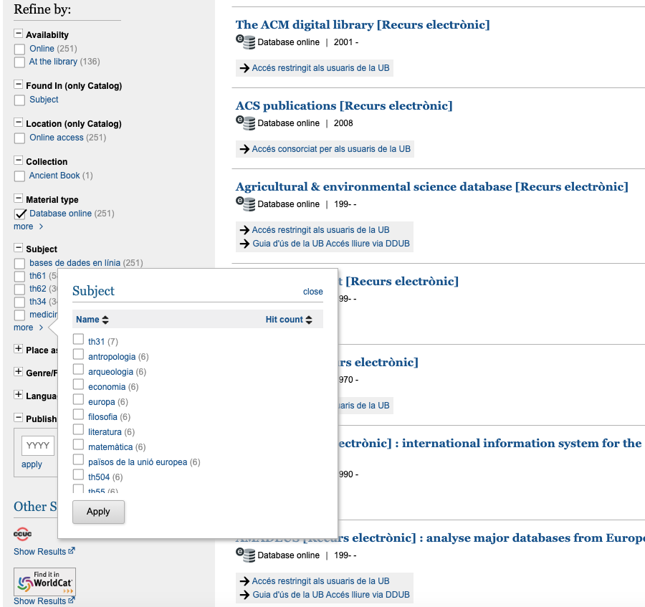
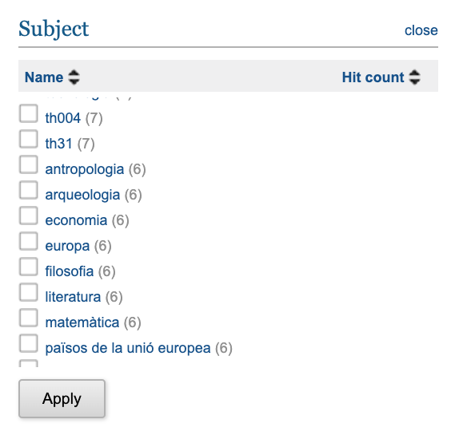
Databases

Slide 29
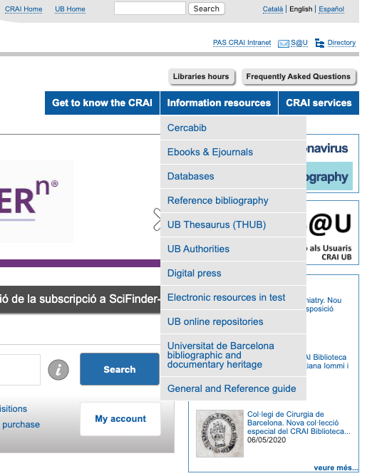
Other resources
UB Thesaurus
UB Authorities
Digital press
Trial electronic resources

Slide 30
Services

Slide 31
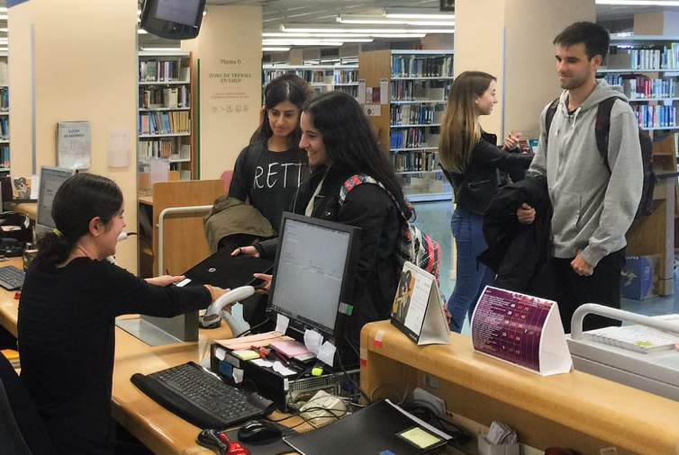
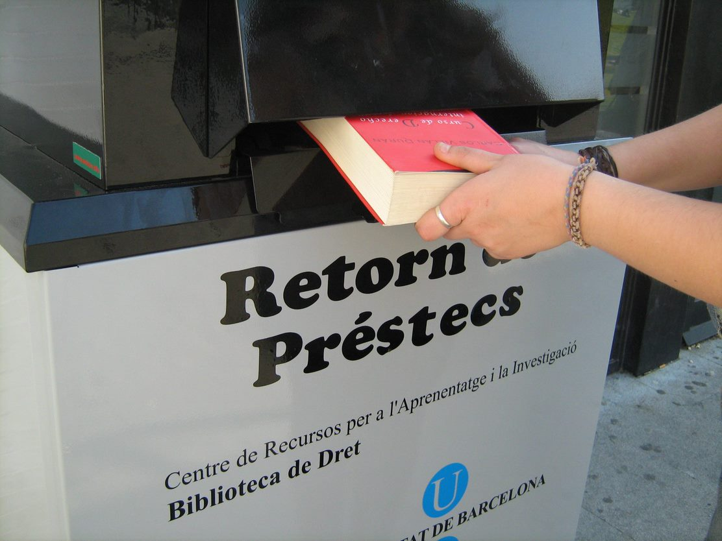
Borrowing documents
You can loan up to
20 documents
30 days
When you place a request for a book from a CRAI library outside your campus, you will receive it at your library of choice in between 2 to 3 days.
Recommended bibliography: 10 days
You can borrow documents from any of the CRAI libraries with your UB card or enrolment document.

Slide 32
Renew or request documents
Renewals
My Account
You can renew your loans as many times as you need, as long as the item has not been requested by another user.
You can renew & request documents at the loan desk or via My account on Cercabib.
Requests
You can place a request on a maximum of 8 items.
Borrowing History
Overdue items
To keep a record of your borrowing history, set it up from My account -> reading history.
If you are late returning the books, your loaning privileges will be suspended between one to several days, depending of the delay.

Slide 33










Library consortium loan (PUC)
PUC is a free service through which users of the universities that are members of the Catalan Consortium of University Services (CSUC) can request and borrow items from another member library.
How to request an item:
In person, at the library that holds the item: PUC in situ.
Online, using the PUC web portal.
You can loan up to
10 documents
21 days
you can renew the documents up to 6 times

Slide 34

Interlibrary loan and digital copies
The digital copies service provides a free digital copy of articles from journals subscribed to the UB's CRAI that are not held at the CRAI Library of your faculty and cannot be accessed online.
Digital copy request form
The interlibrary loan service provides materials not hosted by the CRAI libraries and which are not available through the PUC service from other Catalan universities.
This service has fees.

Slide 35
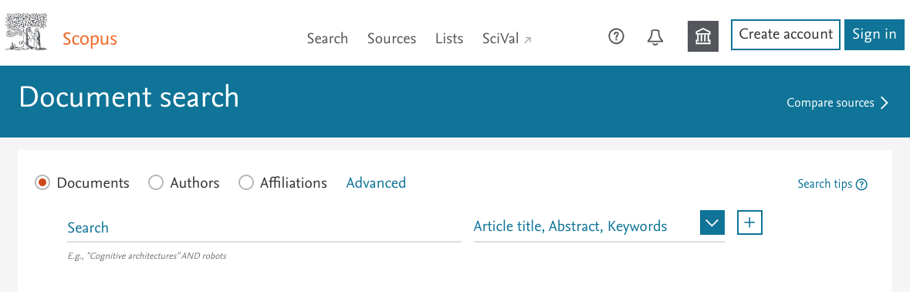
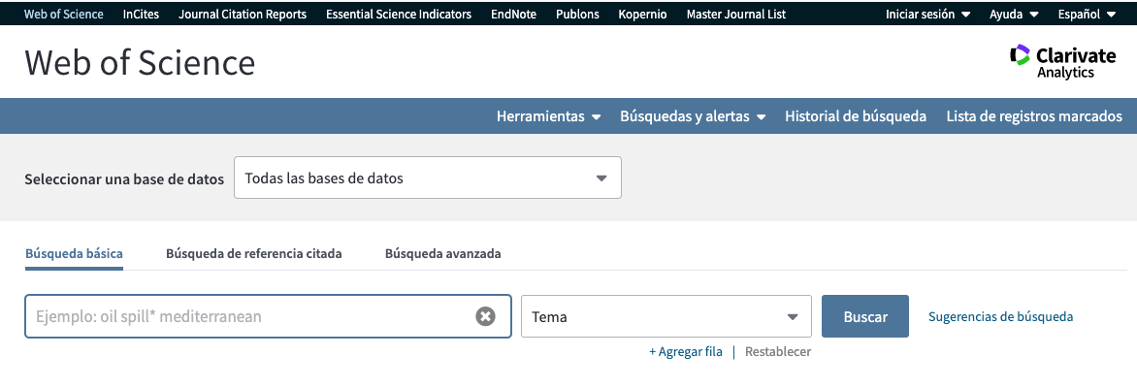
Teaching and research support
Bibliographic information
This service provides support on bibliographic information, such as literature searches on a particular topic or citation information searches on databases, like the Web of Science, Scopus or other. We respond to requests within five working days.

Slide 36
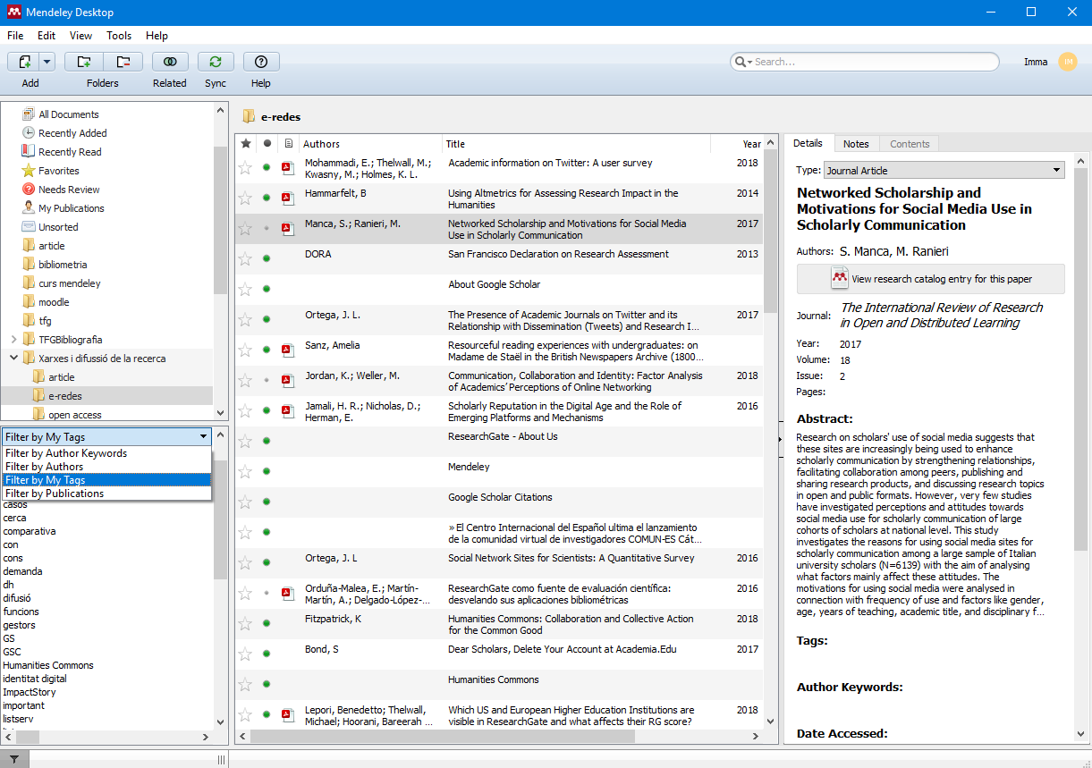





Mendeley
Mendeley is a reference manager and a citation generator.
It helps you to organize your research citations and work, collaborate with other users online, and find information published in your subject area.

Slide 37




Publishing in UB Repositories
The CRAI offers support and advice on how to publish and disseminate scientific and academic output in the UB and other institutional repositories.

Slide 38

CRAI Office for Knowledge Dissemination
Support on copyright, intellectual property and open access
The CRAI Office for Knowledge Dissemination offers UB members advice and information on all aspects of the scientific knowledge generated at the University, and on the use of materials created by others. It focuses particularly on free dissemination options, as well as promoting and providing information on open access initiatives.

Slide 39
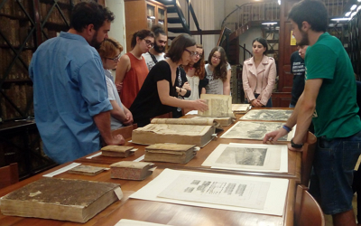
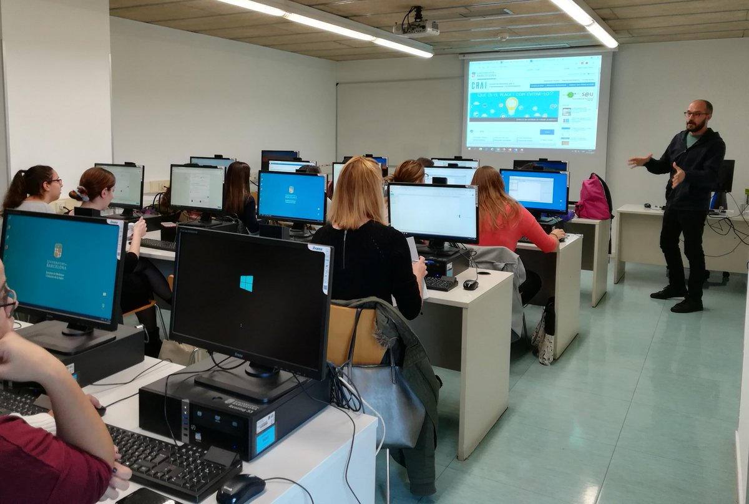
User training
We offer a variety of training sessions about the CRAI, its libraries and the different services and information resources available to our users and other information skills training options.
Scheduled courses and workshops
Tailored courses and workshops
Practical classes and guided visits

Slide 40
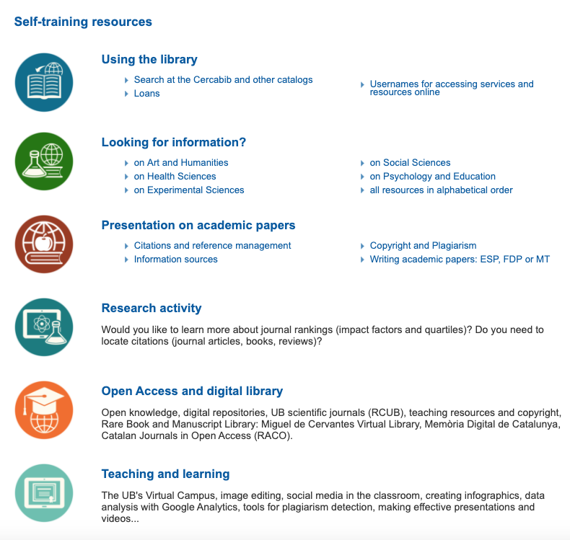
Self-training resources

Slide 41
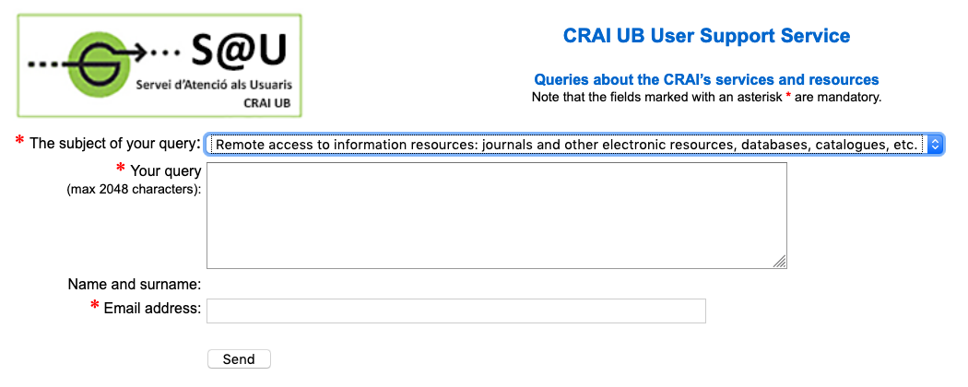

User support service (S@U)
The S@U is an online question and answer information service about our services and resources, where you can also place a complaint or leave a comment. Remember to check the FAQs first to see if your question has already been answered.

Slide 42






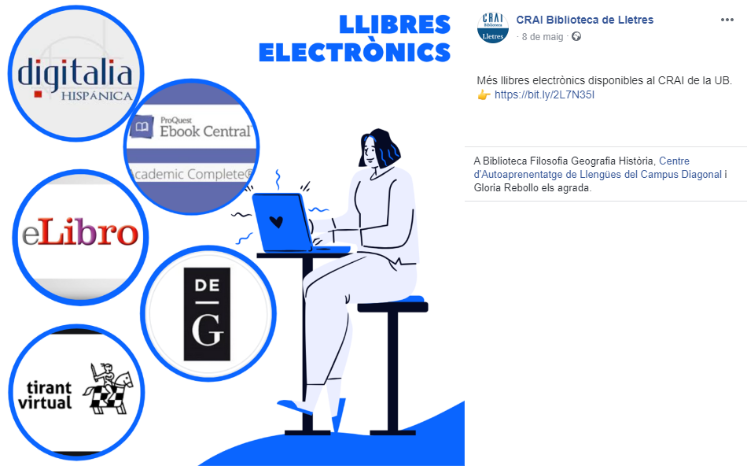
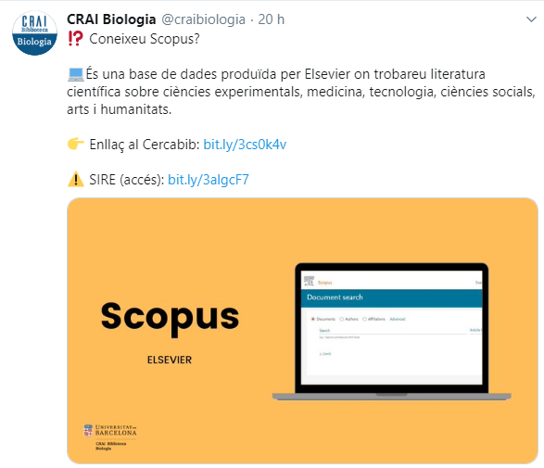
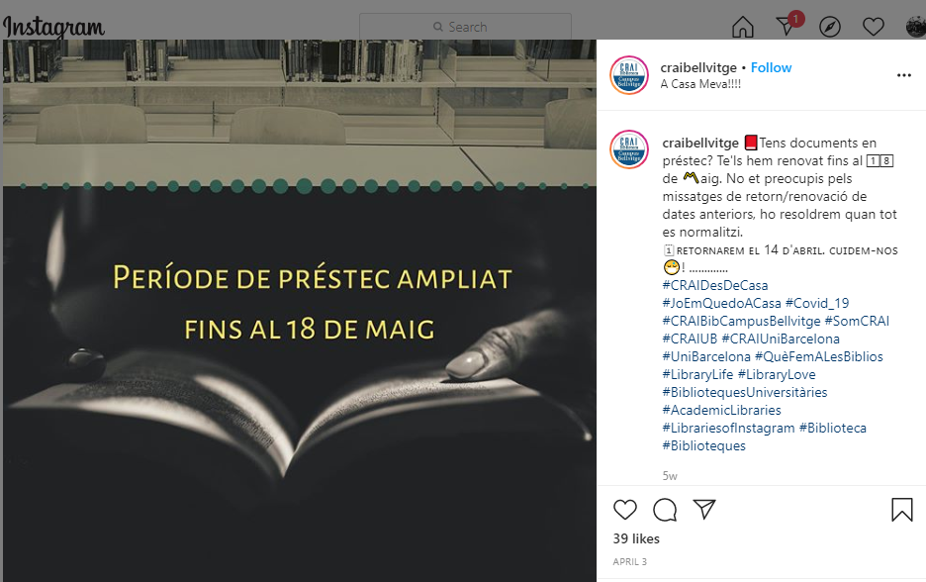
Social networks

Slide 43

Please, help us improve
https://crai.ub.edu/valora

Slide 44


Thank you!
© CRAI Universitat de Barcelona, academic year 2019-20

