Slide 1

Briefing for your Master Thesis
Academic year 2019-20

Slide 2

Some of the referenced linked resources are in catalan, due to the lack of an English version.
Feel free to use a reverse web translator when/if needed.
Attention
Ask us for customized sessions: bibmat@ub.edu
2
Notes:
Conèixer el CRAI Biblioteca de XXXX. Curs 20xx-xx

Slide 3

During the COVID-19 pandemic
Ask for customized training sessions
Check the open access e-resources
Ask us for customized sessions: bibmat@ub.edu
3
Notes:
Conèixer el CRAI Biblioteca de XXXX. Curs 20xx-xx

Slide 4
What is the aim of this presentation?
Preliminary considerations
Information search and management
Criteria to evaluate information
Dealing with Copyright
Before submission
Remember to
Need help?
Make profit from your MT
Examples
Contents
Ask us for customized sessions: bibmat@ub.edu
4
Notes:
Conèixer el CRAI Biblioteca de XXXX. Curs 20xx-xx

Slide 5
1 What is the aim of this presentation?
To help you to identify your information needs.
To set your priorities for developing a plan to look for information.
To ease the lay out management.
Ask us for customized sessions: bibmat@ub.edu
5
Notes:
Conèixer el CRAI Biblioteca de XXXX. Curs 20xx-xx

Slide 6
2 Preliminary considerations: work schedule
Suggested chronological sequence
IDEA
(3 DAYS)
3 MONTHS IN ADVANCE
FINDING INFORMATION
(6 DAYS)
3 MONTHS IN ADVANCE
WRITING/LAY OUT
(15 DAYS)
2 MONTHS IN ADVANCE
Talk to your tutor
Ask us for customized sessions: bibmat@ub.edu
Notes:
Conèixer el CRAI Biblioteca de XXXX. Curs 20xx-xx

Slide 7
2
Preliminary considerations
Communicating your preliminary work:
Identify the core idea.
Be concise.
Be clear.
Ask us for customized sessions: bibmat@ub.edu
7
Notes:
Conèixer el CRAI Biblioteca de XXXX. Curs 20xx-xx

Slide 8
2
Preliminary considerations
First, you need a core idea. Identify the main concept and be concise when expressing it: detect the key thread. Details are a complement to the basic idea, so use examples if necessary.
Get focused: Don’t tell your life story. If you get lost in an explanation, you're rambling. Use short sentences and specific concepts.
Know how to express yourself properly: title should summarize in one sentence the contents of the document.
Ask us for customized sessions: bibmat@ub.edu
8
Notes:
Conèixer el CRAI Biblioteca de XXXX. Curs 20xx-xx

Slide 9
3
Information search and management
Set a search strategy to save time when searching for information
Bibliographic review: indexed fields -like abstract and keywords- included in articles, or books, etc. will help you find trusted publications. You can also use the indexed concepts to search in accurate sources and find similar items to those you are interested in.
Critical analysis: Search for different
points of view on significant or confusing concepts. You must be capable to
make a critical analysis and to to set an unbiased perspective on your work.
Ask us for customized sessions: bibmat@ub.edu
9
Notes:
Conèixer el CRAI Biblioteca de XXXX. Curs 20xx-xx

Slide 10
3
Information search and management
Search strategy
Keyword analysis.
Concept analysis.
Strengths and weaknesses analysis.
Subject classification.
Ask us for customized sessions: bibmat@ub.edu
10
Notes:
Conèixer el CRAI Biblioteca de XXXX. Curs 20xx-xx

Slide 11
3
Information search and management
Search strategy
Keyword analysis : find related terms for the same subject area.
Term analysis : Draw a conceptual term map from generic specific to stablish your information needs and the level of specificity of the resources. The more specific the terms the more specialized the information.
Strengths and weaknesses analysis : Decide which words you’ll use and which ones you’ll discard: verbs, polysemous expressions.
Subject classification: The numeric code representing the content and scope of an item can help you locate similar works. The Mathematics Subject Classification and the Computing Classification System are the mostly used classifications.
Ask us for customized sessions : bibmat@ub.edu
11
Notes:
Conèixer el CRAI Biblioteca de XXXX. Curs 20xx-xx

Slide 12
3
Information search and management
Search estrategy
Be selective AND specific when consulting information resources. Avoid collecting information that you can’t read in detail.
Adjust consulted data/resources to the proper academic level of your work.
Log into your personal account when using Cercabib or the UB Repository to transform them into customized tools.
Access online resources through SIRE
proxy service.
Ask us for customized sessions: bibmat@ub.edu
12
Notes:
Conèixer el CRAI Biblioteca de XXXX. Curs 20xx-xx

Slide 13
3
Information search and management
Start to search
Set a searching syntax.
Starting: set preferences, settings, etc.
Manage results: filter and refine.
Ask us for customized sessions: bibmat@ub.edu
13
Notes:
Conèixer el CRAI Biblioteca de XXXX. Curs 20xx-xx

Slide 14
3
Information search and management
Start to search
Search engines and databases use the same standardized syntax.
You can change your search options from the preferences / settings menu.
You can try different possibilities: compare outcomes filtering the results before or after your search.
Set preferences before starting to search: language, dates, etc.
Apply filters after: refine the outcome of your search by subject, publication type, etc.
Ask us for customized sessions: bibmat@ub.edu
14
Notes:
Conèixer el CRAI Biblioteca de XXXX. Curs 20xx-xx

Slide 15



3 Information search and management: HOW?
Search operators * (*Don’t leave a blank space between operators and words)
No operator | Intersection (AND). Find items that belong simultaneously to both sets.
+ | Addition (OR). Find the sum of two items or more.
@ | Find email address.
SOLVED | Find solved problems.
# | Find trending topic (hashtags).
- | Search exclusion (NOT). Avoid polysemic words, pull out concepts in your search.
" | Quotations. Find items in the same order in which they appear between quotes.
* | Truncation. Find the root of the word and derivatives.
related: | The search item is included within URLs
info: | Information. Find information related to web page source, versions and similar sites, etc.
site: | Find information about a certain domain. Get results of specific addresses.
define | Dictionary. Find word definitions, synonyms, antonyms.
() | Prioritize. Search items in brackets first. To find terms across disciplines building subordinate searches.
15
Notes:
Conèixer el CRAI Biblioteca de XXXX. Curs 20xx-xx

Slide 16
3
Information search and management
Start to search: Where?
As a starting point, provide context on the main subject of your work using the academic generalist search engines. This search will return reference information sources. That is, the results will give you access to: definitions, bibliography, abstracts and generic information, a list of documents or web pages that might contain the information you are looking for. But they will rarely give you access to the full text of an article.
Ask us for customized sessions: bibmat@ub.edu
16
Notes:
Conèixer el CRAI Biblioteca de XXXX. Curs 20xx-xx

Slide 17
3
Information search and management
Start to search: Where?
Google Scholar (Help)
Microsoft Academic (Help)
ScienceResearch (Help). Covers E-Print Network
Wolfram-Alpha: answer engine through dynamic calculations based on integrated data, algorithms and methods.
Ask us for customized sessions: bibmat@ub.edu
17
Notes:
Conèixer el CRAI Biblioteca de XXXX. Curs 20xx-xx

Slide 18





3
Information search and management
Start to search: SEEKING vs FINDING
Full text resources
Login required
No login required
Open Access Button
Ask us for customized sessions: bibmat@ub.edu
18
Notes:
Conèixer el CRAI Biblioteca de XXXX. Curs 20xx-xx

Slide 19




3
Information search and management
Full text resources
No login required to start to search: (But log into them to manage loan, bibliographic alerts, etc.)
arXiv.org
Ask us for customized sessions: bibmat@ub.edu
19
Notes:
Conèixer el CRAI Biblioteca de XXXX. Curs 20xx-xx

Slide 20
3
Information search and management
CRAI Catàleg - Cercabib : is the University of Barcelona CRAI’s discovery tool, which allows you to search simultaneously through the entire CRAI collection, regardless of the format, type or location of your chosen item: paper and electronic copies of books, journals, magazine articles, doctoral theses and audio-visual materials, physically located in one of our CRAI libraries or stored on a UB or external server. The tutorial Cercabib: new way to search in... shows you in detail what Cercabib is and how it works: searching, sorting results, interpreting the different interface elements, configuration options, My Account, and all the other features and innovations. (Help)
CSUC PUC: is a catalogue with more than 5 million titles that provides access to over 12 million items. It includes the library collections of the Consortium of the Catalan University Services libraries and other partner libraries. (Help).
Start to search: SEEKING vs FINDING
Ask us for customized sessions: bibmat@ub.edu
20
Notes:
Conèixer el CRAI Biblioteca de XXXX. Curs 20xx-xx

Slide 21
3
Information search and management
Start to search: SEEKING vs FINDING
Dipòsit Digital: Resource that store full text and open access publications resulting from institutional activity by UB community, including Final Degree works. All universities have open digital and searchable repositories (even through Google).
Open Access button: browser extension that searches articles and neat datasets. If you can’t find and item, you can use the extension to send an email to the author.
Creative Commons Search: to “find content you can share, use and remix”. It’s helpful to avoid misunderstandings with exploitation, reproduction and distribution rights.
Arxiv: Self-managed and open access pre-print electronic repository
specialized in mathematics, physics, astronomy, computer science,
biology, quantitative finance and statistics.
Unpaywall: Legal collector of articles from free access and full text
repositories and open data.
DOAJ: Directory of open access and peer-reviewed journals.
DBLP: open access repository specialized in computer science.
Github: a Git repository service. In addition to the source code, it also
includes comments, bug reports, role requests, and change history.
Demana’ns sessions a mida: bibmat@ub.edu
21
Notes:
Conèixer el CRAI Biblioteca de XXXX. Curs 20xx-xx

Slide 22
3
Information search and management
Start to search: SEEKING vs FINDING
MathSciNet
Zentralblatt Math
Full text resources:
required to start to search
Ebooks and ejournals
Ask us for customized sessions: bibmat@ub.edu
22
Notes:
Conèixer el CRAI Biblioteca de XXXX. Curs 20xx-xx

Slide 23
3
Information search and management
What to consult and what to cite
Consult but not Cite | Consult and Cite
Reference sources (wikipedia) | Items that have helped you to prove and solve
Search engines | Information sources
“Anybody can ask a question - Anybody can answer - The best answers are voted up and rise to the top” | Accredited and well-identified contributors who can prove how they found the answer
Assigned information | Proven information
Talk to your tutor about your concerns
Ask us for customized sessions: bibmat@ub.edu
23
Notes:
Conèixer el CRAI Biblioteca de XXXX. Curs 20xx-xx

Slide 24
3
Information search and management
What to consult and what to cite
Maybe you are not sure about the concepts you have to use, and you want to look for definitions; or not sure about the source of specific data; or you may want to compare / expand your knowledge on a subject. The bibliography must include ONLY the documents that helped you solve and demonstrate your thesis, there is no need to cite complementary bibliography you have looked it up. Forums and similar: even though accredited contributors are reliably identified, they give plain answers as they do not give a developed reason on how they have reached the answer. Think about consulting any doubt with your tutor.
Learn to tell the difference between a search engine and a source of information.
Ask us for customized sessions: bibmat@ub.edu
24
Notes:
Conèixer el CRAI Biblioteca de XXXX. Curs 20xx-xx

Slide 25
4
Criteria to evaluate information
Follow certain criteria to pick and evaluate the information before using it, In order to tell if it’s useful for your work:
Author.
Updated information.
Topics.
Objectivity.
Impact.
Ask us for customized sessions: bibmat@ub.edu
25
Notes:
Conèixer el CRAI Biblioteca de XXXX. Curs 20xx-xx

Slide 26
4
Criteria to evaluate information
Author: Who is the author? Do they cite their sources? Do they include contact details?
Update: Is it easy to locate a publication or the latest update?
Topics: Who is the intended audience. Is the content relevant and useful for your work? Is it inaccurate? If so, it is not a peer reviewed work, and maybe you should not consider it.
Objectivity: Is the information given unbiased? Does it contain reasoned opinions? Is it verified with references?
Impact: How many downloads, citations, references have the source?
Ask us for customized sessions: bibmat@ub.edu
26
Notes:
Conèixer el CRAI Biblioteca de XXXX. Curs 20xx-xx

Slide 27
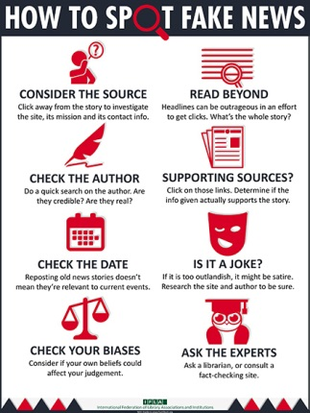
4
Criteria to evaluate information
IFLA. How to Spot Fake News. A: FactCheck.org [2016]. Disponible a: http://www.factcheck.org/2016/11/how-to-spot-fake-news/ [Consultat el 25/1/17]
Ask us for customized sessions: bibmat@ub.edu
27
Notes:
Conèixer el CRAI Biblioteca de XXXX. Curs 20xx-xx

Slide 28
5
Dealing with Copyright
Avoid plagiarism: using someone else's intellectual work can be considered plagiarism if there is no mention made of the sources consulted to produce your own production.
Always cite the source when:
copying fragments, images, graphics, and other items.
you use information from another author’s work or publication.
paraphrase, rewrite or translate a text.
reuse previous own work (auto plagiarism).
you use other people's ideas or words as your own and these are not considered part of general knowledge.
Ask us for customized sessions: bibmat@ub.edu
28
Notes:
Conèixer el CRAI Biblioteca de XXXX. Curs 20xx-xx

Slide 29
5
Dealing with Copyright
Avoid plagiarism
Your work must be original; however you can take a look at other works to get inspiration to develop yours.
Give credit to the texts reproduced in the body of the TFM:
Identify texts copied literally in quotes. Cite the source in a footnote.
Write in your own words.
Identify used sources including bibliographical references.
Quote correctly, following a single citation style.
Ask us for customized sessions: bibmat@ub.edu
29
Notes:
Conèixer el CRAI Biblioteca de XXXX. Curs 20xx-xx

Slide 30
5
Dealing with Copyright
Find out about which licences protect the information you have used:
  Copyright
  Copyleft
  Creative Commons
  GPL/GNU
Ask us for customized sessions: bibmat@ub.edu
30
Notes:
Conèixer el CRAI Biblioteca de XXXX. Curs 20xx-xx

Slide 31
5
Dealing with Copyright
Avoid plagiarism
Reference: finding and identifying.
Citation: footnote.
Bibliography: list of references.
Any doubts concerning how to cite, or which citation style to choose? How to cite and manage the bibliography
Ask us for customized sessions: bibmat@ub.edu
31
Notes:
Conèixer el CRAI Biblioteca de XXXX. Curs 20xx-xx

Slide 32
5
Dealing with Copyright
Reference: a dataset that identifies a
document or source of information. It makes it possible to find and identify an item, so others can read the same material.
Citation: an abbreviated form of reference inserted in the text of a work (it gives credit to the texts reproduced in the body of the Thesis). It allows the reader to identify the source of information and helps to avoid plagiarism. It is an indicator of the quality, completeness and accuracy of the work. Usually placed as a footnote in a page, indicating author, year of publication and page number.
Bibliography: a list of references of the items consulted when writing a paper. Usually placed at the end of the work.
Ask us for customized sessions: bibmat@ub.edu
32
Notes:
Conèixer el CRAI Biblioteca de XXXX. Curs 20xx-xx

Slide 33

5
Dealing with Copyright
After deciding which information sources you will include in the bibliography of your work, and before starting to write the references correctly, it will be very useful to arrange them. Bibliography shouldn’t be long, but if it is: start by sorting items out by type (monographs, websites, figures, etc.); and then, list items alphabetically by block.
(Access by using UB e-mail address or ID)
Reference and citation manager integrated with commercial databases, the UB's institutional repository and the CRAI Cercabib, and can work as a document search engine. It has the characteristics of an advanced social network. (Help)
Ask us for customized sessions: bibmat@ub.edu
33
Notes:
Conèixer el CRAI Biblioteca de XXXX. Curs 20xx-xx

Slide 34
5
Dealing with Copyright
The University of Barcelona has an institutional repository
-Dipòsit Digital- to collect all the production generated in the institution. Your TFM will be published in the Dipòsit Digital unless you specifically tell otherwise.
The materials included in the Dipòsit Digital are freely accessible and searchable.
Whenever possible, they are assigned a Creative Commons license, in accordance with the authors, which allows reusing works, data and information.
Make sure your authorization is properly signed when delivering your Master Thesis.
Ask us for customized sessions: bibmat@ub.edu
34
Notes:
Conèixer el CRAI Biblioteca de XXXX. Curs 20xx-xx

Slide 35
5
Dealing with Copyright
Avoid plagiarism: There are currently several programs that automatically detect evidence of plagiarism in a work. The University of Barcelona has subscribed one of these programs, called Urkund, used by many universities and academic institutions around the world. It works integrated into the Virtual Campus and also can be used directly from the web with any browser.
Plagiarism and academic works: tools for students
Urkund
Ask us for customized sessions: bibmat@ub.edu
35
Notes:
Conèixer el CRAI Biblioteca de XXXX. Curs 20xx-xx

Slide 36
6
Before submission
Number all pages in your work.
Include a summary.
Translate this summary.
Check if you have filled in your rights licence properly.
Sign your rights licence.
Check spelling, vocabulary and syntax.
Ask us for customized sessions: bibmat@ub.edu
36
Notes:
Conèixer el CRAI Biblioteca de XXXX. Curs 20xx-xx

Slide 37
7
Remember to
Greater accessibility means greater visibility.
Make a summary of the contents of your MT. It is a required field in the Digital Repository. If your work doesn't include one, the introduction will be taken as such.
Review the translation of the summary. Once your work is included in the Univeristy Repository, your TFM will be searchable via Google and freely accessible through the Dipòsit Digital; therefore, available in open access and visible to everyone.
Pay attention: review your personal details when signing the rights authorization (language, title, etc.).
Ask us for customized sessions: bibmat@ub.edu
37
Notes:
Conèixer el CRAI Biblioteca de XXXX. Curs 20xx-xx

Slide 38
The oral presentation
Oral expository quality and the ability to debate and defend arguments represent 20% of the final grade.
CUB: criteris de la UB: Presentació oral
7
Remember to
See the bibliography in the guide for further information sources.
Demana’ns sessions a mida: bibmat@ub.edu
38
Notes:
Conèixer el CRAI Biblioteca de XXXX. Curs 20xx-xx

Slide 39
8
Need help?
At the UB CRAI web, under CRAI Services, you will find a compilation of resources to help you to write academic papers.
Take a look to these tutorials complementing the above information:
How to include bibliography using bibtex
Plagiarism: how to avoid it
Ask us for customized sessions: bibmat@ub.edu
39
Notes:
Conèixer el CRAI Biblioteca de XXXX. Curs 20xx-xx

Slide 40
8
Need help?
You can request customized training sessions:
Filling an online form
Sending us an email.
Ask us for customized sessions: bibmat@ub.edu
40
Notes:
Conèixer el CRAI Biblioteca de XXXX. Curs 20xx-xx

Slide 41
9
Make profit form your MT
Digital Single Market: European Union (Europe 2020 Strategy).
If you are registered on GitHub, check the option to upload your curriculum to be considered to be hired.
Ask us for customized sessions: bibmat@ub.edu
41
Notes:
Conèixer el CRAI Biblioteca de XXXX. Curs 20xx-xx

Slide 42
10 Examples
On a proper bibliography:
Duran Prats, Joan. Polinomios y series de Ehrhart. UB, 2014.
Salgado Corbillón, Marcos. Análisis real no estándar. UB, 2015.
Demana’ns sessions a mida: bibmat@ub.edu
42
Notes:
Conèixer el CRAI Biblioteca de XXXX. Curs 20xx-xx

Slide 43
10 Examples
As said in page 28, check CRAI’s webpage to improve your skills on How to cite and manage the bibliography.
Exemples (ISO 690:1987 (UNE 50-104-94))
Book/Monography. Whole. (paper / online) | JULIÀ de Ferran, Olga. Un Primer curs d'estadística. Barcelona : Publicacions i Edicions Universitat de Barcelona, 2011. ISBN 9788447534838. (Data de la consulta i URL del recurs si és en línia)
Book chapter (paper / online) | FRANQUESA i Niubò, Carles. Els conjunts de funcions ${0},\Omega, \Theta$. Dins: FRANQUESA i Niubò, Carles. Barcelona : Publicacions i Edicions Universitat de Barcelona, 2013, p. 24-28. (Data de la consulta i URL del recurs si és en línia).
Journal article (paper / online) | MATSUMOTO, Shigenori. Horocycle flows without minimal sets. Journal of Mathematical Sciences. 2016, vol. 23, núm. 3, p. 661-673. (Data de la consulta i URL del recurs si és en línia).
Blog entry / article | Delgado, Manuel. "El mite interminable" . Dins: El cor de les aparences. Bloc de Manuel Delgado. 25 de maig de 2015. Blog. Accés el 27 de gener de 2016.
Ask us for customized session: bibmat@ub.edu
43
Notes:
Conèixer el CRAI Biblioteca de XXXX. Curs 20xx-xx

Slide 44
10 Examples
(ISO 690-2 and MLA)
Web pages, databases and software. Whole. | Wolfram Research Inc. Wolfram Mathematica v. 11 [amb llicència UB]. Champaign, Illinois: Wolfram Research Inc, 1988 [consulta: 7 de maig de 2016].
Web pages, databases and software. Contributions. | NASA Kennedy Space Center. Frequently Asked Questions. En The NASA Homepage [en línia]. 3 de maig de 2015 [consulta: 8 de maig de 2016]. Disponible a: http://www.nasa.gov/centers/kennedy/about/information/faq.html.
Email messages | Gaudí, Antoni. Dubte drets autors. En: antoni.gaudi@alumnes.ub.edu [correu-e ]. CRAI. Biblioteca de Matemàtiques i Informàtica. Barcelona, 2016. [Consulta: 26 de gener de 2016].
Online video | Camí de l'èxit en la cerca i ús de la informació científica. 24 de juliol de 2014. [Accés el 28 de maig de 2015. Recuperat de https://www.youtube.com/watch?v=wSs-yPMwjYM] .
Ask us for customized session : bibmat@ub.edu
44
Notes:
Conèixer el CRAI Biblioteca de XXXX. Curs 20xx-xx

Slide 45
10 Examples
(MLA)
Social Media | CRAI UB (crai_ub). "El #CRAIUB ha signat la declaració de @haguedec sobre la cerca i l'extracció de coneixement en l'era digital http://t.co/CPtGnRk5Az". 07 maig 2015, 12:17 pm. Tuit Colomines, Agustí. "Una definició d'un joveníssim Andreu Nin: «Nosaltres som “nacionalistes” perquè la “nació” és per a nosaltres la unitat orgànica “autonomista” de la federació. Ara bé: què és el que determina la “nació”? Són els caràcters etnogràfics, la situació geogràfica, els antecedents històrics? No, sinó la voluntat dels qui la componen, el sentiment de la pròpia personalitat, tan arrelat com dèiem abans en l’ànima de Catalunya» («Els partits polítics espanyols i les solucions autonomistes», «El Poble Català», 2 d’octubre de 1912)". Facebook. 21 de gener de 2015. [Data d’accés: 23 de gener de 2015].
Ask us for customized session: bibmat@ub.edu
45
Notes:
Conèixer el CRAI Biblioteca de XXXX. Curs 20xx-xx

Slide 46
10 Examples
(MLA and ISI)
Libraries, code, programming languages, software packages, etc. | R Development Core Team (2008). R: A language and environment for statistical computing. R Foundation for Statistical Computing, Vienna, Austria. ISBN 3-900051-07-0, URL http://www.R-project.org. H. Wickham. ggplot2: elegant graphics for data analysis. Springer New York, 2009. [EK13] Eick, B. and Konovalov, A., ModIsom, Computing automorphisms and checking isomorphisms for modular group algebras of finite p-groups, Version 2.1 (2013), (GAP package), http://www.icm.tu-bs.de/~beick/soft/modisom/. CP2K version 2.4 (Development Version), the CP2K developers group (2013). CP2K is freely available from http://www.cp2k.org/.
Examples taken from: Jackson, Mike. A: Software Sustainability Institute, 30 de juliol de 2014. URL: https://www.software.ac.uk/blog/2016-09-30-oh-research-software-how-shalt-i-cite-thee. [Consulted on 16/09/2019].
Ask us for customized session: bibmat@ub.edu
46
Notes:
Conèixer el CRAI Biblioteca de XXXX. Curs 20xx-xx

Slide 47
10 Examples
How and why should you reference software?
When quoting code, software, libraries, language, etc. -as a source of information or reference to develop the TFM-, you are offering the possibility of being able to access the correct software version and the appropriate tools and components. This means the possibility to reproduce and / or develop the project and, at the end, validate your work.
Find it out:
https://blocmat.ub.edu/2018/09/25/com-i-per-que-shauria-de-citar-el-programari/
Ask us for customized session : bibmat@ub.edu
47
Notes:
Conèixer el CRAI Biblioteca de XXXX. Curs 20xx-xx

Slide 48
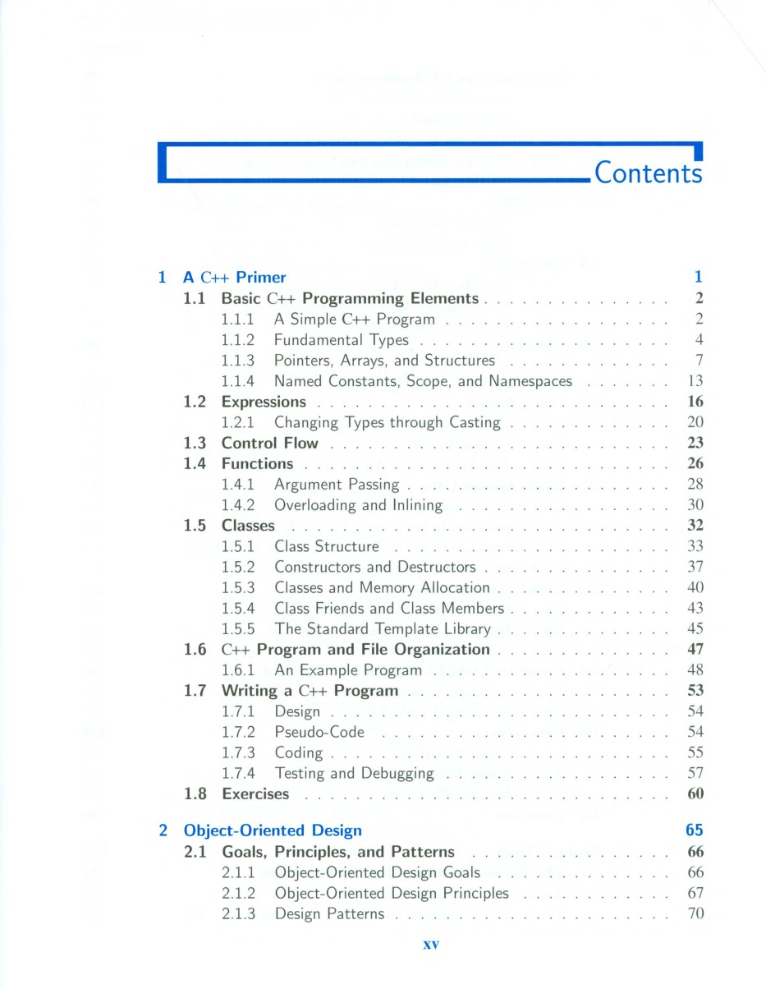
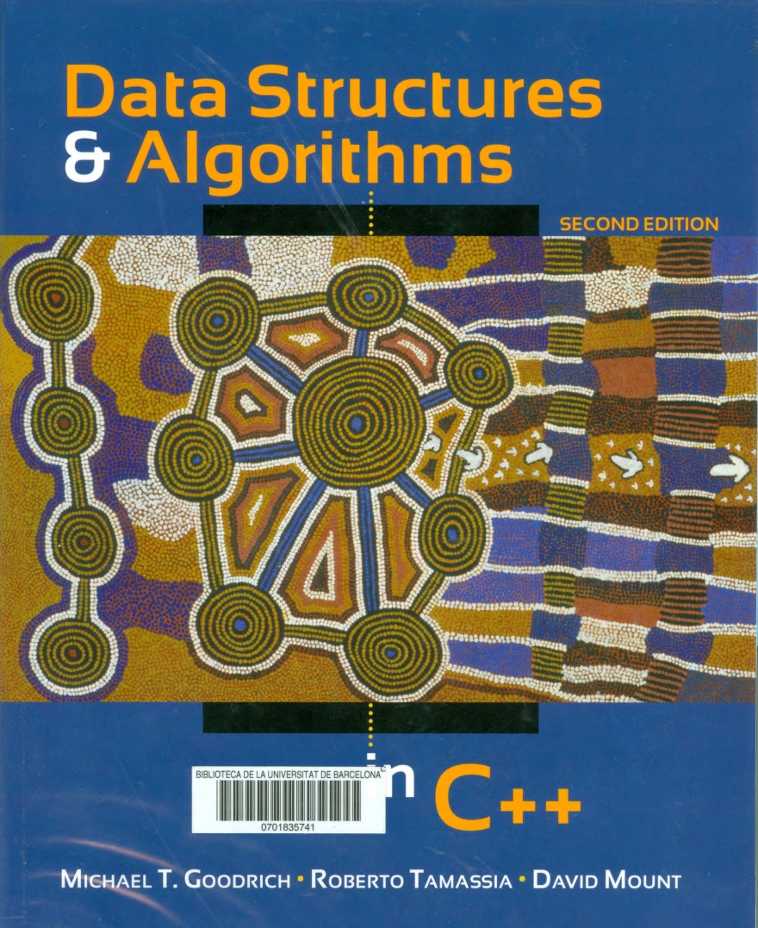
10 Example - Contents
Demana’ns sessions a mida: bibmat@ub.edu
48
Notes:
Conèixer el CRAI Biblioteca de XXXX. Curs 20xx-xx

Slide 49


Thank you!
© CRAI Universitat de Barcelona, academic year 2019-20

