Slide 1
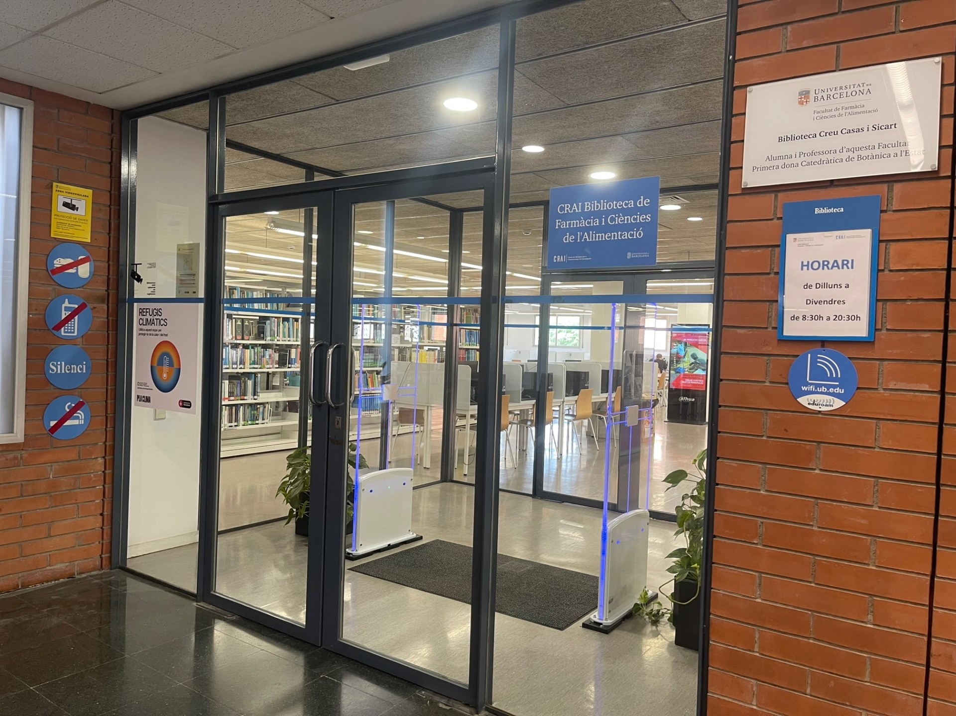

PHARMACY AND FOOD SCIENCE CRAI LIBRARY
DIAGONAL KNOWLEDGE CAMPUS

Slide 2
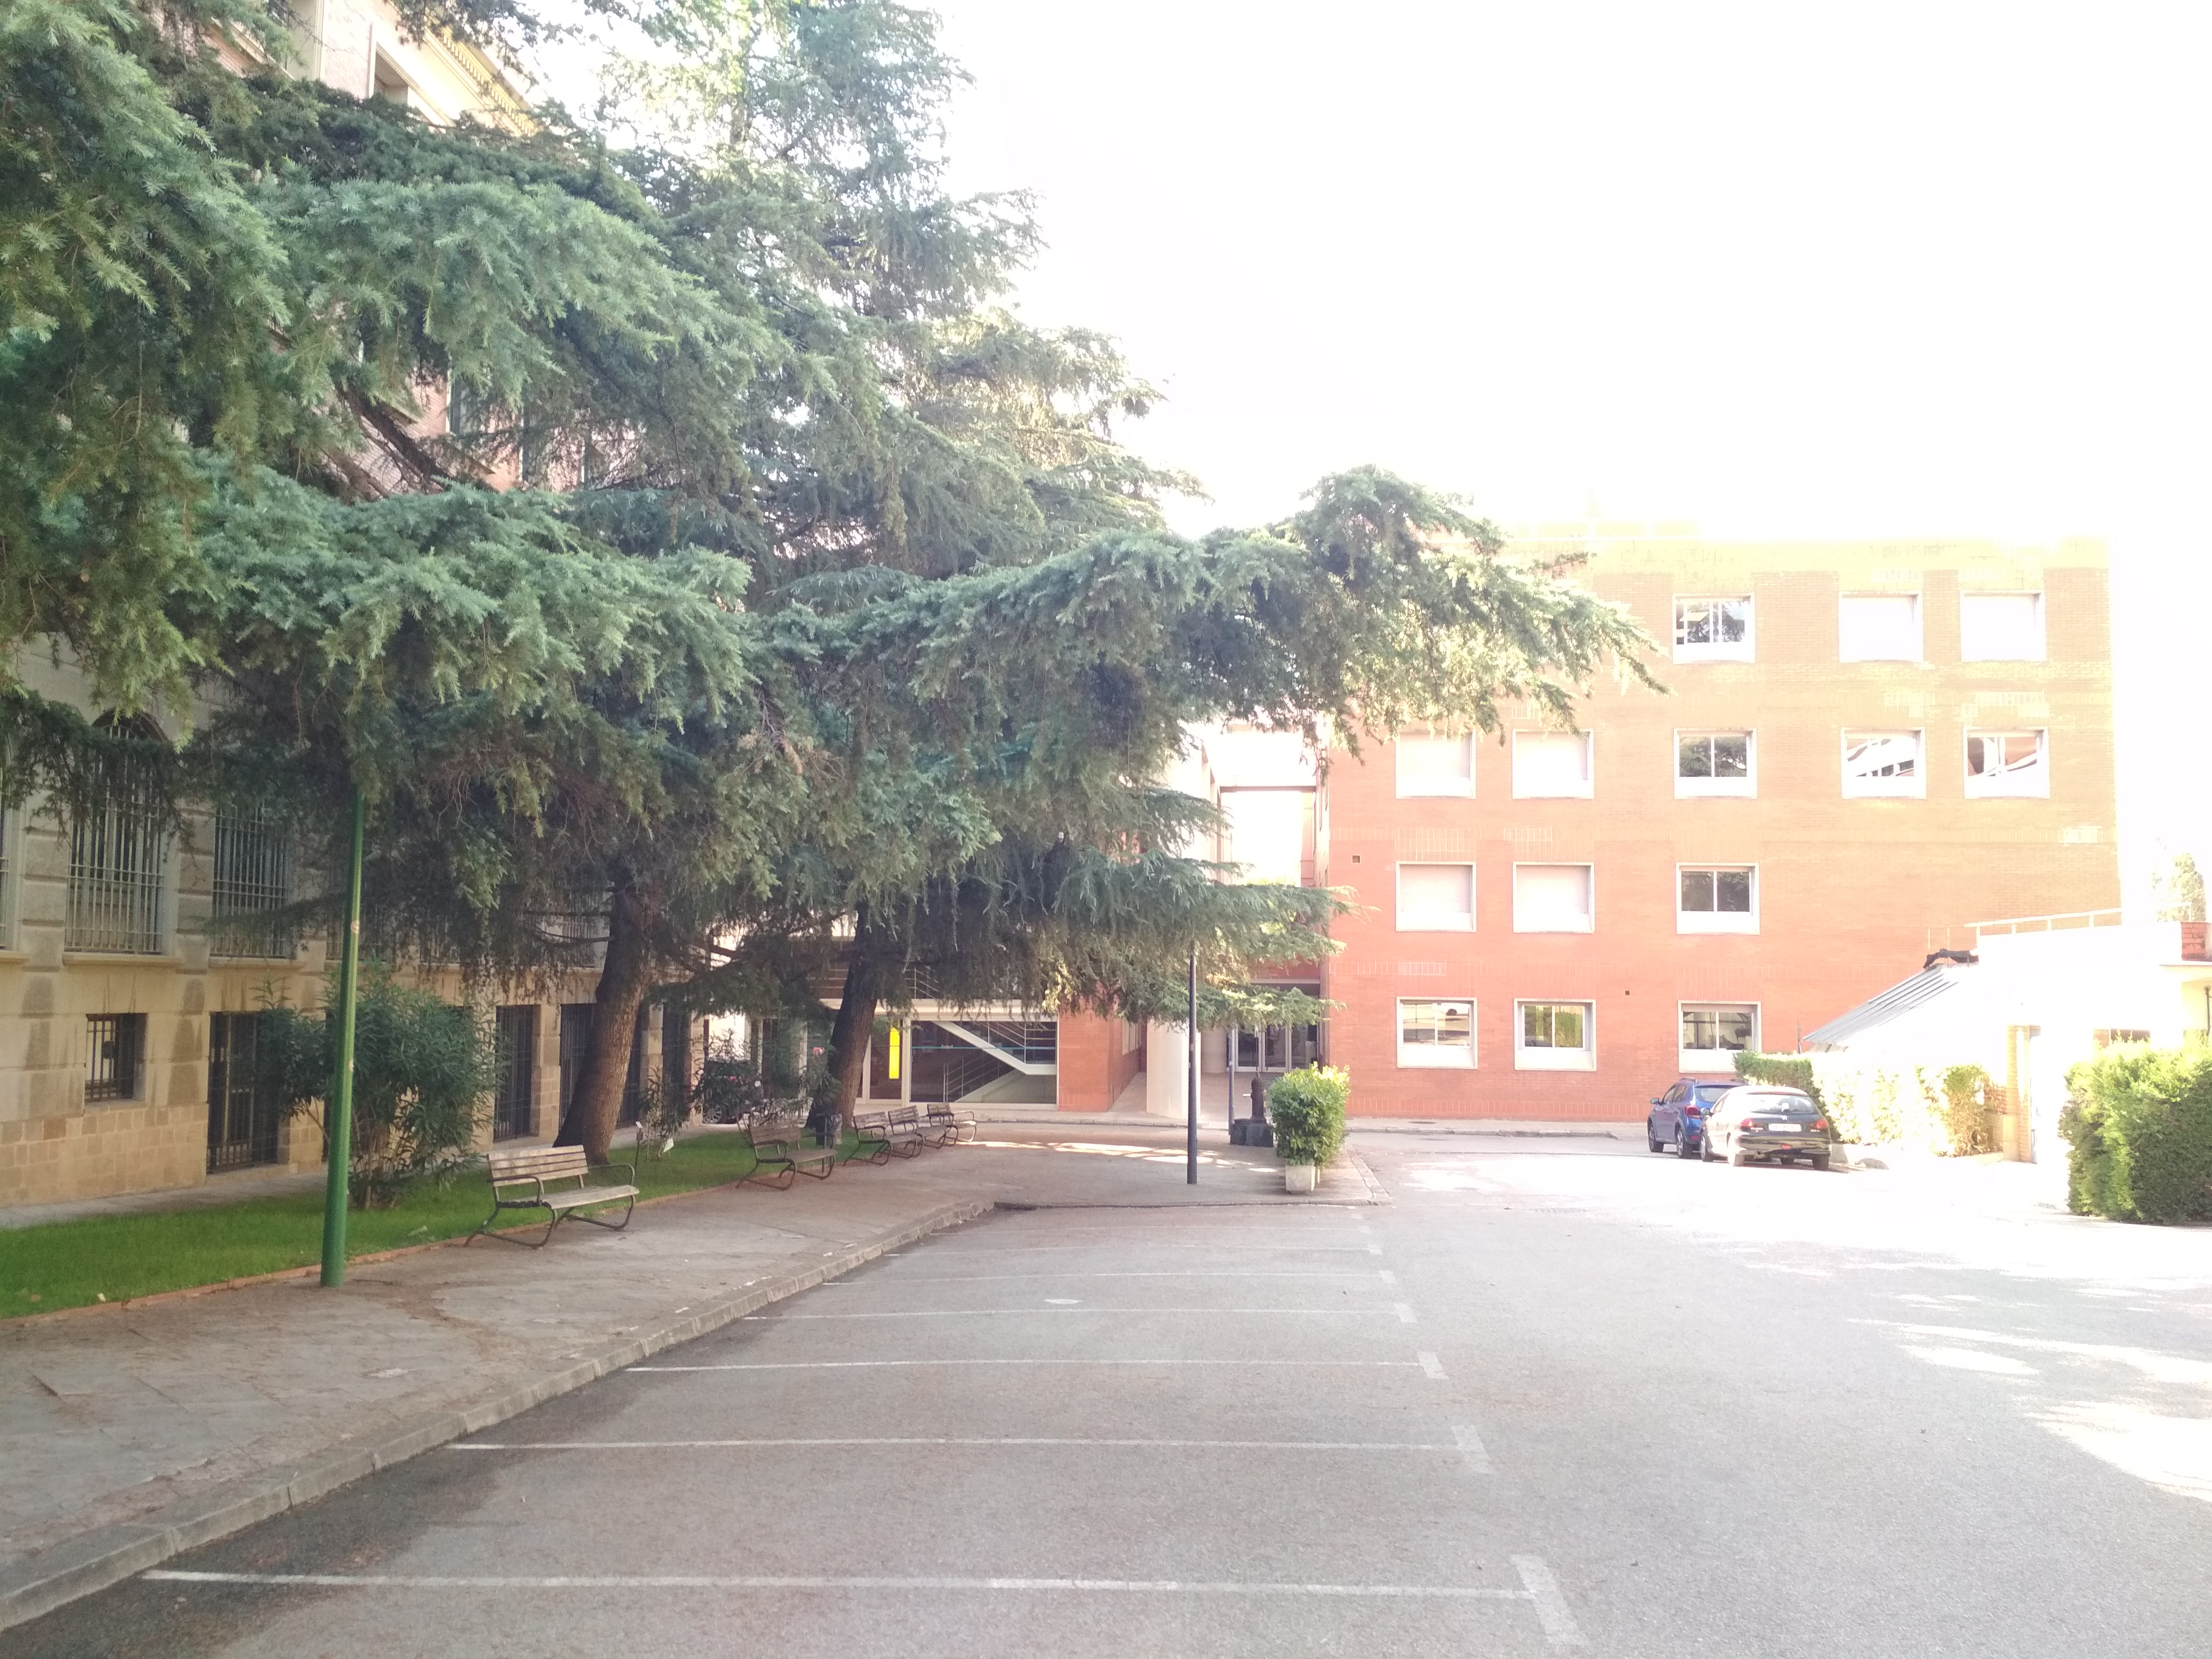
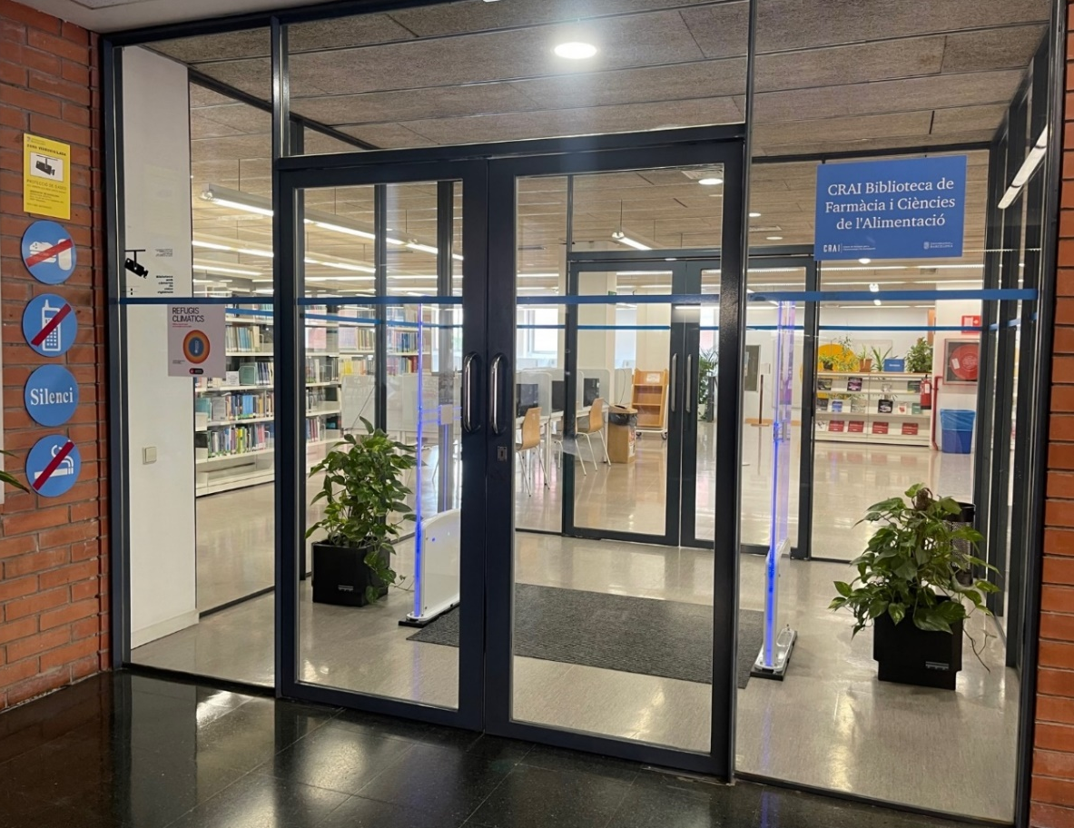
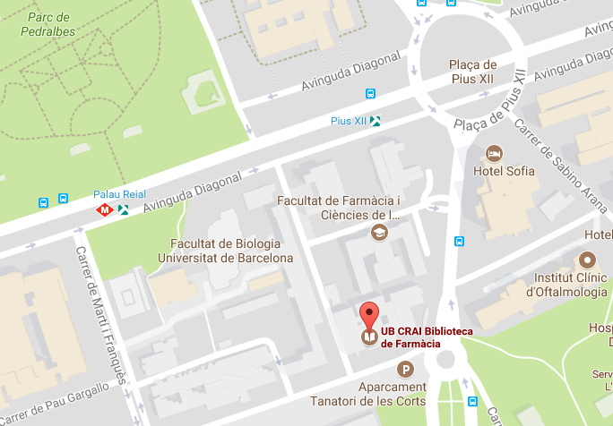

Where are we?
Building B – Ground floor
Metro: line 3 (Palau Reial)
Bus: 7, 33, 63, 67, 78, 113, 175, H6, M12, M14, X30, X43, X79, X83, X84, X97, L97, V5
Tram: Pius XII station

Slide 3
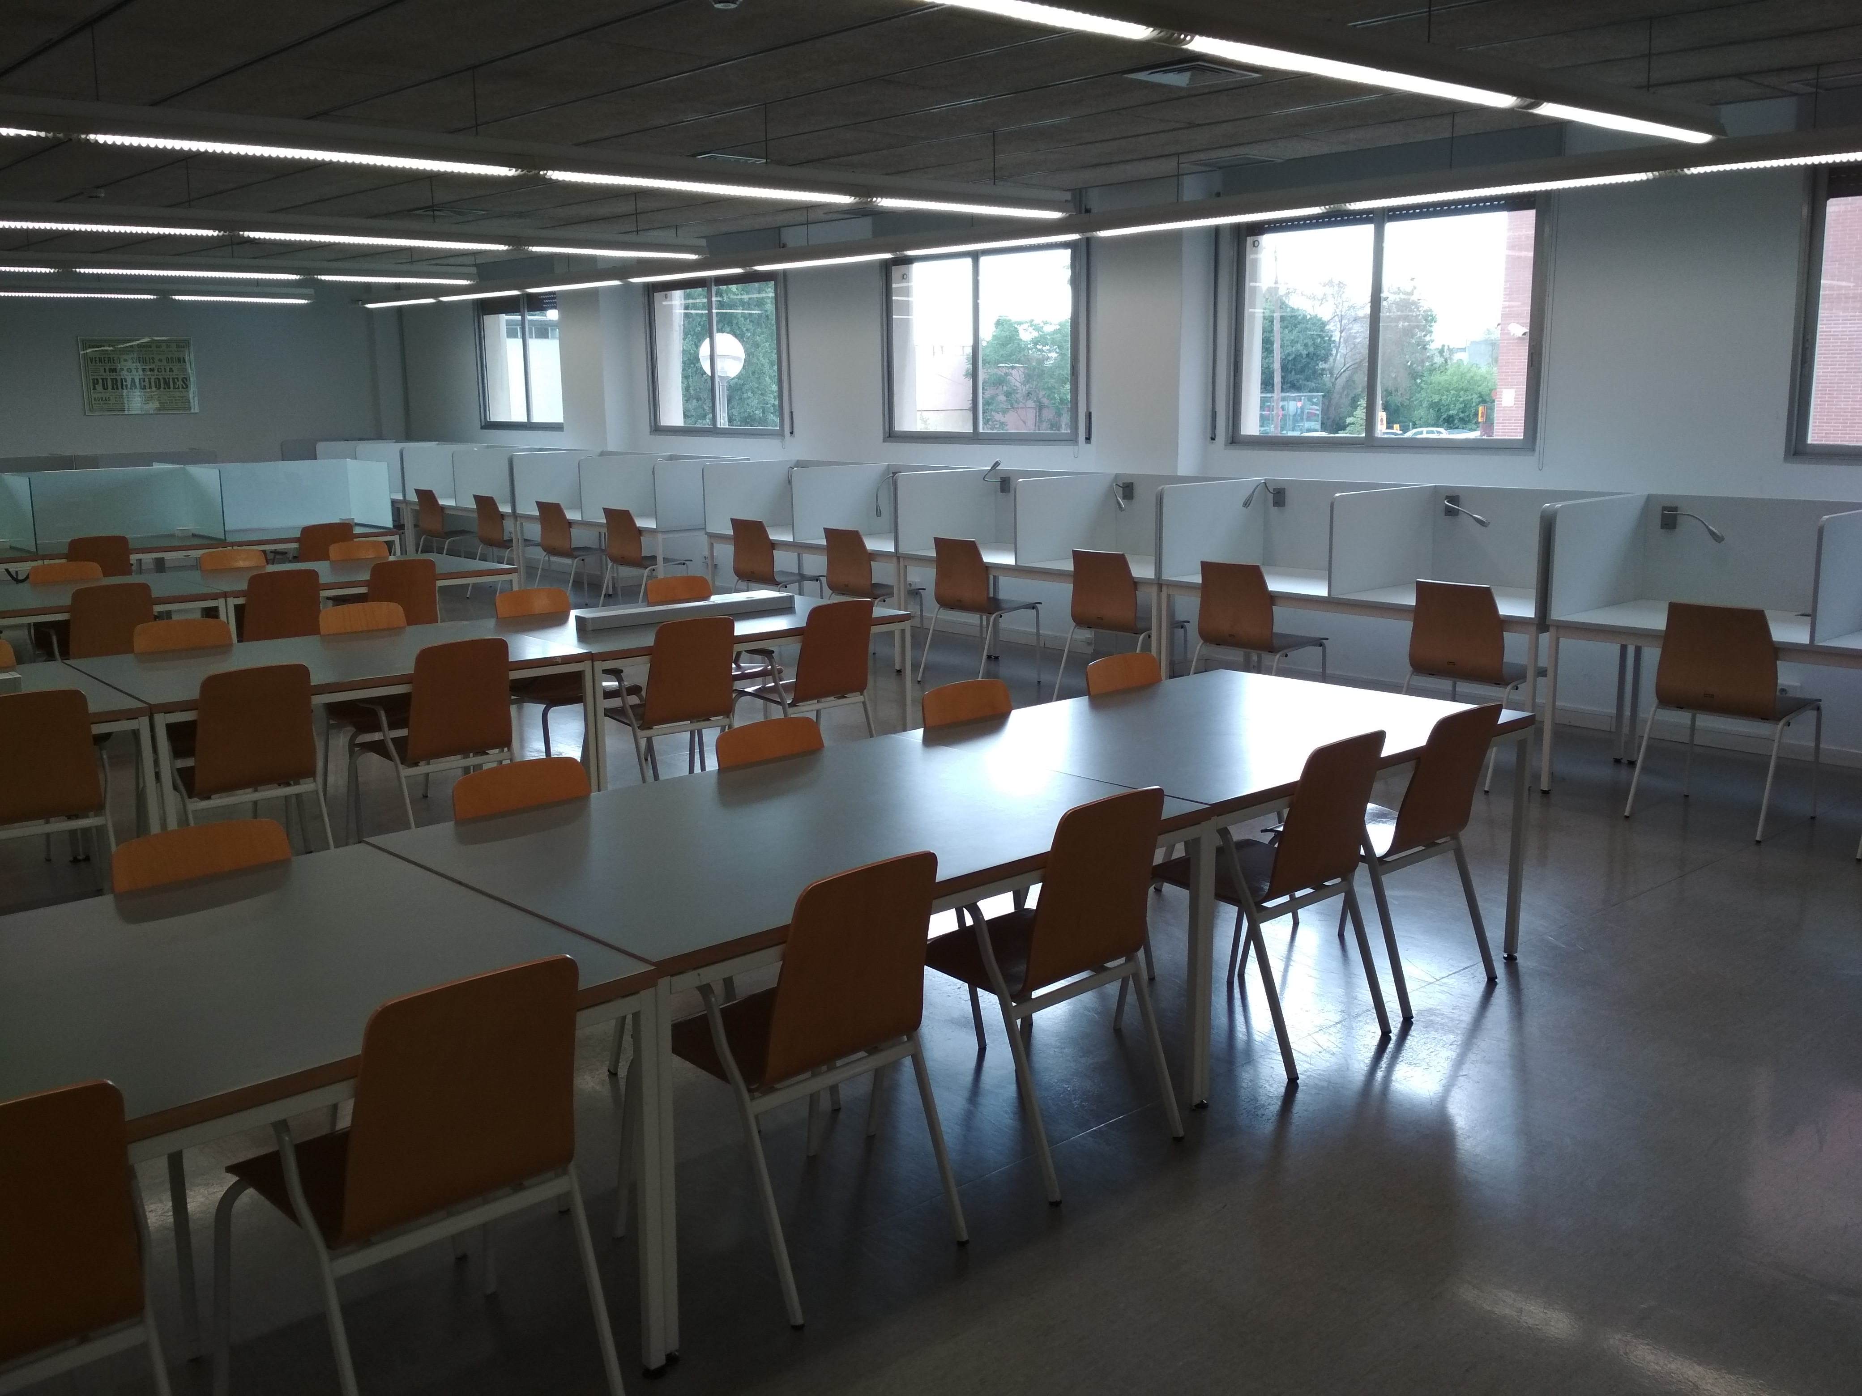
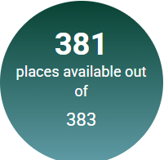
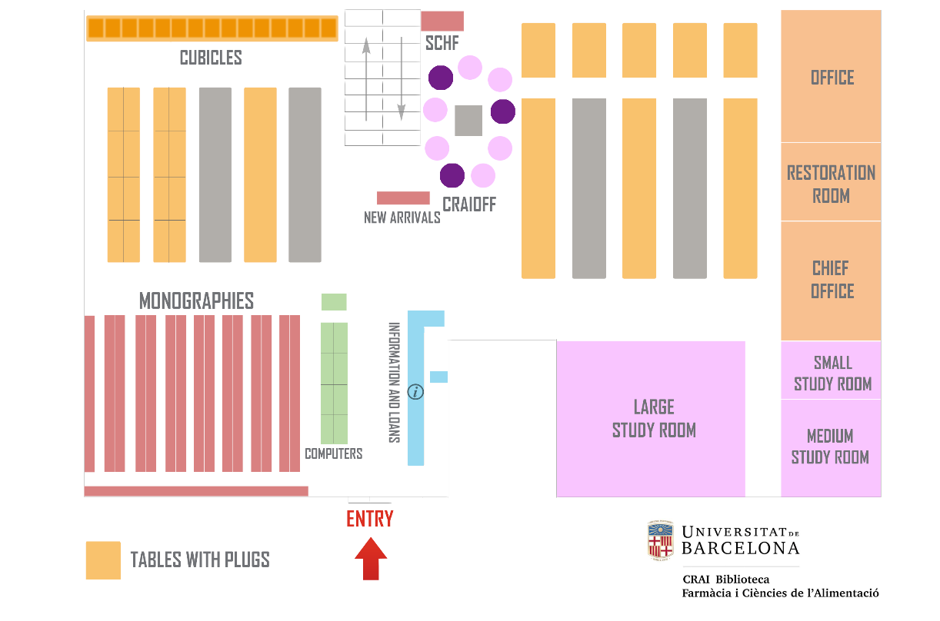
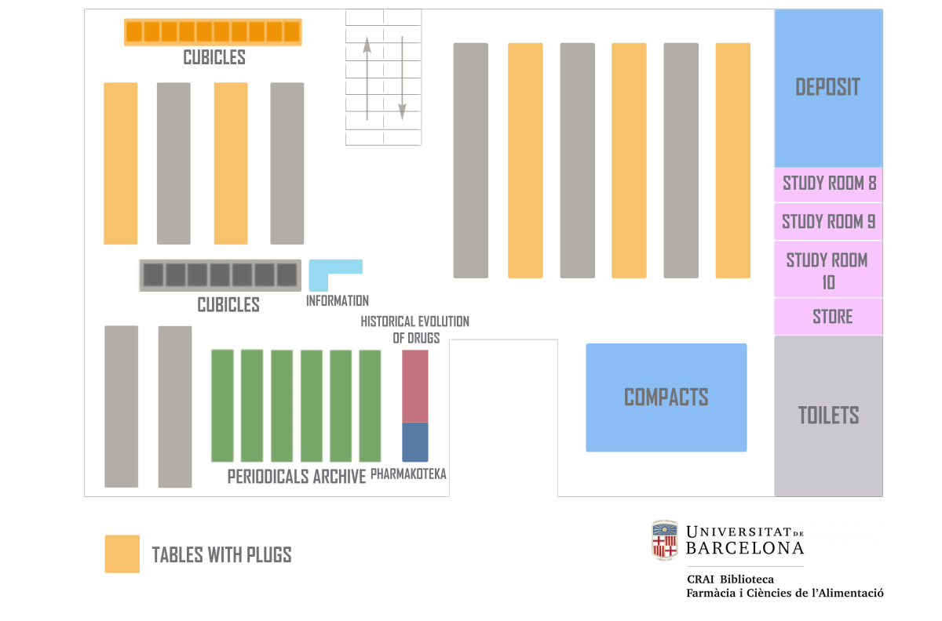
When can you come?
Pharmacy
Monday to Friday,
from 8.30 a.m. to 8.30 p.m.
Library map
You can check the Library's occupancy level in real time
Floor 0
Floor -1

Slide 4
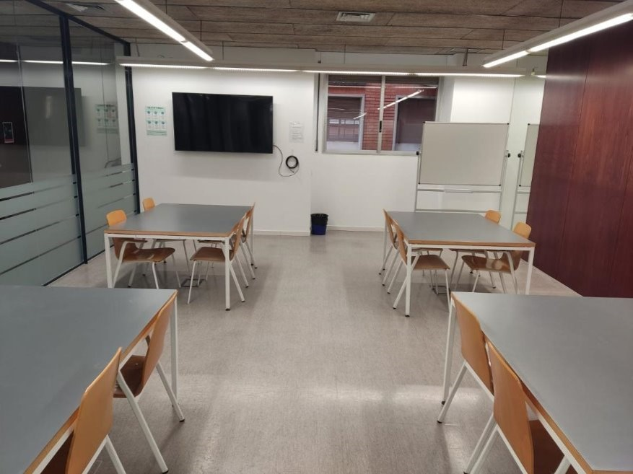





Equipment and facilities
+ 300 reading points
9 computers and 9 laptops*
6 rooms for group work
1 CRAI OFF
Other materials
*4 of the laptops can be used outside the Library, in the Campus facilities.

Slide 5
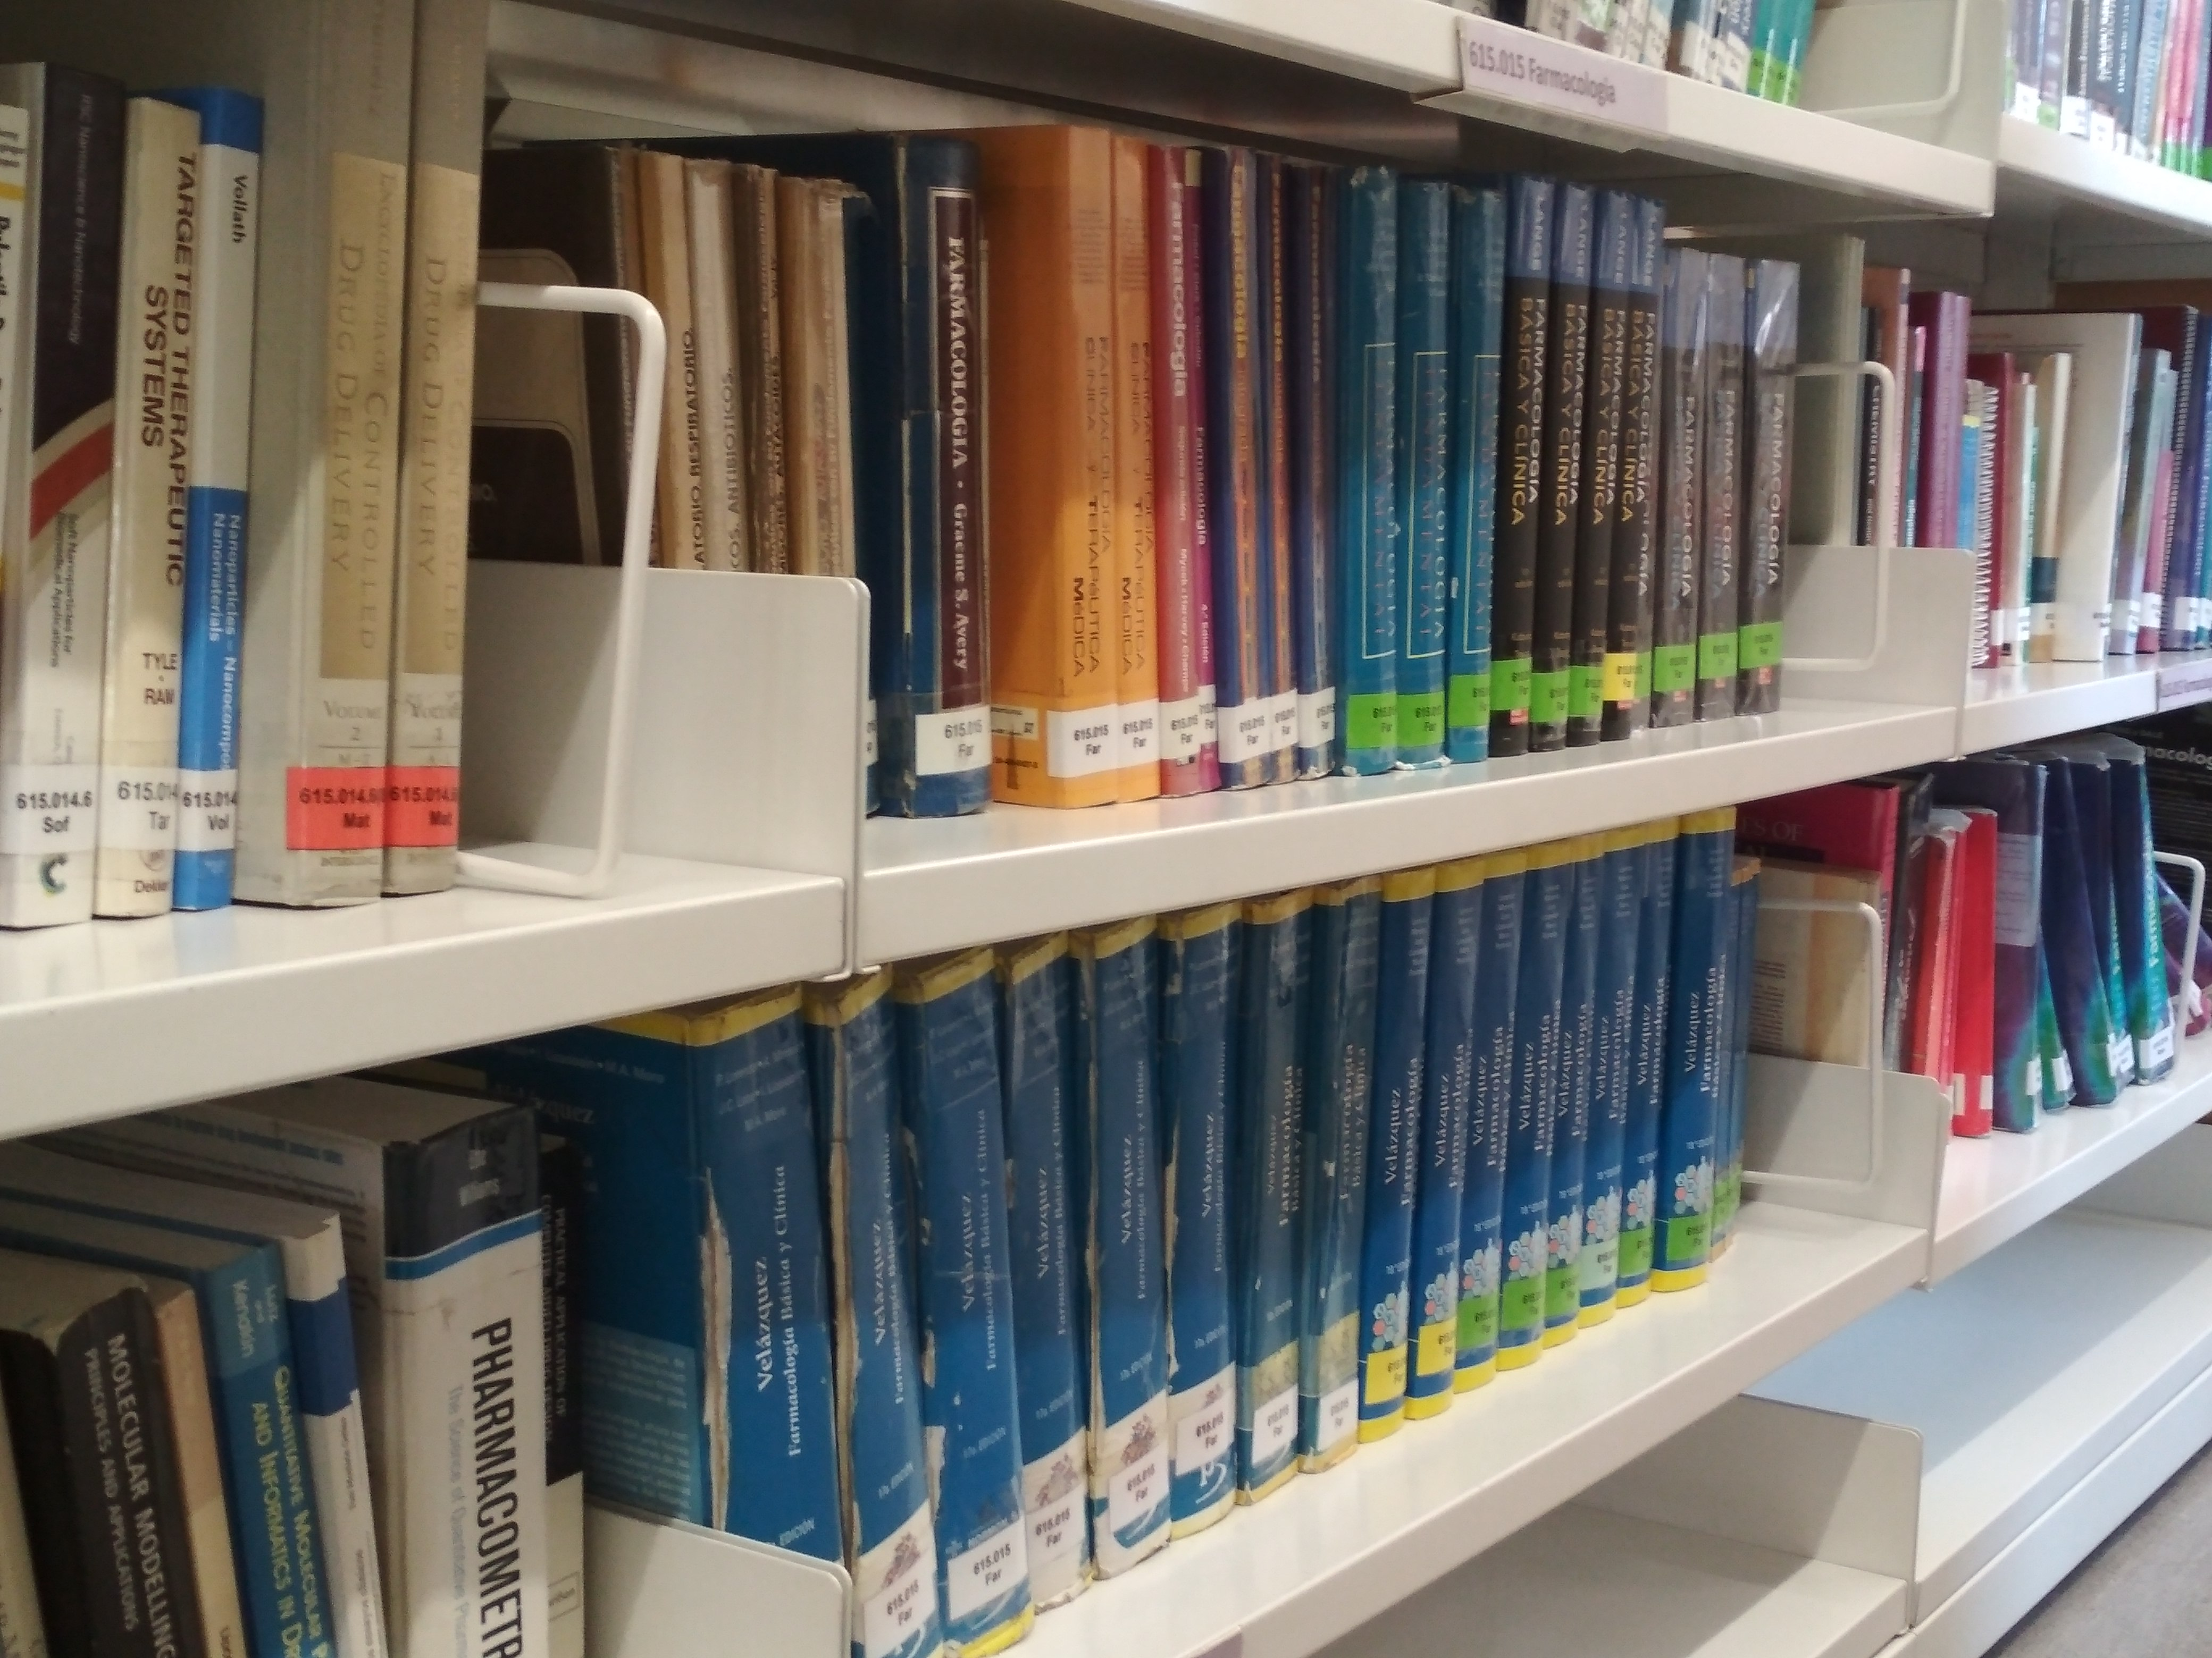






What kind of documents can you find?
Journals
Databases
Reference bibliography
Books
UB Digital Repository: TFG
Audiovisuals

Slide 6
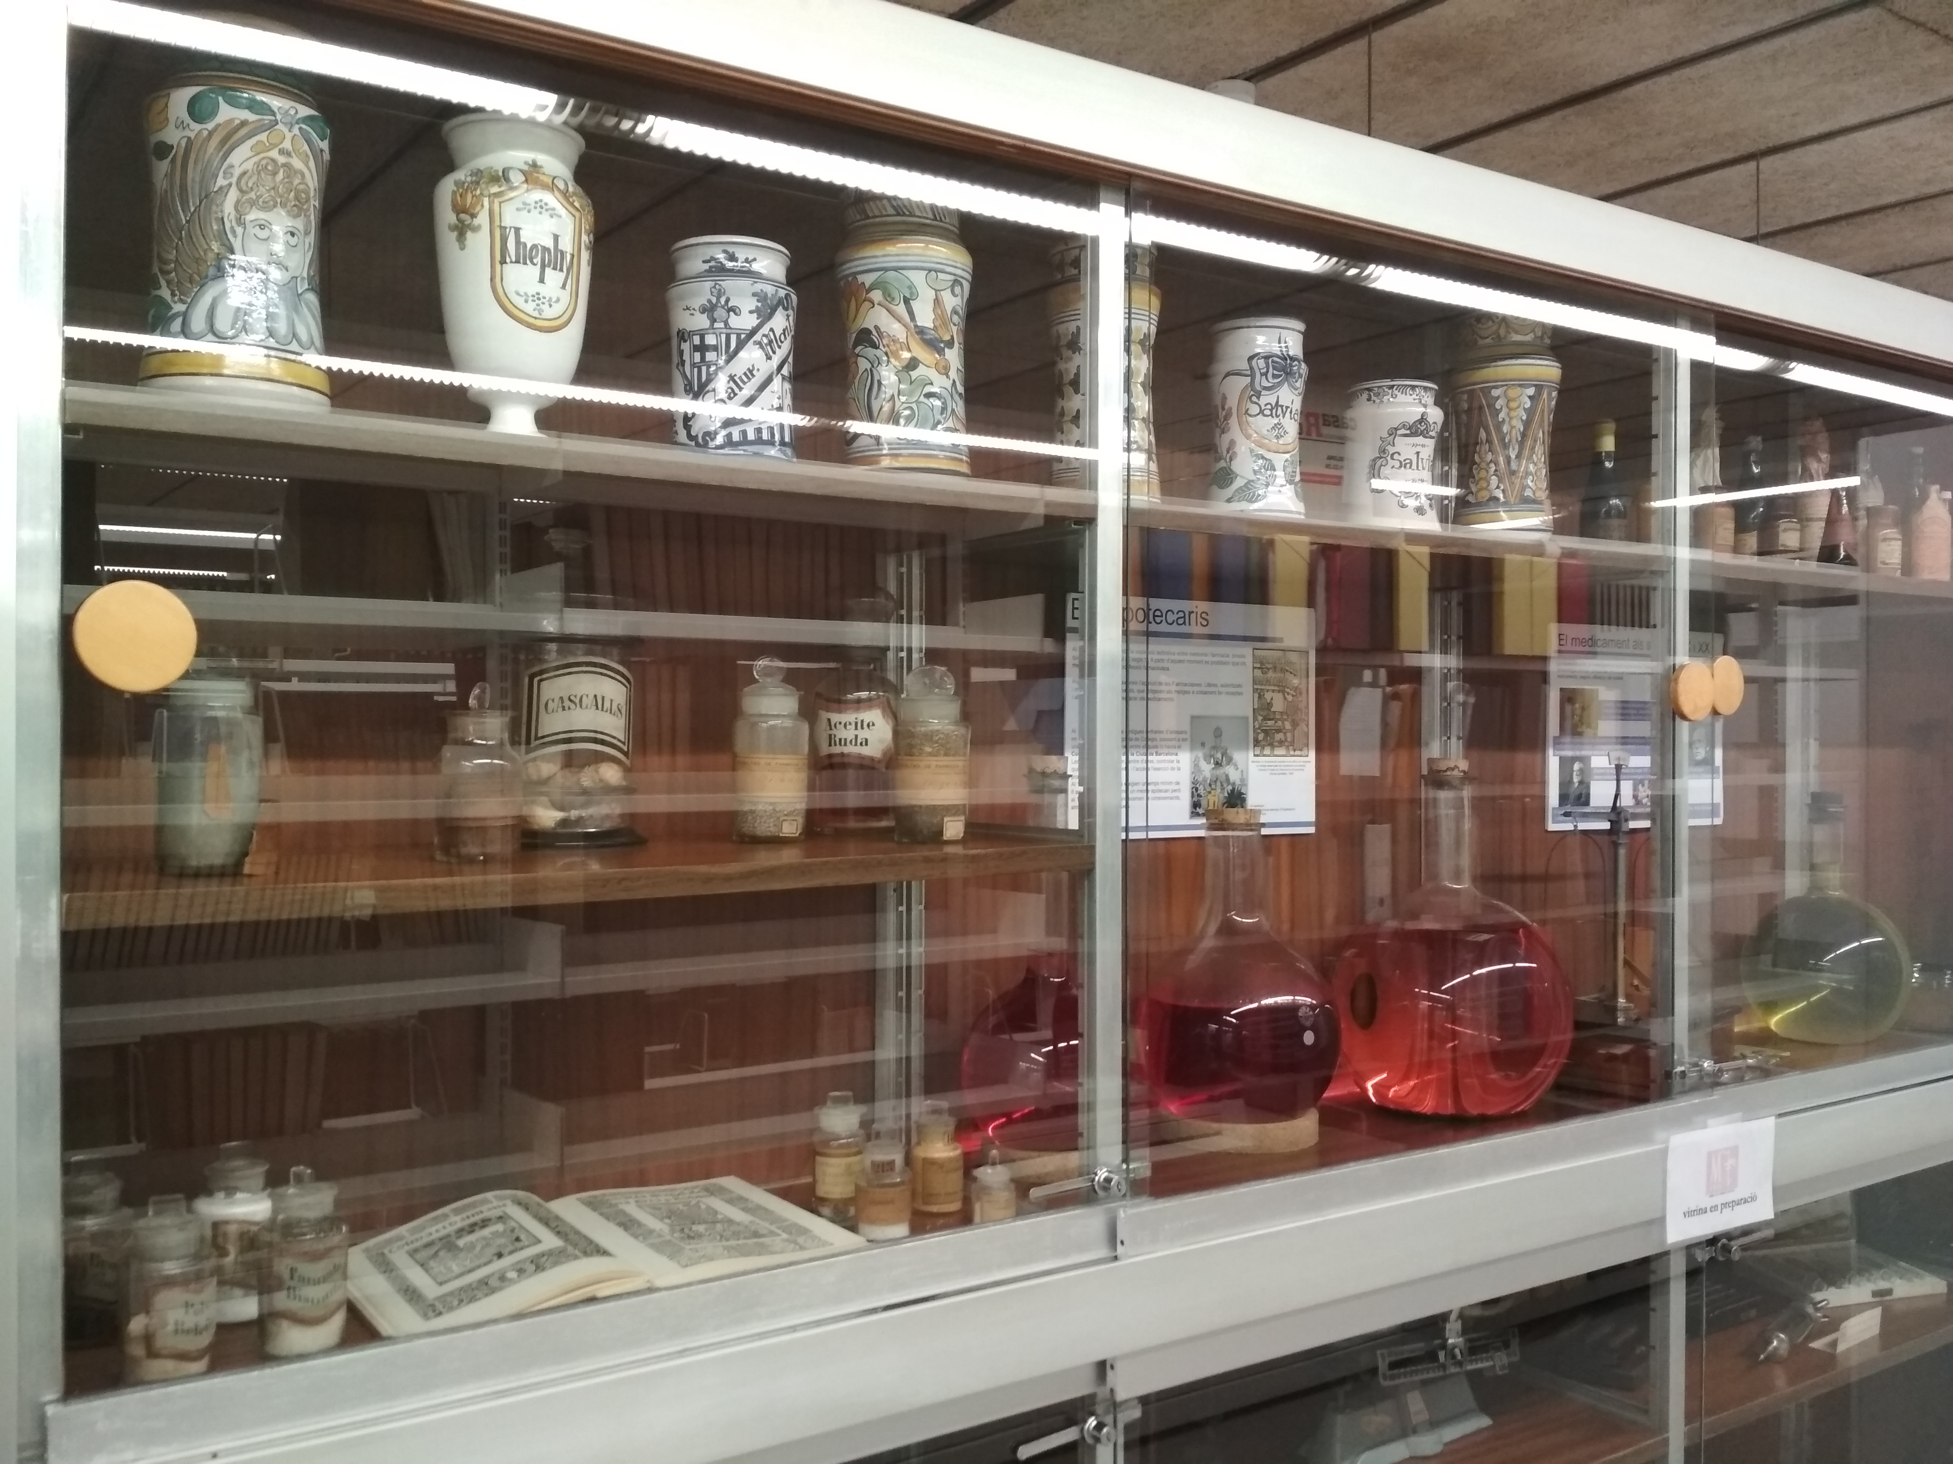
Our collections
Fund of the Catalan Society for the History of Pharmacy
Botany
Pharmacy and pharmacopoeias

Slide 7
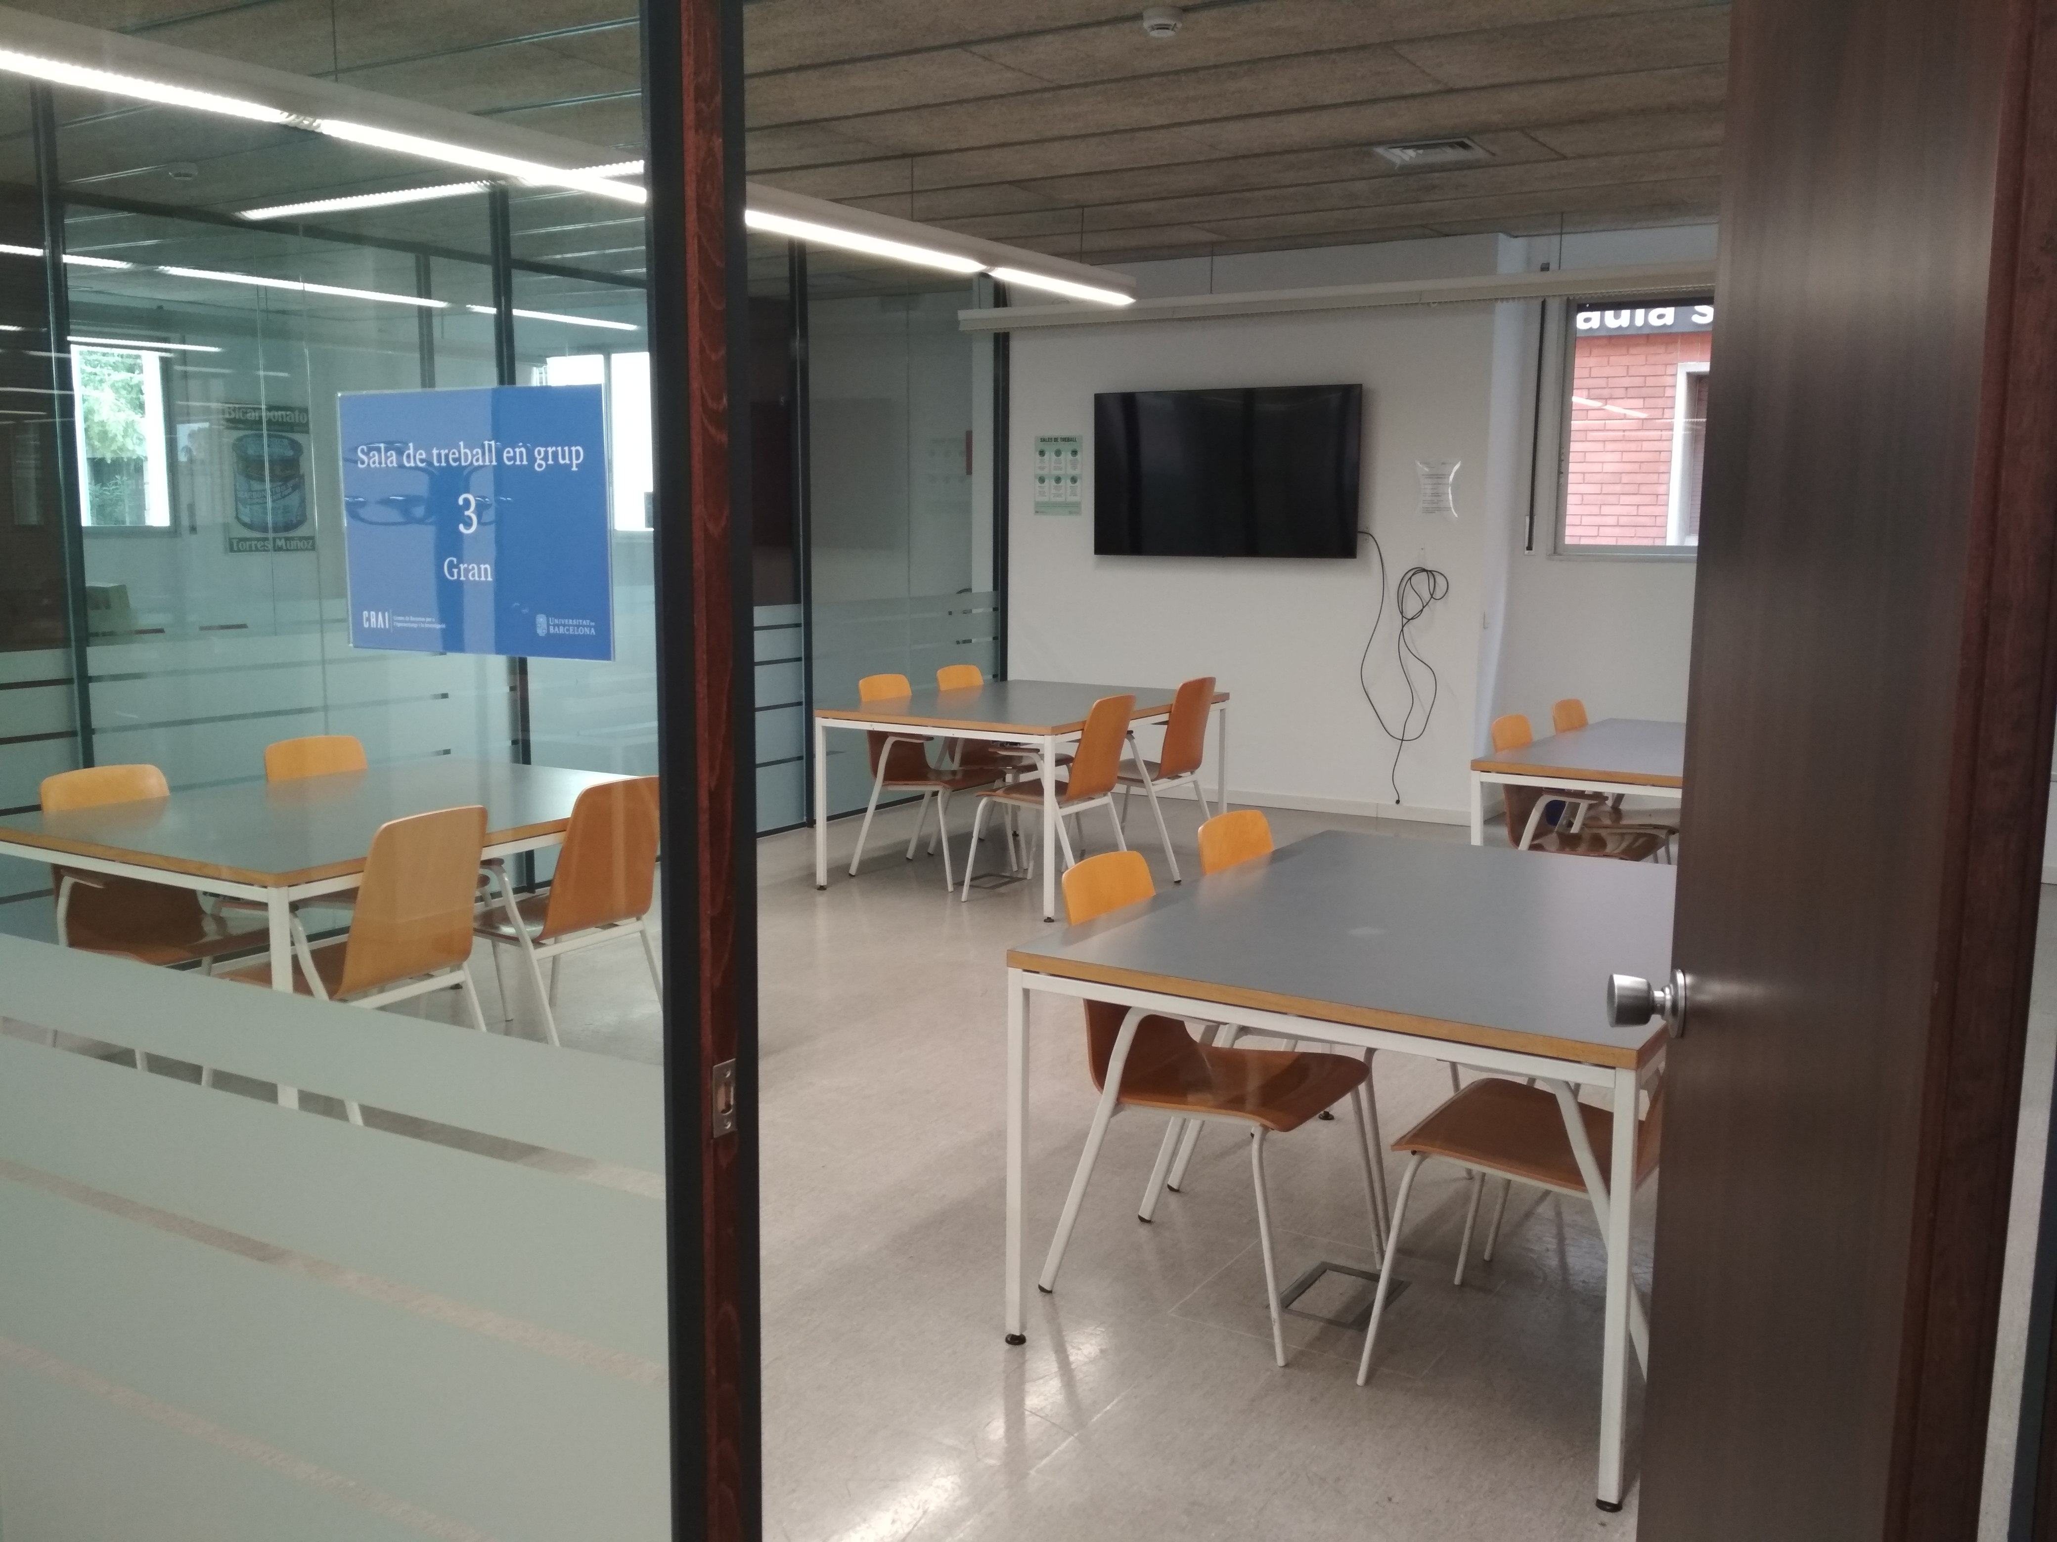
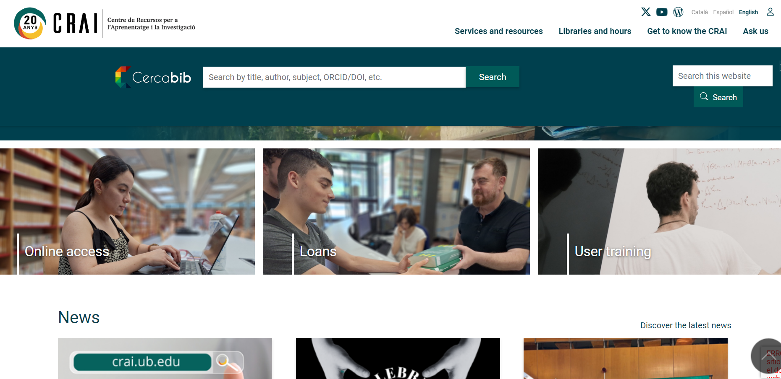
How to find what you are looking for?
https://crai.ub.edu/en

Slide 8
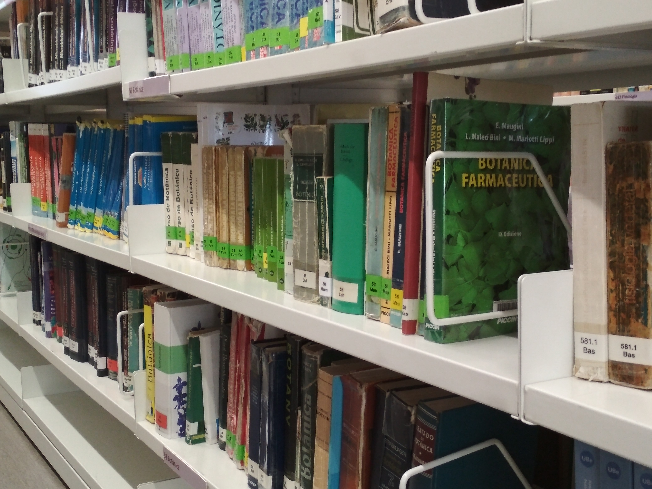

More CRAI services
User support
Space as a service
Information resources
Learning support
Teaching support
Research and open science support
Service charter
of the UB CRAI

Slide 9
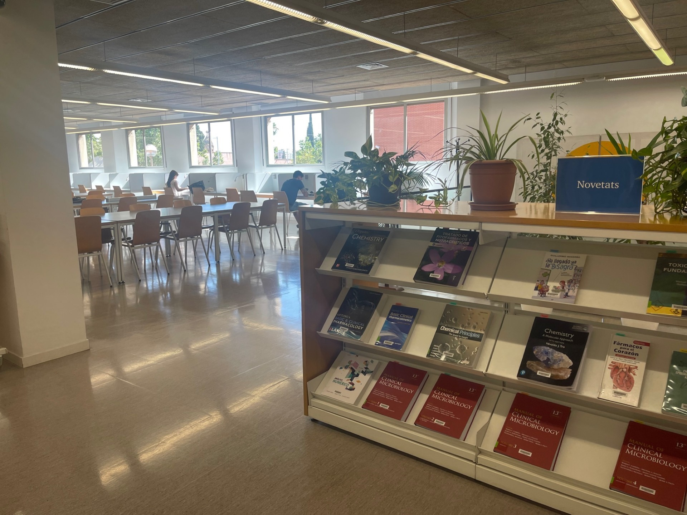
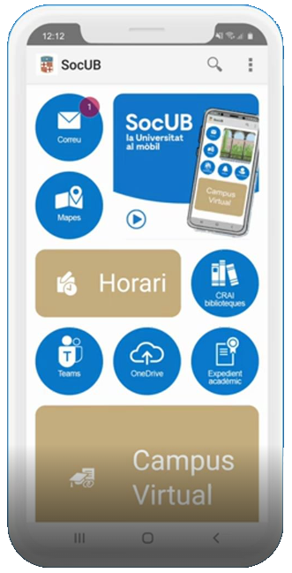
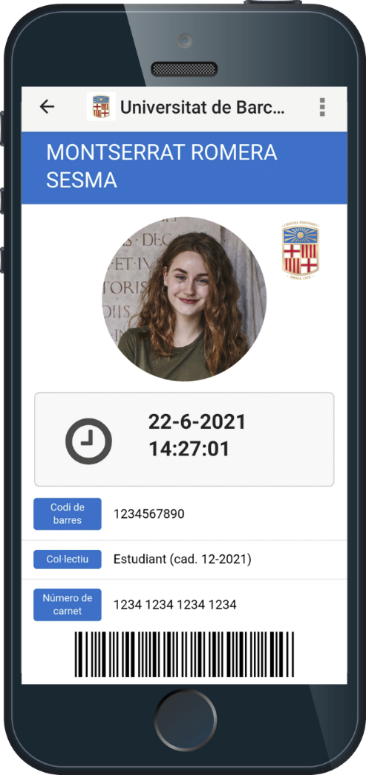
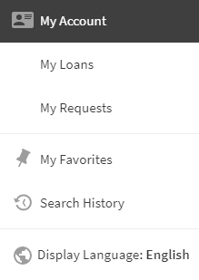

Loans of UB documents
My account
Conditions and loan periods
App SocUB
Digital UB card

Slide 10
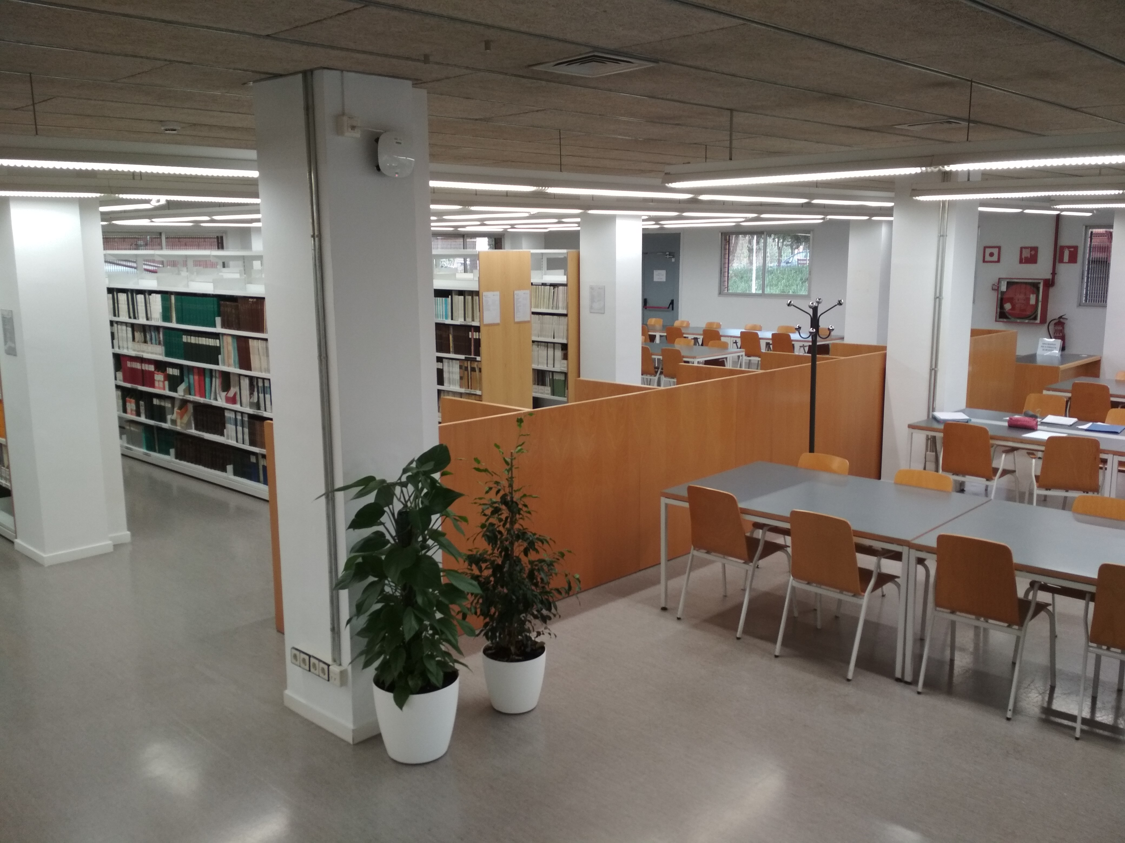


Connecting at UB’s Wi-fi
Eduroam network (Recommended)
UB’s Wi-fi
How to configure it?

Slide 11
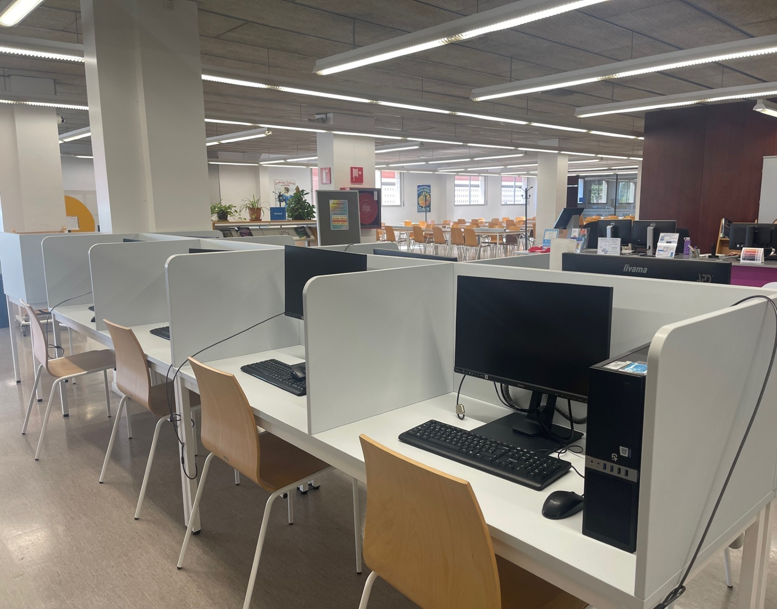



Authentication for online services: Local identifier
Left-hand side of the UB email address.alumnes
email: jarc7@alumnes.ub.edu
local identifier: jarc7.alumnes
+
Intranet UB password
How to set the password and obtaining your personal identifier:
Students >> Help >>

Slide 12
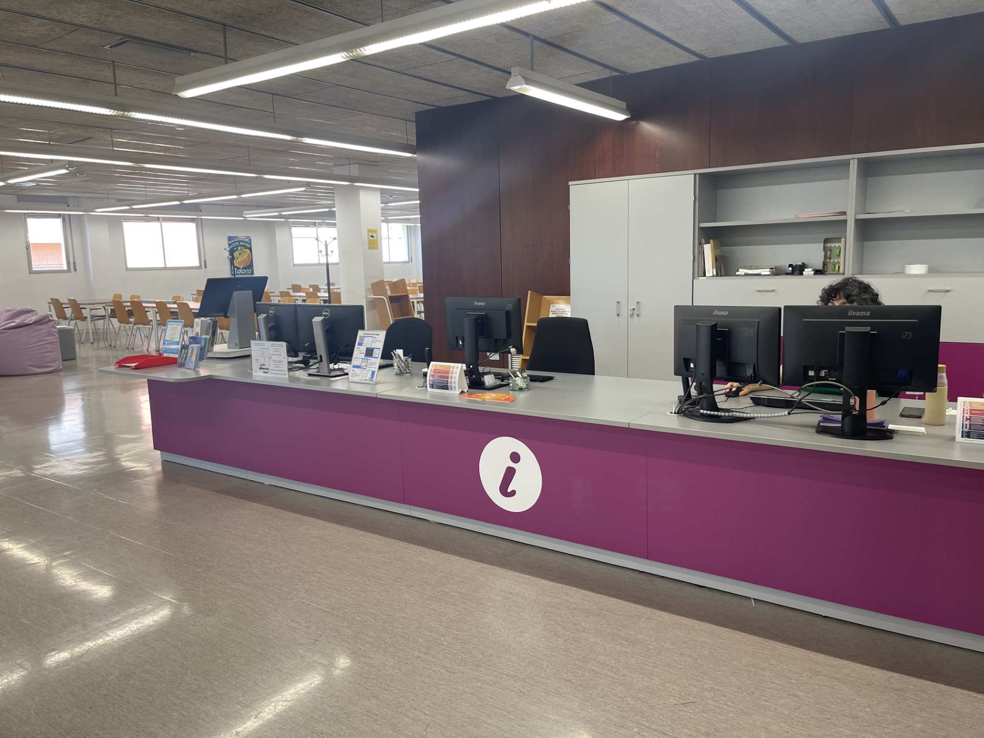





Contact us!
934 021 884
User support service
bibfarinfo@ub.edu
Follow us on social networks!
@craifcca
@craiubfcca.bsky.social

Slide 13
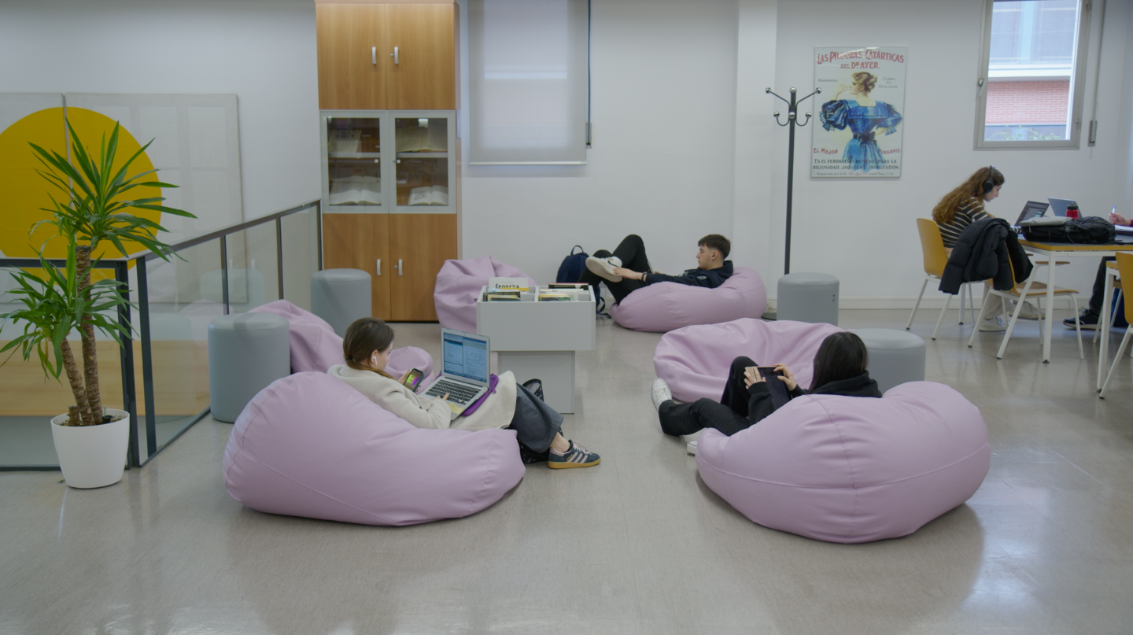
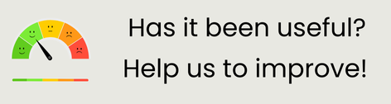

Thank you and welcome!
© CRAI Universitat de Barcelona, academic year 2025-26

