Slide 1
CRAI Project Unit

Slide 2
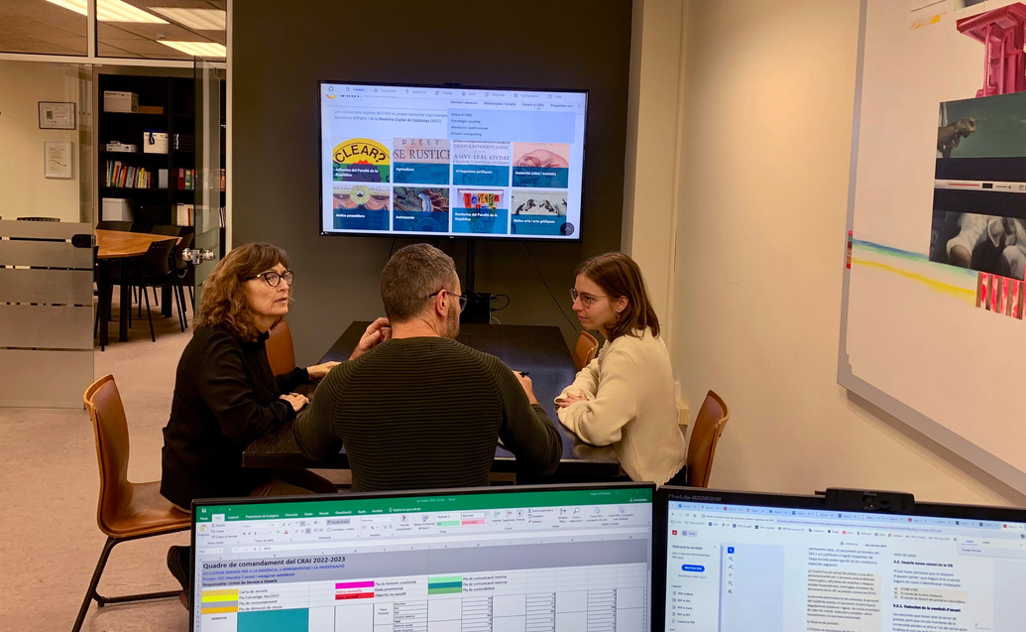
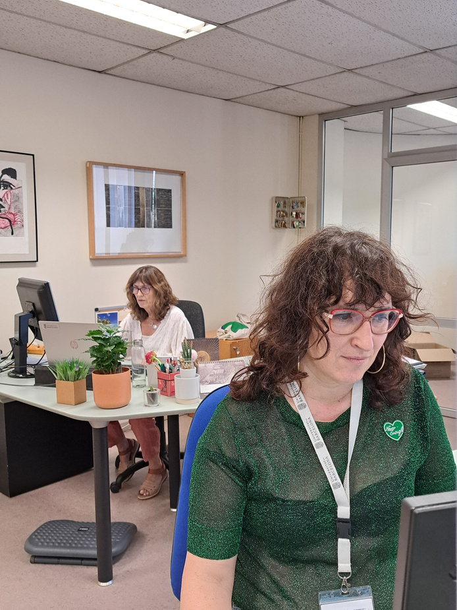
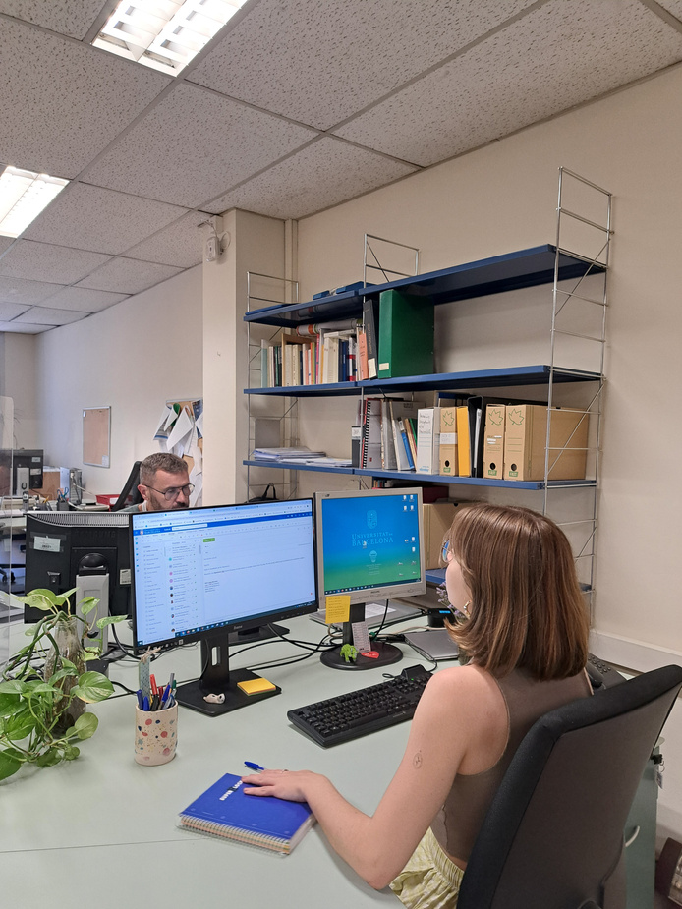
Presentation
The Project Unit (UP) is one of the technical units of The Learning
and Research Resources Centre (CRAI)
of the University of Barcelona.
01

Slide 3
Mission
The mission of UP is to plan, design
and develop projects in accordance
with the CRAI’s mission, strategic areas
and action plans, to improve and innovate in the area of users services.
02

Slide 4
Areas of activity
New projects
& technology prospecting
Website
Marketing & diffusion in social networks
03

Slide 5
... and it is responsible for
To develop new projects, usually in the digital library environment, according to users’ needs
To publish and coordinate material on the CRAI website
To write and distribute news about the CRAI
To study, evaluate and implement information technologies in the CRAI’s services
To create marketing campaigns in line with the priorities of the Annual Marketing Plan
To coordinate the organization of the CRAI’s conferences & seminars
To coordinate, supervise and maintain existing projects
To coordinate the CRAI’s social network channels: blogs, Bluesky, Facebook, etc.
04

Slide 6
Thank you
CRAI of the University of Barcelona, academic year 2024-2025

