Slide 1
Get to know the Philology CRAI Library
Academic year 2021-22

Slide 2
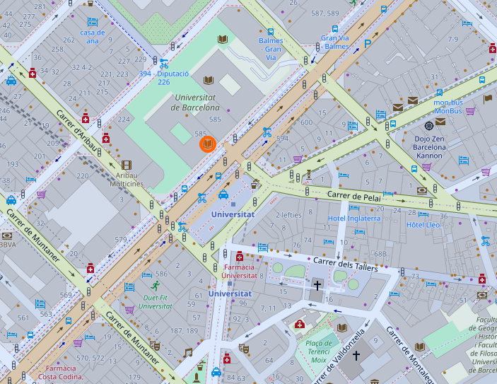
Where are we? When we're open
Address
Gran Via de les Corts Catalanes, 585
08007 Barcelona
Addresses of other libraries
Opening hours
Monday-Friday, from 8:30 to 20:30 h.
Special opening hours in exam periods and at weekends
Library service regulations
CRAI service charter
Contact information
crailletres@ub.edu
Phone number: 934 035 317

Slide 3
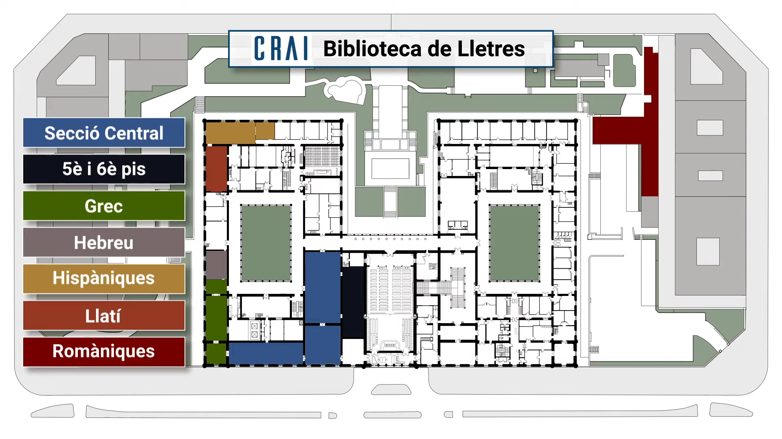
Library Map
Philology CRAI Library
Layouts
Greek (Central)
Hebrew (Central)
Hispanic Studies (Hispàniques)
Latin (Llatí)
Romàniques

Slide 4
The collection
The four sections of the Philology CRAI Library provide comprehensive materials for teaching and research activities at the Faculty of Philology and Communication for the courses: English Studies, Arabic and Hebrew Studies, Literary Studies, Communication and Culture Industries, Catalan Philology, Classics, Spanish, Linguistics and Modern Language and Literature.
It is also a specialized library, as it holds materials from after 1820 from the former Biblioteca Provincial i Universitària (Provincial and University Library) and is responsible for the management of this large encyclopaedic collection, which is an essential part of the history of the University of Barcelona and the city of Barcelona.
The overall collection comprises monographs, printed journals, electronic resources, statistical publications, doctoral theses and audiovisual materials. You can use this form to send your proposals for book purchases.

Slide 5
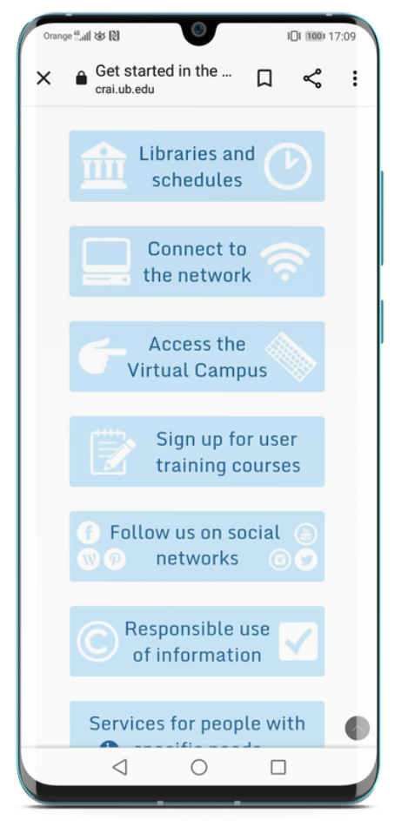
Get started in the CRAI
The Learning and Research Resources Centre (CRAI) of the University of Barcelona at a glance in Get started in the CRAI.

Slide 6
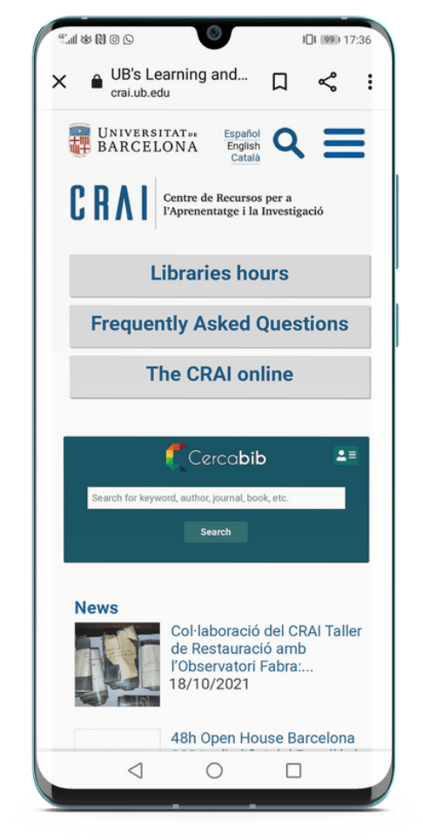
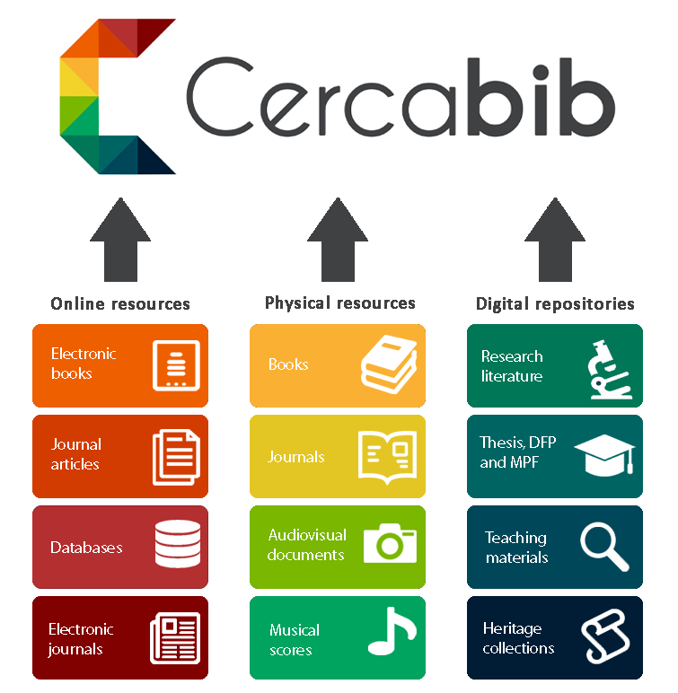
Cercabib
Cercabib is the University of Barcelona CRAI’s discovery tool, which allows you to search simultaneously through the entire CRAI collection, regardless of the format, type or location of your chosen item.

Slide 7
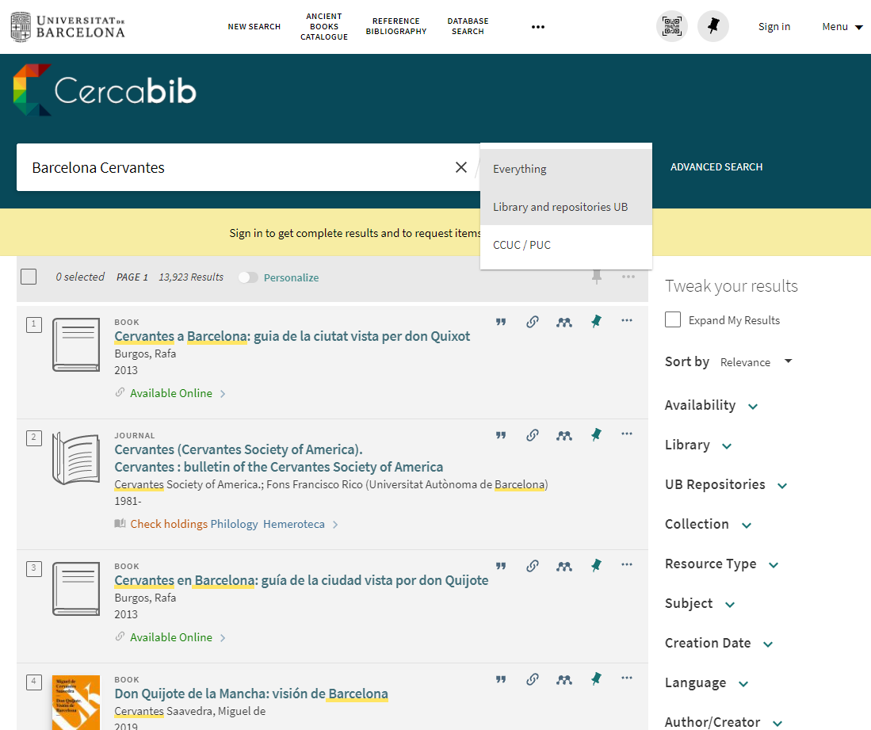
Cercabib: basic search
Limit results to catalog
Start your search by typing a keyword or a phrase.
Refine search results here

Slide 8
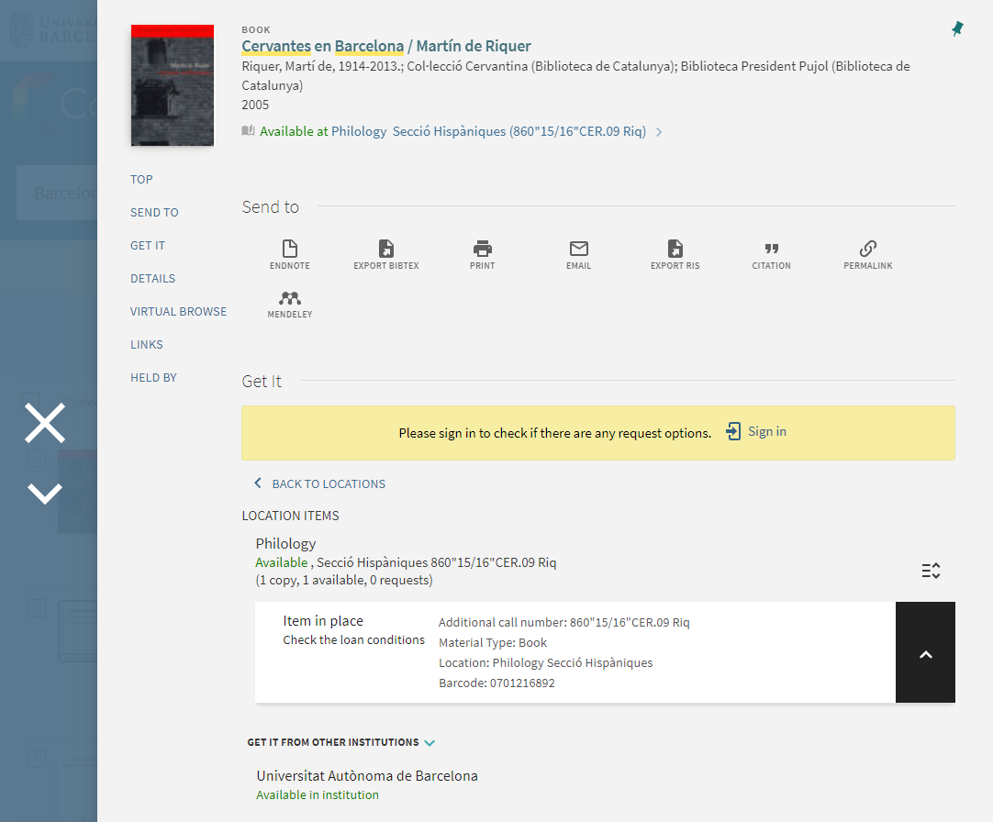
Cercabib: where do I find it?
The document is available at Hispàniques section.
Use the call number to find the document on the shelf.

Slide 9
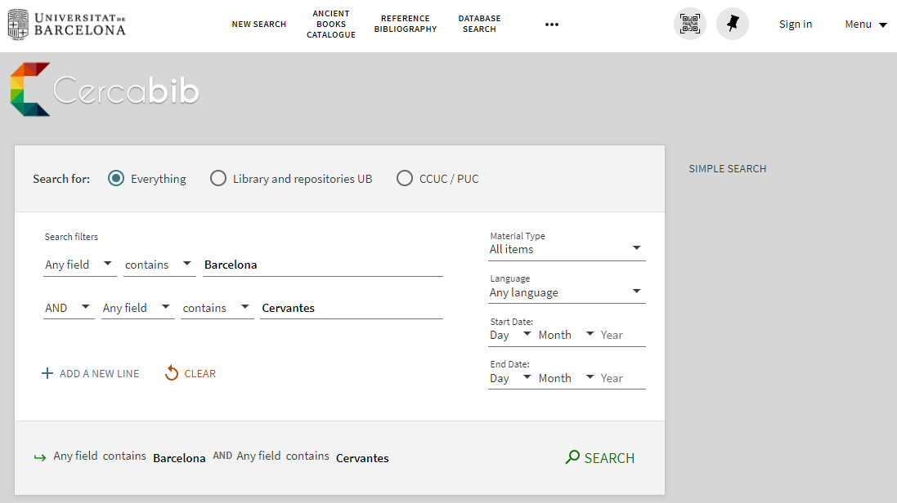
Cercabib: advanced search
Apply filters to refine your query and limit the search results.
Combine search fields

Slide 10
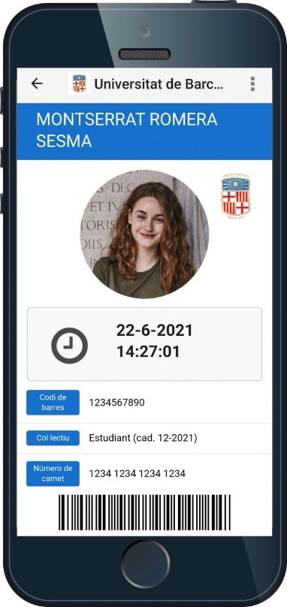
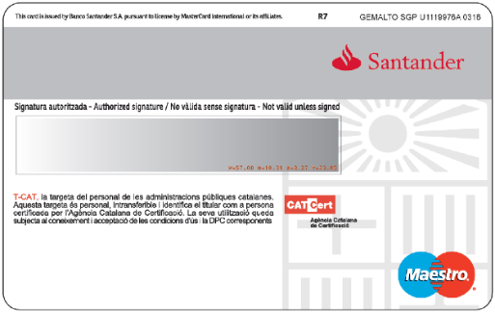
Document loans
Loan service
Documents that cannot be taken out on loan:
Journals and reference works (encyclopaedias, dictionaries, etc.). If digital versions are available online you can consult them off UB premises.
Rare books and manuscripts.
Books with a red dot.
Recommended reading list:
Loan for up to 10 days.
You must have a University of Barcelona Card or ID that provides you are entitled to take out loans.
Digital card, SocUB mobile app
University smartcard.

Slide 11
Loan periods
Users | Documents | Days *
University of Barcelona teaching and research staff (PDI) | 40 | 60
Postgraduate students and administrative and service staff (PAS) | 20 | 30
Bachelor's degree, postgraduate and university extension students | 10 | 21
Audiovisual material: 21 days
* Recommended reading list: 10 days
Recommended weekend reading list (from Friday to Monday): 3 days

Slide 12
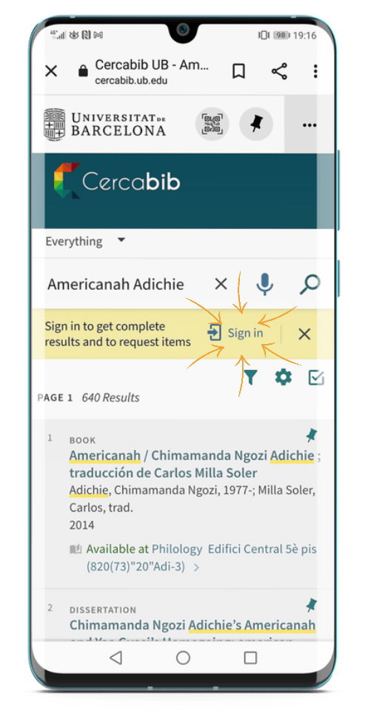
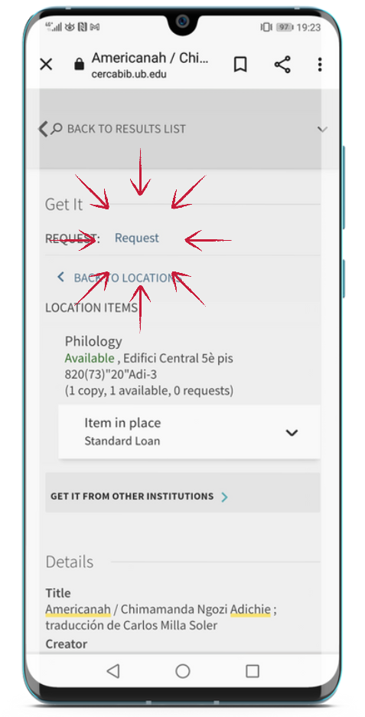
Document loans
Reservations
You can reserve a maximum of 8 items, through My account or from the loan desks.

Slide 13
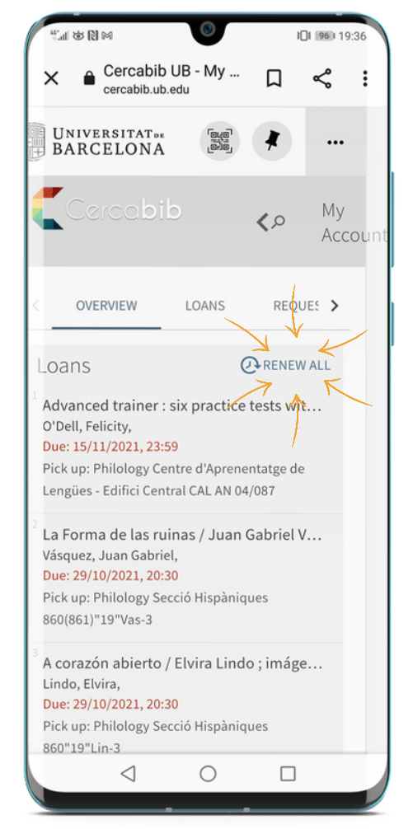
Document loans
Renewals
You can renew loans as often as you need, as long as the item has not been reserved by another user. You can renew documents at the loan desk, by telephone, or via My account on the CRAI website.
Penalties
If you do not return documents on time, you will be barred from using the service for 1-6 days, depending on the item and the number of days overdue:
Normal loan and audiovisual material: 1 day
Recommended reading list: 4 days
Weekend recommended reading list: 6 days

Slide 14
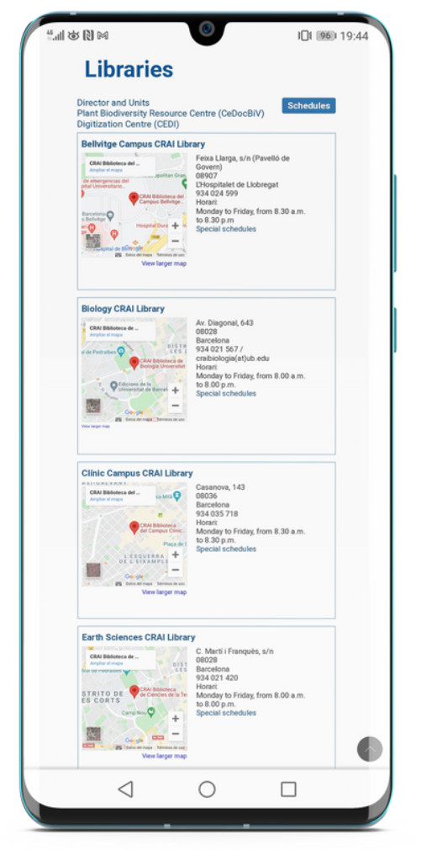
Loan from other UB libraries
If you need an item from another UB library you can:
a) go to the library where the item is held and take it out on loan, or
b) ask the loans desk in your library to transfer the item from its home library. You will receive it in 2 to 3 days.
c) order it directly from My Account.

Slide 15
Library consortium loans (PUC)
The PUC is a free loan service through which users can request and borrow items from another library in the Consortium of University Services of Catalonia (CSUC).
How to request an item
In person, at the library that holds the item: PUC in situ.
Online.
Where to return items
To any CRAI library.
To any of the libraries linked to the institution that holds the item.
User | Items | Renewals | Loan period (days)
Bachelor’s degree students, EHEA undergraduates, Accredited Alumni UB, Postgraduate students, master's degree and doctoral students, Teaching and research staff, Administrative and service staff. | 10 | 6 | 21

Slide 16
Equipment loans
Study rooms
Laptops
This loan service is designed to make it easier to use CRAI library workrooms for individual or group work.
You can reserve study rooms through Cercabib.
Philology study rooms.
Laptops can only be used on library premises.
Request and return laptops at the loans desk.
Read, complete and send the loan agreement form.
Service not available to users currently under a late returns penalty.
Laptops loans available for up to 4 hours.
No reservations.
Regulations

Slide 17
What do I have on loan? My account
This service enables you to access your CRAI user record.
Once you have logged on, you can view and renew your loans, reserve new items, create lists of records, etc.

Slide 18
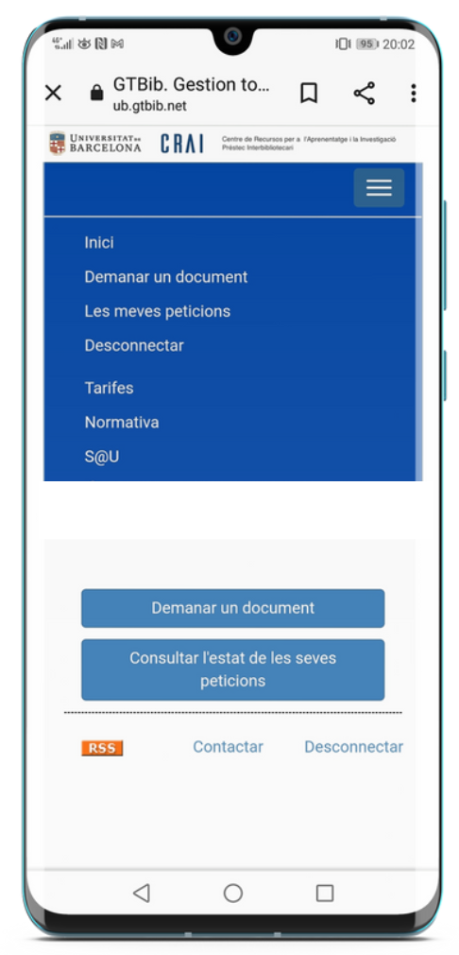
Interlibrary loans
The interlibrary loan service enables users to locate and obtain the original or a copy of any item that is not held by the CRAI and is not available from other Catalan universities through the PUC.
It also centralizes the loan of CRAI collection items to other institutions. This is a paid service.

Slide 19
Wi-Fi and access to Faculty computers
The University's Wi-Fi service enables you to connect to the Internet. To use UB Wi-Fi (wifi.ub.edu) and Faculty computers, log on using your local username.
The University of Barcelona is actively involved in the Eduroam project, which promotes a unique e-mobility environment giving users access to the Internet at all participating organizations.
Access to resources online.
User group | Ending | Email address | Local username | EDUROAM username
PAS / PDI |  | joan.pere.garcia@ub.edu | joan.pere.garcia | joan.pere.garcia@ub.edu
Students | .alumnes | jherg07@alumnes.ub.edu | jherg07.alumnes | jherg07.alumnes@ub.edu
Alumni UB | .a | pperez@alumni.ub.edu | pperez.a | pperez.a@ub.edu

Slide 20
Usernames and password
Service | Username | Password
Computer access | local username [the local part of your UB mailbox + .alumnes] For the mailbox: mgarm008@alumnes.ub.edu the username is: mgarm008.alumnes | UB password
UB Wi-Fi
My account *
Catalan university library loan (PUC) *
Virtual Campus*
MónUB *
Accessing electronic resources (SIRE) *
Interlibrary loans *
Eduroam Wi-Fi | Eduroam username [local username + @ub.edu] local username: mgarm008.alumnes, Eduroam username is: mgarm008.alumnes@ub.edu
UB email | UB email is the username
* Also with UB username (4 characters: you can find it at your enrolment confirmation)

Slide 21
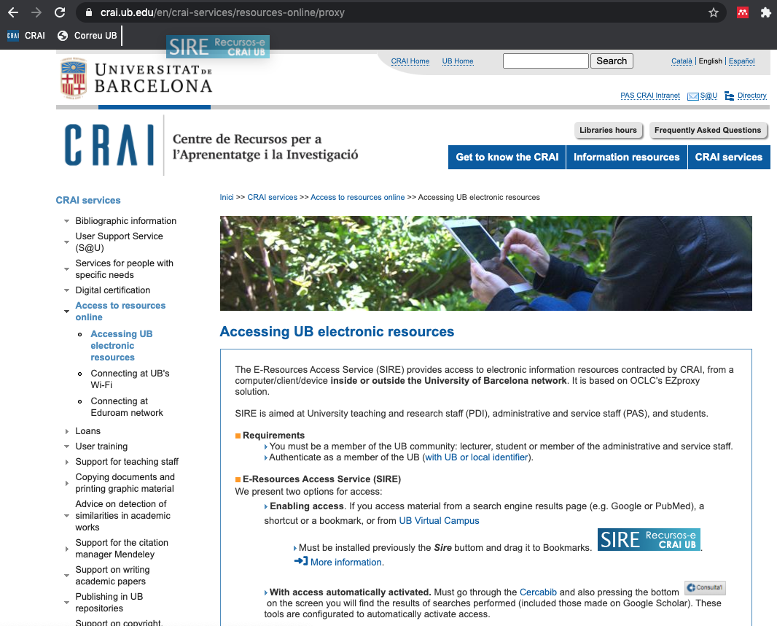
Access to online resources
Use the E-Resources Access Service (SIRE) to consult the electronic information resources to which the CRAI subscribes from a computer or device within or outside the UB network.
To log on to SIRE, you will need the local username or the MónUB username and the UB password.
Drag the button to the bookmarks bar.

Slide 22
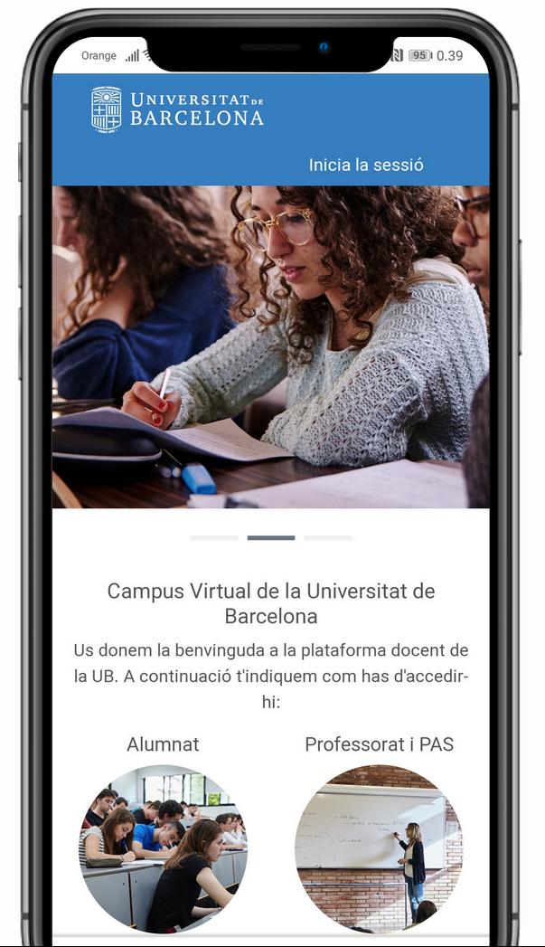
Virtual Campus
Virtual Campus is the online tool for accessing your subjects and consulting recommended reading lists, teaching materials and activities.
https://campusvirtual.ub.edu

Slide 23
S@U, User Support Service
S@U is a 24x7 online information and reference service manned by specialized librarians, who can answer any doubts you have about the CRAI libraries and the full range of services and resources.
S@U is also the channel for delivering your complaints, suggestions and messages of thanks.

Slide 24
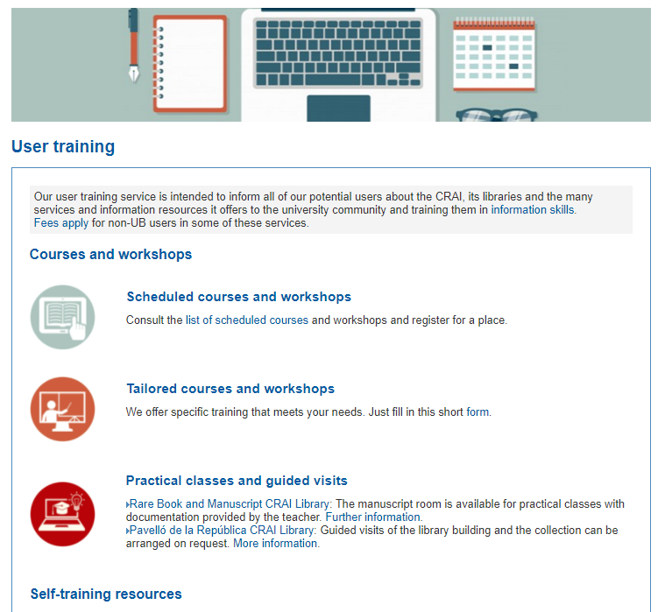
User training
Training courses are available to users who wish to improve their knowledge and search skills; for example, courses on specialized databases or the Mendeley reference manager.
Information about scheduled courses and self-training resources are available on the CRAI Web, and personalized courses can be arranged on request.

Slide 25
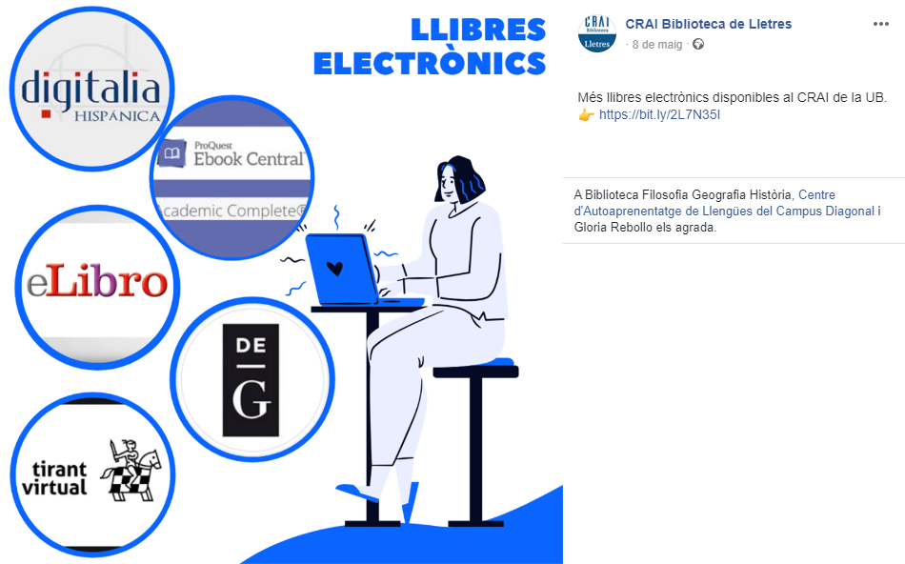
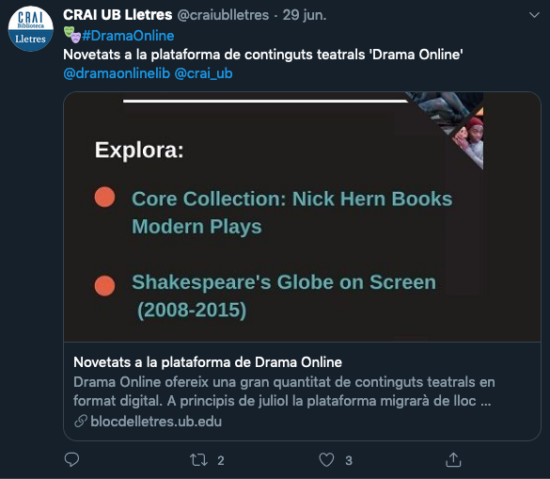
Follow us on social networks: @craiublletres

Slide 26
And if you still have questions...
Ask the CRAI staff
Library staff can answer the majority of your questions.
CRAI home page
The section Frequently asked questions
provides answers to a number of common queries.
S@U, User Support Service
Online information service for any questions about CRAI Libraries and the full range of resources and services. S@U is staffed by specialized librarians and is available 24 hours a day, seven days a week.
Or call us on
934 035 317

Slide 27
Thank you!
© CRAI Universitat de Barcelona. Academic year, 2021-22

