Slide 1


New way to search in ...

Slide 2


What is Cercabib?
It’s a bibliographic resources discovery tool
New version of searching:
      Quick Search: Simple Search
      Narrowing the search by several filters: Advanced Search
      Directly access to the electronic resources
Physical resources available
UB
Repositories
    Digital resources (subscribes and open access selected)
Resources non subscribed

Slide 3
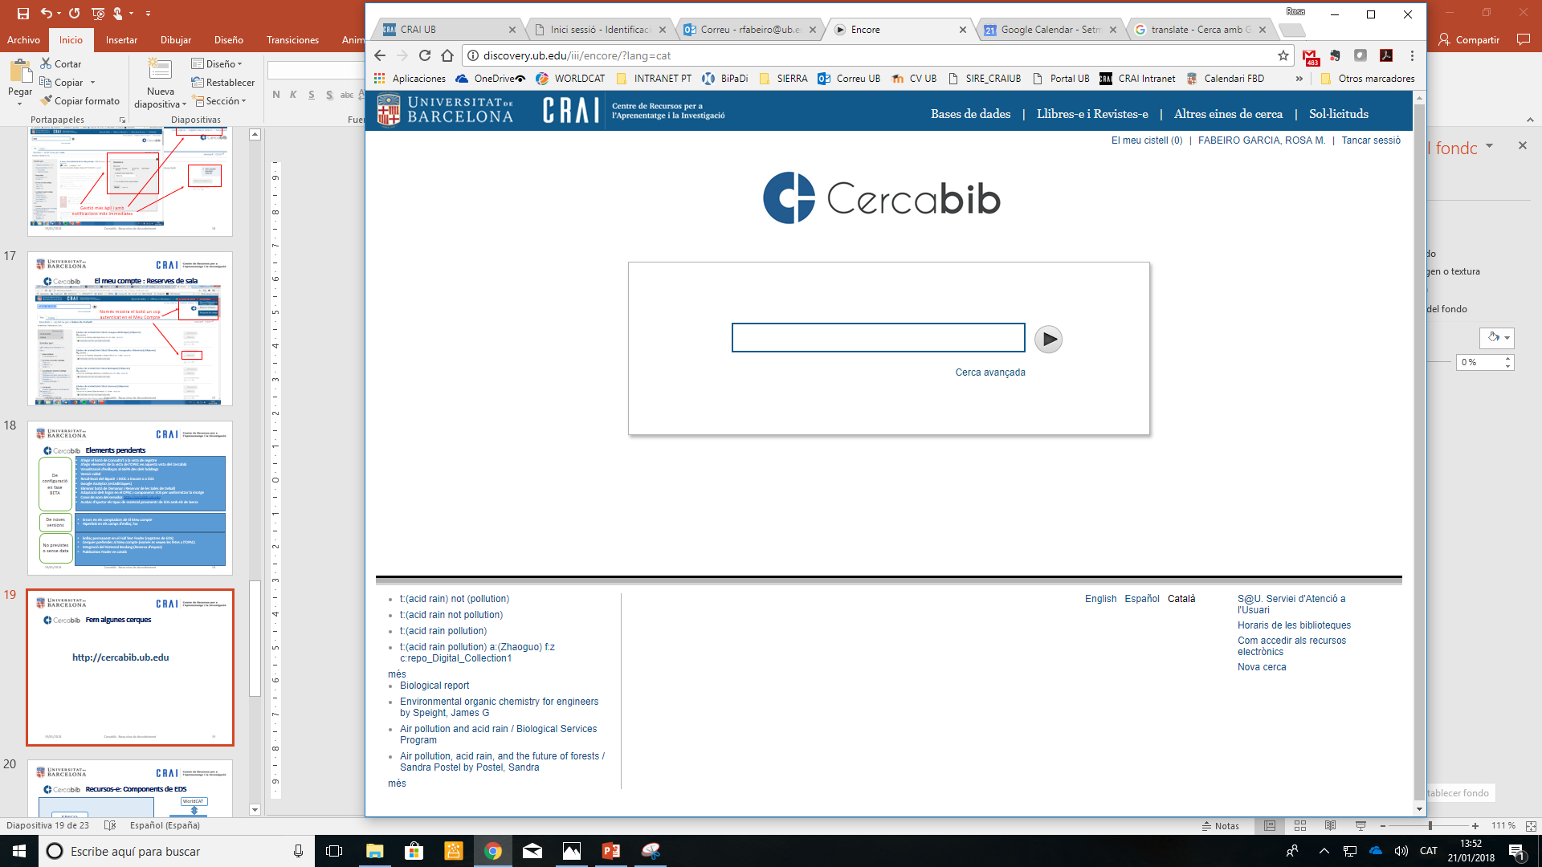
Configuration
Quick links
Search box
Interface languages and other links
Diacritic sensitivity in searches
http://cercabib.ub.edu
History of your search

Slide 4
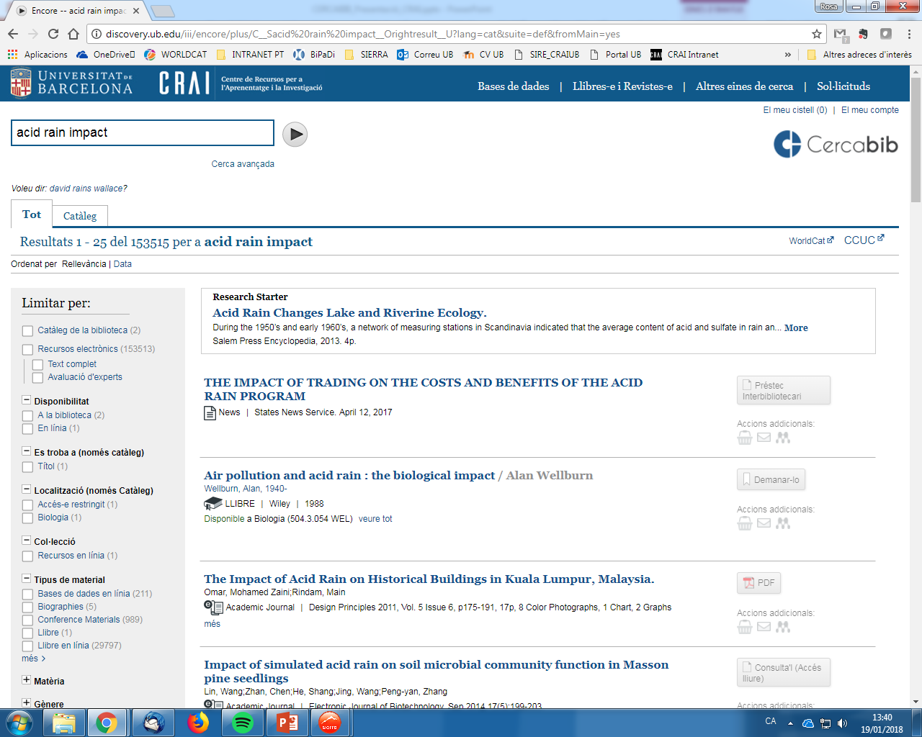
Elements of the results
Where to search?
Expand your search
Research Starter de EBSCO
Manage Result documents
Subjects area and filters

Slide 5
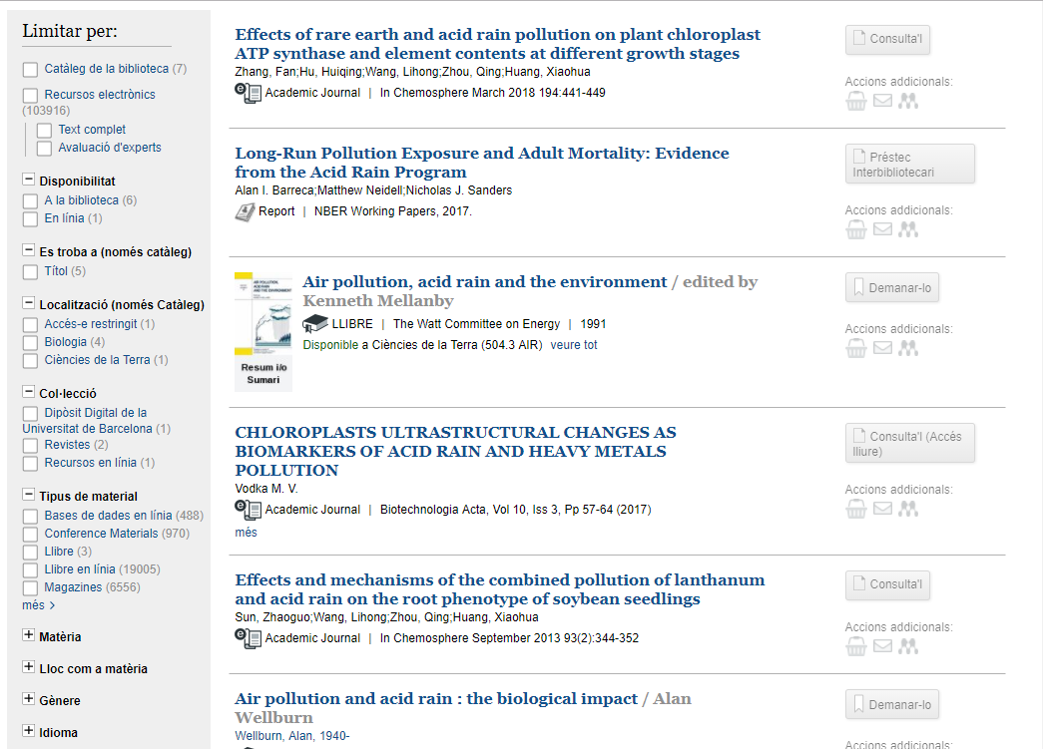
How can you narrow the search? (1)
Search in catalog and electronic resources
Only in UB
Catalog
and
Collections

Slide 6
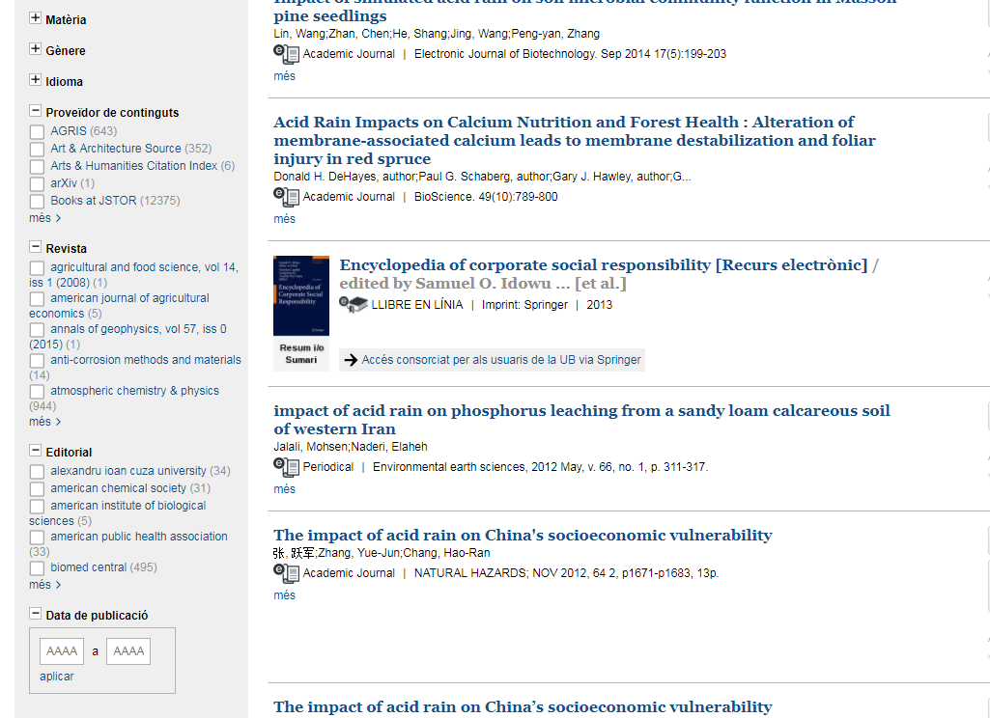
How can you narrow the search? (2)
Only search in EDS
(EBSCO Discovery Service)

Slide 7
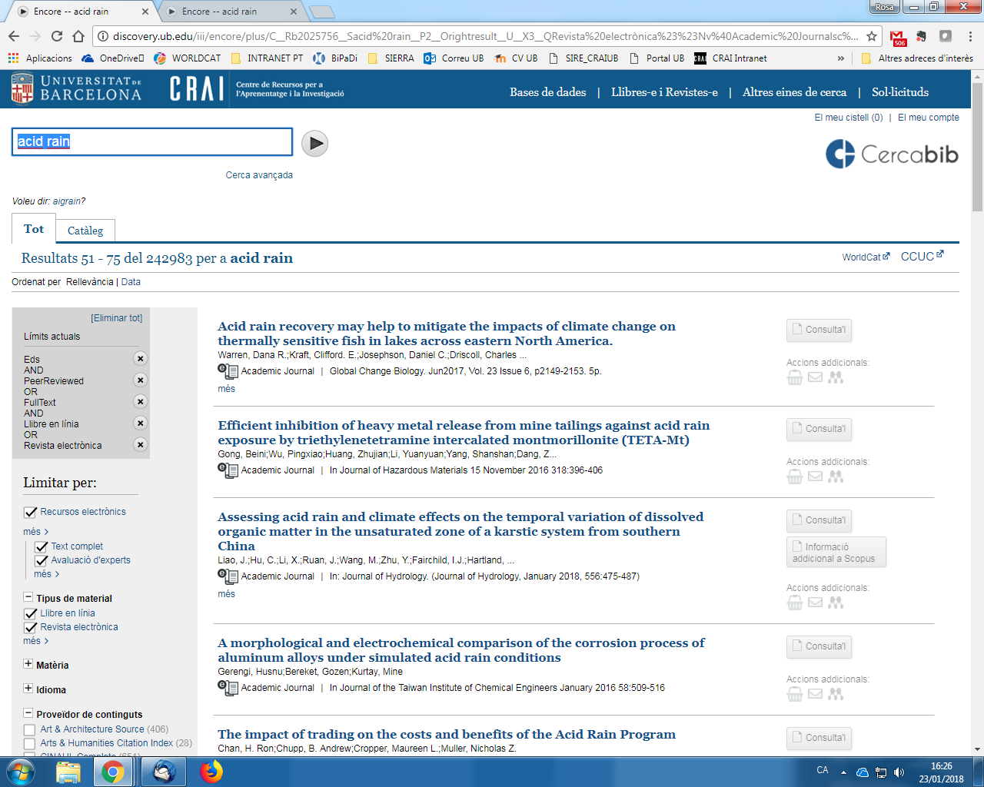
How can you narrow the search?(3)
We can choose more than one option in each filter

Slide 8
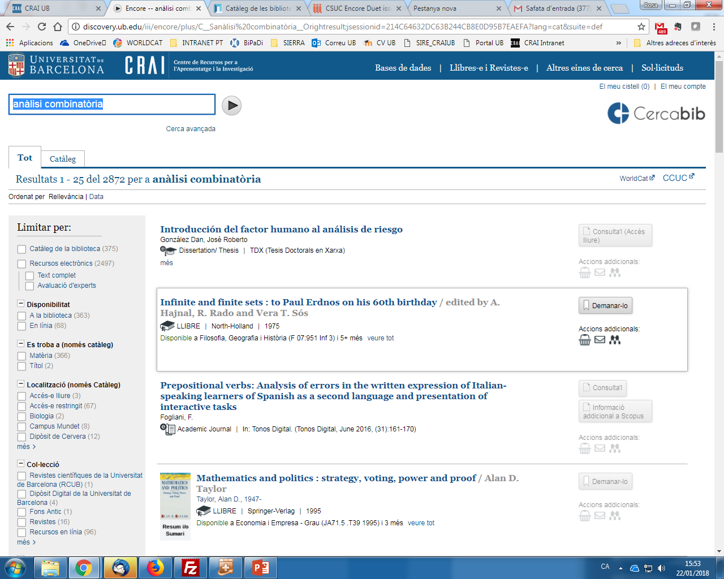
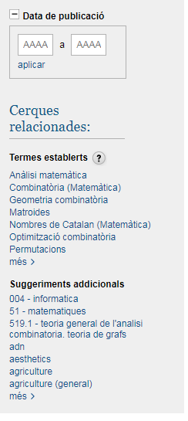
Search terms and authorities
Established terms and suggestions

Slide 9
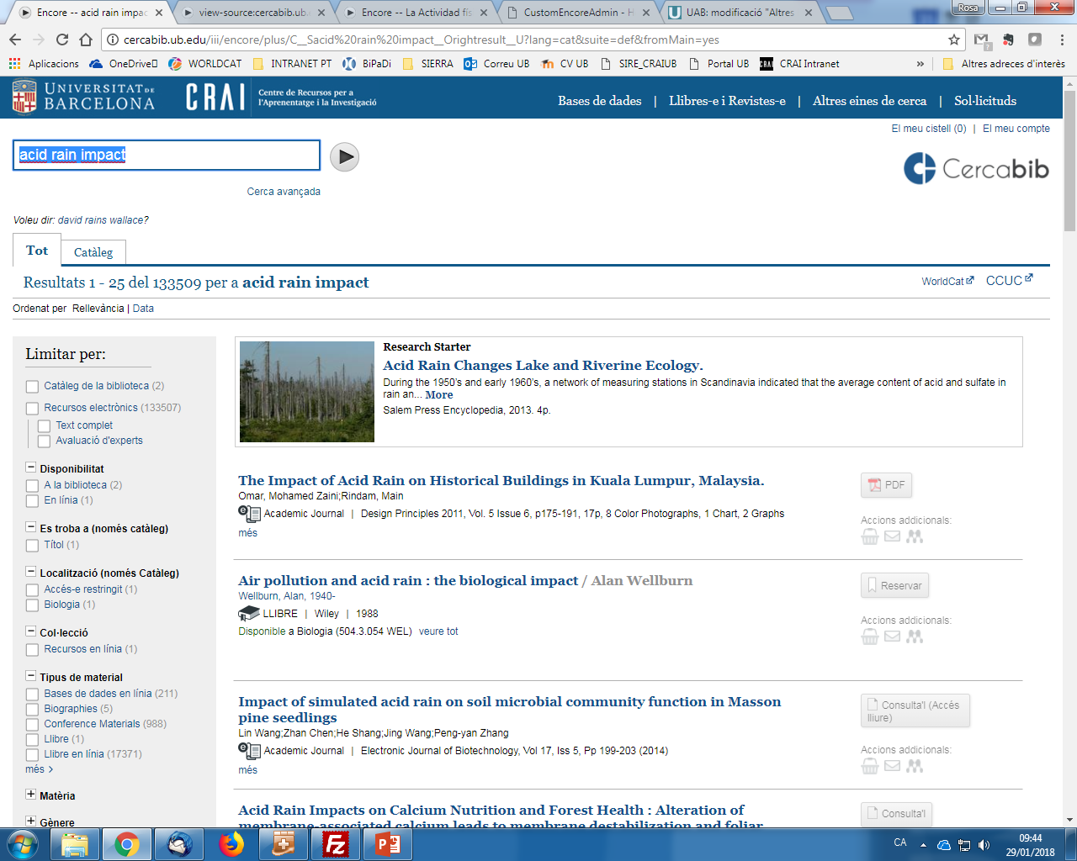

Results from catalog
Other functions
Bibliographic data
Collection location

Slide 10
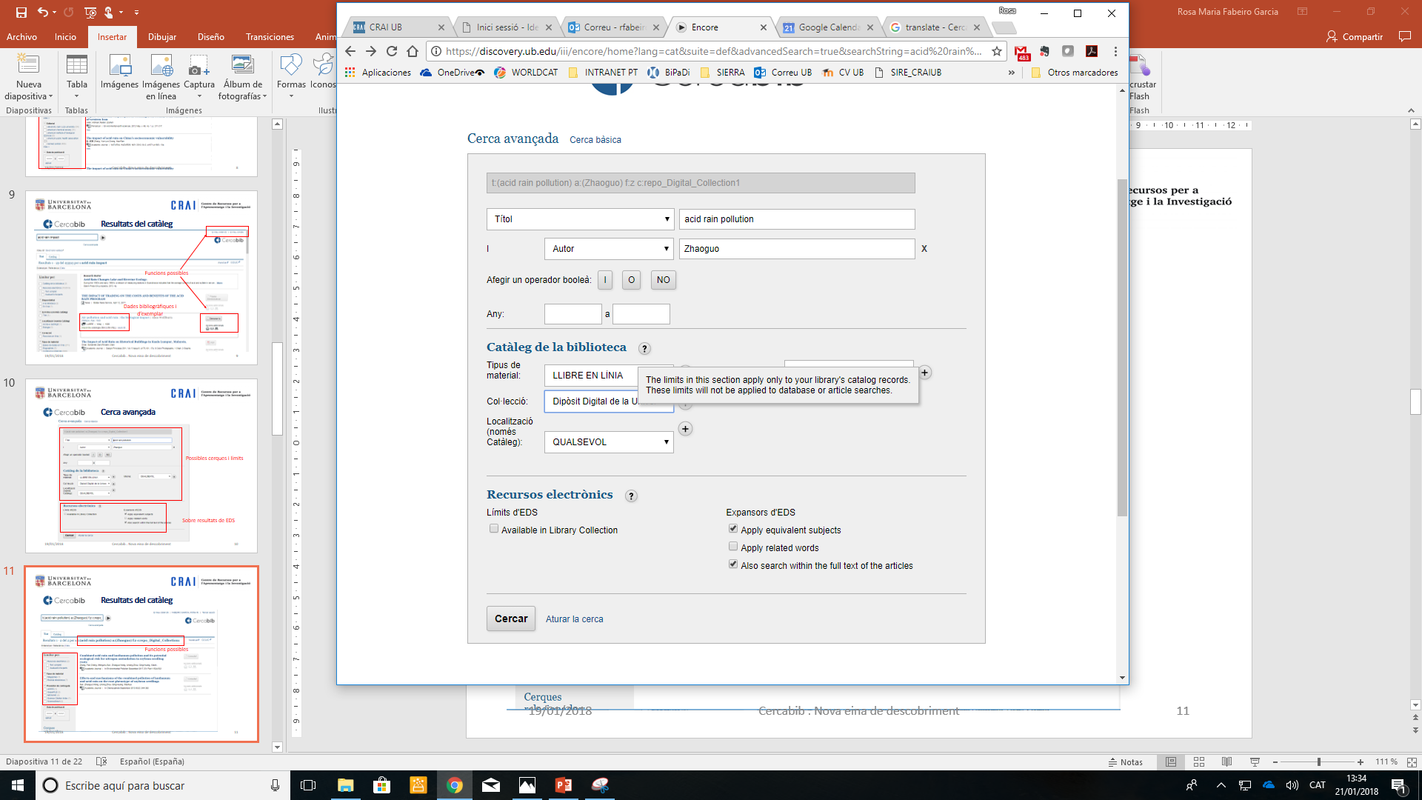
Advanced search
Manage your search
Limit our results from catalog
Search in the EDS
Permet limitar només als recursos subscrits per la UB

Slide 11
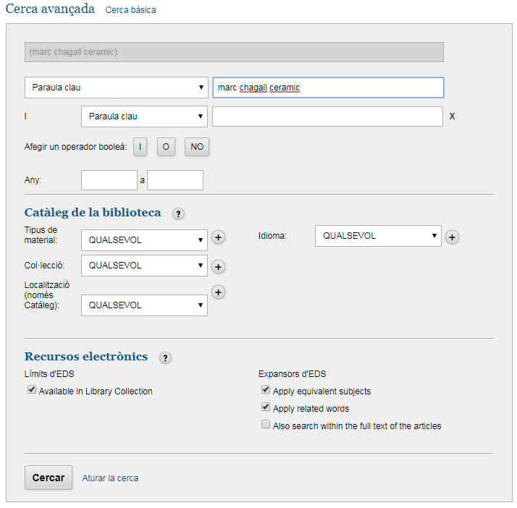
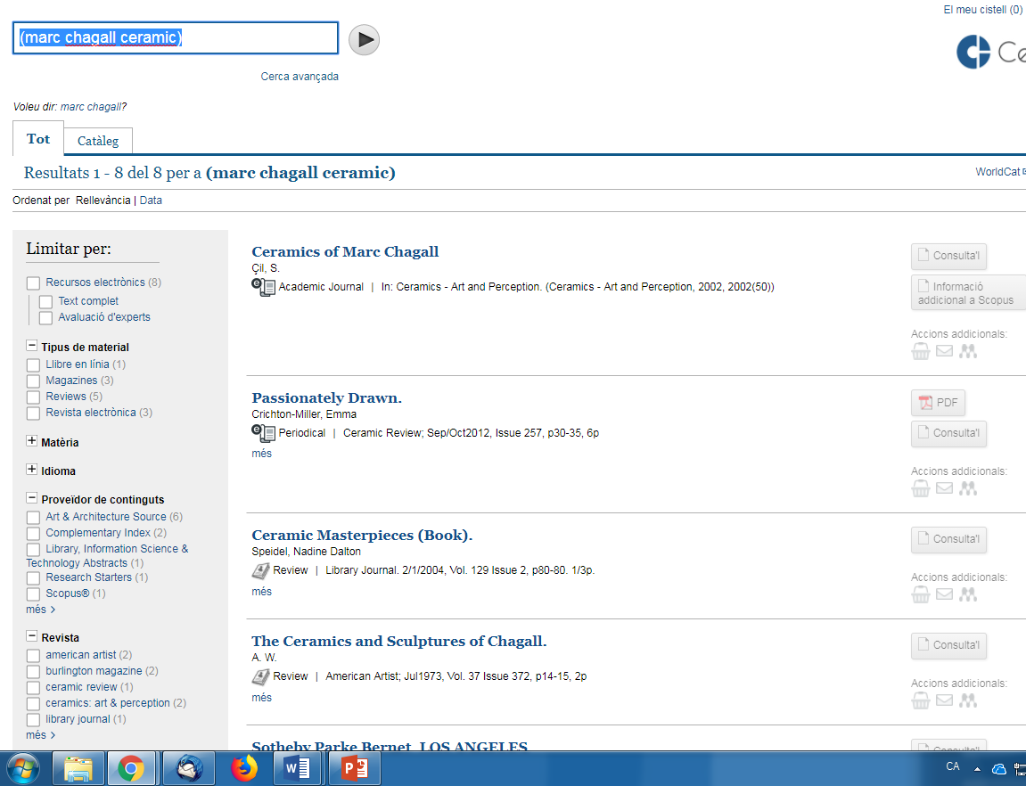
Results in advanced search
BY choosing full text option it shows 382 results
Just Full text

Slide 12
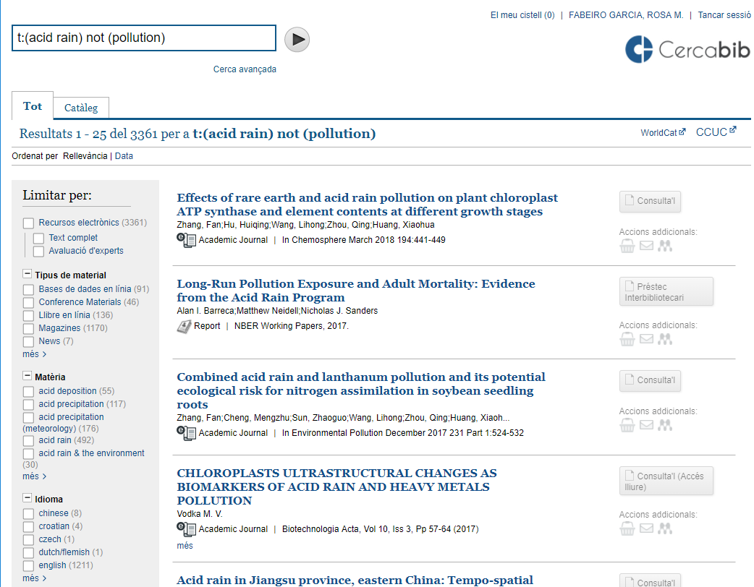
Searches and results (2)
Boolean operators
(OR,AND,NOT)
Language and subject area in EDS

Slide 13
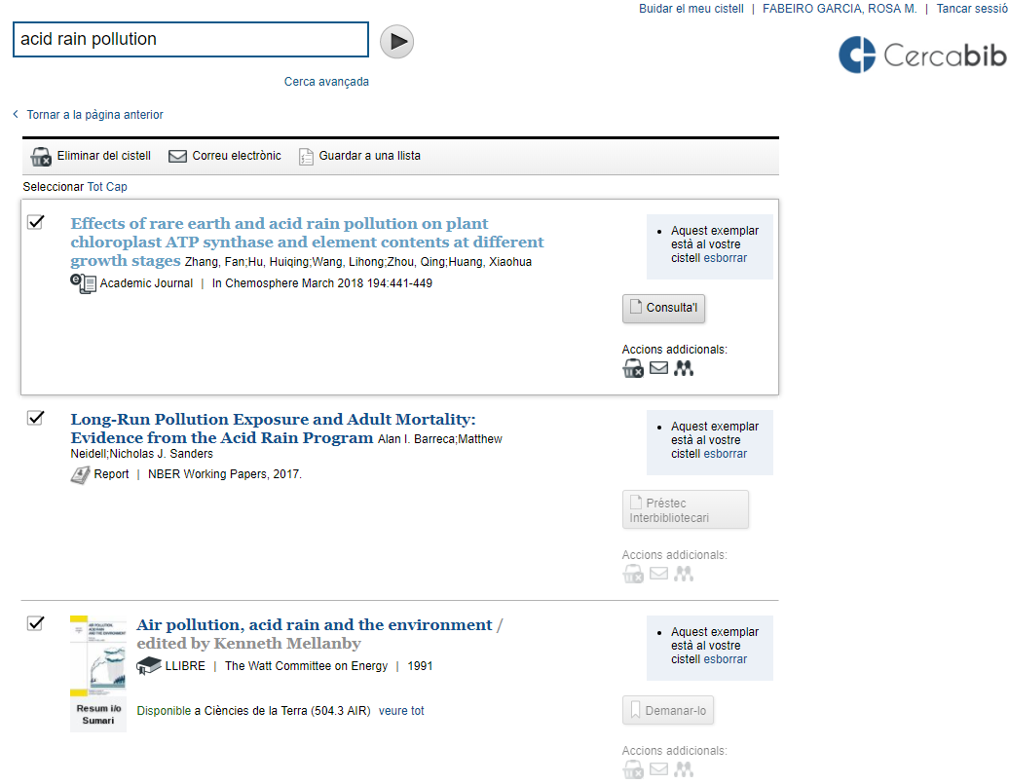
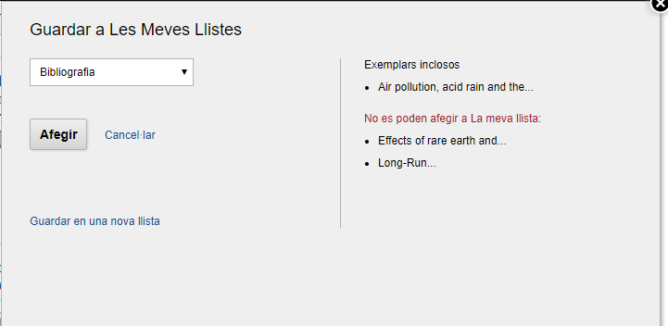
My Cart
Email your results list
Funcions possibles
Dades bibliogràfiques i d’exemplar

Slide 14
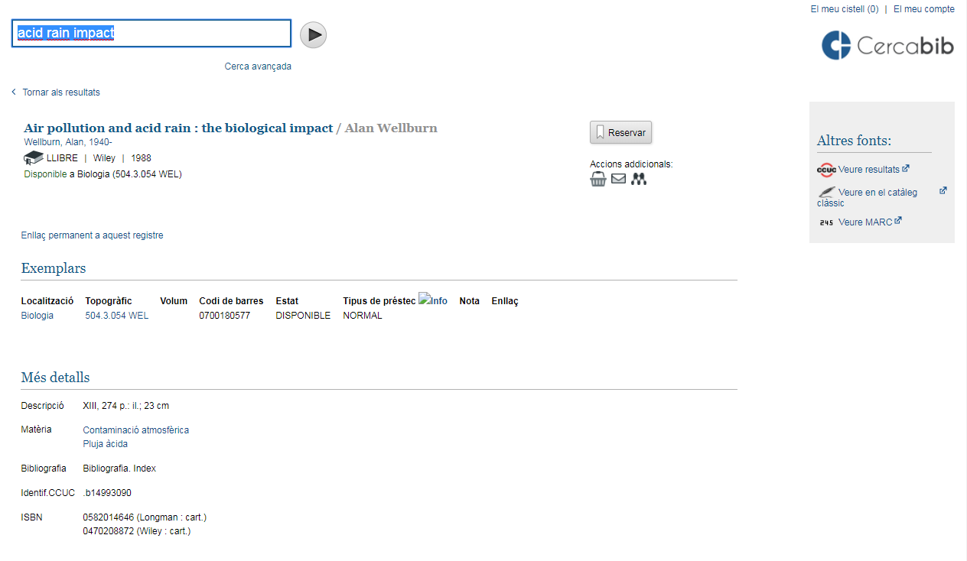
Bibliographic information

Slide 15
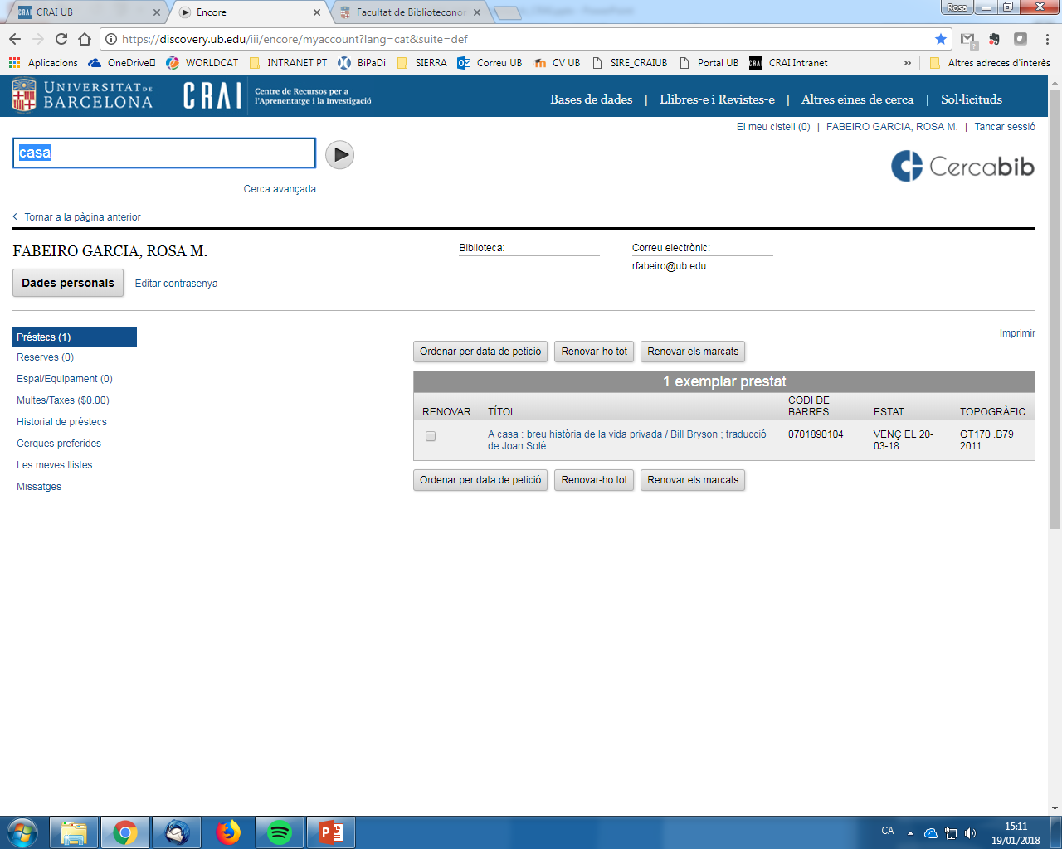
My account

Slide 16
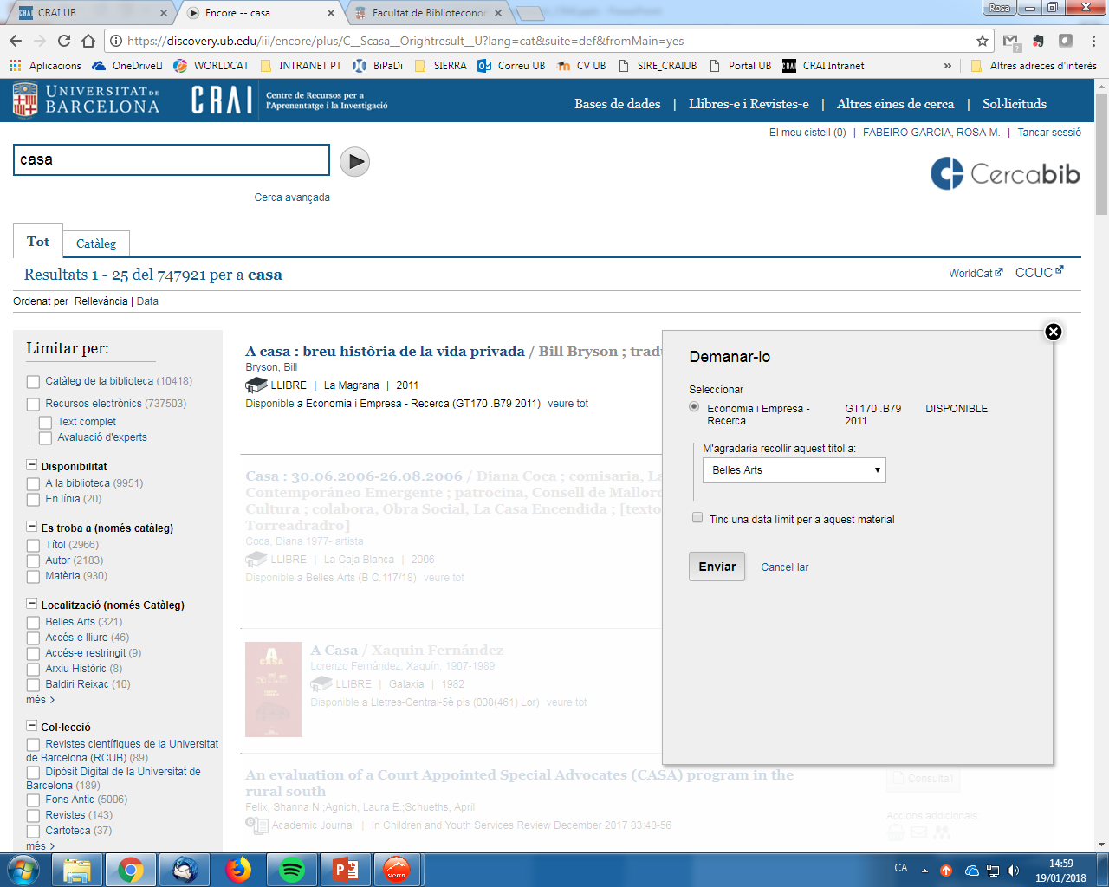
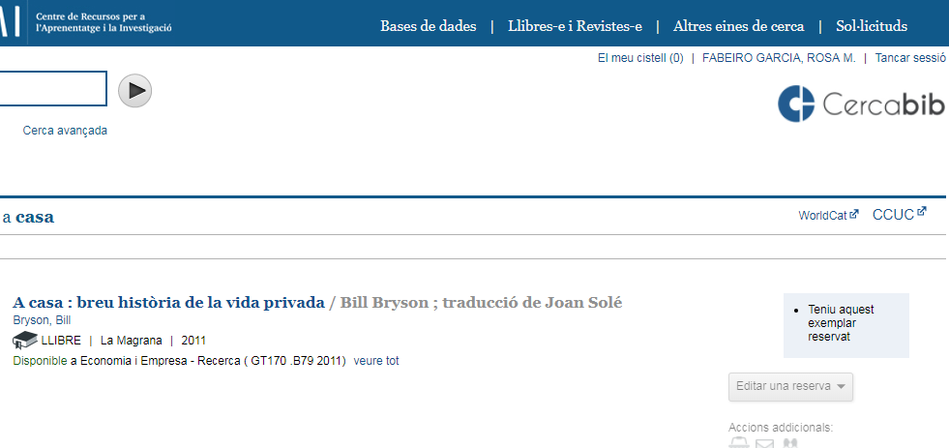
My account: Reserves
Your personal information
Manage your accounts and more information

Slide 17
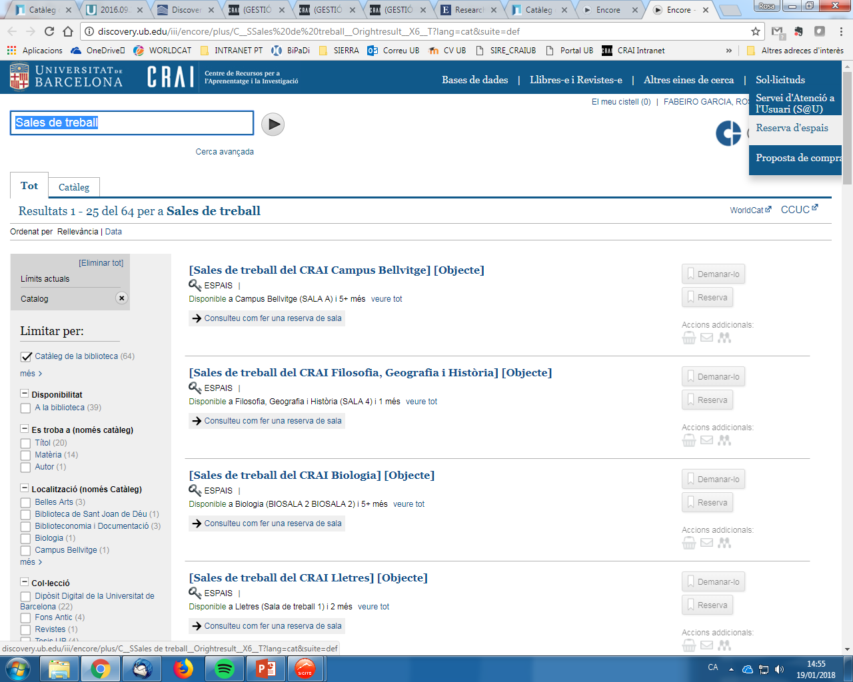
My account: Reserving study rooms
It only shows the access key,
after you identify
“My account”

Slide 18
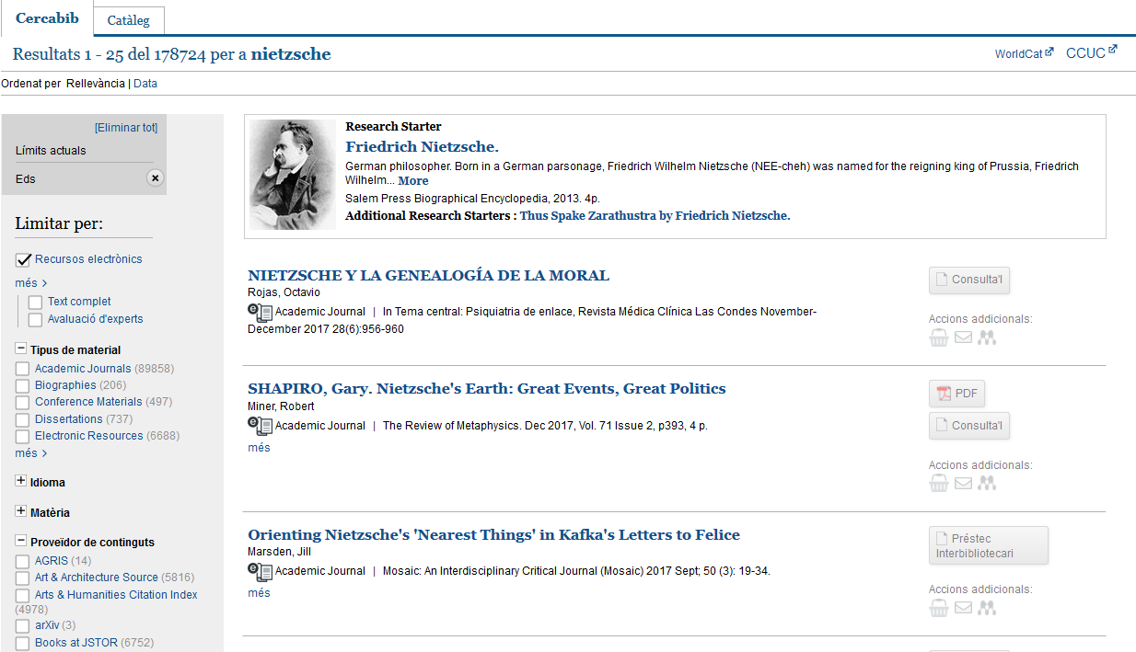
Electronic resources research
Information search
Results:
Index EBSCO
Bibliographic databases metadata or full text
Access to the document: Holdings Management

Slide 19







Access keys and their descriptions
Access keys to the document:
Access to the full text of UB subscribed electronic resources (With authentication)
Direct access to the open access electronic resources
Access to the UB unsubscribed electronic resources from Interlibrary Loan Services
Access to the EBSCOhost full text
Access to the d’EBSCOhost Book Collection
Access keys added:
More information about Web of Science’s articles
More information about Scopus’s articles

Slide 20
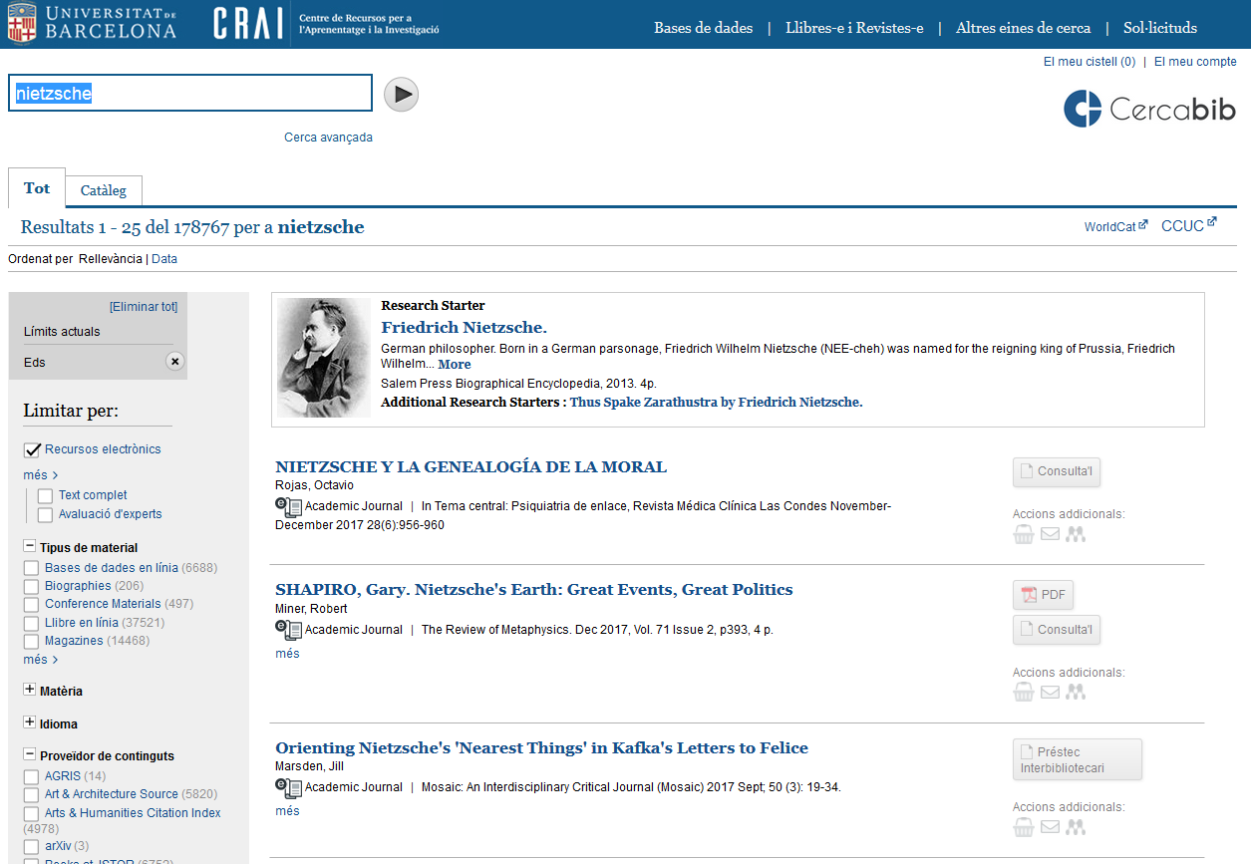
Define electronic resources

Slide 21
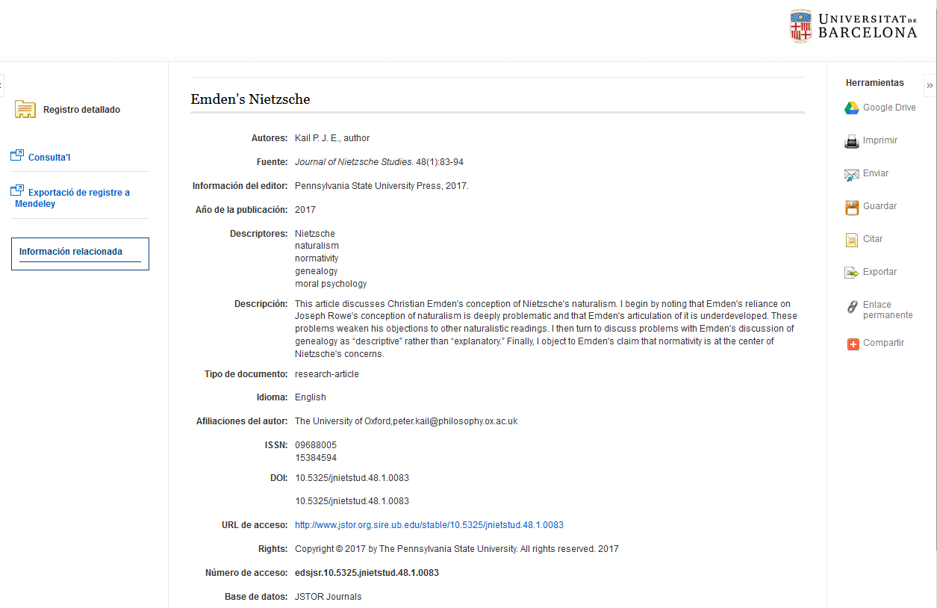
Reference details

Slide 22
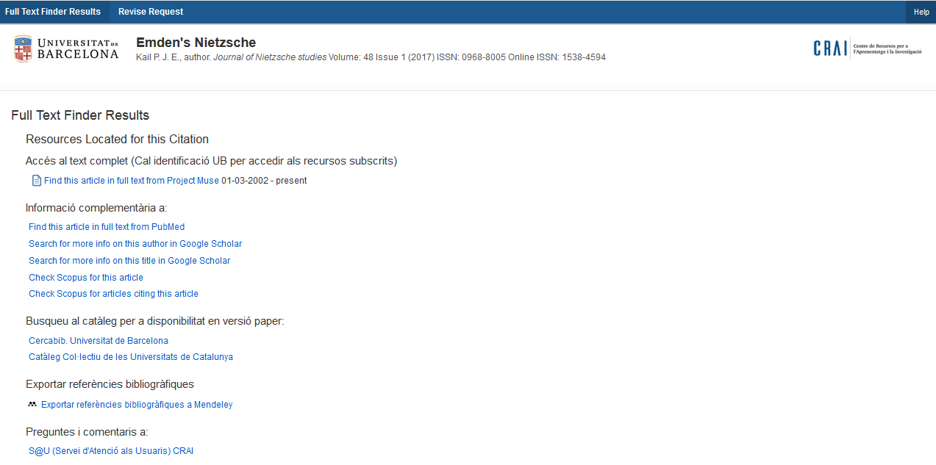
Access to “Consult it” : access to the full text

Slide 23
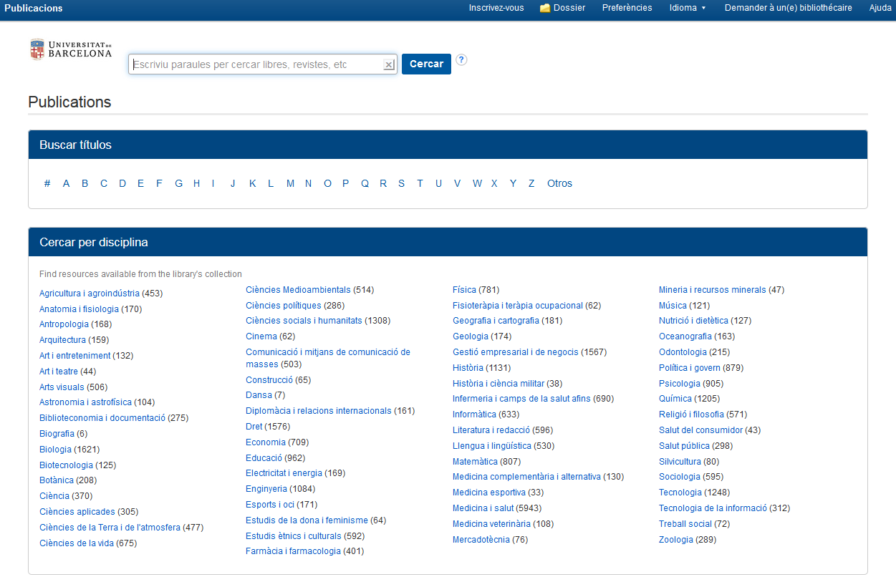
Journals and electronic books list, A-Z

Slide 24
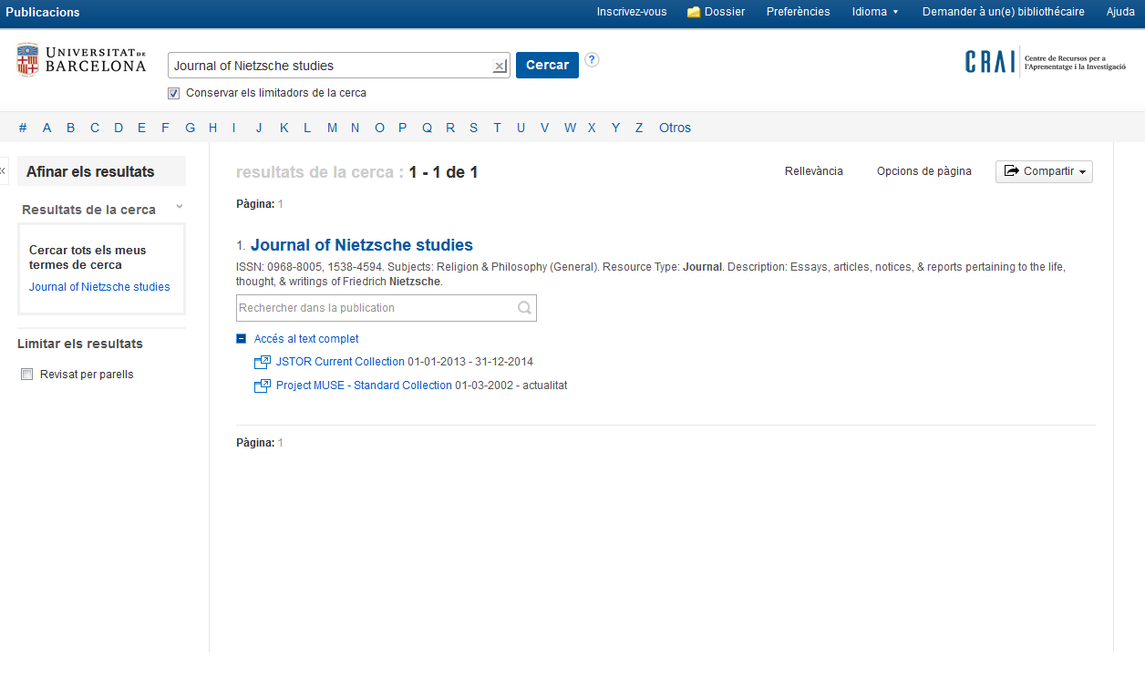
Journals and electronic books list, A-Z

Slide 25

Thank you !
© CRAI Universitat de Barcelona, academic year 2017-18

