Slide 1
Get to know the Fine Arts CRAI Library
Academic year 2023-24

Slide 2
What will we be talking about?
The aim of the session
What is the CRAI UB?
Get started in the CRAI
Where we are and when you can come?
Library map
Equipment
The collection: books, journals, etc.
Searching for information
Cercabib
How to borrow books? UB Card
Loans Service
Using study rooms loans and and laptop loans
What do I have on loan? My account
Library consortium loans (PUC)
Interlibrary loans
Access to online resources
Virtual Campus
Fine Arts information
Information resources
Usernames and passwords
User support service (SAU)
User training
Collections
Wi-Fi and access to Faculty computers
Follows us on social networks and in virtual exhibitions
And if you still have questions...

Slide 3
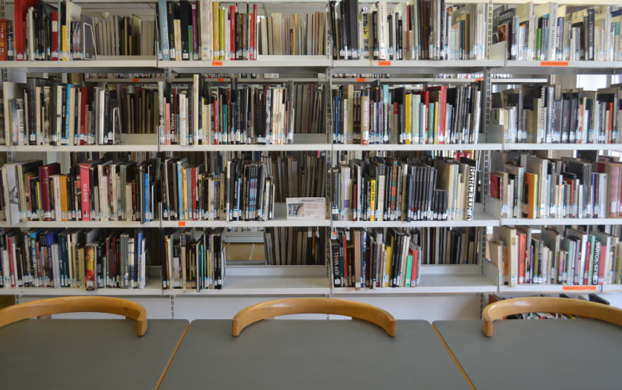
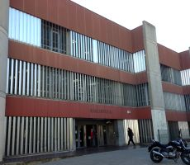
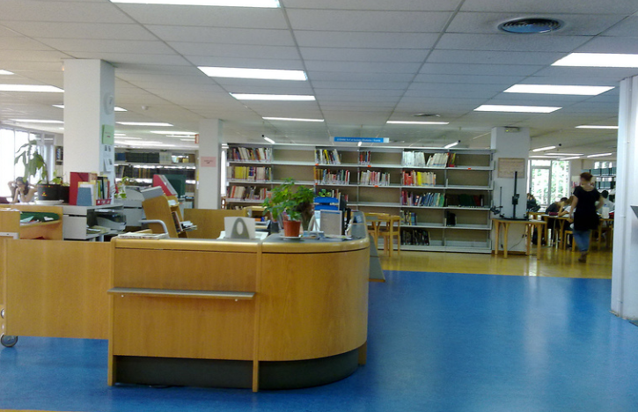
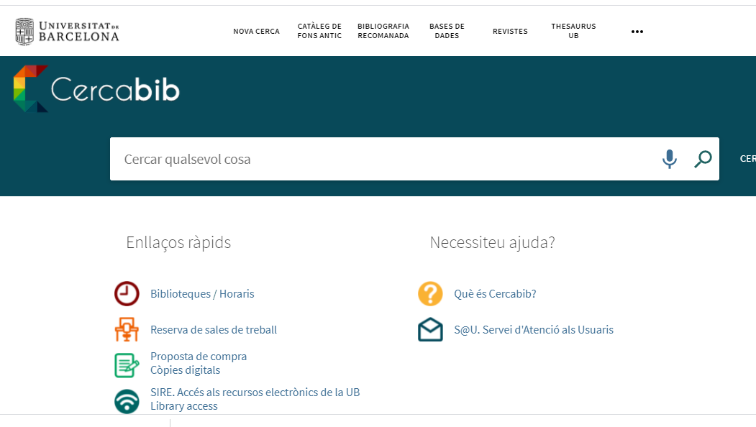
The aim of the session is:
Knowing the
Fine Arts CRAI Library
https://crai.ub.edu/en/about-crai/libraries/fine-arts
Talking about the information resources and services of the
CRAI UB
https://crai.ub.edu/en

Slide 4
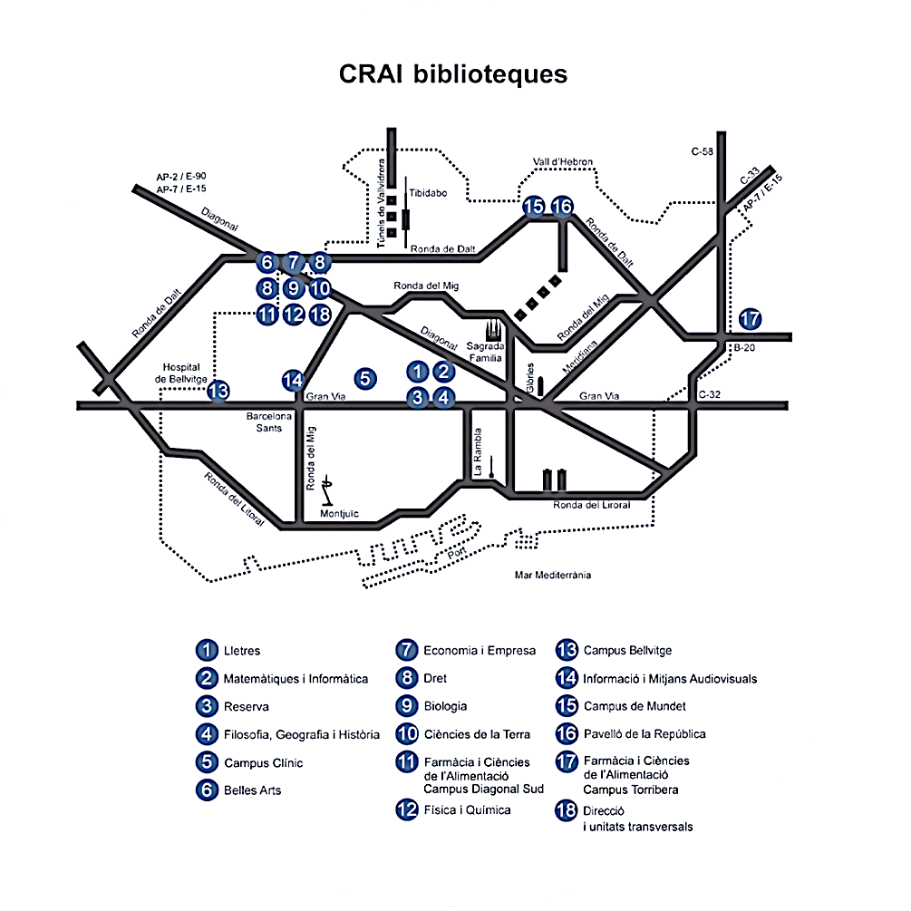
What is the CRAI UB?
CRAI UB
CRAI Libraries
16 libraries, distributed in 21 places
2 libraries of them are patrimonial collections
CRAI offers:
Services
Information resources
and supports:
Learning
Teaching
Research

Slide 5
What is the CRAI UB?
Loan Service
Bibliographic information
User training
Support for bibliographic citation
Support for teaching staff
Support for researchers

Slide 6
Get started in the CRAI https://crai.ub.edu/en/about-crai/get-started-in-the-crai

Slide 7
Where are we?
The Fine Arts CRAI Library
Address:
Baldiri Reixac, 2 934 034 595
craibellesarts@ub.edu
Opening hours:
Monday-Friday from 8.30 a.m. to 8.30 p.m
Special opening hours in exam periods and at weekends (in Catalan)
Library service regulations
CRAI service charter

Slide 8
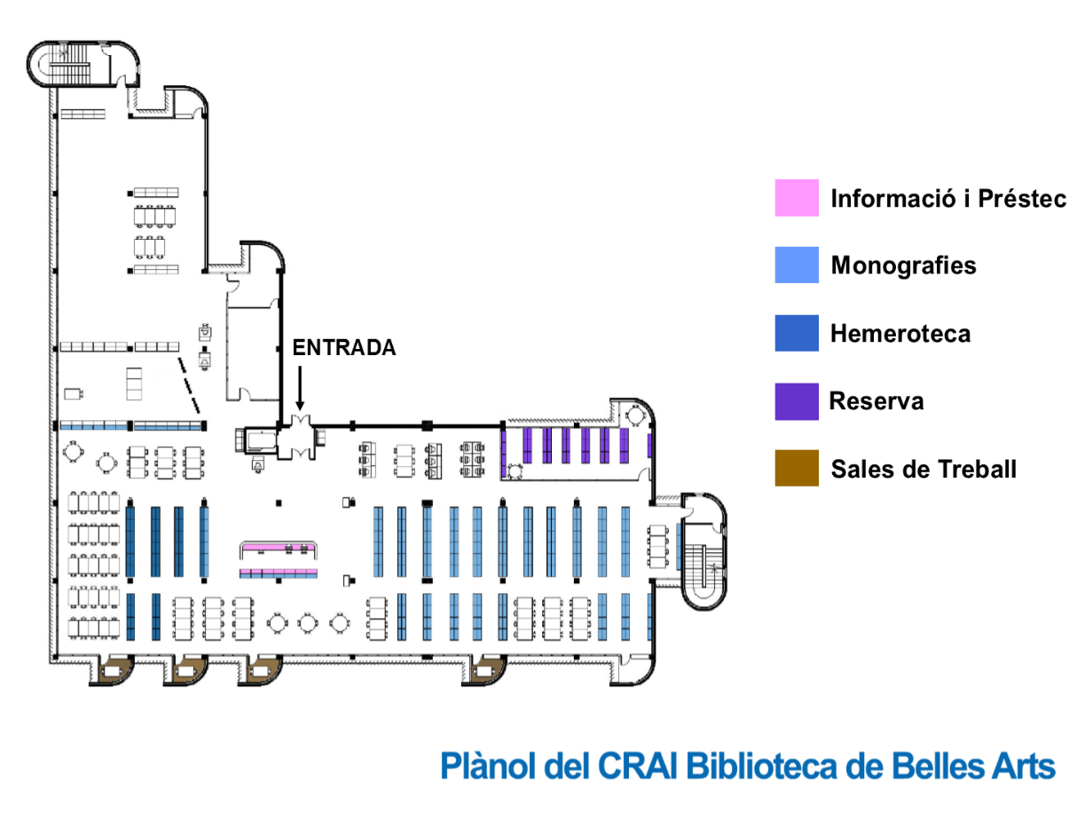
Library map
Bibliographic Information and Loans Desk
Monographs
ENTRANCE
Newspaper archive
Historical collection
Workrooms
Fine Arts CRAI Library map

Slide 9
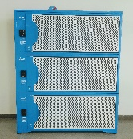
Equipment
222 reading points
4 workrooms
Computer room with 19 computers
15 computers
54 plugs
1 laptop for loan in the Library
Wi-Fi and Eduroam zone
Hemeroteca
525 títols de revistes vives
Three lockers
to keep electric
scooters
Light table
Photo playback table
Notes:
Aules: explicar les normes d’ús

Slide 10
Equipment. Adobe Creative Cloud
The Fine Arts CRAI Library provides the online application manager Adobe Creative Cloud (Adobe CC) which lets the access to a range of IT solutions and tools that allow the creation of texts, images and audiovisual content in a comprehensive way.
Users can practice designing a logo
for a company or create a collage of
photos which reflect the ideas you have
in mind. The application also allows you to
edit a video or a movie.
Tres taquilles per guardar els patinets elèctrics
Taula de llum
Taula de reproducció de fotografies
Notes:
Aules: explicar les normes d’ús

Slide 11
The collection (I): books, journals, etc.
The Fine Arts CRAI Library contains research and specialized collections for the
following studies: Fine Arts, Conservation and Restoration and Design
(56,000 items).
The overall collection comprises monographs (37,000 items), printed
Journals (525 titles), electronic resources, statistical publications, doctoral
theses and audiovisual materials.
Books are organized using the Universal Decimal Classification method and
audiovisual material is organized by and own classification. Journals are
classified alphabetically.
The Library also houses a series of special collections: Oriol Martorell, Jordi
Sabater Pi, Josep Artigas, Giralt Miracle, Miquel Porter i Moix and Artist Books.
You can use this form (in Catalan) to send your proposals for book purchases.

Slide 12
The collection (II): books, journals, etc.
Documents according to their type of loan:
Normal loan documents and the reference bibliography: white sheet and black letters.
Documents of reference bibliography of weekend: white sheet and red letters.
Excluded loan documents: yellow sheet and black letters.

Slide 13
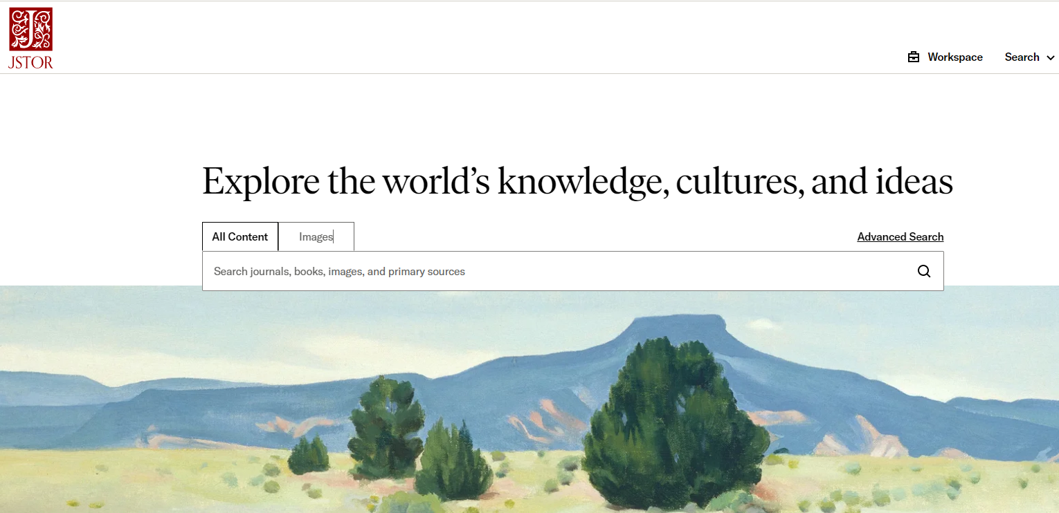
Searching for information From the CRAI UB it’s possible looking for different resources, some of them:
Cercabib: It’s a catalogue which gets the collections of all CRAI UB libraries and it is also included in the CCUC:
Online Repositories: Dipòsit Digital UB, RCUB, RACO, TDX:
Databases: ARAS, JSTOR Arts and Science, Art&Architecture Source:
For searching information you use the search parameters:
In all of these resources we can search by author, document title, subject, publisher, publication year...
And all of them let us “refine” the results that we’ve got in our search.
Notes:
El CRAI és el Centre de Recursos per a l’Aprenentatge i la Investigació, una part del qual són totes la Biblioteques de la UB
Hi podeu accedir des de:
El web de la UB → Informació sobre → Biblioteca
El web de la Facultat → Serveis → Biblioteca
MonUB → Beques i Serveis → Biblioteca
Directe des de Bookmarks/Favorits http://www.bib.ub.es/bub/bub.htm

Slide 14
Cercabib. Two ways to access Access from the CRAI website https://crai.ub.edu/en
Or else...
Notes:
El CRAI és el Centre de Recursos per a l’Aprenentatge i la Investigació, una part del qual són totes la Biblioteques de la UB
Hi podeu accedir des de:
El web de la UB → Informació sobre → Biblioteca
El web de la Facultat → Serveis → Biblioteca
MonUB → Beques i Serveis → Biblioteca
Directe des de Bookmarks/Favorits http://www.bib.ub.es/bub/bub.htm

Slide 15
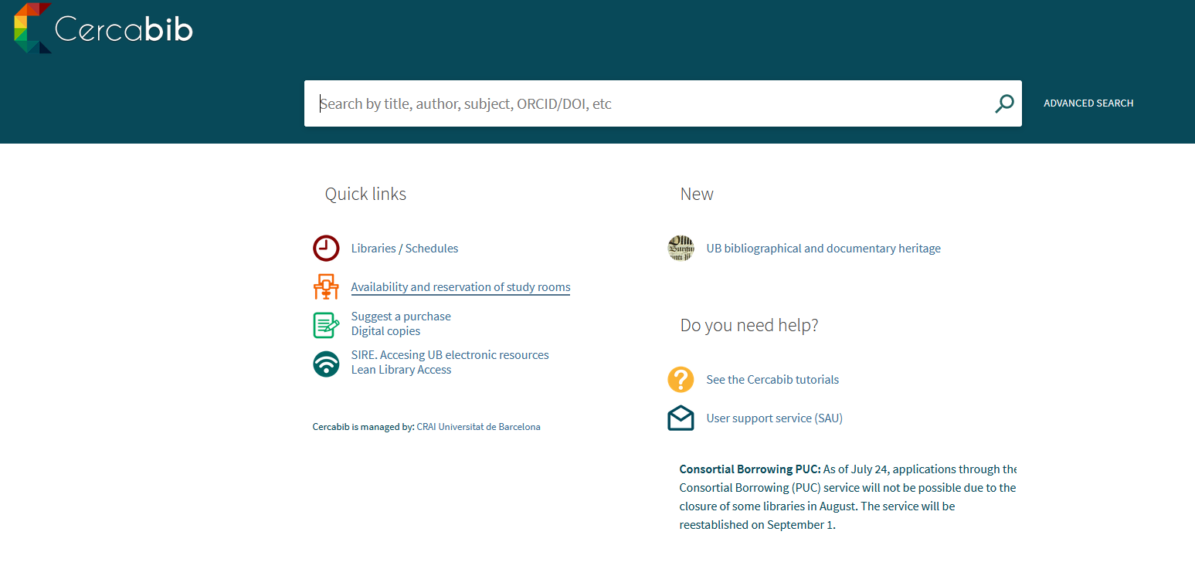
Cercabib Access from the Cercabib website https://cercabib.ub.edu/discovery/search?vid=34CSUC_UB:VU1&lang=en
First, you must sign in to obtain the full results and to reserve documents

Slide 16
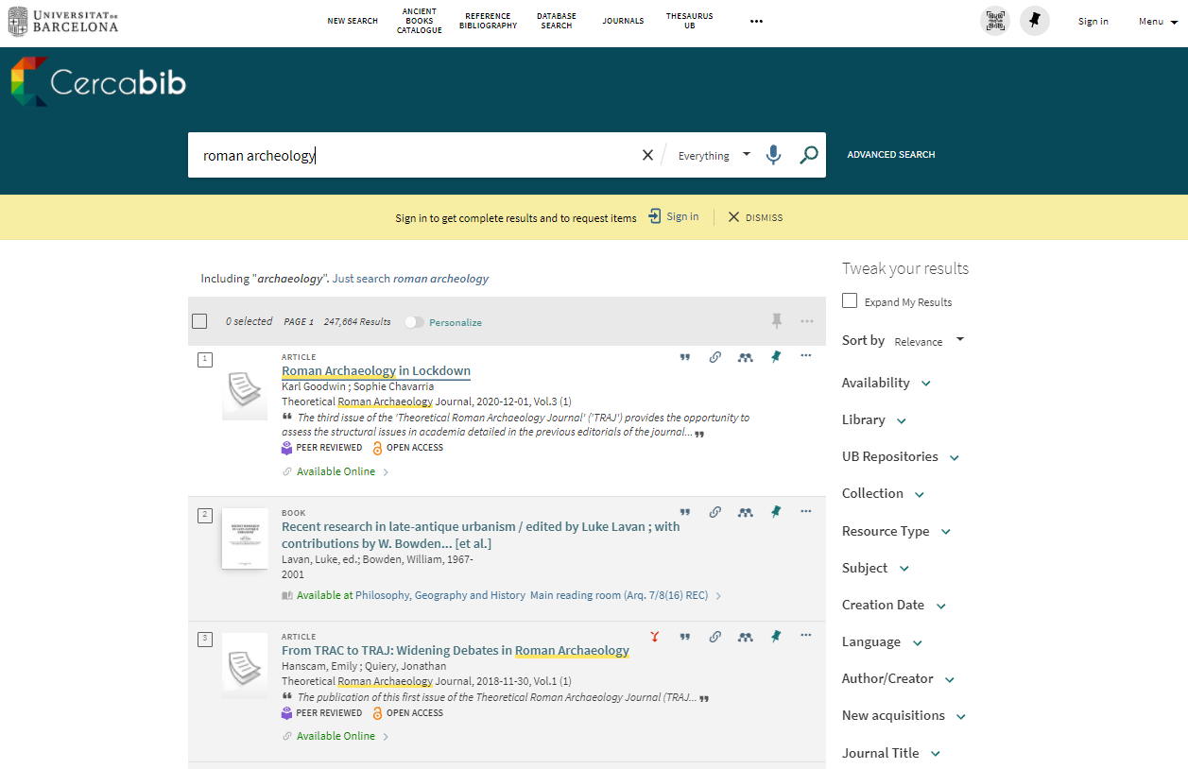
Cercabib: quick search
You can tweak your results
Notes:
El CRAI és el Centre de Recursos per a l’Aprenentatge i la Investigació, una part del qual són totes la Biblioteques de la UB
Hi podeu accedir des de:
El web de la UB → Informació sobre → Biblioteca
El web de la Facultat → Serveis → Biblioteca
MonUB → Beques i Serveis → Biblioteca
Directe des de Bookmarks/Favorits http://www.bib.ub.es/bub/bub.htm

Slide 17
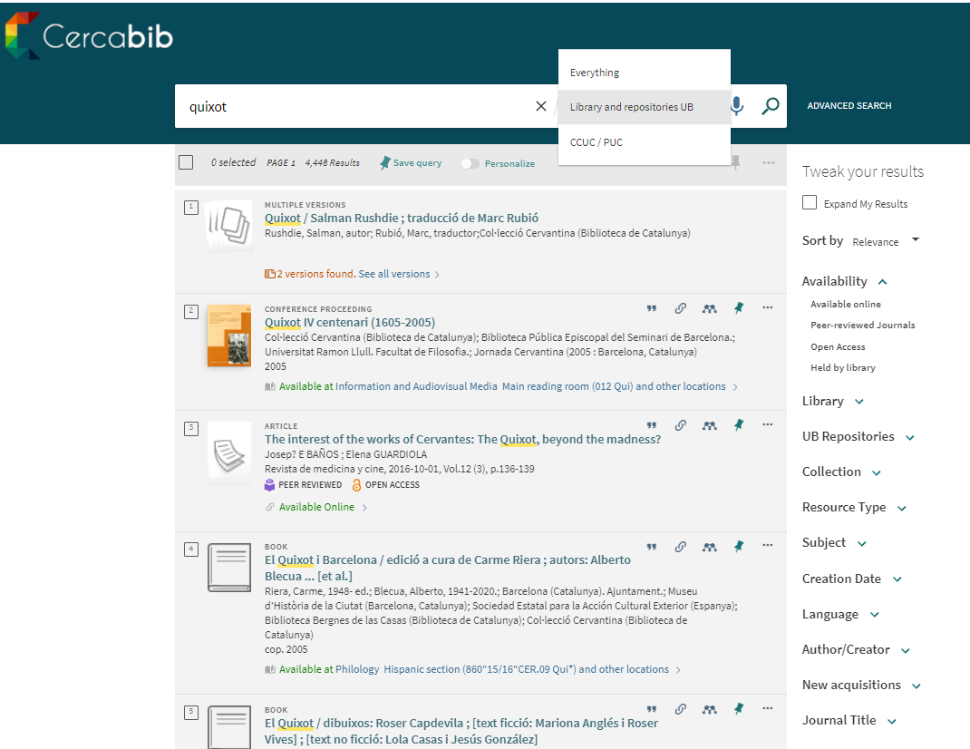
Where do I find it? (I)
Notes:
Conèixer el CRAI Biblioteca de XXXX. Curs 20xx-xx

Slide 18
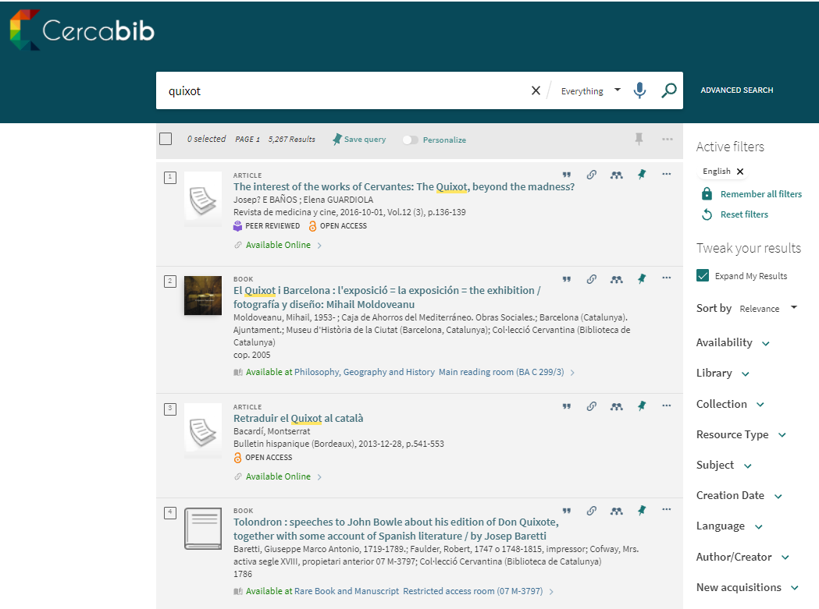
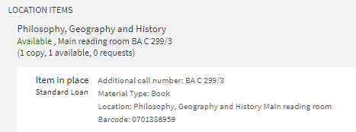
Where do I find it? (II)

Slide 19
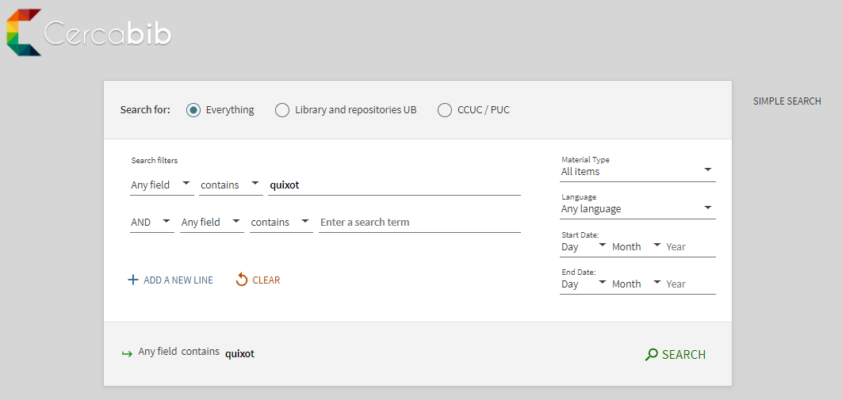
Cercabib: advanced search
Combine search fields and/or refine your search.

Slide 20
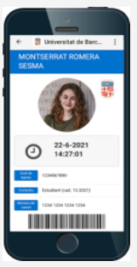
How to borrow books? UB card
You only need your digital card UB
The University of Barcelona digital card, accessed from the SocUB (in Catalan) mobile app.

Slide 21
Loans service (I)
https://crai.ub.edu/en/crai-services/loans/loansUB
Document loans allow you to consult CRAI resources off library premises for a specified period of time.
You must have a UB Card or ID that provides you are entitled to take out loans.
Loan service regulations (in Catalan)
Documents that cannot be taken out on loan:
Journals and works of reference (encyclopaedias, dictionaries, etc.). If digital versions are available online you can consult them off UB premises.
Rare books and manuscripts.
Books with a red dot or the label "Not for loan".
Reference bibliography:
Loan for up to 10 days.
Reservation through My Account, or at the lending desks of the CRAI libraries.

Slide 22
Loans service (II)
https://crai.ub.edu/en/crai-services/loans/loansUB
Users | Items | Days
UB teaching staff (active, retired or emeritus)/ guest or visiting teaching staff / teaching staff from affiliated centres with venia docendi / EIM, Hispanic Studies, Language Services and IDP-ICE teaching staff / UB departments or research groups researchers / users with specific needs | 40 | 60
PhD students / university master’s degree, inter-university master’s degree and UB-specific master’s degree students / administrative and service staff (active or retired) | 20 | 30
UB bachelor’s degree students, students from affiliated, inter-university, accreditation, national or international mobility centres / students from the Institute for Lifelong Learning (IL3) taking courses at the University / students on UB-specific postgraduate courses / university extension students / students from the University of Experience / members of Alumni UB authorized by the UB | 10 | 21
Teaching hospitals staff (Clínic, Bellvitge, Sant Joan de Déu) / non-UB teaching staff of centres with an agreement, the UB Group and the IDP-ICE / staff of research institutes in which the UB participates, is affiliated, linked, with an agreement or of the UB Group / GEO3BCN-CSIC researchers and research fellows | 15 | 21
Students from centres with agreements or from the UB Group / EIM, Hispanic Studies, Language Services and the IDP-ICE students / teaching and research staff, administrative and service staff, doctoral and master's degree students from the Universitat d'Andorra and the Universitat Jaume I / UB Doctors’ Senate members / primary and secondary school teaching staff / COBDC members / UB charitable and teaching foundations members / users authorized by the UB teaching and research staff or by the CRAI | 5 | 10
Audiovisual material loan: 21 days
Reference bibliography: 10 days
Reference bibliography for weekends (from Friday to Monday): 3 days

Slide 23
Loans service (III)
https://crai.ub.edu/en/crai-services/loans/loansUB
Renewals
Reservations
You can renew loans as often as you need, as long as the item in question has not been reserved by another user. You can renew documents at the loan desk, by telephone, or via My account on the CRAI website.
You can reserve a maximum of 8 items, through My account or from the loan desks.
Penalties
History
If you do not return books in time,
you will be barred from using
the service, depending on the
item and the number of
days overdue:
Normal loan and audiovisual material: 1 day
Loan of reference bibliography: 2 days
Loan of weekend reference bibliography: 3 days
You can see the list of the items you have borrowed during your studies at the UB under the Loans section in My account.
Notes:
Conèixer la Biblioteca de ........ (2005-2006)
23

Slide 24
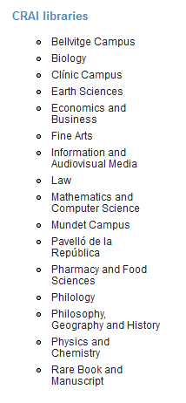
Loan from other UB libraries
If you need an item from another UB library you can:
a) go to the library where the item is held and take it out on loan,
b) ask the loans desk at your library to transfer the item from its home library. You will receive it in 2 to 3 days,
c) order it directly from My Account.

Slide 25
Using study room loans https://crai.ub.edu/en/crai-services/loans/ub-equipment
This loan service is designed to make it easier to use CRAI library workrooms for individual or group work. You can reserve documents from the Cercabib using the option in My account.
Rules of use of the study rooms (in Catalan)
Laptop loans https://crai.ub.edu/en/crai-services/loans/ub-equipment
Laptops run on Windows OS
Request and return laptops at the loans desk
The loan agreement form (in Catalan) must be read, signed and filled out correctly.
Service not available to users currently under a late returns penalty
Laptop loans available for up to 4 hours
Laptops cannot be reserved
Laptops can only be used on Library premises
Regulations (in Catalan)

Slide 26
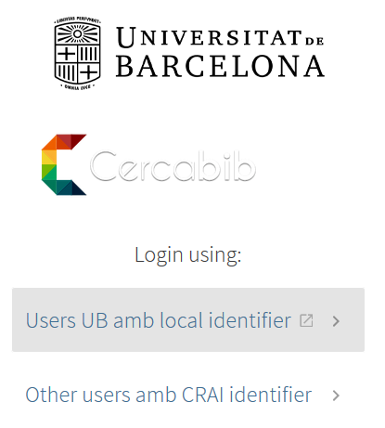
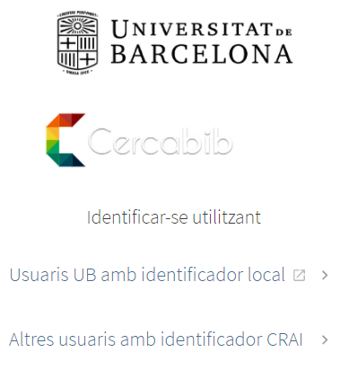
What do I have on loan? My account
This service allows you to access your CRAI user registration.
Once identified, you can view and renew your loans, reserve documents or get lists of bibliographic records, among other services.

Slide 27
Library consortium loans (PUC) https://crai.ub.edu/en/crai-services/loans/loans-puc
The PUC is a free loan service through which users can request and borrow items from another library in the Consortium of University Services of Catalonia (CSUC).
How to request an item:
In person, at the library that holds the item: PUC in situ.
Online, using the CCUC/PUC S search in Cercabib.
Where to return items:
To any UB CRAI library.
To any of the libraries linked to the institution that holds the item.
Notes:
El CRAI és el Centre de Recursos per a l’Aprenentatge i la Investigació, una part del qual són totes la Biblioteques de la UB
Hi podeu accedir des de:
El web de la UB → Informació sobre → Biblioteca
El web de la Facultat → Serveis → Biblioteca
MonUB → Beques i Serveis → Biblioteca
Directe des de Bookmarks/Favorits http://www.bib.ub.es/bub/bub.htm

Slide 28
PUC online https://crai.ub.edu/en/crai-services/loans/loans-puc
Requirements:
- You must be registered in your institution's library user database.
- You must not have any overdue loans at your institution.
- You must not be blocked from using your library account by your institution.
1 Connect to Cercabib, choose the University Union Catalogue of
Catalonia option (CCUC).
2 Search for the document and display the CCUC/PUC option to find out if it is available. Identify yourself to request it and choose where you want to pick it up.
3 When your item arrives at the chosen library you will receive email notification.
4 You can return the item to any of the libraries at your university or at the institution that owns the item.
Notes:
El CRAI és el Centre de Recursos per a l’Aprenentatge i la Investigació, una part del qual són totes la Biblioteques de la UB
Hi podeu accedir des de:
El web de la UB → Informació sobre → Biblioteca
El web de la Facultat → Serveis → Biblioteca
MonUB → Beques i Serveis → Biblioteca
Directe des de Bookmarks/Favorits http://www.bib.ub.es/bub/bub.htm

Slide 29
PUC loan conditions
Users | Items | Renewals | Days
Bachelor’s degree students, authorized Alumni UB Postgraduate, master’s degree and doctoral students University teaching and research staff (PDI) University administrative and service staff (PAS) | 10 | 6 | 21
Notes:
El CRAI és el Centre de Recursos per a l’Aprenentatge i la Investigació, una part del qual són totes la Biblioteques de la UB
Hi podeu accedir des de:
El web de la UB → Informació sobre → Biblioteca
El web de la Facultat → Serveis → Biblioteca
MonUB → Beques i Serveis → Biblioteca
Directe des de Bookmarks/Favorits http://www.bib.ub.es/bub/bub.htm

Slide 30
Interlibrary loans https://crai.ub.edu/en/crai-services/loans/inter-library-loans
The interlibrary loan service enables users to locate and obtain the original or a copy of any item that is not held by the CRAI and is not available from other Catalan universities through the PUC.
It also centralizes the loan of CRAI collection items to other institutions. This is a paid service.

Slide 31
Access to online resources https://crai.ub.edu/en/crai-services/resources-online/proxy
Use the E-Resources Access Service (SIRE) to consult the electronic information resources to which the CRAI subscribes from a computer or device within or outside the UB network.
To access SIRE, you will need the UB username and password that you use to access UB intranet (PDI, PAS or MónUB).
More information about SIRE (in Catalan)

Slide 32
Access to online resources. Lean Library Access
https://crai.ub.edu/ca/que-ofereix-el-crai/acces-recursos/library-access
Lean Library Access is an extension of the browser that gets the access to the electronic resources subscribed by the CRAI of the Universitat de Barcelona.
Once the extension is installed on the browser bar, it will be activated in green color when identifies a resource subscribed by the CRAI
While you’re browsing electronic journals, databases and other electronic resources, the extension will detect those CRAI has subscribed, and it shows you an emergent advise (pop-up) and you’ll have direct access to the documents.
Besides, the extension will show you alternatives free access sources for those resources which are not subscribed by the CRAI.

Slide 33
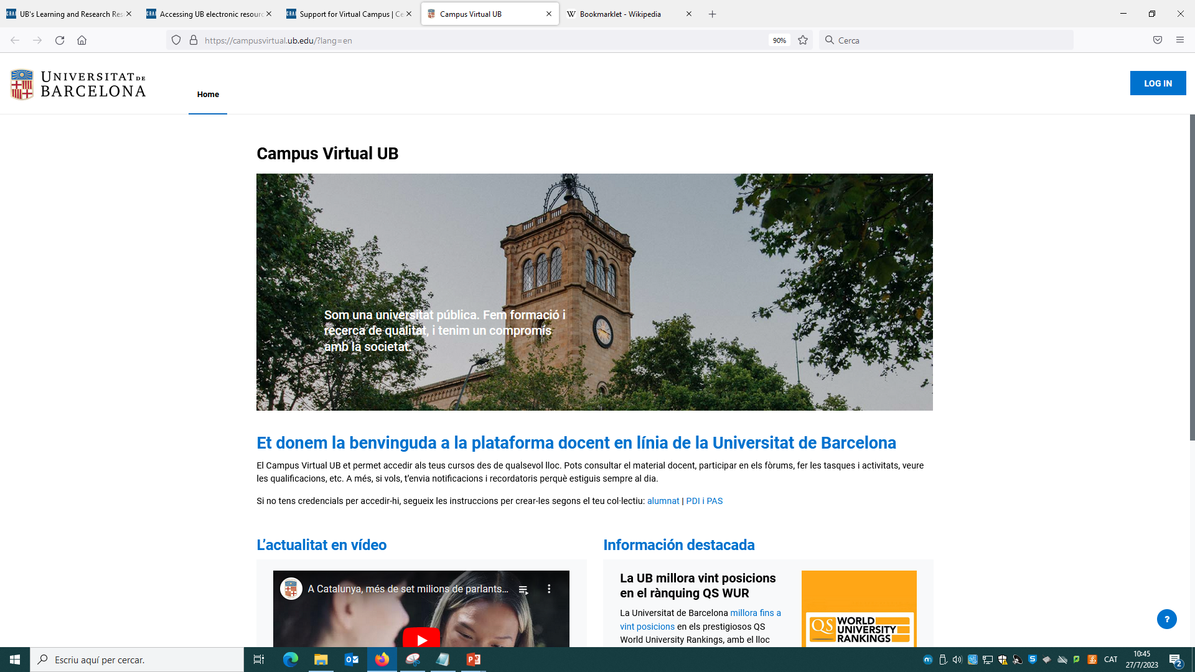
Virtual Campus
https://campusvirtual.ub.edu/?lang=en
It is the work tool with which you access your subjects and visualize the recommended bibliography, teaching materials and activities.
Virtual Campus
Identifier
and password
Virtual Campus

Slide 34
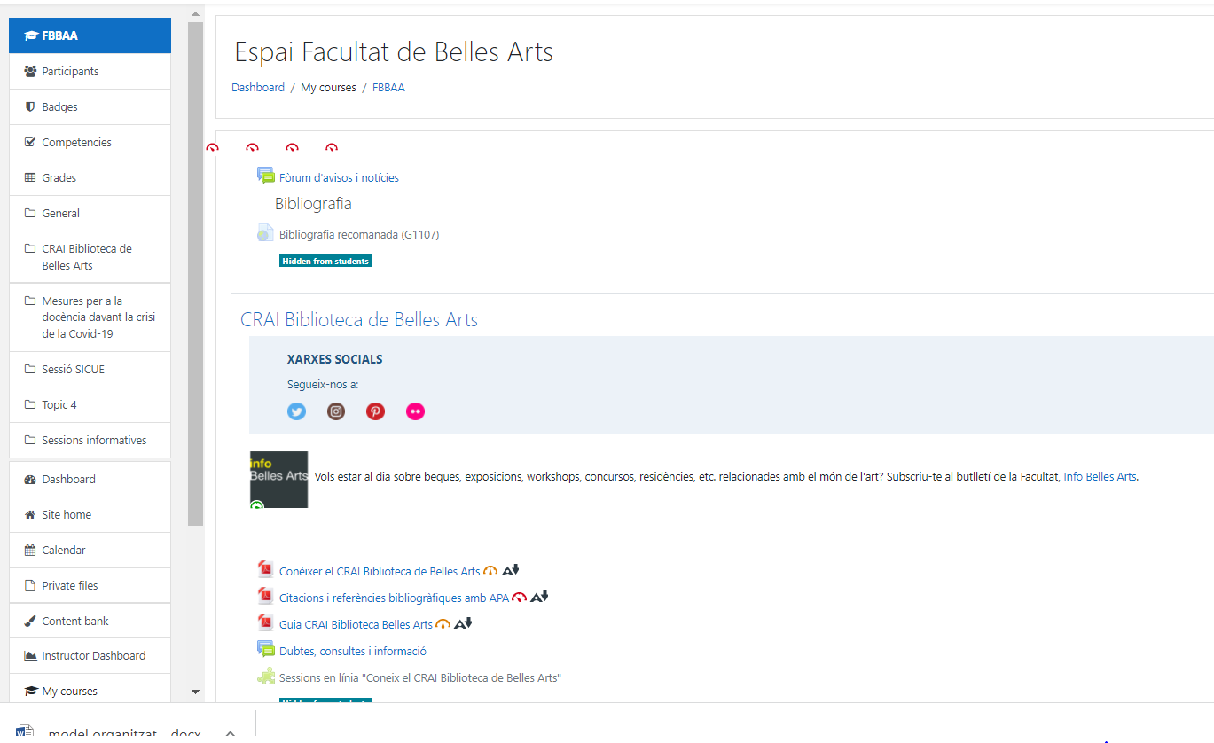
Virtual Campus. Faculty of Fine Arts
https://campusvirtual.ub.edu/course/view.php?id=13723&lang=en
Important!

Slide 35
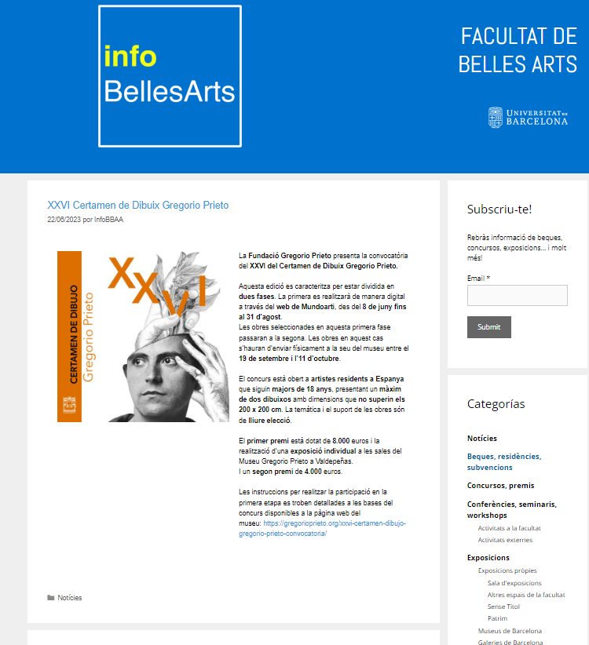
Fine Arts information
http://www.ub.edu/InfoBBAA/
(in Catalan)
Info Belles Arts
News
Exhibitions
Events
Grants
Residences
Conferences, meetings and Workshops
Art markets

Slide 36
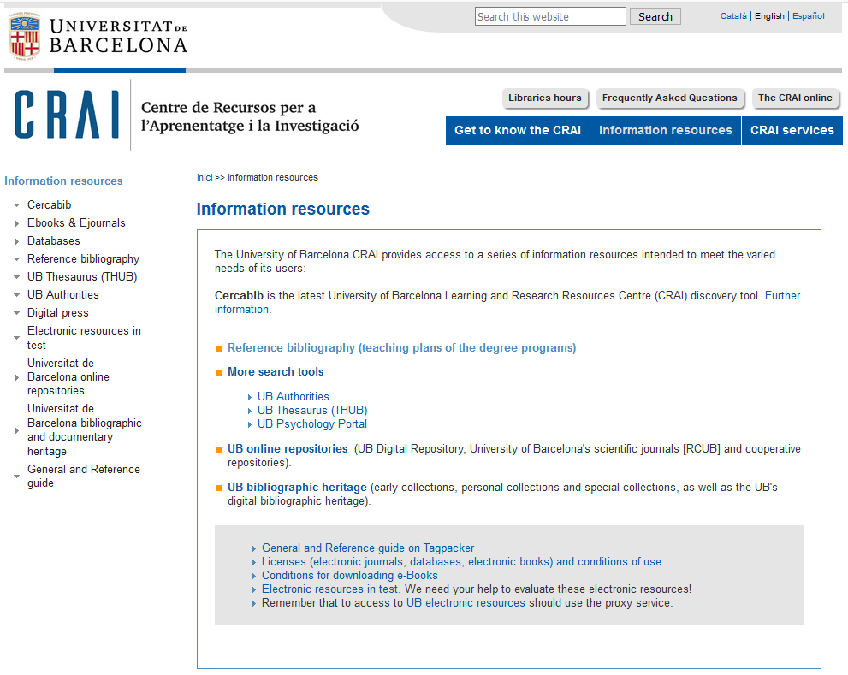
Information resources
https://crai.ub.edu/en/information-resources

Slide 37
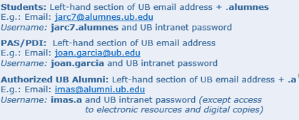
Usernames and passwords
https://crai.ub.edu/en/crai-services/resources-online/authentication
Username | Services | Access
UB | Virtual Campus How to access electronic resources Interlibrary loan Digital copies | Students: Alphanumeric code Contrasenya PAS/PDI: DNI / Identification no Password Authorized UB Alumni: Alumni code Alumni password
Local | Virtual Campus How to access electronic resources Digital copies Computers Loans Interlibrary loan PUC or library consortium loans Cercabib «My account» Wi-Fi UB | Students: Part esquerra del correu UB +.alumnes Exemple: Correu: jarc7@alumnes.ub.edu Identificador: jarc7.alumnes i la Contrasenya intranet UB PAS/PDI: Part esquerra del correu de la UB Exemple: joan.garcia@ub.edu Identificador: joan.garcia i la Contrasenya intranet UB Alumni UB Premium: Part esquerra del correu UB +.a Exemple: Correu: imas@alumni.ub.edu Identificador: imas.a i la Contrasenya intranet UB
Watch the video (in Catalan)

Slide 38
SAU, User Support Service https://crai.ub.edu/en/crai-services/sau
A 24x7 online information and reference service manned by specialized librarians, who can answer any doubts you have about the CRAI libraries and the full range of services and resources.
SAU is also the channel for delivering your complaints, suggestions and messages of thanks.
Notes:
Què és?
A què respon?

Slide 39
User training https://crai.ub.edu/en/crai-services/user-training
We offer you training courses in search skills, such as courses on specialized databases or bibliographic managers: Zotero, Mendeley, EndNote.
Also support courses and advice when preparing your final degree thesis, final master's thesis or your doctoral thesis.
Also on all those resources that have to do with the evaluation of scientific production: impact factor, immediacy index, quartiles, etc.
Information about scheduled training courses is available on the CRAI Web, and personalized courses (in Catalan) can be arranged on request.
Self-training resources are also available on the CRAI web.
Notes:
Conèixer la Biblioteca de ........ (2005-2006)
39
Què és?
A què respon?

Slide 40
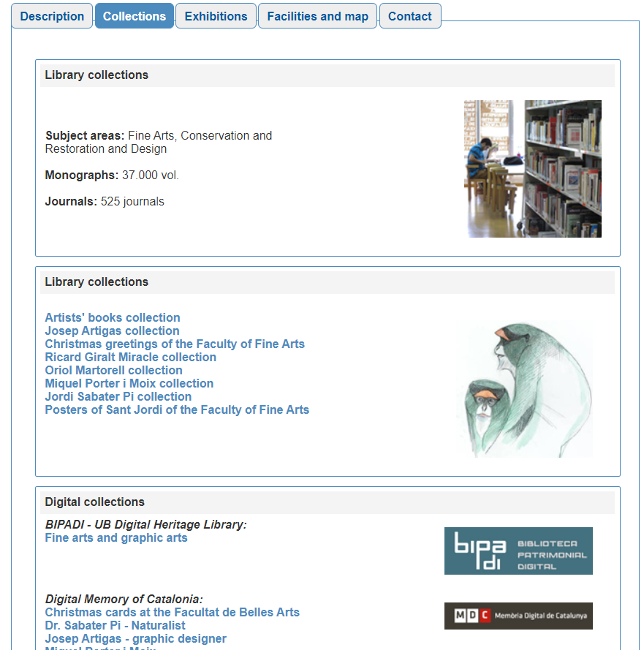
Collections https://crai.ub.edu/en/about-crai/libraries
Each CRAI library has this section in this web.
It is a selection of information resources related to the subject areas of teaching and research at the University. You will find databases, books and electronic journals, textbooks, etc.
Notes:
Conèixer la Biblioteca de ........ (2005-2006)
40
Què és?
A què respon?

Slide 41
Wi-Fi and access to Faculty computers
https://crai.ub.edu/en/crai-services/resources-online/wifi-eduroam
The University's Wi-Fi service enables you to connect to the Internet without a physical connection to the network. To use UB Wi-Fi, configure (in Catalan) your laptop and log on using your local username (in Catalan).
The University of Barcelona is actively involved in the Eduroam project, which promotes a unique e-mobility environment giving users access to the Internet at all participating organizations. Consult the Eduroam configuration guide (in Catalan).
User group | Ending | Email address | Local username
PAS / PDI |  | joan.pere.garcia@ub.edu cherrera@ub.edu | joan.pere.garcia cherrera
Students | .alumnes | jherg07@alumnes.ub.edu | jherg07.alumnes
Alumni UB | .a | pperez@alumni.ub.edu | pperez.a
Notes:
Què és?
A què respon?

Slide 42
Follow us on social networks! https://crai.ub.edu/ca/coneix-el-crai/difusio-marqueting/blogs-i-xarxes-socials (in Catalan)
Twitter
Flickr
@craibellesarts
http://www.flickr.com/photos/craibellesarts
Pinterest
http://pinterest.com/craibellesarts
@craibellesarts
And virtual exhibitions:
http://crai.ub.edu/en/coneix-el-crai/difusio-marqueting/exposicions-virtuals
Notes:
Diapositiva optativa

Slide 43
And if you still have questions...
Ask the CRAI staff
Library staff can answer the majority of your questions.
CRAI home page
The section "Frequently asked questions"
provides answers to a number of common queries.
SAU, User Support Service
Online information service for any questions about CRAI libraries and the full range of resources and services. SAU is staffed by specialized librarians and is available 24 hours a day, seven days a week.
Or call us on
934 034 595

Slide 44
Thank you!
© CRAI Universitat de Barcelona, academic year 2023-24

